Slide 1
Ethical Standards and Confidentiality
  Counseling And Mental Health

Slide 3
What are ethics?

Slide 4

Definition of Ethics
  Beliefs of an individual or group that guide them in making correct or proper choices
  Comes from the Greek word ethikos meaning moral character
  Developed by Greek philosophers
Notes:
Sometimes the words values and ethics are used interchangeably. Values are beliefs or attitudes about what is good. Ethics are beliefs that an individual or group uses to decide what is proper behavior.

Slide 5
How are ethics defined?
Notes:
Who or what defines ethics in your life?

Slide 6

How are ethics defined?
  Involves a decision-making process
  Set of moral principles
  What is right or wrong
Notes:
Ethics on the job often deal with a code of conduct, a set of principles for both the employer and the employee. Ask for and offer some examples of workplace ethics for both the employer and the employee.
What are some examples of proper behavior in the area of counseling and mental health?
What are some examples of improper behavior in the area of counseling and mental health?

Slide 7
From where do people derive their ethics?

Slide 8

Origination of Ethics
  Citizenship-based
  Cultural-based
  Law-based
  Professional relationship-based
  Religious-based
Notes:
Citizenship-based ethics - This means to engage fellow citizens with the establishment of liberty, justice and dignity for all.

Slide 9
What are the major purposes of a professional code of ethics in Counseling and Mental Health?
Notes:
Professional codes of ethics refer to the codes developed by professional associations to provide guidelines for practice by counselors and mental health professionals.

Slide 10

Purposes of Code of Ethics
  Provide a framework for ethical behavior
  Set standards for the profession
  Protect not only the professionals but the clients as well
Notes:
A Counseling and Mental Health professional should always put the client’s needs before his or her own needs.

Slide 11
Code of Ethics
  Abc
  Abc
Notes:
The 2014 American Counseling Association (ACA) Code of Ethics states professional values are an important way of living out an ethical commitment. The following are core professional values of the counseling profession:
Enhancing human development throughout the life span
Honoring diversity and embracing a multicultural approach in support of the worth, dignity, potential and uniqueness of people within their social and cultural contexts
Promoting social justice
Safeguarding the integrity of the counselor–client relationship
Practicing in a competent and ethical manner

Slide 12
American Counseling Association (ACA) Code of Ethics Contents
  The counseling relationship
  Confidentiality
  Professional responsibility
  Relationships with other professionals
  Evaluation, assessment and interpretation
  Supervision, teaching and training
  Research and publication
  Distance counseling, technology and social media
  Resolving ethical issues
Notes:
The American Counseling Association (ACA) Code of Ethics contains nine main sections that address the following areas:

Slide 13
Ethics in Organizations
  All human service disciplines follow a code of ethics
  They are required to be followed by members of professional organizations which include:
    American Association for Marriage and Family Therapy
    American Mental Health Counselors Association
    American Psychological Association
    National Board of Certified Counselors
Notes:
Codes of ethics are developed to protect the individuals and the group the members belong to.
If time permits, follow the web links and locate the organization’s code of ethics:
American Association for Marriage and Family Therapy (AAMFT)
https://www.aamft.org/iMIS15/AAMFT/Content/Legal_Ethics/Code_of_Ethics.aspx
American Mental Health Counselors Association (AMHCA)
http://www.amhca.org/assets/news/AMHCA_Code_of_Ethics_2010_w_pagination_cxd_51110.pdf
American Psychological Association (APA)
First to publish a Code of Ethics in 1953
http://www.apa.org/
National Board of Certified Counselors (NBCC)
http://www.nbcc.org/
Teacher note: You may opt to have the students compare and contrast two professional organizations’ codes of ethics.

Slide 14
Guidelines for Ethical Standards
  Areas covered are:
    Assessment and diagnosis
    Client relationships
    Counseling process
    Education and training
    Privacy and confidentiality
  Recordkeeping and fees
  Resolution of ethical problems
  Responsibility and integrity
Notes:
Most ethic documents are very similar in content.

Slide 15

Definitions
  Confidentiality
  Privacy
  Privileged communication
Notes:
The individual’s right to privacy might be compromised when the interest of society outweighs the individual’s right to privacy.
Confidentiality – refers to the counselor’s ethical obligation to respect the client’s privacy and to promise to clients that information revealed in counseling will be protected from disclosure without their consent
Privacy – refers to the right of persons to decide what information about themselves will be shared with or withheld from others
Privileged communication – laws which protect clients from having confidential communications with their counselors disclosed in a court of law without their permission

Slide 16

Morality
  Morality involves judgment or evaluation of action
Notes:
Moral conduct is decided by a society. What morals are decided by a society?
Moral principles form the foundation for many ethical guidelines that counselors follow.
In 1984, Kitchener identified five moral principles that are viewed as the cornerstone of our ethical guidelines. Ethical guidelines cannot address all situations that a counselor is forced to confront. Reviewing these ethical principles, which are at the foundation of the guidelines, often helps to clarify the issues involved in a given situation.
The five principles - autonomy, justice, beneficence, nonmaleficence and fidelity - are each absolute truths in and of themselves. By exploring the dilemma in regards to these principles, one may come to a better understanding of the conflicting issues.

Slide 17

Kitchener’s Moral Decisions
  Autonomy
  Beneficence
  Fidelity
  Justice
  Nonmaleficence
Notes:
Autonomy allows an individual the freedom of choice and action. As a professional in this field, you may encourage clients to make their own decisions and act on their own values. Special considerations can include:
Help clients to understand how their decisions and values may or may not be received within the context of the society in which they live and how they impose on the rights of others.
Persons not capable of making competent choices (children, some people with mental illness or some active addicts) should not be allowed to act on decisions that can harm themselves or others.
Beneficence reflects the counselor's responsibility to contribute to the welfare of the client. Simply stated it means to do good, to be proactive and also to prevent harm when possible.
Fidelity involves the notions of loyalty, faithfulness, and honoring commitments. Clients must be able to trust the counselor and have faith in the therapeutic relationship if growth is to occur. Therefore, the counselor must take care not to threaten the therapeutic relationship nor to leave obligations unfulfilled.
Justice does not mean treating all individuals the same. Kitchener (1984) points out that the formal meaning of justice is "treating equals equally and unequally but in proportion to their relevant differences.” If an individual is to be treated differently, the counselor needs to be able to offer a rationale that explains the necessity and appropriateness of treating this individual differently.
Nonmaleficence is the concept of not causing harm to others. Often explained as "above all do no harm,” this principle is considered by some to be the most critical of all the principles, even though theoretically they are all of equal weight (Kitchener, 1984; Rosenbaum, 1982; Stadler, 1986). This principle reflects both the idea of not inflicting intentional harm and not engaging in actions that risk harming others.
When exploring an ethical dilemma, you need to examine the situation and see how each of the above principles may relate to that particular case. At times this alone will clarify the issues enough that the means for resolving the dilemma will become obvious to you. In more complicated cases it is helpful to be able to work through the steps of an ethical decision-making model and to assess which of these moral principles may be in conflict.

Slide 18
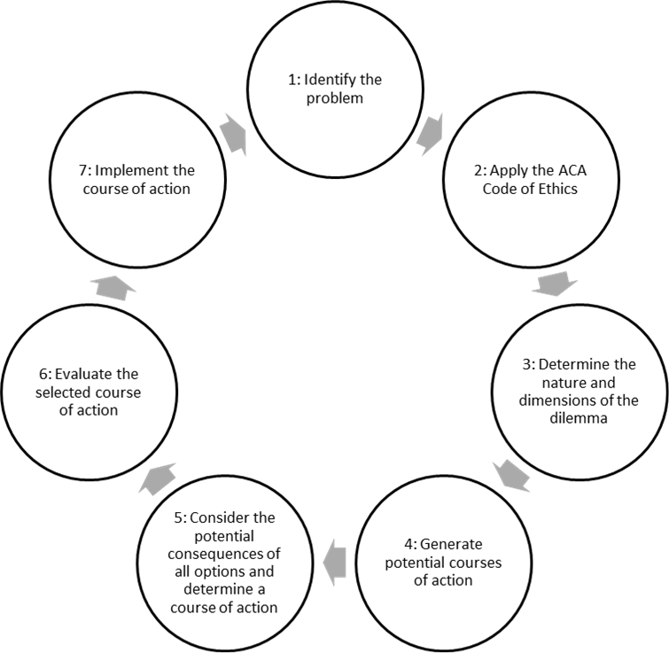
Ethical Decision-making Model
Notes:
The decision-making process for a counselor must involve several components.
1. Identify the Problem
Gather as much information as you can that will illuminate the situation. In doing so, it is important to be as specific and objective as possible. Writing ideas on paper may help you gain clarity. Outline the facts, separating out innuendos, assumptions, hypotheses or suspicions. There are several questions you can ask yourself: Is it an ethical, legal, professional or clinical problem? Is it a combination of more than one of these? If a legal question exists, seek legal advice.
Other questions that it may be useful to ask yourself are: Is the issue related to me and what I am or am not doing? Is it related to a client and/or the client's significant others and what they are or are not doing? Is it related to the institution or agency and their policies and procedures? If the problem can be resolved by implementing a policy of an institution or agency, you can look to the agency's guidelines. It is good to remember that dilemmas you face are often complex, so a useful guideline is to examine the problem from several perspectives and avoid searching for a simplistic solution.
2. Apply the ACA Code of Ethics
After you have clarified the problem, refer to the Code of Ethics (ACA, 2014) to see if the issue is addressed there. If there is an applicable standard or several standards and they are specific and clear, following the course of action indicated should lead to a resolution of the problem. To be able to apply the ethical standards, it is essential that you have read them carefully and that you understand their implications.
If the problem is more complex and a resolution does not seem apparent, then you probably have a true ethical dilemma and need to proceed with further steps in the ethical decision-making process.
3. Determine the nature and dimensions of the dilemma
There are several avenues to follow in order to ensure that you have examined the problem in all its various dimensions.
Consider the moral principles of autonomy, nonmaleficence, beneficence, justice and fidelity. Decide which principles apply to the specific situation, and determine which principle takes priority for you in this case. In theory, each principle is of equal value, which means that it is your challenge to determine the priorities when two or more of them are in conflict.
Review the relevant professional literature to ensure that you are using the most current professional thinking in reaching a decision.
Consult with experienced professional colleagues and/or supervisors. As they review with you the information you have gathered, they may see other issues that are relevant or provide a perspective you have not considered. They may also be able to identify aspects of the dilemma that you are not viewing objectively.
Consult your state or national professional associations to see if they can provide help with the dilemma.
4. Generate potential courses of action
Brainstorm as many possible courses of action as possible (minimum 3-5). Be creative and consider all options. If possible, enlist the assistance of at least one colleague to help you generate options.
5. Consider the potential consequences of all options, and determine a course of action
Considering the information you have gathered and the priorities you have set, evaluate each option and assess the potential consequences for all the parties involved. Ponder the implications of each course of action for the client, for others who will be affected and for yourself as a counselor. Eliminate the options that clearly do not give the desired results or cause even more problematic consequences. Review the remaining options to determine which option or combination of options best fits the situation and addresses the priorities you have identified.
6. Evaluate the selected course of action
Review the selected course of action to see if it presents any new ethical considerations. Stadler (1986) suggests applying three simple tests to the selected course of action to ensure that it is appropriate. In applying the test of justice, assess your own sense of fairness by determining whether you would treat others the same in this situation. For the test of publicity, ask yourself whether you would want your behavior reported in the press. The test of universality asks you to assess whether you could recommend the same course of action to another counselor in the same situation.
If the course of action you have selected seems to present new ethical issues, then you'll need to go back to the beginning and reevaluate each step of the process. Perhaps you have chosen the wrong option or you have identified the problem incorrectly.
If you can answer in the affirmative to each of the questions suggested by Stadler (thus passing the tests of justice, publicity, and universality) and you are satisfied that you have selected an appropriate course of action, then you are ready to move on to implementation.
7. Implement the course of action
Taking the appropriate action in an ethical dilemma is often difficult. The final step involves strengthening your ego to allow you to carry out your plan. After implementing your course of action, it is good practice to follow up on the situation to assess whether your actions had the anticipated effect and consequences.

Slide 19
Penalties for Non-Compliance
  The patient has a right to take the professional to court.
  The professional can be taken to court in a civil or criminal case and can face jail time.
  Monetary fines are most common and can range from $100.00-$100,000.00.
  The act of disclosure must be seen as a willful act of neglect on the doctor’s part in order for a penalty to be issued.
Notes:
Penalties for non-compliance are severe for any health care professional.
Clinical applications: Physicians should not provide ineffective treatments to patients as these offer risk with no possibility of benefit and thus have a chance of harming patients. In addition, physicians must not do anything that would purposely harm patients without the action being balanced by proportional benefit. Because many medications, procedures and interventions cause harm in addition to benefit, the principle of nonmaleficence provides little concrete guidance in the care of patients. This principle is most helpful when it is balanced against beneficence. In this context nonmaleficence posits that the risks of treatment (harm) must be understood in light of the potential benefits. Ultimately, the patient must decide whether the potential benefits outweigh the potential harms.
Examples of nonmaleficent actions: Stopping a medication that is shown to be harmful or refusing to provide a treatment that has not been shown to be effective

Slide 20

Beneficence
  Due to the nature of the relationship between physicians and patients, doctors do have an obligation to:
    Prevent and remove harms
    Weigh and balance possible benefits against possible risks of an action
Notes:
Definition: Beneficence is action that is done for the benefit of others. Beneficent actions can be taken to help prevent or remove harms or to simply improve the situations of others.
Clinical applications: Physicians are expected to refrain from causing harm, but they also have an obligation to help their patients. Ethicists often distinguish between obligatory and ideal beneficence. Ideal beneficence comprises extreme acts of generosity or attempts to benefit others on all possible occasions. Physicians are not necessarily expected to live up to this broad definition of beneficence. However, the goal of medicine is to promote the welfare of patients, and physicians possess skills and knowledge that enable them to assist others. Due to the nature of the relationship between physicians and patients, doctors do have an obligation to:
prevent and remove harms
weigh and balance possible benefits against possible risks of an action
Beneficence can also include protecting and defending the rights of others, rescuing persons who are in danger and helping individuals with disabilities.
Examples of beneficent actions: Resuscitating a drowning victim, providing vaccinations for the general population, encouraging a patient to quit smoking and start an exercise program and talking to the community about STD prevention

Slide 21

Red Flags of Boundary Violations
  You are with the client while off-duty.
  You feel you are the only one who understands the client – other staff are “too critical” or don’t understand.
  You keep secrets with the client.
  You spend an exceptional amount of time with a particular client.
Notes:
You are with the client while off-duty.
You feel you are the only one who understands the client – other staff are “too critical” or don’t understand.
You keep secrets with the client.
You spend an exceptional amount of time with a particular client.

Slide 22

Red Flags of Boundary Violations
  You accept gifts, cards, letters or excessive compliments.
  You are guarded or defensive if asked a question.
  You see the client as “my client.”
Notes:
You accept gifts, cards, letters or excessive compliments.
You are guarded or defensive if asked a question.
You see the client as “my client.”

Slide 23

Breech of Confidentiality
  The consequences of breaching confidentiality laws may include:
    Criminal charges and lawsuits
    Immediate termination
    Loss of reputation
    Written warnings
Notes:
The consequences of breaching confidentiality laws may include:
• Criminal charges and lawsuits
• Immediate termination
• Loss of reputation
• Written warnings

Slide 24
  Does a parent have an unrestricted right of access to the school counseling records of his or her minor child?
Notes:
Texas Attorney General Opinion No. JC-0538 states the following: Generally, all student records are available to parents. Only under very narrow and unusual circumstances may a minor child’s school counseling records be withheld from a parent. Under the Federal Family Educational and Privacy Rights Act, a public school may withhold a minor child’s counseling records from a parent only if the records are kept in the sole possession of the counselor, are used only as the counselor’s personal memory aid, and are not accessible or revealed to any other person except a temporary substitute for the counselor. Within this circumscribed category, state law permits the counselor to withhold a minor child’s records only if the counselor is a “professional,” as defined in section 611 .001(2) of the Health and Safety Code, and further, if the counselor “determines that release” of such record “would be harmful to the patient’s physical, mental, or emotional health.” If the counselor does not fall within the category of licensed professional under section 611 .001(2) of the Health and Safety Code, section 26.004 of the Education Code prevails, and the parent “is entitled to access to all written records” of the school district “concerning the parent’s child, including . . . counseling records.”
Texas Education Agency
School Guidance and Counseling
http://www.tea.state.tx.us/index3.aspx?id=3400

Slide 25
Guidelines for Professional Ethics

Slide 26

Professional Ethics
  Guidelines for professional ethics
  Personal life
  Professionalism
  Respect for resources
Notes:
A good work ethic is an attitude that combines hard work, good performance and dependable results.
How can your ethics help you develop strong relationships in a work environment?

Slide 27

Professionalism
  Professionalism includes being:
    Dependable
    On time
    Polite
    Respectful
Notes:
Professionals do not use profanity on the job and avoid gossip.
Can you think of any other descriptions for professional behavior?

Slide 28

Professionalism
Soft Skills – Professionalism
(Click on link)
Notes:
United States Department of Labor
Soft Skills – Professionalism information.
http://youtu.be/7dPWVjQSad4

Slide 29

Personal Life
  Separate work life from private life
  Avoid discussing personal problems
  Keep personal telephone calls to a minimum
Notes:
Do not let what happens at home or in your personal life affect your work life.
Is it a good idea to date someone you work with? Why or why not?

Slide 30
Do Not Steal Or Waste Resources
  Stealing is:
    Illegal
    Unethical
  Do not take items such as:
    Cash
    Equipment
    Inventory
    Property
  Wasting resources costs the company money
    Recycle items such as:
      Magazines
      Paper products
      Plastic bottles
Notes:
Embezzlement occurs when a trusted employee takes either money or goods entrusted to him or her. He or she can be arrested, fined and/or sent to prison.
A 2010 report by TD Bank Financial Group estimated that employee theft played a role in the bankruptcy of one out of 10 failed small- to medium-sized businesses. A study of 23 large retail companies by loss-prevention consulting firm Jack L. Hayes International shows that 71,095 dishonest employees were apprehended in 2012, up 5.5 percent from 2011. In total, more than $50 million was recovered in those cases, up 7 percent from a year earlier. How would you feel if you were a business owner and this was occurring at your place of business?
Wasting resources can cost money and lead to environmental problems.

Slide 31
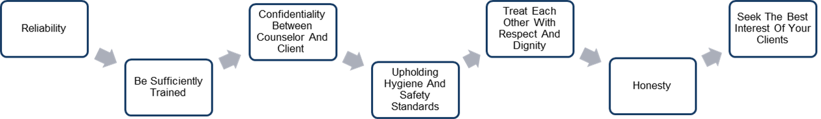

Work Ethic Qualities
Notes:
A reliable employee:
Arrives at work on time
Carries out a variety of assigned tasks without constant prompting
Gets enough rest to work effectively
Is committed
Keeps personal matters separate from business matters
Maintains good personal, physical and mental health
Provides skilled and competent services
Takes on extra work when necessary without complaint
Works a full shift
Respect and dignity – Treat each other well. Be a team player – employees work with a large team.
Honesty - Give accurate information to clients. Employees admit their mistakes and find out how to prevent making them again. You also need to be courteous and sincere.
Interest of clients – Your clients are the bread and butter of your job. Always treat your customers with respect and maintain their confidentiality. Never share your client’s personal information or matters with others – even with your family or close friends.
Keep current on the latest information, techniques and skills by continuing your education in the field of Counseling and Mental Health.
How can joining a career and technical student organization help you build a good work ethic?

Slide 32
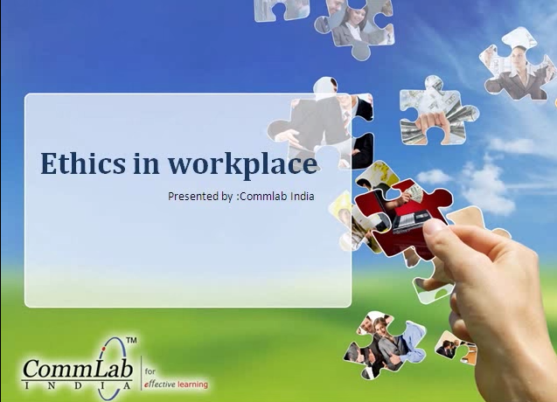

Ethics in the Workplace
Notes:
Ethics in the Workplace!
A presentation on how companies can easily implement business ethics in the workplace and still achieve their goals.
http://youtu.be/0mUxMpMTT28

Slide 33



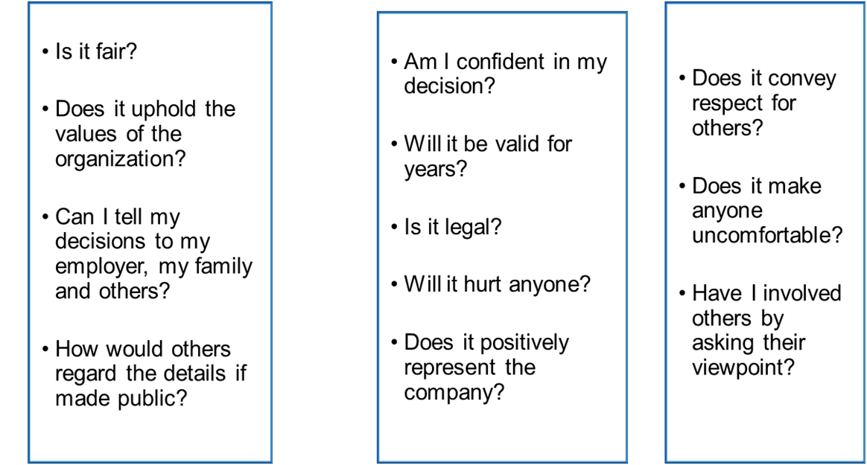
Questions to Keep in Mind
Notes:
To determine whether a decision or action is based on sound workplace ethics, managers and employees should ask these questions.
Are all of these valid questions to keep in mind as an employee? Why or why not?

Slide 34

Questions?

Slide 35
References and Resources
  National Institute of Mental Health
  Health and education on mental health issues.
  http://www.nimh.nih.gov/index.shtml
  Texas Education Agency
  School Guidance and Counseling
  http://www.tea.state.tx.us/index3.aspx?id=3400
  USSF School of Medicine
  The Principles of Medical Ethics
  http://missinglink.ucsf.edu/lm/ethics/Content%20Pages/fast_fact_basic_principle.htm

Slide 36
References and Resources
  YouTube™:
  Ethics in the Workplace!
  A presentation on how companies can easily implement business ethics in the workplace and still achieve their goals.
  http://youtu.be/0mUxMpMTT28
  United States Department of Labor
  Soft Skills – Professionalism information.
  http://youtu.be/7dPWVjQSad4

Slide 37
References and Resources
  National Institute of Mental Health
  Health and education on mental health issues.
  http://www.nimh.nih.gov/index.shtml
  Texas Education Agency
  School Guidance and Counseling
  http://www.tea.state.tx.us/index3.aspx?id=3400
  USSF School of Medicine
  The Principles of Medical Ethics
  http://missinglink.ucsf.edu/lm/ethics/Content%20Pages/fast_fact_basic_principle.htm

Slide 38
References and Resources
  YouTube™:
  Ethics in the Workplace!
  A presentation on how companies can easily implement business ethics in the workplace and still achieve their goals.
  http://youtu.be/0mUxMpMTT28
  United States Department of Labor
  Soft Skills – Professionalism information.
  http://youtu.be/7dPWVjQSad4

