Slide 1
Ethical Standards in Cosmetology
Cosmetology I

Slide 3
What are Work Ethics?
Notes:
What percentage of people are removed from their job because of a lack of work ethics? 80 percent of people!
What are ethics? They are a set of (often unspoken – and generally understood) moral principles relating to a specified group, field or form of conduct. A group of moral principles, standards of behavior or set of values regarding proper conduct in the workplace.
Ethics on the job often deal with a code of conduct or a set of principles for BOTH the employer and the employee. Ask for and offer some examples of workplace ethics from both the employer and the employee.

Slide 4
Work Ethics
  Work Ethics for an Employer
    To provide a safe work environment for staff and employees
    To treat employees with dignity and respect
    To provide a fair wage for the services rendered
    To handle all business transactions with integrity and honesty
  Work Ethics for an Employee
    To show up on time
    To tend to company business the whole time while at work
    To treat the company’s resources, equipment and products with care
    To give respect to the company by working with honesty and integrity

Slide 5
What Do Professional Ethics in Cosmetology Include?

Slide 6
Professional Ethics
  Professionalism
  Personal life
  Respect for resources
  Guidelines for professional ethics
Notes:
A good work ethic is an attitude that combines hard work, good performance and dependable results.
How can your ethics help you develop strong relationships in a work environment?

Slide 7
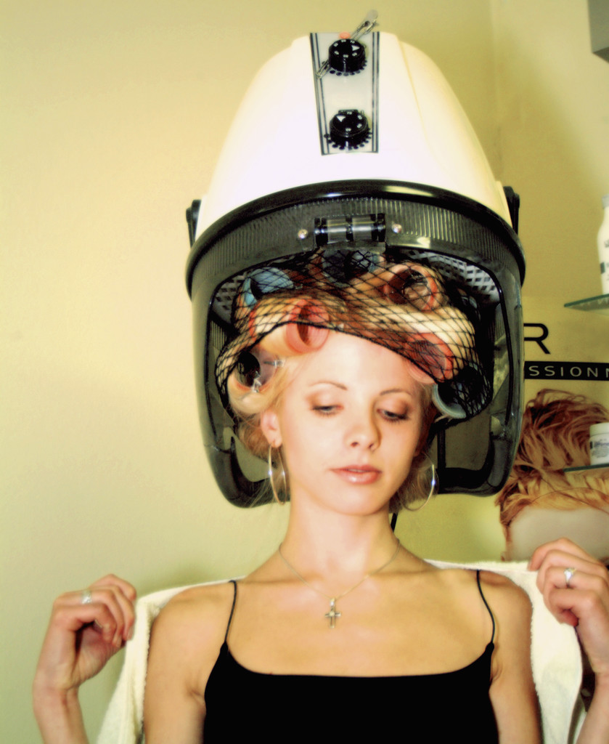
Professionalism
  Professionalism includes being:
    dependable
    on time
    polite
    respectful
Notes:
Professionals do not use profanity on the job and avoid gossip.
Can you think of any other descriptions for professional behavior?

Slide 8
Professionalism
  Soft Skills – Professionalism
  (click on link)
Notes:
United States Department of Labor
Soft Skills – Professionalism information.
http://youtu.be/7dPWVjQSad4

Slide 9
Personal Life
  Separate work life from private life
  Avoid discussing personal problems
  Keep personal telephone calls to a minimum
Notes:
Do not let what happens at home or in your personal life affect your work life.
Is it a good idea to date someone that you work with? Why or why not?

Slide 10

Do Not Steal or Waste Resources
  Stealing is:
    illegal
    unethical
  Do not take items such as:
    beauty supplies
    cash
    equipment
    inventory
    property
  Wasting resources costs the company money
  Recycle items such as:
    magazines
    paper products
    plastic bottles
    using pumps instead of aerosol cans
Notes:
Embezzlement occurs when a trusted employee takes either money or goods entrusted to them. They can be arrested, fined and/or sent to prison.
A 2010 report by TD Bank Financial Group estimated that employee theft played a role in the bankruptcy of one out of 10 failed small- to medium-sized businesses. A study of 23 large retail companies by loss-prevention consulting firm Jack L. Hayes International shows that 71,095 dishonest employees were apprehended in 2012, up 5.5 percent from 2011. In total, more than $50 million was recovered in those cases, up 7 percent from a year earlier. How would you feel if you were a business owner and this was occurring at your place of business?
Wasting resources can cost money and lead to environmental problems.

Slide 11
Guidelines for Professional Ethics

Slide 12
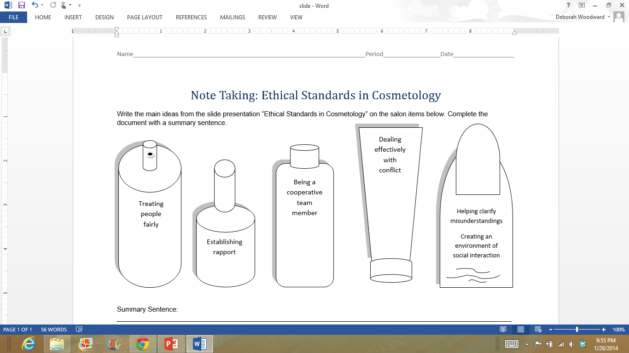
Human Relations Soft Skills/Transferable Skills
Notes:
These are considered soft skills or transferable skills. These are skills which individuals must develop, refine, practice and reinforce. Why are they called transferable skills? They are called transferable skills because you can transfer them from one situation or career to another. Here is a list of additional transferable skills:
Accepting responsibility
Completing projects on time
Cooperating
Decision making
Leadership
Management
Negotiating
Patience with difficult people
Problem solving
Setting priorities
Tactfulness
Can you think of skills you have that you can transfer to many different situations or careers?

Slide 13
Work Ethic Qualities
  Reliability
  Be sufficiently trained
  Confidentiality between cosmetologist and client
  Upholding hygiene and safety standards
  Treat each other with respect and dignity
  Honesty
  Seek the best interest of your clients
Notes:
A reliable employee:
Arrives at work on time
Keeps personal matters separate from business matters
Works a full shift
Carries out a variety of assigned tasks without constant prompting
Provides skilled and competent services
Takes on extra work when necessary without complaint
Gets enough rest to work effectively
Maintains good personal, physical and mental health
Committed - the quality that supports all your abilities and skills to build a strong work ethic
In order to maintain high standards, the code of ethics dictates that each member needs to be a professionally trained cosmetologist who has undergone sufficient training so that he or she can handle his or her customers with care, upholding hygiene and safety standards.
Respect and dignity – Treat each other well. Be a team player – employees work with a large team.
Honesty - Give accurate information to clients. Employees admit their mistakes and find out how to prevent making them again. You also need to be courteous and sincere.
Interest of clients – Your clients are the bread and butter of your job. Always treat your customers with respect and maintain their confidentiality. Never sharing your client’s personal information or matters with others – even with your family or close friends.
Keep abreast of the latest information, techniques and skills by continuing your education in the field of cosmetology.
How can joining a career and technical student organization help you build a good work ethic?

Slide 14

Code of Ethics
  Workplace ethics serve as guiding principles that effective leaders use to set the professional tone and behavior
  Employee treatment
  Wages, benefits and working conditions
  Behavior of employees
Notes:
Workplace ethics serve as guiding principles that effective leaders use in setting professional tone and behavior.
Many establishments have created written codes of ethics, which are designed to remove the guesswork about what is acceptable and unacceptable behavior.
These codes of ethics may include employee treatment, wages and benefits, working conditions, behavior of employees and any other issues that may impact operations.

Slide 15
Questions to Keep in Mind
  Is it fair?
  Does it uphold the values of the organization?
  Can I tell my decisions to my employer, my family and others?
  How would others regard the details if public?
  Does it make anyone uncomfortable?
  Does it convey respect for others?
  Have I involved others by asking their viewpoint?
  Am I confident in my decision?
  Will it be valid for years?
  Is it legal?
  Will it hurt anyone?
  Does it positively represent the company?
Notes:
To determine whether a decision or action is based on sound workplace ethics, managers and employees should ask these questions.
Are all these valid questions to keep in mind as an employee? Why or why not?

Slide 16

Questions?

Slide 17
References and Resources
  Images:
    Microsoft Clip Art: Used with permission from Microsoft.
  Textbook:
    Frangle, C.M. (2012). Milady standard cosmetology. Clifton Park, NY: Cengage Learning.
  Websites:
    Cosmetology and Ethics
    Code of ethics and responsibilities.
    http://www.ehow.co.uk/about_6565776_cosmetology-ethics.html
    Texas Department of Licensing and Regulations
    This department is responsible for the regulation of 26 occupations and industries.
    http://www.license.state.tx.us/index.htm

Slide 18
References and Resources
  Websites:
    United States Environmental Protection Agency
    Healthy Hair Care and the Environment.
    http://www.epa.gov/region9/healthy-hair/salon.html
  YouTube™:
    Work Ethics Orientation
    Southeastern Technical College Swainsboro Peggy Braswell Cosmetology Work Ethics Orientation.
    http://youtu.be/4TxnHQUE0gc

