Slide 1
Ethical Standards in Cosmetology II

Slide 2
Copyright
Copyright and Terms of Service
Copyright © Texas Education Agency, 2014. These materials are copyrighted © and trademarked ™ as the property of the Texas Education Agency (TEA) and may not be reproduced without the express written permission of TEA, except under the following conditions:
1) Texas public school districts, charter schools, and Education Service Centers may reproduce and use copies of the Materials and Related Materials for the districts’ and schools’ educational use without obtaining permission from TEA.
2) Residents of the state of Texas may reproduce and use copies of the Materials and Related Materials for individual personal use only, without obtaining written permission of TEA.
3) Any portion reproduced must be reproduced in its entirety and remain unedited, unaltered and unchanged in any way.
4) No monetary charge can be made for the reproduced materials or any document containing them; however, a reasonable charge to cover only the cost of reproduction and distribution may be charged.
Private entities or persons located in Texas that are not Texas public school districts, Texas Education Service Centers, or Texas charter schools or any entity, whether public or private, educational or non-educational, located outside the state of Texas MUST obtain written approval from TEA and will be required to enter into a license agreement that may involve the payment of a licensing fee or a royalty.
Contact TEA Copyrights with any questions you may have.
2

Slide 3
What are Work Ethics?
3
Notes:
What percentage of people are removed from their jobs because of a lack of work ethics? 80 percent of people!
What are ethics? They are a set of (often unspoken and generally understood) moral principles relating to a specified group, field or form of conduct. Ethics are a group of moral principles, standards of behavior or set of values regarding proper conduct in the workplace.
Ethics on the job often deal with a code of conduct or a set of principles for BOTH the employer and the employee. Ask for and offer some examples of workplace ethics from both the employer and the employee.

Slide 4
Work Ethics
Work Ethics for an Employer
Work Ethics for an Employee
To show up on time
To tend to company business the whole time while at work
To treat the company’s resources, equipment and products with care
To give respect to the company by working with honesty and integrity
To provide a safe work environment for staff and employees
To treat employees with dignity and respect
To provide a fair wage for the services rendered
To handle all business transactions with integrity and honesty
Copyright © Texas Education Agency, 2014. All rights reserved.
4
Notes:
A list of work ethics for an employer or a company might be:
• To provide a safe work environment for all staff and employees
• To treat employees with dignity and respect
• To provide a fair wage for the services rendered
• To handle all business transactions with integrity and honesty
A list of work ethics for an employee might be:
• To show up on time
• To tend to company business the whole time while at work; giving 100%
• To treat the company’s resources, equipment and products with care
• To give respect to the company by working with honesty and integrity
Ask the students to list some ethical issues that might come up at work.

Slide 5
Work Ethics
Code of Ethic
Decisions to Keep in Mind
Influences
Work Ethics Qualities
5
Copyright © Texas Education Agency, 2014. All rights reserved.
Notes:
A work ethic is a personal commitment to doing your very best as part of the team. Employees who have a good work ethic are often successful in their careers.

Slide 6
Influences
Cultural backgrounds
Individual experiences
Personal codes of conduct
Religious beliefs
Copyright © Texas Education Agency, 2014. All rights reserved.
Notes:
Ethics can be influenced by cultural backgrounds, religious beliefs, personal codes of conduct and individual experiences.
These factors all help guide the decisions people make.

Slide 7
Work Ethic Qualities
Commitment
The dedication you show to doing something
Flexibility
Effectively communicate, resolve conflicts and develop negotiation skills
Honesty
Responsibility
Teamwork
The ability to adapt willingly to changing circumstances
You are truthful in your words and actions
Employees use quality products the proper way and serve clients to the best of their abilities
Other people can count on you to do what you say you will do
Your ability to be aware of what a particular situation demands of you
Reliability
Excellence
You strive to do your best at all times, no matter what you are doing
Quality in Cosmetology
Copyright © Texas Education Agency, 2014. All rights reserved.
Notes:
Many employers expect the following qualities from employees:
Commitment – employees possess the quality that supports all their abilities and skills to build a strong work ethic
Excellence – employees make the most of opportunities to improve their abilities and learn new skills
Flexible - employees can adjust to changes without complaining
Honest - employees admit their mistakes and learn how to prevent making them again
Quality in Cosmetology - employees use quality products the proper way and serve clients to the best of their abilities
Reliable – employees can be trusted to perform their duties such as:
arrives to work on time
keeps personal matters separate from business matters
works a full shift
carries out a variety of assigned tasks without constant prompting
takes on extra work when necessary without complaint
gets enough rest to work effectively
maintains good personal physical and mental health
Responsible - employees show up for work on time and work diligently to become familiar with job duties and perform them correctly
Teamwork – employees work well with a large team

Slide 8
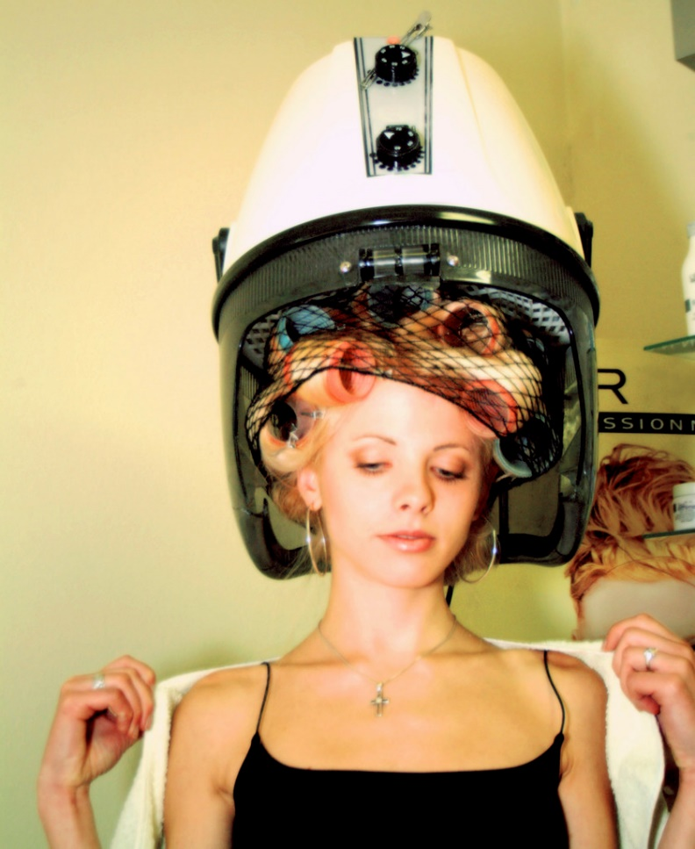
Professionalism
Professionalism includes being:
dependable
on time
polite
respectful
8
Notes:
Professionals do not use profanity on the job and avoid gossip.
Can you think of any other descriptions for professional behavior?

Slide 9

Do Not Steal or Waste Resources
Stealing is:
– illegal
– unethical
Do not take items such as:
– beauty supplies
– cash
– equipment
– inventory
– property
Wasting resources costs the company money
Recycle items such as:
– magazines
– paper products
– plastic bottles
9
Notes:
Embezzlement occurs when a trusted employee takes either money or goods entrusted to him or her. He or she can be arrested, fined and/or sent to prison.
A 2010 report by TD Bank Financial Group estimated that employee theft played a role in the bankruptcy of one out of 10 failed small- to medium-sized businesses. A study of 23 large retail companies by loss-prevention consulting firm Jack L. Hayes International shows that 71,095 dishonest employees were apprehended in 2012, up 5.5 percent from 2011. In total, more than $50 million was recovered in those cases, up 7 percent from a year earlier. How would you feel if you were a business owner and this was occurring at your place of business?
Wasting resources can cost money and lead to environmental problems.

Slide 10
Code of Ethics
Employee treatment
Wages
Benefits
Working conditions
Behavior of employees
Acceptance of gifts
Copyright © Texas Education Agency, 2014. All rights reserved.
Notes:
Workplace ethics serve as guiding principles that effective leaders use in setting the professional tone and behavior of the workplace.
Many establishments have created written codes of ethics, which are designed to remove the guesswork about what is acceptable and unacceptable behavior in the workplace.
These codes of ethics may include:
employee treatment
wages and benefits
working conditions
behavior of employees
acceptance of gifts from guests/vendors/suppliers
any other issues that may impact operations

Slide 11
Decisions to Keep in Mind

Slide 12
Services – Client Focused
Be honest in explaining the services you provide
Do not attempt to provide a service which exceeds your skill or capability
Maintain confidentiality
Make your clients' satisfaction and health a priority
Provide quality care for clients
12
Notes:
Services – Client Focused
Always provide appropriate quality services for your clients.
Strive to always be honest in thoroughly explaining the services you provide and the fee charged for your services.
If your client’s needs exceed your skill or capability, have an initial discussion with the client and attempt to refer the client to the appropriate professional or organization.
Your client’s well-being, satisfaction and health should be your main concern as a professional.
All discussions with clients and services provided to clients must remain confidential.

Slide 13
Professionalism – Self-Focused
Continue to grow in skills and techniques
Abide by all professional requirements and regulations
Be honest concerning the services you provide
Be professional and supportive
Remember that your behavior reflects on your profession
13
Notes:
Professionalism – Self-Focused
Continue to grow in your skills and techniques, educating yourself in becoming the best in your profession.
Abide by all professional, local, state and federal requirements and regulations regarding cosmetology services.
Be honest when informing potential clients of the services you offer through your website and other social media marketing strategies.
Contribute to your profession through networking, and support the growth of the profession by encouraging and helping others who seek to join it.
Treat those with whom you work in a professional and supportive manner.
Make every effort to project professionalism and ethical behavior in how you conduct yourself at your place of business or place of employment.
Be aware that even when you are not working, your behavior reflects on your profession.

Slide 14
Professionalism
Soft Skills - Teamwork
(click on link)
14
Notes:
United States Department of Labor
Soft Skills – Teamwork.
http://youtu.be/sMFh9QYFh2I

Slide 15
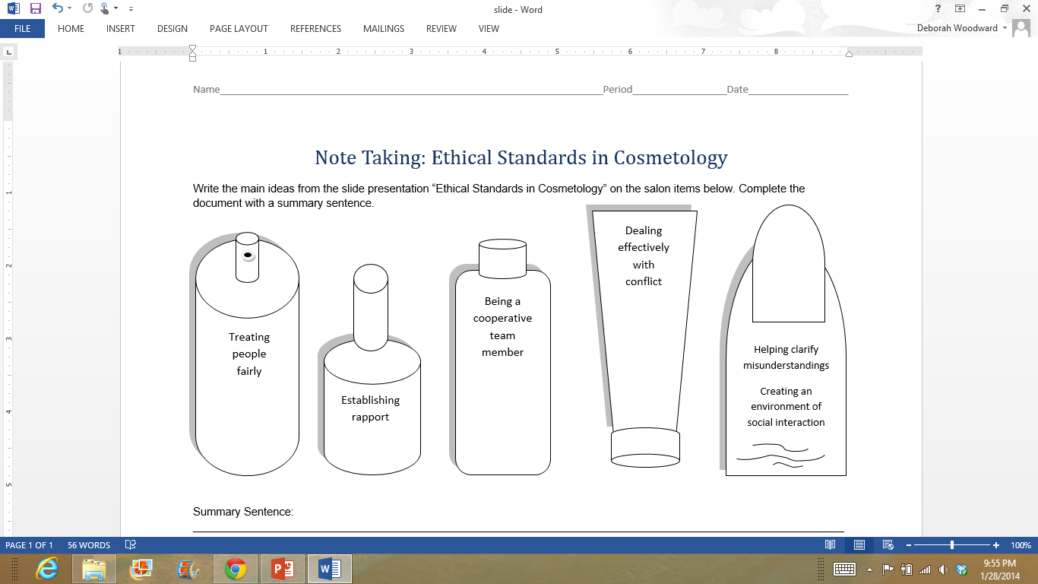
Human Relations Soft Skills/Transferable Skills
15
Notes:
These are considered soft skills or transferable skills. These are skills which individuals must develop, refine, practice and reinforce. Why are they called transferable skills? They are called transferable skills because you can transfer them from one situation or career to another. Here is a list of additional transferable skills:
Accepting responsibility
Completing projects on time
Cooperating
Decision making
Leadership
Management
Negotiating
Patience with difficult people
Problem solving
Setting priorities
Tactfulness
Can you think of skills you have that you can transfer to many different situations or careers?

Slide 16
Work Ethic Qualities
Be sufficiently trained
Confidentiality between cosmetologist and client
Treat each other with respect and dignity
Honesty
Seek the best interest of your clients
Upholding hygiene and safety standards
Reliability
16
Notes:
A reliable employee:
Arrives at work on time
Keeps personal matters separate from business matters
Works a full shift
Carries out a variety of assigned tasks without constant prompting
Provides skilled and competent services
Takes on extra work when necessary without complaint
Gets enough rest to work effectively
Maintains good personal, physical and mental health
In order to maintain high standards, the code of ethics dictates that each member needs to be a professionally trained cosmetologist who has undergone sufficient training so that he or she can handle his or her customers with care, upholding hygiene and safety standards.
Your clients are the bread and butter of your job. Always treat your customers with respect and maintain their confidentiality. Never share your client’s personal information or matters with others – even with your family or close friends.
Treat each other well. Be a team player – employees work with a large team.
Give accurate information to clients. Admit your mistakes and find out how to prevent making them again. Be courteous and sincere.
Keep abreast of the latest information, techniques and skills by continuing your education in the field of cosmetology.
How can joining a career and technical student organization help you build a good work ethic?

Slide 17
Questions to Keep in Mind
Is it fair?
Am I confident in my decision?
Does it uphold the values of the organization?
Can I tell my decisions to my employer, my family and others?
How would others regard the details if made public?
Will it be valid for years?
Is it legal?
Will it hurt anyone?
Does it positively represent the company?
Does it make anyone uncomfortable?
Have I involved others by asking their viewpoint?
Does it convey respect for others?
18
Notes:
To determine whether a decision or action is based on sound workplace ethics, managers and employees should ask these questions.
Are all these valid questions to keep in mind as an employee? Why or why not?

Slide 18

Questions?
18

Slide 19
References and Resources
Images:
Microsoft Clip Art: Used with permission from Microsoft.
Textbook:
Frangle, C.M. (2012). Milady standard cosmetology. Clifton Park, NY: Cengage Learning.
Websites:
Cosmetology and Ethics
Code of ethics and responsibilities.
http://www.ehow.co.uk/about_6565776_cosmetology-ethics.html
Texas Department of Licensing and Regulations
This department is responsible for the regulation of 26 occupations and industries.
http://www.license.state.tx.us/index.htm
19

Slide 20
References and Resources
United States Environmental Protection Agency
Healthy Hair Care and the Environment.
http://www.epa.gov/region9/healthy-hair/salon.html
YouTube™:
Work Ethics Orientation
Southeastern Technical College Swainsboro Peggy Braswell Cosmetology Work Ethics Orientation.
http://youtu.be/4TxnHQUE0gc
20

