Slide 1
Ethics and the Work Environment
  Introduction to Cosmetology

Slide 3
What are personal care services?
  Personal care professionals help people with their personal appearance including styling hair, giving manicures, providing facial treatments and giving makeup advice. They also provide health and fitness training.
  Have you ever used one or more of these personal care services? What kind of services did you receive?

Slide 4
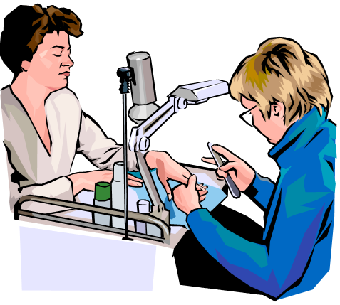
Personal Care Services
  Cosmetologists
  Electrolysis Technicians
  Funeral Directors/Morticians
  Nail Technicians, Manicurists and Pedicurists
  Skin Care Specialists/Estheticians
Notes:
Personal care professionals help people with their personal appearance including styling hair, giving manicures, providing facial treatments and giving makeup advice. They also provide health and fitness training. Additional occupations include:
Barbers
Companions
Electrologists
Embalmers
Funeral directors/morticians/attendants
Hairdressers and hairstylists
Personal and home care aides
Personal trainers
Spa attendants
Massage therapists
What kind of ethics do these personal care services practice? Who benefits from these ethics?

Slide 5

Careers in Personal Care Services
  Employment in this area is anticipated to grow by 27 percent over the next decade.
  This growth will add more than 1.3 million jobs
Notes:
According to the Bureau of Labor Statistics, employment in personal care service occupations is anticipated to grow by 27 percent over the next decade, adding more than 1.3 million jobs. What factors contribute to this growth?
As consumers become more concerned with health, beauty and fitness, the number of cosmetic and health spas will rise, causing an increase in demand for workers in this group. The personal care and service group contains a wide variety of occupations; however, two of them—personal care aides and childcare workers—will account for nearly two-thirds of the group’s new jobs.
Personal and home care aides will experience increased demand as a growing number of elderly people require assistance with daily tasks.
What are other occupations in the personal care service industry?

Slide 6

Texas Department of Licensing and Regulation (TDLR ) Requirements
  TDLR application
  Student permits
  Licensing requirements
  Technical skills
  Interpersonal skills
  Communication skills
  Student assets
  General school policies
  Course requirements
  Ethical and legal conduct
Notes:
If you decide to enroll in the cosmetology program offered at school, there are steps you must take:
TDLR application: Students must complete this application and pay $25.00 by money order or credit card before they can begin to use a time clock to track student hours.
Student permits: TDLR Law, Sec. 1602.266
The department shall require a student enrolled in a school of cosmetology in this state to hold a permit stating the student’s name and the name of the school. The permit shall be displayed in a reasonable manner at the school.
The department shall issue a student permit to an applicant who submits an application to the department for a student permit accompanied by the required fee.
Licensing requirements: 1500 total clock hours
One thousand (1000) clock hours in the school
Five hundred (500) academic hours awarded upon graduation and completion of 1000 lab/class hours
Required practical applications
Mastery of the written and practical state exam
Technical skills: A small percentage (about 15%) of your success. Technical skills can include sterilization and sanitation procedures, hair care, nail care and skin care.
Interpersonal (people) and communication skills – 85% of your success
Personal image and hygiene
Goal setting
Reliability and punctuality
Communication
Sales capability
Student assets
Aspiration
Teamwork
Determination
Dedication
General school policies
Clocking procedures
Lockers
Dress code
Standards of conduct
Campus student handbook or student conduct code
Course requirements
Course of study handout
Course outline/syllabus
Grading policy
Ethical and legal conduct
For this lesson, we are going to focus on ethical and legal conduct in cosmetology.

Slide 7

Salon Rules and Regulations
  Licensed employees
  Sanitation
  Business license
  Hazardous chemical management
Notes:
Operating a beauty salon isn't as relaxing as visiting one. Have you ever thought of operating your own beauty salon? What rules and regulations do you think apply to operating a beauty salon?
Many rules and regulations apply to the industry to ensure safety, responsible business practices and compliance with the law. Rules and regulations depend on what type of beauty salon you're operating and where your business is located, as they are set by state boards and city codes. The rules for hair salons are different than those for nail salons. What are the rules for our city?
Licensed employees - To ensure that your clients receive the best service, make sure your employees have the proper education and training to be qualified at their trade. Most states require beauty school graduates to pass an exam and earn a license to practice in their profession. We have already discussed the requirements for a Texas license.
Sanitation – Sanitation must be a top priority for a beauty salon to meet industry and client cleanliness standards. Many bacteria can be found in salons, making certain sanitation practices standard for all types of beauty salons. Every product, appliance or tool that comes in contact with a client must be disinfected and sanitized. What are some sanitation practices you have or have not observed in a salon?
Business license – Your business must obtain the proper licenses and certificates to meet legal standards. When opening or operating a spa, you must get all the licenses required by your state.
Hazardous chemical management - Employers and workers can take steps to protect health when working with products that contain potentially hazardous chemicals.

Slide 8
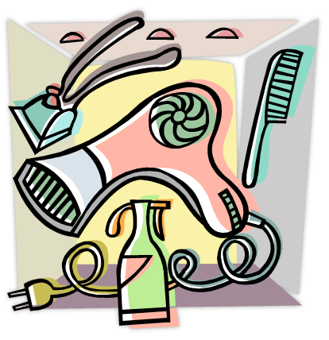
What are Work Ethics?
Notes:
What percentage of people are removed from their job because of a lack of work ethics? 80 percent of people!
What are ethics? They are a set of (often unspoken – and generally understood) moral principles relating to a specified group, field or form of conduct. A group of moral principles, standards of behavior or set of values regarding proper conduct in the workplace.
Ethics on the job often deal with a code of conduct or a set of principles for BOTH the employer and the employee. Ask for and offer some examples of workplace ethics from both the employer and the employee.

Slide 9
Work Ethics
  To provide a safe work environment for staff and employees
  To treat employees with dignity and respect
  To provide a fair wage for the services rendered
  To handle all business transactions with integrity and honesty
  To show up on time
  To tend to company business the whole time while at work
  To treat the company’s resources, equipment and products with care
  To give respect to the company by working with honesty and integrity
Notes:
A list of work ethics for an employer or a company might be:
• To provide a safe work environment for all staff and employees
• To treat employees with dignity and respect
• To provide a fair wage for the services rendered
• To handle all business transactions with integrity and honesty
A list of work ethics for an employee might be:
• To show up on time
• To tend to company business the whole time while at work; giving it 100%
• To treat the company’s resources, equipment and products with care
• To give respect to the company by working with honesty and integrity
Ask the students to list some ethical issues that might come up at work.

Slide 10
What do professional ethics in cosmetology include?

Slide 11
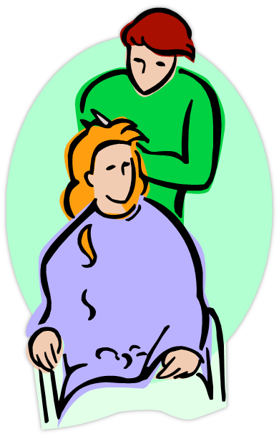
Professional Ethics
  Professionalism
  Personal life
  Respect for resources
  Guidelines for professional ethics
Notes:
A good work ethic is an attitude that combines hard work, good performance and dependable results.
How can your ethics help you develop strong relationships in a work environment?

Slide 12
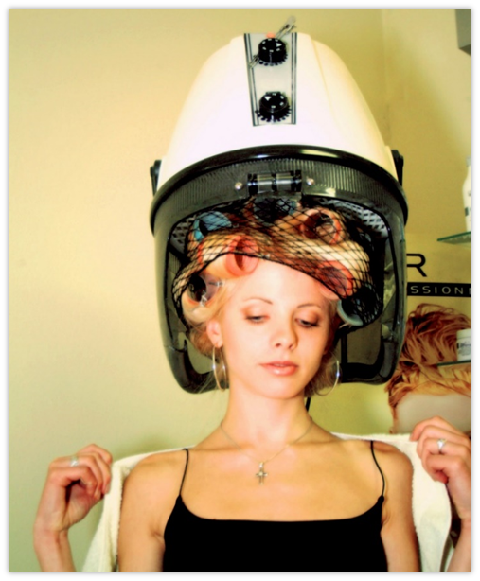
Professionalism
  Professionalism includes being:
    Dependable
    On time
    Polite
    Respectful
Notes:
Professionals do not use profanity on the job and avoid gossip.
Can you think of any other descriptions for professional behavior?

Slide 13

Skills Needed in Cosmetology
  Communication skills
  Clerical development
  Customer service
  Personal qualities
  Salon fundamentals
  Salon management
Notes:
Communication skills
Client communication: Direct the conversation. Do not gossip or complain. Do not talk about personal issues, politics or religion. Talk about beauty and fashion. Be a good listener.
In-salon communication with co-workers. The same as above applies.
Discuss the importance of communicating effectively with co-workers.
Clerical development
Have clients complete an intake form – also called a client questionnaire or consultation card. This can be a good tool to open up communication lines and build an excellent relationship with your clients.
Customer service
Keeping your clients happy and providing them with the best customer service should be your number one priority.
Personality qualities
Project a positive attitude
Manners: Good human relations, kind and considerate
Maintain professional appearance, personal hygiene and behavior
Demonstrate correct client care and professionalism at all times
Project professionalism, confidence and enthusiasm when providing information
Your personal qualities play an important role in how your non-verbal communication is perceived by your clients.
Salon fundamentals
Provide good customer service
Demonstrate respect to clients
Explaining treatment/service/product to the clients
Demonstrate good communication skills
Salon management
Salon manager is a potential career path for a cosmetologist, but it requires a very different skill set. What are some responsibilities as a manager?
Some answers could include:
Having an aptitude for math and accounting
Being able to read documents such as profit and loss statements
Understanding marketing
Keeping clients and employees happy

Slide 14
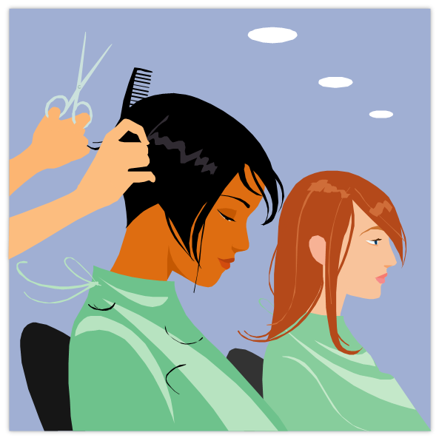
Communication Skills Needed in Cosmetology
Notes:
Five Tips for building better communication skills in the salon
Today’s salon guests are very sophisticated and fashion aware. Here are five tips that can help build better communication in your salon behind the chair.
http://youtu.be/pzLIKoxwKnY

Slide 15

Personal Life
  Separate work life from private life
  Avoid discussing personal problems
  Keep personal telephone calls to a minimum
Notes:
Do not let what happens at home or in your personal life affect your work life.
Is it a good idea to date someone that you work with? Why or why not?

Slide 16

Do Not Steal or Waste Resources
  Stealing is:
    Illegal
    Unethical
  Do not take items such as:
    Beauty supplies
    Cash
    Equipment
    Inventory
    Property
  Wasting resources costs the company money
    Recycle items such as:
      Magazines
      Paper products
      Plastic bottles
Notes:
Embezzlement occurs when a trusted employee takes either money or goods entrusted to them. They can be arrested, fined and/or sent to prison.
A 2010 report by TD Bank Financial Group estimated that employee theft played a role in the bankruptcy of one out of 10 failed small- to medium-sized businesses. A study of 23 large retail companies by loss-prevention consulting firm Jack L. Hayes International shows that 71,095 dishonest employees were apprehended in 2012, up 5.5 percent from 2011. In total, more than $50 million was recovered in those cases, up 7 percent from a year earlier. How would you feel if you were a business owner and this was occurring at your place of business?
Wasting resources can cost money and lead to environmental problems.

Slide 17
Guidelines for Professional Ethics

Slide 18

Services – Client Focused
  Be honest in explaining the services you provide
  Confidentiality
  Do not attempt to provide a service which exceeds your skill or capability
  Provide quality care for clients
  Satisfaction and health
Notes:
Services – Client Focused
Always provide appropriate quality services for your clients.
Confidential - All discussions with clients and services provided to clients must remain confidential.
If your client’s needs exceed your skill or capability, have an initial discussion with the client and attempt to refer the client to the appropriate professional or organization.
Strive always to be honest in thoroughly explaining the services you provide and the fee charged for your services.
Your client’s well-being, satisfaction and health should be your main concern as a professional.

Slide 19

Professionalism – Self Focused
  Abide by all professional requirements and regulations
  Behavior reflects on your profession
  Be honest concerning the services you provide
  Be professional and supportive
  Continue to grow in skills and techniques
Notes:
Professionalism – Self Focused
Abide by all professional, local, state and federal requirements and regulations regarding cosmetology services.
Be aware that even when you are not working, your behavior reflects on your profession.
Be honest by informing potential clients concerning the services you offer through your website and other social media marketing strategies.
Continue to grow in your skills and techniques, continuing to educate yourself in becoming the best in your profession.
Contribute to your profession through networking and through supporting the growth of the profession by encouraging and helping others who seek to join the profession.
Make every effort to project professionalism and ethical behavior in how you conduct yourself at your place of business or place of employment.
Treat those with whom you work in a professional and supportive manner.

Slide 20
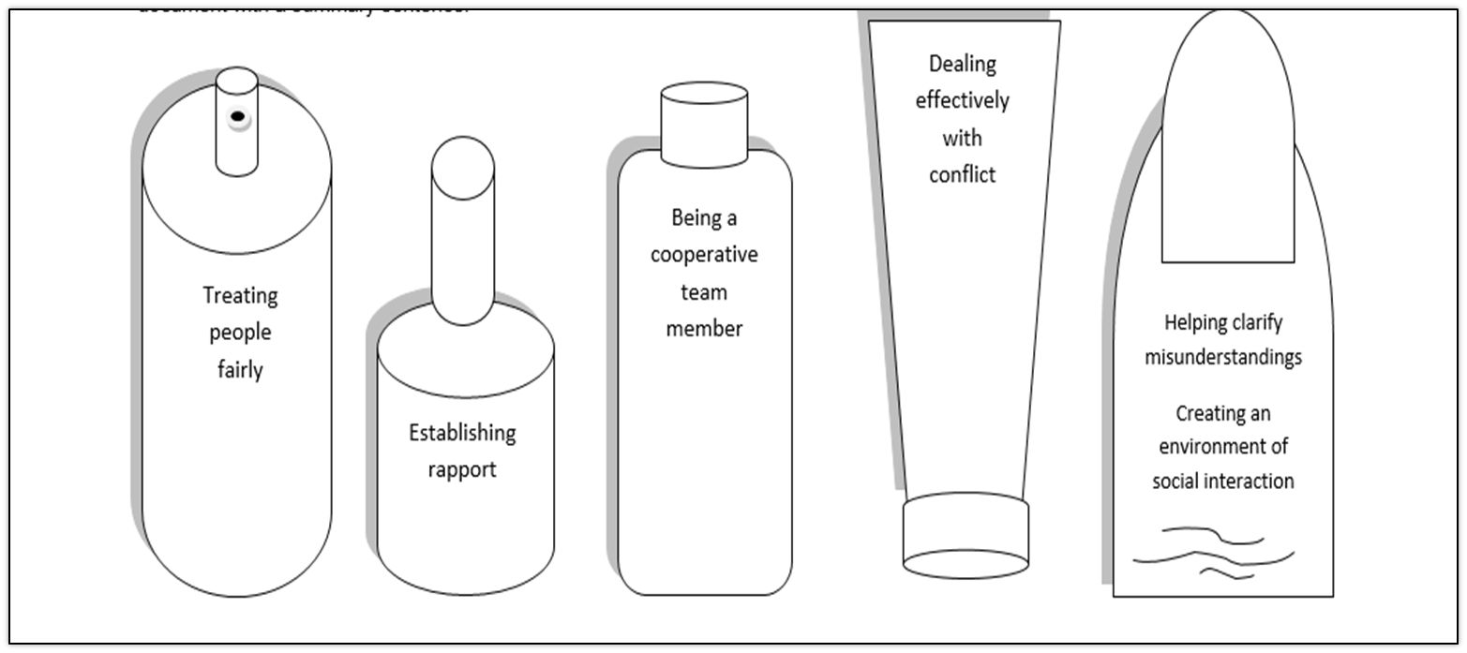
Human Relations Soft Skills/Transferable Skills
Notes:
These are considered soft skills or transferable skills. These are skills which individuals must develop, refine, practice and reinforce. Why are they called transferable skills? They are called transferable skills because you can transfer them from one situation or career to another. Here is a list of additional transferable skills:
Accepting responsibility
Completing projects on time
Cooperating
Decision making
Leadership
Management
Negotiating
Patience with difficult people
Problem solving
Setting priorities
Tactfulness
Can you think of skills you have that you can transfer to many different situations or careers?

Slide 21
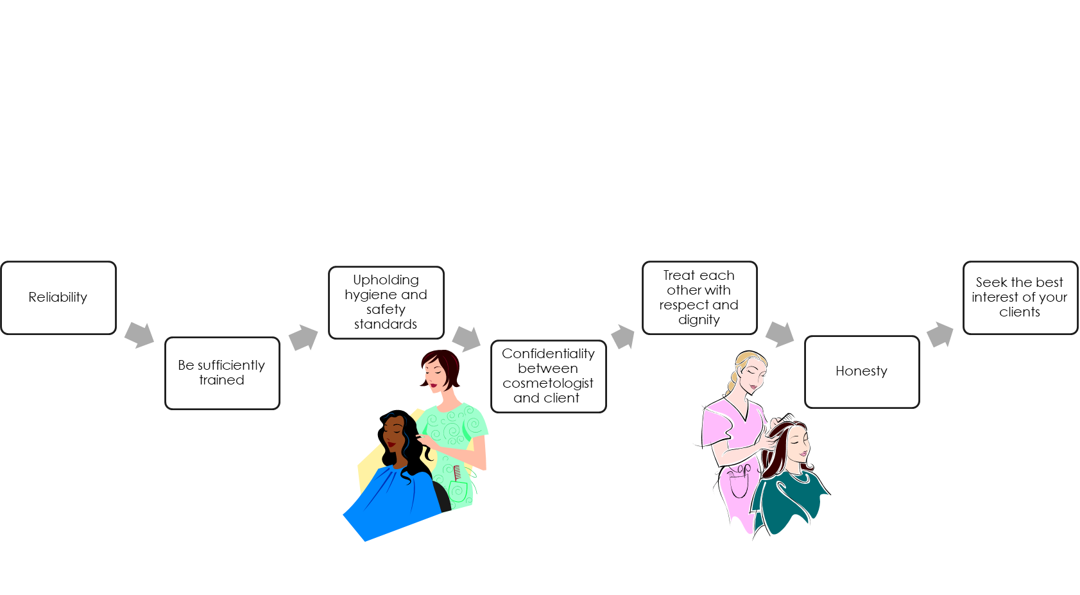
Work Ethic Qualities
Notes:
A reliable employee:
Arrives at work on time
Carries out a variety of assigned tasks without constant prompting
Committed - the quality that supports all your abilities and skills to build a strong work ethic
Gets enough rest to work effectively
Keeps personal matters separate from business matters
Maintains good personal, physical and mental health
Provides skilled and competent services
Takes on extra work when necessary without complaint
Works a full shift
In order to maintain high standards, the code of ethics dictates that each member needs to be a professionally trained cosmetologist who has undergone sufficient training so that he or she can handle his or her customers with care, upholding hygiene and safety standards.
Honesty - Give accurate information to clients. Employees admit their mistakes and find out how to prevent making them again. You also need to be courteous and sincere.
Interest of clients – Your clients are the bread and butter of your job. Always treat your customers with respect and maintain their confidentiality. Never share your client’s personal information or matters with others – even with your family or close friends.
Keep abreast of the latest information, techniques and skills by continuing your education in the field of cosmetology.
Respect and dignity – Treat each other well. Be a team player – employees work with a large team.
How can joining a career and technical student organization help you build a good work ethic?

Slide 22
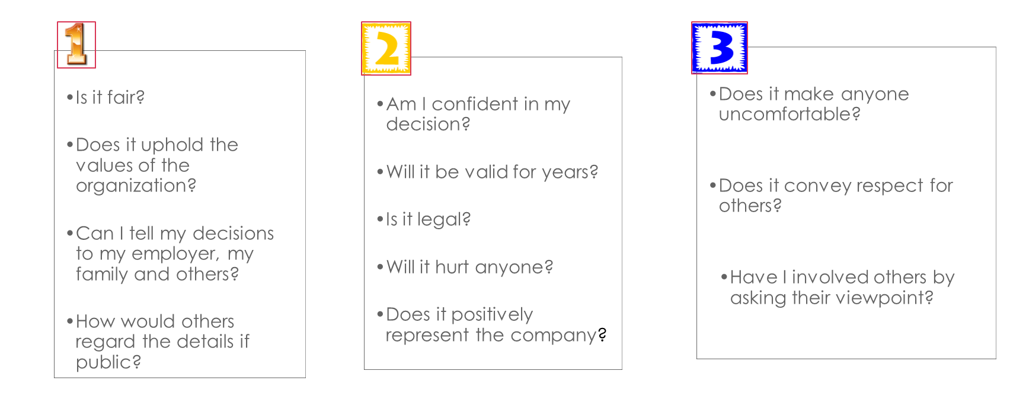
Questions to Keep in Mind
Notes:
To determine whether a decision or action is based on sound workplace ethics, managers and employees should ask these questions.
Are all these valid questions to keep in mind as an employee? Why or why not?

Slide 23

Questions?

Slide 24
References and Resources
  Images:
  Microsoft Clip Art: Used with permission from Microsoft.
  Textbook:
  Frangle, C.M. (2012). Milady standard cosmetology. Clifton Park, NY: Cengage Learning.
  Websites:
  Cosmetology and Ethics
  Code of ethics and responsibilities.
  http://www.ehow.co.uk/about_6565776_cosmetology-ethics.html
  Texas Department of Licensing and Regulations
  This department is responsible for the regulation of 26 occupations and industries.
  http://www.license.state.tx.us/index.htm
Notes:
Articles:
Advertising Ideas for Salon Services
An effective advertising strategy is vital to making your salon a success.
http://www.ehow.com/list_6819694_advertising-ideas-salon-services.html
How To Make a Flyer for a Beauty Salon
A flyer can help attract potential customers.
http://www.ehow.com/how_6595829_make-flyer-beauty-salon.html
How to Make a Flyer in Microsoft® Word
Flyers are useful, low-cost advertising tools, and you can use Microsoft® Word to create flyers to your liking.
http://www.ehow.com/how_4903668_flyer-microsoft-word.html
Images:
Microsoft Clip Art: Used with permission from Microsoft.
Textbooks:
lpert, Arlene, and Milady Publishing Company. Miladys standard cosmetology 2004. Milady Pub Corp, 2002.
TDLR Law and rules
http://www.license.state.tx.us
Five Tips for building better communication skills in the salon
Today’s salon guests are very sophisticated and fashion aware. Here are five tips that can help build better communication in your salon behind the chair.
http://youtu.be/pzLIKoxwKnY

Slide 25
References and Resources
  United States Environmental Protection Agency
  Healthy Hair Care and the Environment.
  http://www.epa.gov/region9/healthy-hair/salon.html
  YouTube™:
  Five Tips for building better communication skills in the salon
  Today’s salon guests are very sophisticated and fashion aware. Here are five tips that can help build better communication in your salon behind the chair.
  http://youtu.be/pzLIKoxwKnY

