Slide 1
What Would You Do?
Ethics in Culinary Arts

Slide 3
Regulations and Work Ethics
  Employment in foodservice requires training in:
    Laws and regulations
    Workplace ethics

Slide 4

Regulations
  USDA
  FDA
  Environmental
  OSHA
  State and Local
Notes:
The main goal of a food service industry is to provide good quality food and service to customers.
All quality standards must be considered such as:
• safety
• nutritional value
• appearance
• consistency
• flavor
• texture
• convenience
• ease of handling
• packaging
• storage

Slide 5
USDA
  Food Grading
    Involves applying specific quality standards to products
    Grade is based on quality at time of packaging
  Food Inspections
    A test of a businesses’ practices against standards
    Conducted by the Food Safety and Inspection Service (FSIS)
Notes:
The U.S. Department of Agriculture grades and inspects poultry and poultry products, eggs and egg products, and meat and meat products. It also controls food grading, processing plant inspections, and the use of pesticides, preservatives, and food additives.

Slide 6

FDA
  Labels
    Requires nutrition labels on food packages
    Shows percent of daily dietary value in food
  Menus
    Regulates health claims made by restaurants
    Must meet standards listed in the Nutrition Labeling and Education Act
  Food code
    Give guidelines for handing food safely
    Updated every two years
Notes:
The Food and Drug Administration (FDA) is part of the U.S. Department of Health and Human Services. It enforces the Food, Drug, and Cosmetic Act of 1938. This law covers food and the packaging of foods other than fish, poultry, and meat.

Slide 7
Environmental
  Environmental Protection Agency (EPA)
  Decides how solid waste is managed
  Solid waste includes:
  Packaging material
  Containers
  Recyclables
  National Environmental Policy Act (NEPA)
  Protects the environment from damage caused by building development
Notes:
The Environmental Protection Agency (EPA) decides how solid waste is managed in the United States. The EPA recommends that businesses reduce solid waste by eliminating packaging where possible. It also recommends that reusable food containers be cleaned and sanitized before reusing.
The National Environmental Policy Act (NEPA) of 1969 protects the environment from damage caused by building development. Whenever a new restaurant is planned, an environmental impact statement (EIS) must be completed. This describes the impact of the proposed facility and any negative effects it might have on the environment.

Slide 8
OSHA
  Occupational Safety and Health Administration
    Sets standards and inspects workplaces for safety
    Oversee record keeping of job-related illness or injury
Notes:
The Occupational Safety and Health Administration (OSHA) has two main responsibilities:
• sets standards and inspects workplaces to make sure that employers provide safe and healthful environments
• oversees record keeping of job-related illness and injury
• an accident report log shows the details of any accident that happens in business

Slide 9
State and Local
  Health regulations that affect foodservice are written by the state
  Local health departments enforce state regulations
  County health department enforces regulations in rural areas and small cities
Notes:
Many of the health regulations that affect foodservice operations are written by the state.
Local health departments then enforce state regulations.
The county health department enforces regulations in rural areas and small cities.

Slide 10

Work Ethics
  Influences
  Work Ethics Qualities
  Code of Ethic
  Decisions to Keep in Mind
Notes:
A work ethic is a personal commitment to doing your very best as part of the team. Employees who have a good work ethic are often successful in their careers.

Slide 11
Influences
  Cultural backgrounds
  Religious beliefs
  Personal codes of conduct
  Individual experiences
Notes:
Ethics can be influenced by cultural backgrounds, religious beliefs, personal codes of conduct, and individual experiences.
These all help guide the decisions people make.

Slide 12
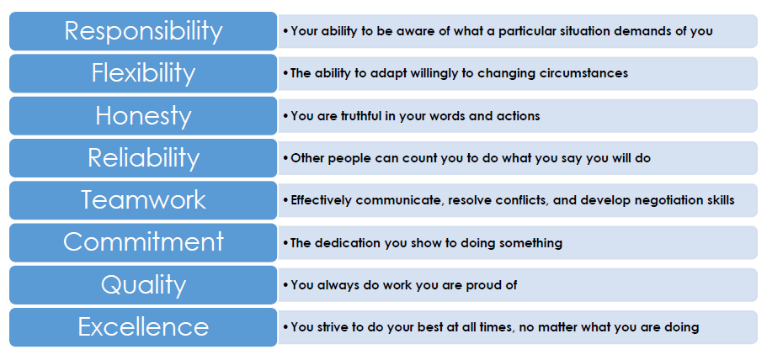
Work Ethic Qualities
Notes:
Responsible - employees show up for work on time and work diligently to become familiar with job duties and do them correctly
Flexible - employees can adjust to changes without complaining
Honest - employees admit their mistakes and finding out how to prevent from making them again
A reliable employee:
•Arrives to work on time
•Keeps personal matters separate from business matters
•Works a full shift
•Carries out a variety of assigned tasks without constant prompting
•Take on extra work when necessary without complaint
•Gets enough rest to work effectively
•Maintains good personal physical and mental health
Teamwork – as a foodservice employee, you will work with a large team
Commitment - the quality that supports all your abilities and skills to build a strong work ethic
Quality in foodservice - means that you use quality ingredients, prepare and serve them in the most pleasing way and you serve customers to the best of your ability
Excellence – employees make the most of opportunities to improve their abilities and learn new skills

Slide 13
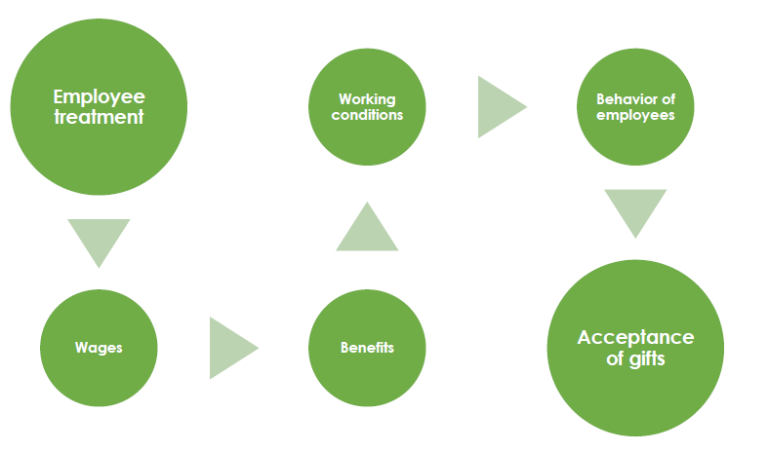
Code of Ethics
Notes:
Workplace ethics serve as guiding principles that effective leaders use in setting the professional tone and behavior.
Many establishments have created written codes of ethics, which are designed to remove the guesswork about what is acceptable and unacceptable behavior.
These codes of ethics may include employee treatment, wages, benefits, working conditions, behavior of employees, and acceptance of gifts from guests/vendors/suppliers and any other issues that may impact operations.

Slide 14
Decisions to Keep in Mind
  Is it legal?
  Will it hurt anyone?
  Does it positively represent the company?
  Does it make anyone uncomfortable?
  Does it convey respect for others?
  Have I involved others by asking their viewpoint?
  Is it fair?
  Does it uphold the values of the organization?
  Can I tell my decisions to employer, family, and others?
  How would others regard details if public?
  Am I confident my decision will be valid for years?
Notes:
To determine whether a decision or action is based on sound workplace ethics, managers and employees should ask these questions.

Slide 15
Question?

Slide 16
References and Resources
  Images:
    Microsoft Office Clip Art: Used with permission from Microsoft.
  Textbooks:
    Culinary essentials. (2010). Woodland Hills, CA: Glencoe/McGraw Hill.
    Foundations of restaurant management & culinary arts: Level one. (2011). Boston, MA: Prentice Hall.
  Website:
    Ethics Resource Center
    ERC is a nonprofit, nonpartisan research organization, dedicated to independent research that advances high ethical standards and practices in public and private institutions.
    http://www.ethics.org/

