Slide 1
What Would You Do?
Ethics in Travel and Tourism Management

Slide 3

Professional Ethics and Legal Responsibilities
  Employment in the travel industry requires training in:
    Professional ethics
    Legal responsibilities

Slide 4
Professional Ethics
  Professional Manner
  Private Life
  Do Not Steal or Waste Resources
  Guidelines for Ethical Behavior
Notes:
A good work ethic is an attitude that combines hard work, good performance, and dependable results.

Slide 5
Professional Manner
  Professional behavior includes being:
    on time
    polite
    respectful
    dependable
Notes:
Professionals do not use profanity on the job and avoid gossip.
Can you think of any other descriptions for professional behavior?

Slide 6
Personal Life
  Separate work life from private life
  Avoid discussing personal problems
  Keep personal telephone calls to a minimum
Notes:
Do not let what happens at home affect your work life.

Slide 7
Do Not Steal or Waste Resources
  Stealing is
    Illegal
    unethical
  Do not take items such as:
    cash
    property
    office supplies
    food
    toiletries
  Wasting resources costs the company money
  Recycle items such as:
    paper products
    grease
    oil
Notes:
Embezzlement occurs when a trusted employee takes either money or goods entrusted to them. They can be arrested, fined, and/or sent to prison.
Wasting resources can cost money and lead to environmental problems.

Slide 8
Ethics in Hospitality
  Truth-in-Menu Laws
  Sexual Harassment
  Discrimination
  Technology Issues
Notes:
Truth-in-menu laws have been developed to protect consumers from unethical restaurant owners. The menus should be accurate.
The Federal Drug Administration requires that any health claims meet the new FDS standards.
Sexual harassment is considered to be any unwelcome behavior of a sexual nature that creates an intimidating, hostile, or offensive work environment. Any act of sexual harassment should be reported to the manager and they are required to investigate.
Discrimination is showing prejudice in the treatment of a person because of his or her race, religion, age, national origin, or gender.
Technology issues have posed situations where employees have access to new types of technology such as credit cards abuse, security cameras, and company computer systems. All should be used appropriately.

Slide 9
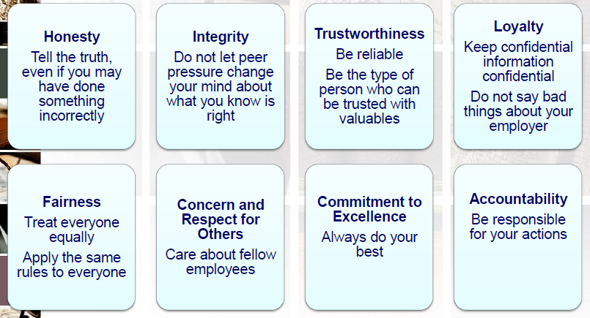
Guidelines for Ethical Behavior
Notes:
These ethical guidelines have been generally accepted by businesses.

Slide 10
Making Ethical Decisions
  Is it legal?
  Does it hurt anyone?
  Is it fair?
  Am I being honest?
  Can I live with myself?
  Would I publicize my decision?
  What if everyone did it?
Notes:
Ask yourself these questions before taking action that might be unethical.

Slide 11
Legal Responsibilities
  Policies and Procedures
  Equal Opportunity Laws
  Worker’s Rights
  Safety Laws

Slide 12
Policies and Procedures
  Employee handbook ensures safe and efficient running of the company
  May include:
    Attendance
    Appropriate dress
    Employee conduct
    Personal phone calls
Notes:
An employee handbook explains all company policies and procedures concerning employees. Human Resources is charged with making sure each employee receives a copy and understands the contents.

Slide 13
Equal Opportunity Laws
  Civil Rights Act – 1964, 1991
  Age Discrimination Employment Act and Older Workers Benefit Protection Act – 1967, 1990
  Immigration Reform and Control Act – 1986
  Americans with Disabilities Act - 1990
Notes:
Civil Rights Act – 1964, 1991
• Bans employment discrimination based on
• race, color, religion, sex, national origin
Age Discrimination Employment Act and Older Workers Benefit Protection Act – 1967, 1990
• Bans discrimination against workers age 40 and over
Immigration Reform and Control Act – 1986
• Bans employment of noncitizens who are not authorized to work in the U.S.
Americans with Disabilities Act – 1990
• Bans discrimination against individuals with disabilities in matters of employment, government services, public accommodations, commercial facilities, and transportation.

Slide 14
Worker’s Rights Laws
  Fair Labor Standards Act – 1938
  Equal Pay Act – 1963
  Family and Medical Leave Act – 1993
Notes:
Fair Labor Standards Act – 1938
Minimum wage
Overtime pay
Restrictions on employment of children
Record keeping
Equal Pay Act – 1963
Men and women must be paid equal for similar work
Family and Medical Leave Act – 1993
Protected leave for family and medical reasons

Slide 15
Safety Laws
  Occupational Safety and Health Act – 1970
    Assures safe and healthful working conditions for all workers
    Employers must display OSHA Poster
Notes:
The OSH Act also established the Occupational Safety and Health Administration that makes sure the laws and regulations of the OSH Act are carried out.

Slide 16

Questions?

Slide 17
References and Resources
  Images:
    Microsoft Office Clip Art: Used with permission from Microsoft.
  Textbooks:
    Reynolds, J. S. (2010). Hospitality services: Food & lodging. Tinley Park, IL: Goodheart-Willcox Company.
  Website:
    Ethics Resource Center
    ERC is a nonprofit, nonpartisan research organization, dedicated to independent research that advances high ethical standards and practices in public and private institutions.
    http://www.ethics.org/

