Slide 1
Famous Chefs and Entrepreneurs in the Food Industry

Slide 3
Past and Present: Chefs and Entrepreneurs
Notes:
Today’s chef has earned a mark of respect and distinction that describes a professional cook who has reached the position through hard work and dedication to quality.
Entrepreneurs have contributed to the foodservice industry by cultivating new restaurants chains and franchises.

Slide 4
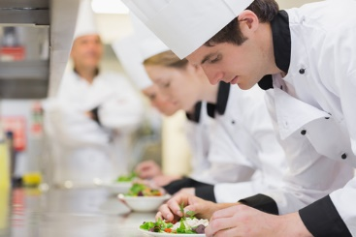
Chef
A highly skilled professional who is proficient in all aspects of food preparation
Notes:
Many of the chef’s duties are managerial and oversees all of the operations of a restaurant.

Slide 5
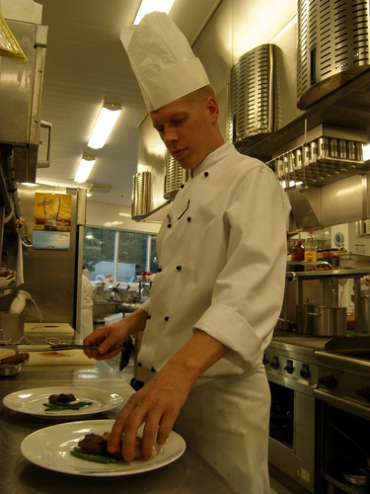
History of the Chef Title
French for “chief”
Short for chef de cuisine or chief of the kitchen
Mark of respect and distinction
Describes a professional cook
Notes:
The chef must also be an excellent cook and oversee the work of other cooks.

Slide 6
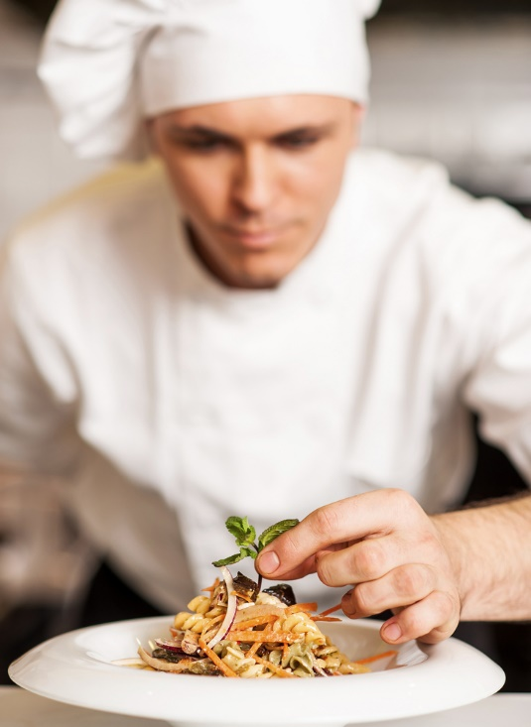
Famous Chefs in History
Alice Waters
Ferdinand Metz
Fernand Point
Georges August Escoffier
Julia Child
Marie-Antoine Carême
Paul Bocuse
Notes:
These are just a few of the chefs that made an impact in the foodservice industry.
We will learn more about them and others later in the lesson.

Slide 7
Culinary Kitchen Brigade
Executive Chef – Chef de Cuisine
Sous Chef – assistant chef
Chef de Partie – line or station chef
Saucier – sauce cook
Poissonier – fish cook
Grillardin – grill cook
Friturier – fry cook
Rotisseur – roast cook
Entremetier – vegetable cook
Potager – soup cook
Tournant – swing cook
Garde Manager – pantry chef
Patissier – pastry chef
Boucher – butcher
Georges August Escoffier is credited for developing the kitchen brigade system
A chain of command
Assigns certain responsibilities to kitchen staff
Notes:
One of the most important contributions from Georges Escoffier is the brigade system that is based on the military rankings.
He is also referred to as the “King of the Kitchen.”

Slide 8
Entrepreneur
A self-motivated person who runs a business
Notes:
Food service entrepreneurs usually begin by opening a small business such as a deli, bakery or small restaurant.
As an owner, you can decide what type of restaurant to open.
Imagine being your own boss!

Slide 9
Business Owners
Create and run a business
Takes personal and financial risks
Hopes for personal satisfaction and financial rewards
Notes:
Would you like to one day own your own foodservice business?

Slide 10
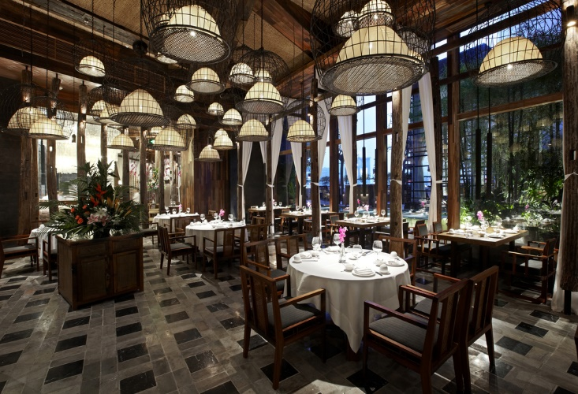
Food Entrepreneurs
Bill Darden
Dave Thomas
Colonel Harlan Sanders
Ray Kroc
Ruth Fretel
Steve Ells
Notes:
These are a few of the food entrepreneurs we are familiar with.
Do you know who they are and what foodservice business they started?
Bill Darden – Red Lobster®
Dave Thomas – Wendy’s®
Colonel Harlan Sanders – Kentucky Fried Chicken®
Ray Kroc - McDonalds®
Ruth Fretel – Ruth’s Chris Steak House®
Steve Ells – Chipotle Mexican Grill®

Slide 11
Julia Child
Encouraged people to care about food and cooking
Inspired Americans to cook French recipes
Wrote several cookbooks
Starred in several television programs
Donated her kitchen to the Smithsonian Institute in 2001
Notes:
Julia Child had a passion for food and enjoyed preparing it as much as eating it.
She was the first chef to be featured on national television.

Slide 12
Cooking with Julia Child
(click on link)
Notes:
Julia Child’s kitchen is still available for the public to view in the exhibition - FOOD: Transforming the American Table 1950-2000.
Click on hyperlink to view video:
Cooking with Julia Child
Through her television shows, Julia Child shared her love for culinary arts with the world.
https://youtu.be/rwiv30rV4LU

Slide 14
Let’s Review!
What are the chef’s duties?
Who created the kitchen brigade?
Name the first five positions in the brigade.
Do you think entrepreneurs are risk-takers?
Why was Julia Child so successful?
Notes:
Answers to the questions are found within the slide presentation or may vary with class discussion.

Slide 16
References and Resources
Images:
Shutterstock™ images. Photos obtained with subscription. (Slides 4, 5, 6, 8, 9, 10, 13, 15)
Textbooks:
Culinary essentials. (2010). Woodland Hills, CA: Glencoe/McGraw-Hill.
Foundations of restaurant management & culinary arts. (2011) Boston, MA: Prentice Hall.
Draz, J., & Koetke, C. (2014). The culinary professional. Tinley Park, Illinois: The Goodheart-Willcox Company.
Website:
Chef Jobs, Training, and Career Paths
The contemporary kitchen, from institutional to fine-dining restaurant, runs according to a strict hierarchy in which the chef plays the lead role. Assignments differ based on the precise needs of a given kitchen, but in most upscale American and European facilities the nomenclature and roles are determined by the Brigade System.
http://www.culinaryschools.org/chef-types/
Julia Child's Kitchen at the Smithsonian
Julia Child shared the passions, philosophies, and products of this kitchen in her home with family, friends, colleagues, and fans for 45 years. Now she is sharing the kitchen itself with millions, having donated it to the National Museum of American History in 2001.
http://americanhistory.si.edu/juliachild/
YouTube™:
Cooking with Julia Child
Through her television shows, Julia Child shared her love for culinary arts with the world.
https://youtu.be/rwiv30rV4LU

