Slide 1
Federal Agencies + Travel = Quality Control
Travel and Tourism Management

Slide 3
Quality Control
Notes:
What is quality?
Quality is a high level of value or excellence.
Quality control is a system for verifying and maintaining a desired level of quality in an existing product or service by careful planning, use of proper equipment, continued inspection and corrective action as required.

Slide 4
Federal Agencies
Notes:
Special government organizations set up for a specific purpose such as the management of resources, financial oversight of industries or national security issues.

Slide 5
Agency Abbreviations
CBP
CDC
DHS
DOT
EPA
FAA
FDA
FEMA
FBI
FMC
ICE
NSA
OSHA
Treasury
TSA
USCG
Notes:
Can you name the agencies?
Agencies that oversee the travel and tourism industry include:
CBP – U. S. Customs and Border Protection
CDC – Centers for Disease Control and Prevention
DHS – Department of Homeland Security
DOT – Department of Transportation
EPA – Environmental Protection Agency
FAA – Federal Aviation Administration
FDA – Food and Drug Administration
FEMA – Federal Emergency Management Agency
FBI – Federal Bureau of Investigation
FMC – Federal Maritime Commission
ICE – U. S. Immigration and Customs Enforcement Administration
NSA – National Security Agency
OSHA – Occupational Safety and Health Administration
TREASURY – U. S. Department of Treasury
TSA – Transportation Security Administration
USCG – United States Coast Guard
How do you think these agencies assist the travel and tourism industry?
Can you name any other federal agency that may assist the industry?

Slide 6
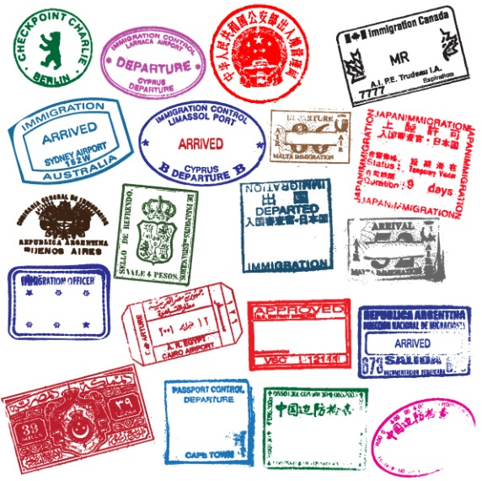
Travel Documents
Passports
Tourist Cards
Visas
Notes:
Some of the federal agencies oversee many of the required documents needed to travel abroad.

Slide 7
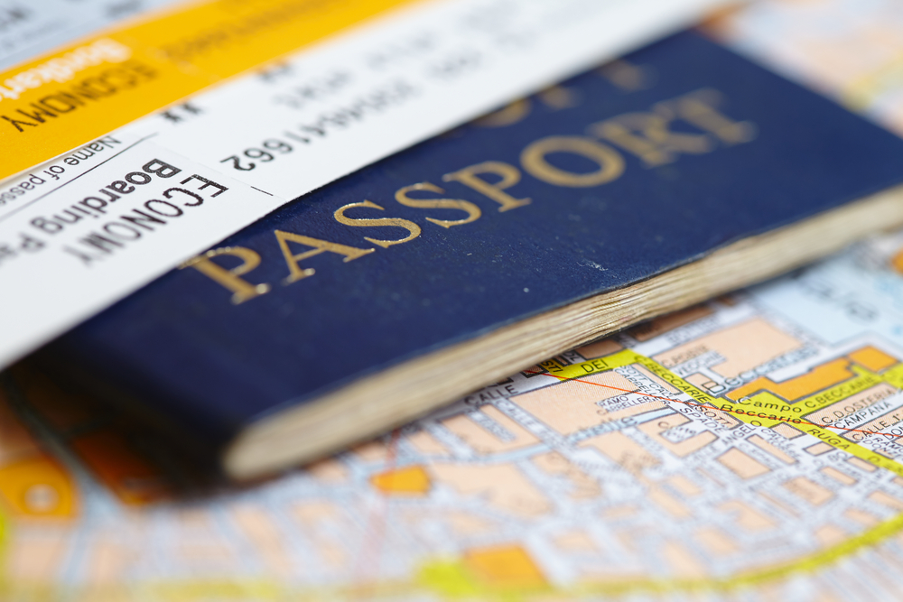
Passports
Allows a traveler to leave the country and return
Document issued by a national government
Proof of a person’s identity and citizenship
Notes:
Most countries require travelers to show a passport when they enter and exit their country.
Passports are a formal document issued by an authorized official of a country to one of its citizens that is usually necessary for exit from and reentry into the country, that allows the citizen to travel in a foreign country in accordance with visa requirements and that requests protection for the citizen while abroad.

Slide 8
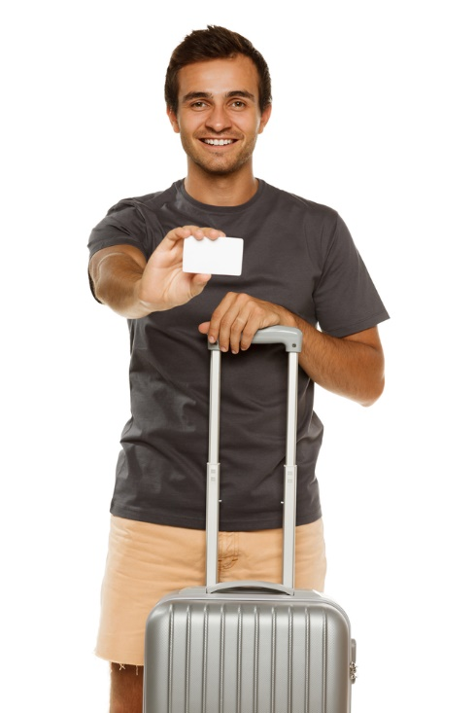
Tourist Cards
Form used instead of (or in addition to) a passport
Mexico and most other South American countries require U.S. citizens to have one
Must be carried by travelers for duration of trip
Surrendered upon leaving country
Notes:
Tourist card - a citizenship identity card issued to a tourist usually for a stated period of time in lieu of a passport or a visa.

Slide 9
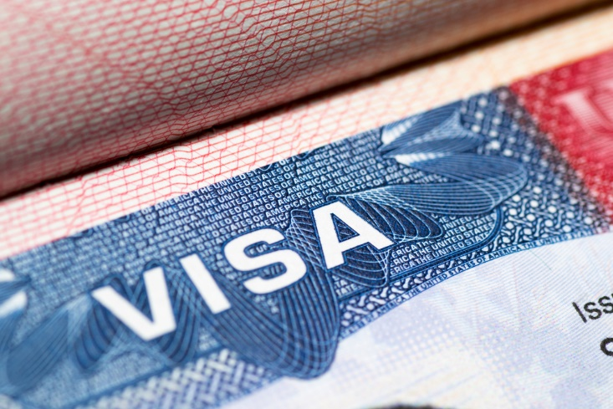
Visas
A permission issued by a country to a noncitizen
Authorizes the holder to enter, exit or live in the country for a specific time
Visa stamps are usually placed on a page of a passport book
Notes:
Visas - an official mark or stamp on a passport that allows someone to enter or leave a country usually for a particular reason.

Slide 10
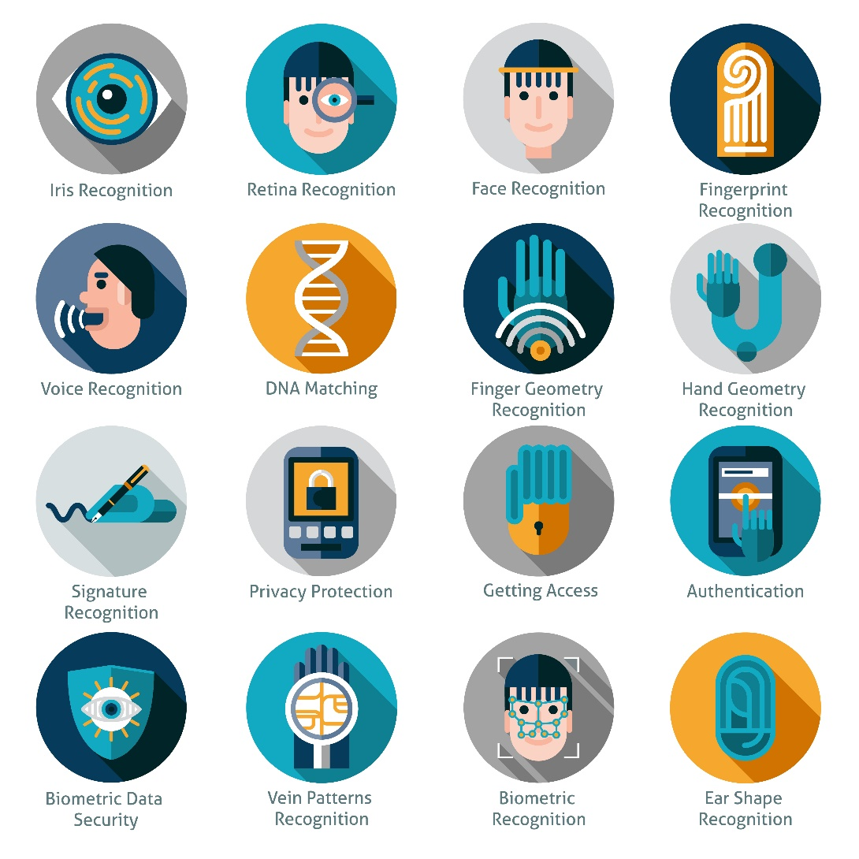
Future Trends – Biometric Technology
Unique, measurable characteristics that label or identify people
Examples:
Blood samples
DNA samples
Fingerprints
Iris scans
Voice recognition
Notes:
Biometrics is identification that is readable by computers and is more secure.
Have you seen anything like this?
Think of the new iPhones with fingerprint recognition.

Slide 11
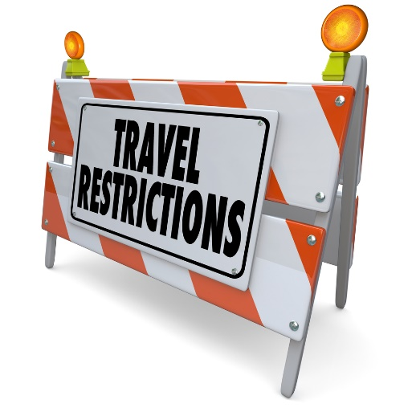
Travel Advisories
STEP
U.S. Department of State
Notes:
It is recommended to check these websites before traveling out of the country.

Slide 12
STEP
(click on link)
Notes:
STEP - Smart Traveler Enrollment Program
A free service to allow U. S. citizens and nationals traveling abroad to enroll their trip with the nearest U. S. Embassy or Consulate.
https://step.state.gov/step/

Slide 13
U.S. Department of State
(click on link)
Notes:
The U.S. Department of State is the official source for information on travel requirements for U.S. citizens who wish to travel abroad.
Travel.State.Gov
U.S. Department of State - Bureau of Consular Affairs
Safety. Security. Service. Our highest priority is to protect the lives and interests of U.S. citizens overseas.

Slide 14
U.S. Department of State Advisories
Information includes:
Criminal penalties and legal system
Current political environment
Entry and exit information
Medical emergencies, facilities and insurance
Safety and security
Special circumstances (weather)
Tourist attractions
Notes:
The information on the U.S. Department of State includes all of the topics.
Travelers need to know this information before they visit a foreign country.

Slide 15
A Recipe for Applying in Person for a U.S. Passport
(click on link)
Notes:
Click on hyperlink to view video:
A Recipe for Applying in Person for a U.S. Passport
Applying in person for a U.S. passport is as easy as following a recipe. With this step by step video guide, we give you all of the ingredients you’ll need to make a passport so you can get out and enjoy a tasty, travel treat!
https://youtu.be/SDeJqRyL3JY

Slide 16
Notes:
What does this quote mean to you?

Slide 17
Let’s Review!
What is quality control in the travel and tourism industry?
What do federal agencies oversee in the industry?
Name three federal agencies and their mission.
What travel documents would U.S. citizens need when they travel abroad.?
What future trends in travel might we eventually see?
Where can we find information on travel advisories?
How can you get a passport?
Notes:
Answers to the questions are found within the slide presentation or may vary with class discussion.

Slide 18
Questions?

Slide 19
References and Resources
Images:
Shutterstock™ images. Photos obtained with subscription. (slides 1, 3, 4, 6, 7, 8, 9, 10, 11, 14, 16, 18)
Textbooks:
Mancini, M. (2013). Access: Introduction to travel and tourism. Clifton Park, NY. Cengage Learning.
Reynolds, J. S. & Chase, D. M. (2014). Hospitality services. Tinley-Park, Illinois: The Goodheart-Willcox Company
Websites:
STEP - Smart Traveler Enrollment Program
A free service to allow U. S. citizens and nationals traveling abroad to enroll their trip with
the nearest U. S. Embassy or Consulate.
https://step.state.gov/step/

Slide 20
References and Resources
Websites:
Travel.State.Gov
U.S. Department of State - Bureau of Consular Affairs
Safety. Security. Service. Our highest priority is to protect the lives and interests of U.S.
citizens overseas.
http://travel.state.gov/content/travel/english.html
YouTube(tm):
A Recipe for Applying in Person for a U.S. Passport
Applying in person for a U.S. passport is as easy as following a recipe. With this step by
step video guide, we give you all of the ingredients you’ll need to make a passport so you
can get out and enjoy a tasty, travel treat!
https://youtu.be/SDeJqRyL3JY

