Slide 1
Financial Obligations Throughout the family life cycle
Interpersonal Studies

Slide 3
What are the Family Life Cycle Stages?
Notes:
What are examples of characteristics and tasks unique to specific stages of the family life cycle?
What are examples of characteristics and tasks common among most or all stages of the family life cycle?

Slide 4
Family Life-Cycle Stages
Beginning
Adjusting to married life
Starting a home
Making career decisions
Completing Education
Childbearing
Planning arrival of baby
Birth of children
Parenting roles and responsibilities
Adjustments to lifestyles
Parenting
Adjustments to lifestyles and schedules
Addition of more children
Family life revolves around children
Family health and safety
Notes:
Do families progress through each stage of the family life cycle in an orderly, sequenced fashion? Explain and give examples.

Slide 5
Family Life-Cycle Stages
Older Adult
Retirement
Grandparenting
Travel and hobbies
Health Problems
Launching
Preparing for children to become independent
Children leave home
Adjusting to the “empty nest”
Opportunities to reconnect with spouse
Mid-years
Parents re-focus on their relationship
Height of careers and earnings
May become grandparents
Health problems may be an issue
Notes:
Given that the stages are not “definite”, why is it helpful to understand the stages of the family life cycle?
Older adults are also referred to as aging adults.

Slide 6
What are some financial obligations and opportunities throughout the family life cycle stages?
Notes:
What is the difference between financial obligations and opportunities?
What are examples of financial obligations and opportunities at each stage of the family life cycle?
During which stages do financial obligations typically require the largest percentage of a family’s financial resources? Why?

Slide 7
Beginning Stage
Living expenses
Home furnishings
Education expenses
Loan repayments
Transportation (vehicle and insurance)
Savings
Notes:
What is an example of a financial obligation that might be viewed as an opportunity?

Slide 8
Childbearing
Prenatal/birth/postnatal health care
Infant clothing and furnishings
Child care
Savings
Possible loss of one income
Notes:
What is the cost of raising a child today?

Slide 9
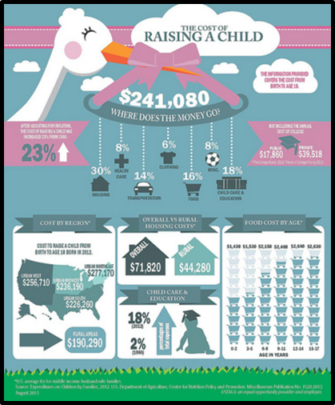
The Cost of Raising a Child
http://www.cnpp.usda.gov/calculatorintro.htm
(click on poster)
Notes:
The United States Department of Agriculture (USDA) released its annual report, Expenditures on Children by Families, also known as the Cost of Raising a Child. Students can use the interactive calculator and worksheet “Cost of Raising a Child” to estimate how much it will annually cost to raise a child or two! http://www.cnpp.usda.gov/calculatorintro.htm

Slide 10
Parenting
Child care equipment
Health care
Additional insurance
More housing space and furnishings
Monthly expenses increase
Savings
Fund for children’s education
Toddler
Preschooler
School-Age
Adolescent
Notes:
What financial obligations are included in the toddler, preschool, school-age and adolescent years?
What are some additional monthly expenses?
Answers might include:
Health issues
Extra-curricular activities
Gifts for various occasions
Orthodontics
Transportation

Slide 11
Launching
College or trade school expenses
Assistance to children in establishing independent living
Reevaluation of housing needs
Savings, IRAs
Notes:
What are examples of things the family may give up in order to accomplish the things they have set as priorities, such as children attending college?

Slide 12
Mid-Years
Travel and recreational opportunities
Care for aging parents
Gifts to children and grandchildren
Increased savings/investments for retirement
Notes:
During which stages can more of a family’s financial resources be used to take advantage of financial opportunities? Why?

Slide 13
Empty Nest Syndrome
(click on picture)
Notes:
How to Cope with Empty Nest Syndrome
Don't know what to do with yourself now that the kids are gone? Time to focus on you for a change.
http://youtu.be/BPSphFM96mk

Slide 14
Older Adult
Travel and recreational opportunities
Retirement costs
Health insurance
Health care
Notes:
What is an example of a financial opportunity that might become an obligation?

Slide 15
Financial Considerations
Financial Decisions
Priorities
Notes:
What is a priority?
Where do individuals and families get their priorities?
Answers might include:
Culture background
Religion
Financial status
Family background
What factors influence priorities?
Why is it important for individuals and families to recognize their priorities?
Lead students to discuss how families determine personal priorities and philosophies that are important. Examples of family priorities might include:
Family relationships
Security
Health
Religion
Education
Financial security
Nice possessions
Helping others
Travel
Recognition
Work
Freedom
Citizenship
Entertainment
Volunteerism

Slide 16
Questions?

Slide 17
References and Resources
Microsoft Clip Art: Used with permission from Microsoft.
Textbooks:
Lowe, Ross. _Consumer Education and Economics_. 6th ed. N.p.: Glencoe/McGraw Hill, 2006. Print.
Madura, Jeff, Mike Casey, and Sherry J. Roberts. _The Financial Plan_. Personal Financial Literacy. Boston: Pearson, 2010. 23-29. Print.
YouTube™:
How to Cope with Empty Nest Syndrome
Don't know what to do with yourself now that the kids are gone?
Time to focus on you for a change.
http://youtu.be/BPSphFM96mk
The Leading Practical Money Skill Site on the Net.
Interactive games concerning budgeting, banking, credit and money management
http://www.practicalmoneyskill.com/foreducators/lessonplans/highschool.php

Slide 18
References and Resources
YouTube™:
United States Department of Agriculture (USDA)
Released its annual report; Expenditures on Children by Families, also known as the Cost
of Raising a Child.
http://www.cnpp.usda.gov/calculatorintro.htm
United States Department of Labor
"Saving Fitness: A Guide To Your Money and Your Financial Future"
http://www.dol.gov/ebsa/pdf/savingsfitness.pdf

