Slide 1
Finger Wave Hair Style
Cosmetology I

Slide 3
What is a Finger Wave Hair Style?
  The process of shaping and directing the hair into an S pattern through the use of the fingers, combs and waving lotion
Notes:
Finger waving teaches the technique of moving and directing hair.
It also provides the valuable training in molding hair to the curved surface of the head.

Slide 4
History
  All the rage in the 1920’s and 30’s
  Softer, more feminine look
  Film stars Mae West and Jean Harlow made look popular
Notes:
Finger waves have been a part of our fashion for many years.
As the times change with our society, the trends will change as well. Nevertheless, every part of fashion will only repeat itself.
In the early twenties, finger waves were in demand. Today, there are fashion designers that are now bringing finger waves back in style.

Slide 5
Fabulous Finger Waves
  Fabulous Finger Waves - 1920s and 1930s finger wave tutorial
  (click on link)
Notes:
Click on hyperlink to view YouTube™ video:
Fabulous Finger Waves - 1920s and 1930s finger wave tutorial
How to create the classic 1920s and 1930s finger waves
http://youtu.be/hMcbkGDyEQc

Slide 6
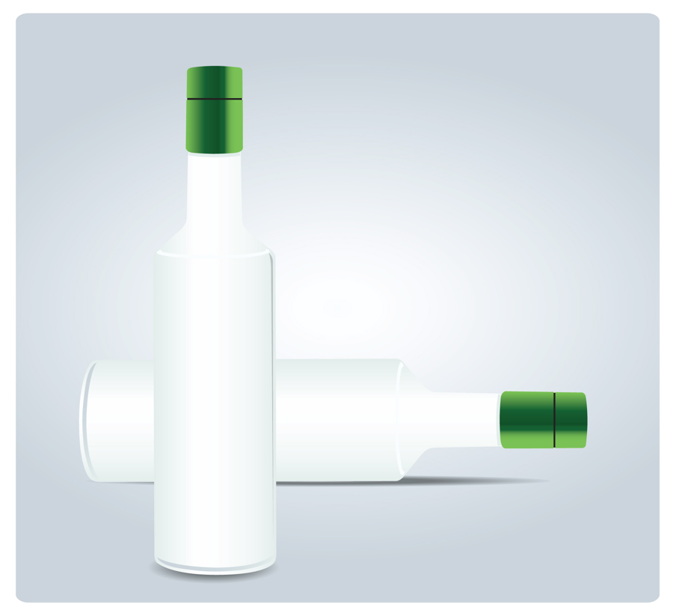
Finger Waving Lotion
  A type of hair gel that makes the hair pliable enough to keep it in place during the procedure
Notes:
Use the waving lotion sparingly being careful not to get the lotion in your client’s eyes.

Slide 7
Types
  Horizontal finger waves
  Vertical finger waves
    Two waves
    Three ridges
    1” wide
    4 “ long
  If the hair is not firmly held, the wave gets combed out
  Examples of Finger Wave Hairstyles
  (click on link)
Notes:
There are several types of finger waves. We will be concentrating on the horizontal with two waves and three ridges, 1” wide and 4” long.
Click on the hyperlink to view the website:
Hairstyles Weekly
Examples of Finger Wave Hair Styles
http://hairstylesweekly.com/tag/finger-waves-hairstyles/

Slide 8
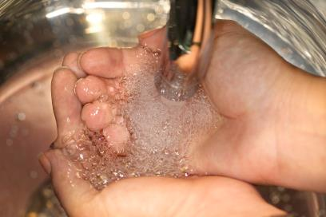
Reminder
  Safety and Sanitation Precautions - Cosmetology Administrative Rules
Notes:
Remind students of the safety and sanitation procedures before they begin working on a client.
Click on the photo to view Texas Department of Licensing and Regulation’s 10 most common violations. Use this as an eye opener for students to understand how important it is to practice state law.
Cosmetology Administrative Rules
These standards include:
clean and disinfect equipment, tools, implements and supplies before use on each client
use clean towels for each client
use clean cutting and shampoo capes for each client
use a sanitary neck strip or towel
employ good hygiene habits while providing cosmetology service
Demonstrate:
draping for wet styling (explain purpose)
sanitation - hand sanitizer and hospital grade Environmental Protection Agency registered disinfectant
safety - shielding the client’s face from the spray bottle with cupped hands
how to keep hair and setting lotion out of the client’s eyes
Explain the importance of keeping pointed implements away from the client’s face.

Slide 9
Our Goal : Working Toward Mastery
Achieve Mastery
Get Experienced
Projects Worked On
Get Familiar
Time Spent
9
Notes:
Stress the importance of practicing and working towards mastery.

Slide 10
Let’s Review
  How long have finger waves been in existence and why should we learn this technique?
  Why is it important to practice safety and sanitation precautions?
  What implement can you use to measure a finger wave and how long should it be?
  Why is it important to be able to identify the open and closed end of a wave?
Notes:
How long have finger waves been in existence and why should we learn this technique?
Finger Wave hair styles have been in existence for many years.
We should learn this technique because history tends to repeat itself.
Why is it important to practice safety and sanitation precautions?
It is important to practice safety and sanitation precautions so that you and/or clients do not become ill.
What implement can you use to measure a finger wave and how long should it be?
A tail comb can be used to measure how long a wave should be. The wave should be about four inches.
Why is it important to be able to identify the open and close end of a wave?
The wave has an open end to let you know where the wave starts and a closed end to let you know where the wave stops.

Slide 11

Questions

Slide 12
Resources and References
  Images:
    Microsoft Office Clip Art: Used with permission from Microsoft.
  Textbook:
    Milady standard cosmetology: Situational problems. (2012). Clifton Park, NY: Cengage Learning.
  YouTube™:
    Fabulous Finger Waves - 1920s and 1930s finger wave tutorial
    How to create the classic 1920s and 1930s finger waves
    http://youtu.be/hMcbkGDyEQc
  Websites:
    Hairstyles Weekly
    Examples of Finger Wave Hair Styles
    http://hairstylesweekly.com/tag/finger-waves-hairstyles
    Texas Department of Licensing and Regulation
    To be the leader in public service, customer satisfaction, and innovation
    http://www.tdlr.texas.gov/cosmet/saloncodeviolations.htm

