Slide 1
Focus on Serving Children – Our Future

Slide 3
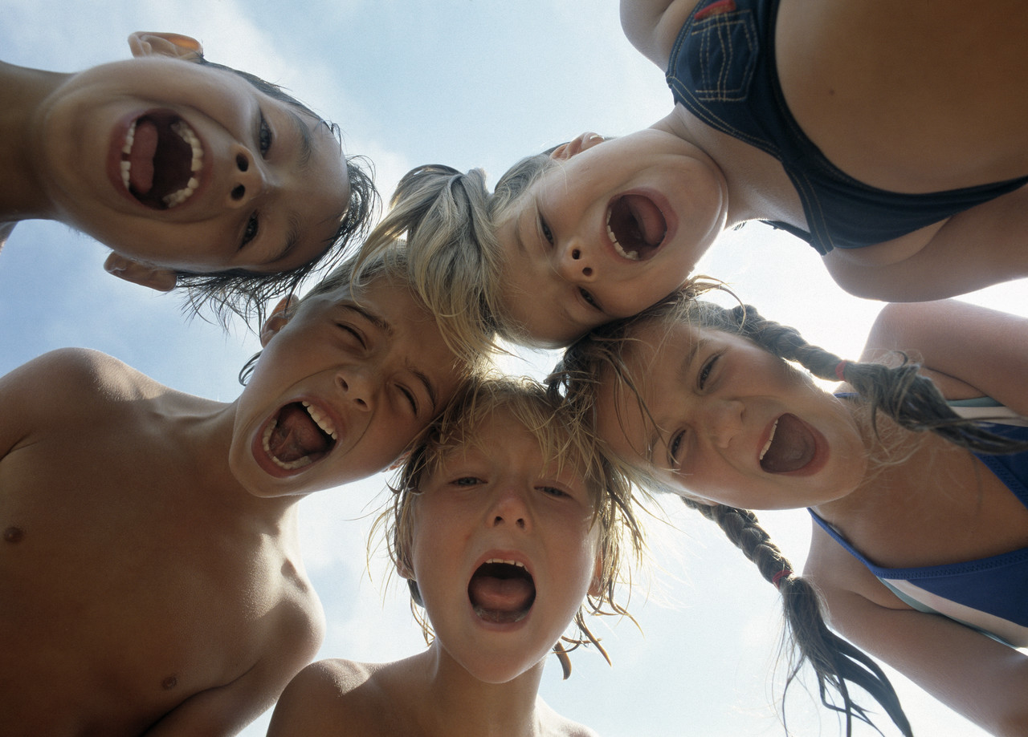
The Future
Notes:
Future is defined as time regarded as still to come, something that will exist or happen in a later time
When you think of the future, what and who do you think of?
Who will be our future:
leaders?
decision-makers?
teachers?
community members?
business people?
What will they be able to do for us?
What can we do for them?

Slide 4
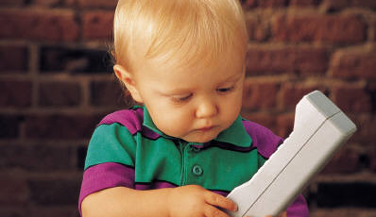
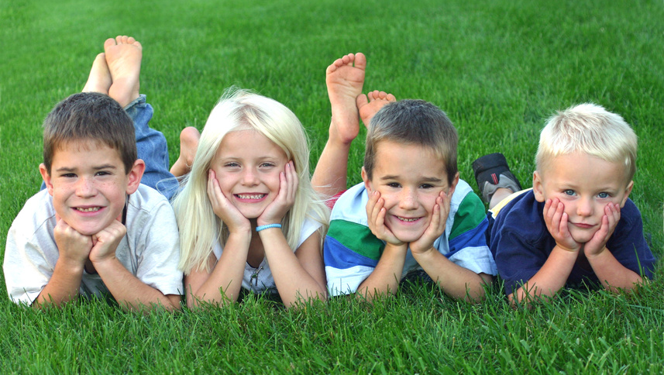
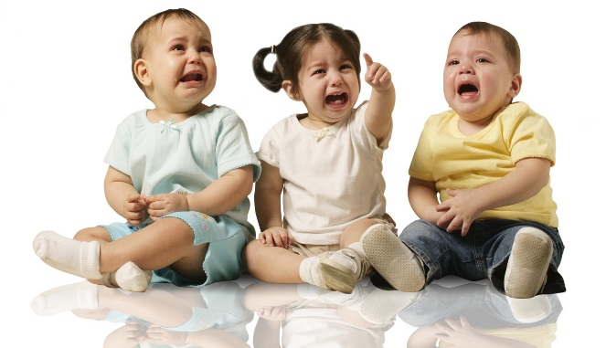
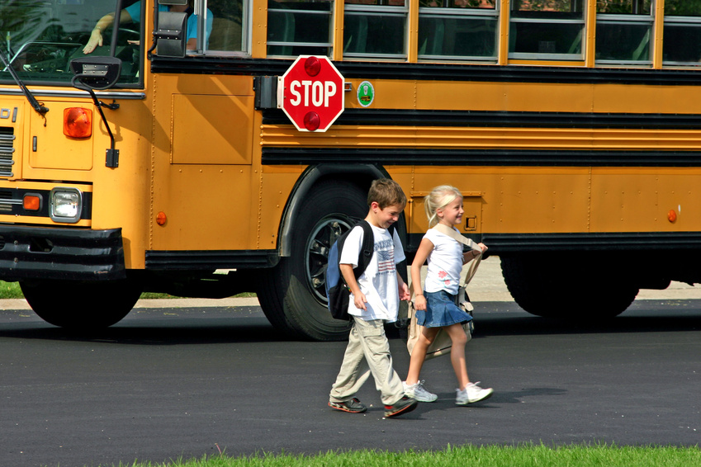
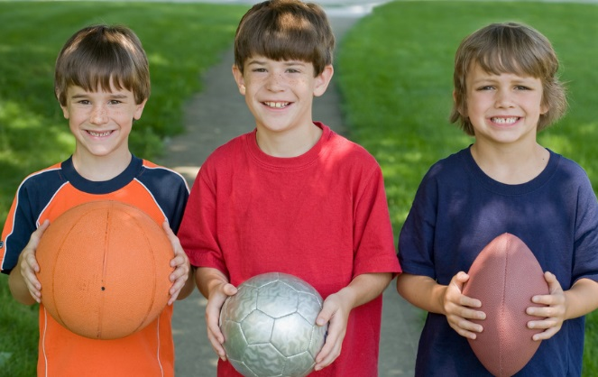
Notes:
Babies grow rapidly. Their minds are absorbing information at a rapid pace. It is important that we teach them and they learn as much as possible so that they can be productive young adults in the future.

Slide 5
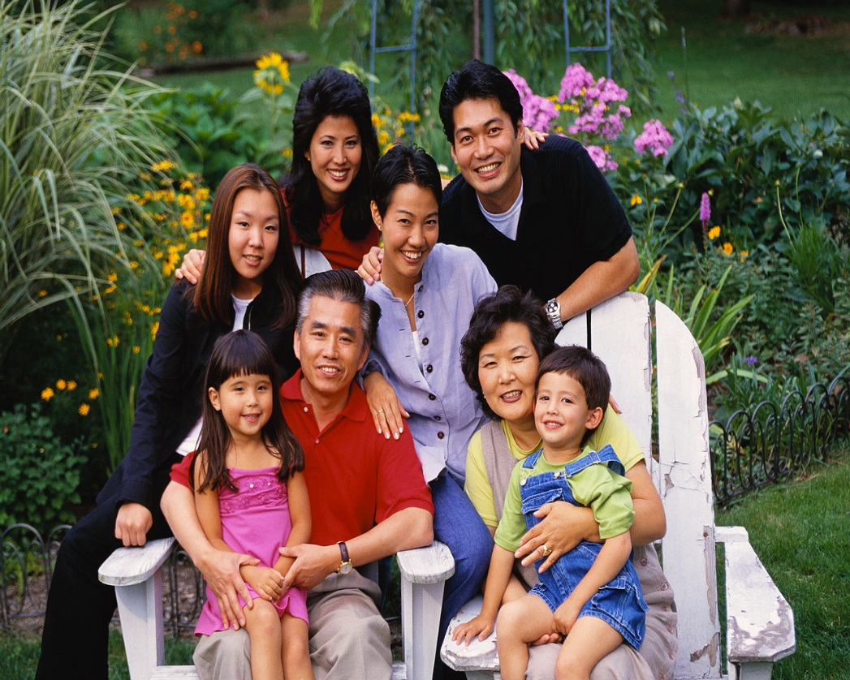
Who Are They?
  Babies
  Toddlers
  Children
  Brothers
  Sisters
  Cousins
  Nieces
  Nephews
  Friends
Notes:
Our “future” are today’s babies, toddlers, children, brothers, sisters, cousins, nieces, nephews and friends.

Slide 6

What do They Like?
  Playing
  Laughing
  Dancing
  Making friends
  Learning
Notes:
Children like to play games, laugh, dance, make friends and enjoy learning. What can we teach them?

Slide 7
What Do You Think?
  Children
    What are they interested in?
    What do they enjoy doing?
    What do they love?
    What do they need?
  You
    What are you interested in?
    What do you enjoy doing?
    What do you love?
    What do you need?
Notes:
Children enjoy many of the same things you do.

Slide 8
Service Learning
  Service Learning: Turning Ideas Into Action
  (click on link)
Notes:
Click on hyperlink:
Service Learning: Turning Ideas Into Action
A media loop for the Turning Ideas into Action communications kit. Learn and Serve America created this kit to help you spread the word about service-learning and its impact on learning and transforming communities. You are on the front lines of making the case for service-learning and are one of its greatest advocates.
http://youtu.be/4JE_zmCUDtg

Slide 9

The Future
  What do children see in you?
  How can we serve children?
  How will you change the future?
Notes:
Answers will vary. Allow time for students to answer the graphic organizer Serving the Future Notes.

Slide 10
Questions?

Slide 11
References and Resources
  Images:
    Microsoft Office Clip Art: Used with permission from Microsoft.
  YouTube™:
    Service Learning: Turning Ideas Into Action
    A media loop for the Turning Ideas into Action communications kit. Learn and Serve
    America created this kit to help you spread the word about service-learning and its impact
    on learning and transforming communities. You are on the front lines of making the case for
    service-learning and are one of its greatest advocates.
    http://youtu.be/4JE_zmCUDtg
  Websites:
    Farmington Woods Elementary School
    School news and links to curriculum
    http://fwes.wcpss.net/
    National Youth Leadership Council
    Information for students and educator on service-learning practices
    http://www.nylc.org/

