Slide 1
Focusing on the Needs of Children
Principles of Human Services

Slide 3
What are the needs of children?
Notes:
Allow for questions and discussion. Check for understanding.
Possible answers might be:
Clothing
Discipline
Education
Food
Intellectual stimulation
Medical care
Safety
Security
Shelter
Stable home
What happens to the child when these needs are not met? Family? Society?
An educator is to understand the needs of children and what happens if these needs are not met. Sometimes, children and adults are victims of child abuse and domestic violence. Special problems such as divorce, family violence, illness or death in the family can strongly impact children. During very difficult family changes, children may have developmental regressions. Such behavior is not a selfish way to get attention. It may be a sign that the child is under great stress and needs help from caregivers in order to cope with the stress. Understanding how various factors may influence children helps the caregiver know how best to relate to them.

Slide 4
Basic Needs of Children
Intellectual
Emotional
Physical
Social
Notes:
Early childhood development is critical to the physical, emotional, social and intellectual development of a child’s life. Children learn with all of their senses by using their eyes, ears, mouth and hands to explore their new world. It is important to understand the aspects of growth during each stage to nurture healthy growth and development of the child. Most of the developmental milestones occur in a sequential order and transpire in specific time frames allowing assistance to be provided to children with special needs as considered necessary. In order to understand the impact of early childhood development on each individual, we should have an understanding of the different theorists affecting child development, such as Piaget, Erikson, Skinner and Kohlberg.
The basic needs of children include the following:
Emotional needs - Emotional feelings can be love, hate, happiness, anger, jealousy and fear. Another part of emotional development for children is understanding how to express their emotions while learning how to control their responses to certain emotions. Emotions play a vital role in personality development. Children can learn how to express their emotions in a healthy manner through interactions with parents, siblings, caregivers and others.
Intellectual needs - Intellectual development includes all of the brain’s activities and functions such as memory, perception, problem solving, decision-making and imagining.
Physical needs - Some of these changes occur in the entire body such as bones and muscles, internal organs and the brain. Other physical development changes include hormones and motor skills.
Social needs - Children first learn about interacting with and relating to other people by observing their parents. A child's social development is greatly influenced by how much or how little contact he or she has with other people.

Slide 5
Responsibilities of Caregivers
Meet nutritional and educational needs
Provide a safe, nurturing environment
Well-trained in first aid and CPR
Photos obtained through a license with Shutterstock.com
Notes:
Child care providers should be responsible and well-trained caregivers. Caregivers should be trained in first aid and CPR. Professional caregivers should complete a certification program and have a cleared criminal background check.
Caregivers are responsible for providing a safe, nurturing environment for children. They are responsible for protecting children from injury as well as for meeting the needs of the child. They are responsible for providing shelter, nutritional and educational needs of the children in their care.
Caregivers have many roles and responsibilities. They must have excellent training and experience to provide the most adequate care to children. Caregivers are responsible for the safety and security of the children and facility. They are also responsible for following the state’s laws and regulations pertaining to the operation of the child care center and providing an adequate educational program to develop the children’s physical, intellectual, social and emotional needs. Discipline is appropriate and does not cause harm to the children. The facility is clean, and the physical setting is inviting and homelike. The teachers and staff attend to the children and there is a good adult-child ratio. The parents feel welcomed and there is open communication between the parents and the caregivers.
Allow for questions and discussion. Check for understanding.

Slide 6
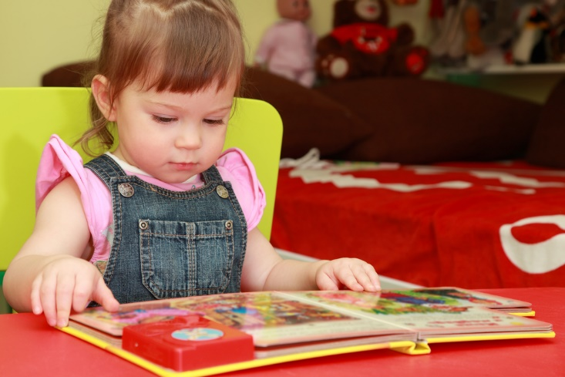
Developmentally Appropriate Guidance Techniques
A child’s environment should be:
Comfortable
Safe
Secure
Stable
Photos obtained through a license with Shutterstock.com
Notes:
Developmentally appropriate child guidance techniques have a significant impact on the growth and development of children. Their environment should be a safe, comfortable, stable setting for learning and development. Children learn best in a secure atmosphere. Children should be provided an upbringing that provides the least restrictive learning environment for all children. Quality education professionals that work with children in early childhood should establish relationships with them that create a desire for learning by all. If children struggle with learning during this period, their self-competence development will be affected.

Slide 7
Promoting Positive Behavior
Positive behaviors include:
Encouraging initiative
Getting along with others
Pro-social skills
Self-control
Setting appropriate limits
Photos obtained through a license with Shutterstock.com
Notes:
Caregivers should actively promote positive behaviors, which improve the atmosphere and help prevent problems. Positive behaviors include pro-social skills, self-control and getting along with others. Many direct guidance strategies used by caregivers help promote positive behavior in children. Direct guidance is used when a caregiver works directly with a child. To promote positive behavior, a few general guidelines should be followed, which include observing children at all times, being consistent, modeling positive behavior, communicating at the child’s level, setting appropriate limits and encouraging initiative, independence and responsibility.
These are three different types of guidance techniques:
Redirecting- With redirection, children are led in a new activity related to their play at the time.
Encouraging use of words- A caregivers can encourage children to use words to share their wishes. For example, when Suzy reaches for a car that Joshua is using, the caregiver might say, “Suzy, ask Joshua, ‘May I play with the yellow car?’ “If Joshua says, “No,” the caregiver can help Suzy choose another toy from the shelf.
Giving the child a choice- The caregiver can also distract a child from a conflict or from negative behavior by giving choices. Giving him or her two choices at a time makes the decision easier on the child and caregiver.
Using any one of these positive guidance techniques can help deter abusive behavior by reducing frustration.

Slide 8
What is child abuse?
Notes:
Allow for questions and discussion. Check for understanding.

Slide 9
Child Abuse and Neglect
Last year:
231 Texas children died because of abuse or neglect at the hands of their parents or guardians
65,948 children were confirmed victims of abuse or neglect
Source: Helpandhope.org
Notes:
It's hard to talk or even think about child abuse – but child abuse and neglect are simply too destructive to be ignored.
Last year:
231 Texas children died because of abuse or neglect at the hands of their parents or guardians.
65,948 children were confirmed victims of abuse or neglect.
17,108 children were removed from their homes because of abuse or neglect.
Help for Parents. Hope for Kids.
It's not easy being a parent. But recognizing that you have room for improvement is the first step toward becoming a better parent. Here you will learn where to find the help you need to begin your journey toward becoming a healthier, happier family.
http://helpandhope.org/preventing-child-abuse.html

Slide 10
National Child Abuse Statistics
Source: Childhelp.org
Notes:
Child Abuse in America
Children are suffering from a hidden epidemic of child abuse and neglect. Every year more than 3 million reports of child abuse are made in the United States involving more than 6 million children (a report can include multiple children). The United States has one of the worst records among industrialized nations – losing on average between four and seven children every day to child abuse and neglect.
National Child Abuse Statistics
http://www.childhelp.org/pages/statistics

Slide 11
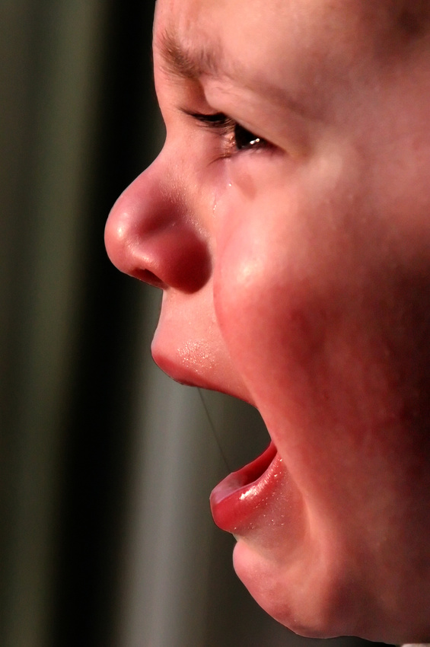
Child Maltreatment
Includes:
Emotional abuse
Neglect / Abandonment
Physical abuse
Sexual abuse
Notes:
Child maltreatment includes physical, sexual and psychological abuse, as well as neglect (including medical neglect). Maltreatment in general is associated with a number of negative outcomes for children, including lower school achievement, juvenile delinquency, substance abuse and mental health problems. Certain types of maltreatment can result in long-term physical, social and emotional problems, and even death. For example, "shaken baby syndrome" can result in mental retardation, cerebral palsy or paralysis. Child maltreatment includes both fatal and nonfatal maltreatment.

Slide 12
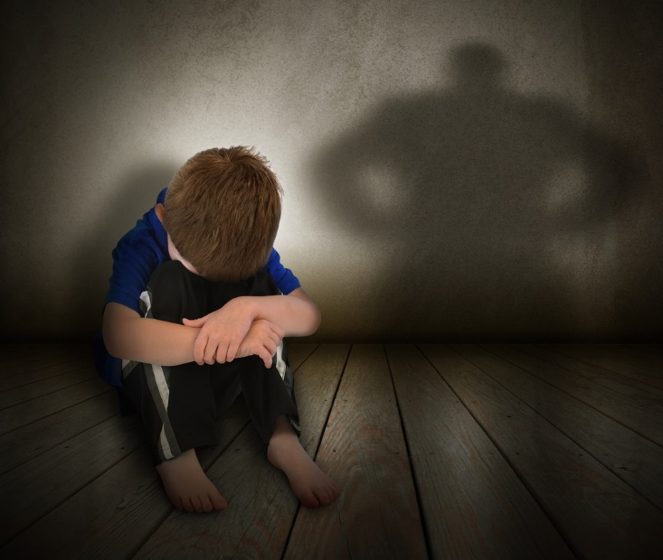
Factors Affecting Child Abuse
The child’s age and developmental status when the abuse or neglect occurred
The frequency, duration and severity of abuse
The relationship between the victim and his or her abuser
The type of abuse (emotional, physical, sexual or abandonment)
Photos obtained through a license with Shutterstock.com
Notes:
Child abuse and neglect are serious problems in our country, and there are presently no signs of the problem getting any better. Over 3 million reports of child abuse are made every year in the United States, involving an estimated 6 million children. While physical injuries may or may not be immediately visible, abuse and neglect can have consequences for children, families and society that last lifetimes, if not generations.
Not all abused and neglected children will experience long-term consequences. The outcomes of individual cases vary widely and are affected by a combination of factors, including the following:
The child’s age and developmental status when the abuse or neglect occurred
The frequency, duration and severity of abuse
The relationship between the victim and his or her abuser (English et al., 2005; Chalk, Gibbons, & Scarupa, 2002)
The type of abuse (neglect, physical, sexual or abandonment)

Slide 13
Emotional Abuse
May include:
Constant criticism
Threats
Rejection
Withholding love, support or guidance
Notes:
Emotional abuse: A form of abuse that happens when one person purposely hurts another through constant yelling, teasing or insulting.

Slide 14
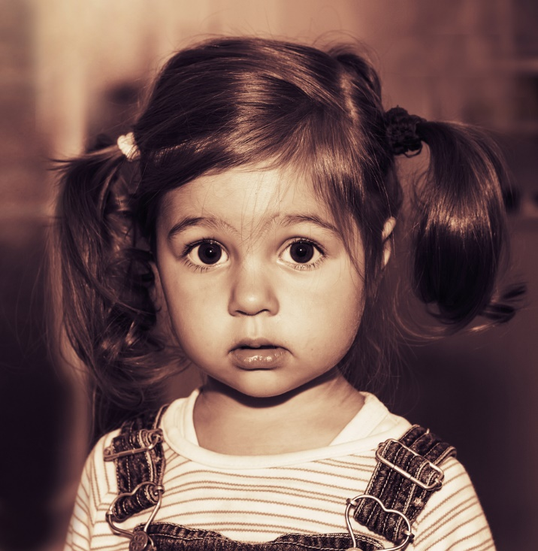
Neglect / Abandonment
A child is considered to be abandoned when the:
child has been left alone in circumstances where the child suffers serious harm
parent has failed to maintain contact with the child or provide reasonable support for a specified period of time
parent’s identity or whereabouts are unknown
Photos obtained through a license with Shutterstock.com
Notes:
Abandonment is now deﬁned in many states as a form of neglect. In general, a child is considered to be abandoned when the parent’s identity or whereabouts are unknown, the child has been left alone in circumstances where the child suffers serious harm, or the parent has failed to maintain contact with the child or provide reasonable support for a speciﬁed period of time.
What are the effects of abandonment on children?
Parental abandonment, and its effects, often leave children with lingering questions about their own self-worth.
Some children may over-identify with the absent parent and develop a set of fantasies about him or her which - although they may provide temporary comfort - are not based in reality.

Slide 15
Physical Abuse
Physical abuse: The physical injury of one person by another through such behavior as hitting, kicking, biting or throwing objects
Notes:
Physical abuse is non-accidental physical injury (ranging from minor bruises to severe fractures or death) as a result of punching, beating, kicking, biting, shaking, throwing, stabbing, choking, hitting (with a hand, stick, strap or other object), burning or otherwise harming a child, that is inﬂicted by a parent, caregiver or other person who has responsibility for the child. Such injury is considered abuse regardless of whether the caregiver intended to hurt the child.
Physical discipline, such as spanking or paddling, is not considered abuse as long as it is reasonable and causes no bodily injury to the child.

Slide 16
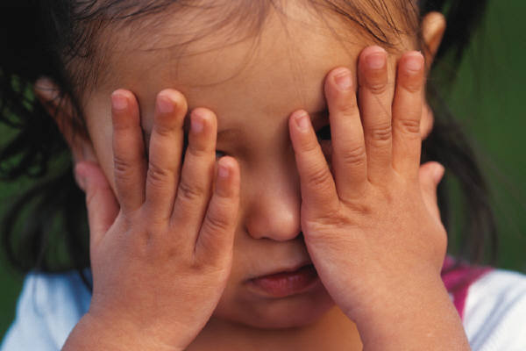
The Kelsey Briggs Story. (True Story Original) (click on link)
Notes:
Kelsey Briggs lost her life before the age of three due to child abuse. Her grandparents should have reported it, and Kelsey’s mom should have saved Kelsey from her death.
How could this have been prevented?
The Kelsey Briggs Story. (True Story Original)
Kelsey Briggs lost her life before the age of three due to Child Abuse.
http://youtu.be/EzDP2IFztek

Slide 17
Sexual Abuse
Sexual abuse: A form of abuse in which one person forces another to engage in sexual activities.
Photos obtained through a license with Shutterstock.com
Notes:
Sexual abuse includes activities by a parent or caregiver such as fondling a child’s genitals, penetration, incest, rape, sodomy, indecent exposure and exploitation through prostitution or the production of pornographic materials

Slide 18
Sexual Abuse
Five Steps to Protect Our Children (click on link)
Five Steps to Protect Our Children
Step 1 – Learn the Facts
Step 2 – Minimize Opportunity
Step 3 – Talk About It
Step 4 – Recognize the Signs
Step 5 – React Responsibly
Notes:
Darkness to Light: End Child Sexual Abuse
Five Steps to Protect Our Children
http://www.d2l.org/site/c.4dICIJOkGcISE/b.6143703/k.2746/The_5_Steps_to_Protecting_Our_Children.htm
Click on the link and review the five steps with the students. Allow for questions and discussion. Check for understanding.

Slide 19
Behavioral Consequences of Child Abuse
Children who experience maltreatment are at an increased for:
Alcoholism
Criminal record and behavior
Delinquency
Drug abuse
Engagement in high-risk sexual behaviors
Not graduating from school
Low academic achievement
Smoking
Teen pregnancy
Notes:
Children who experience maltreatment are at an increased risk for smoking, alcoholism and drug abuse as adults, as well as engaging in high-risk sexual behaviors (Felsite et al. 1998; Runyan et al. 2002).
Those with a history of child abuse and neglect are 1.5 times more likely to use illicit drugs, especially marijuana, in middle adulthood (Widom et al. 2006).
Studies have found abused and neglected children to be at least 25 percent more likely to experience problems such as delinquency, teen pregnancy and low academic achievement (Kelley et al. 1997). Similarly, a longitudinal study found that physically abused children were at greater risk of being arrested as juveniles. This same study also found that abused youth were less likely to have graduated from high school and more likely to have been a teen parent (Langsford et al. 2007).
A National Institute of Justice study indicated that being abused or neglected as a child increased the likelihood of arrest as a juvenile by 59 percent. Abuse and neglect also increased the likelihood of adult criminal behavior by 28 percent and violent crime by 30 percent (Widom & Maxfield 2001).
Early child maltreatment can have a negative effect on the ability of both men and women to establish and maintain healthy intimate relationships in adulthood (Colman et al. 2004).

Slide 20
Consequences of Child Abuse
Child may experience:
Increased risk for adverse health effects
Learning difficulties
Memory difficulties
Post-traumatic stress disorder
Psychiatric disorders
Severe or fatal head trauma such as Shaken Baby Syndrome
DEATH!!!
Notes:
Children may experience severe or fatal head trauma as a result of abuse. Nonfatal consequences of abusive head trauma include varying degrees of visual impairment (e.g., blindness), motor impairment (e.g., cerebral palsy) and cognitive impairments (National Center on Shaken Baby Syndrome 2009).
Children who experience maltreatment are also at increased risk for adverse health effects and certain chronic diseases as adults, including heart disease, cancer, chronic lung disease, liver disease, obesity, high blood pressure, high cholesterol and high levels of C-reactive protein (Felitti et al. 1998; Danese et al. 2009).
In one long-term study, as many as 80 percent of young adults who had been abused met the diagnostic criteria for at least one psychiatric disorder at age 21. These young adults exhibited many problems, including depression, anxiety, eating disorders and suicide attempts (Silverman et al. 1996).
In addition to physical and developmental problems, the stress of chronic abuse may result in anxiety and may make victims more vulnerable to problems such as post-traumatic stress disorder, conduct disorder, and learning, attention and memory difficulties (Dallam 2001; Perry 2001).
Last year, 231 Texas children died because of abuse or neglect at the hands of their parents or guardians.

Slide 21
What is domestic violence?
Notes:
Allow for questions and discussion. Check for understanding.

Slide 22
Domestic Violence
Phase 3 – Honeymoon
Phase I – Tension
Phase 2 – Incident
Source: Domestic Violence Roundtable
Notes:
Cycle of Domestic Abuse:
Phase I – Tension Building: Tension increases, breakdown of communication, victim becomes fearful and feels the need to placate the abuser.
Phase 2 – Incident: Verbal, emotional, physical abuse, anger and blaming. It also includes arguing, threats and intimidation.
Phase 3 – The incident is “forgotten” and no abuse is taking place. The abuser apologizes, gives excuses, blames the victim, denies the abuse occurred or says it wasn’t as bad as the victim claims. This is called the “Honeymoon” phase.
Domestic Violence Roundtable
The cycle of domestic violence.
http://www.domesticviolenceroundtable.org/domestic-violence-cycle.html

Slide 23
Domestic Violence (click on link)
Notes:
Battering is a pattern of behavior used to establish power and control over another person with whom an intimate relationship is or has been shared through fear and intimidation, often including the threat or use of violence. Battering happens when one person believes that he or she is entitled to control another. Domestic violence may include not only the intimate partner relationships of spousal, live-in partners and dating relationships, but familial, elder and child abuse may also be present in a violent home. Abuse generally escalates over a period of time and falls into one or more of the following categories: physical battering, sexual assault and emotional or psychological abuse.
Why do some individuals stay in that type of relationship?
Domestic Violence
This is a video made to help raise awareness of domestic violence.
http://youtu.be/xYWxfxMOUO4

Slide 24
Skills and Resources Available to Address Abuse
Notes:
The first step to preventing child abuse is to know the makeup of healthy family relationships. Once the criterion is established for a healthy relationship, it is then easier to determine what makes that relationship unhealthy. Family violence is often a result of a need for power and control in a relationship. This need may be a result from a history of family violence or inappropriate gender-role messages. Conflict resolution skills are needed and ground rules for handling conflict need to be established in all families. Conflict will occur in all relationships. The answer to family success is to find a way to manage anger and resolve issues as they arise without violence.
Society has a responsibility to protect children and families against abuse and violence. According to a publication by the U.S. Department of Health and Human Services, the educator has a vital role in identifying, reporting and preventing child abuse and neglect. Over the last few decades, various organizations have developed programs directed at informing educators that they are a valuable resource. Child care providers and educators must become involved in preventing and responding to child abuse and neglect. These reasons are related to:
Community efforts
Educational opportunities
Legal concerns
Professional responsibilities
Personal commitments
Additional information on this publication can be found at:
http://www.childwelfare.gov/pubs/usermanuals/educator/educator.pdf

Slide 25
Child Protective Services Division of Texas
Investigating reports of abuse and neglect of children
Providing services to children and families in their own homes
Placing children in foster care.
Providing services to help youth in foster care make the transition to adulthood
Placing children in adoptive homes
Notes:
Child Protective Services Division of Texas is another organization available to assist families in crisis. The Child Protective Services Division investigates reports of abuse and neglect of children. It also:
Places children in adoptive homes
Places children in foster care
Provides services to children and families in their own homes
Provides services to help youth in foster care make the transition to adulthood
For additional information and legal definitions of abuse and neglect, visit: http://www.dfps.state.tx.us/Child_Protection/About_Child_Protective_Services/
1-800-252-5400

Slide 26
Reporting Suspected Abuse and Neglect
Child Abuse and Neglect Reporting and Requirements (click on link)
Notes:
The public education system plays an important role in reporting suspected abuse and neglect of Texas’ children. Of the 199,474 completed investigations of suspected child abuse and neglect conducted by the Texas Department of Family and Protective Services (DFPS) in 2012, 35,100, or 17.6%, were reported by school personnel.
Texas Education Agency
Child Abuse and Neglect Reporting and Responsibilities
http://www.tea.state.tx.us/index4.aspx?id=25769803997

Slide 27
National Child Abuse Hotline
(click on picture)
Notes:
Childhelp National Child Abuse Hotline 1-800-4-A-CHILD
This hotline is staffed 24/7 by degreed counselors.
http://youtu.be/tQ5uzupV-q8

Slide 28
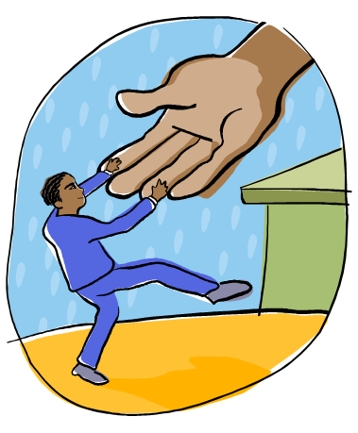
How to Help Someone in Need
Don’t be afraid to let the person know that you are concerned for his or her safety.
Acknowledge that he or she is in a very difficult and scary situation.
Be supportive.
Be non-judgmental.
Notes:
Additional tips include:
Continue to be supportive if he or she ends the relationship.
Help him or her develop a safety plan.
Encourage him or her to talk to people who can provide help and guidance.
Remember that you cannot “rescue” him or her.

Slide 29
Help for Parents. Hope for Kids
Help and Hope (click on link)
Notes:
Help for Parents. Hope for Kids. It’s not easy being a parent. Recognizing that you have room for improvement is the first step toward becoming a better parent. Here you will learn where to find the help you need to begin your journey toward becoming a healthier, happier family. http://www.helpandhope.org/videos.html

Slide 30
Picture Door Organizer
Picture Door Organizer (click on link)
Notes:
Teacher note: The students will be constructing a picture door organizer for their project. Show the video and make sure the students understand the steps in constructing the picture door organizer. You may opt to have a picture door organizer on hand so that the students can see one first hand.
Picture Door Organizer
This organizer is a multi-purpose tool. The students can incorporate information, key terms, sequential events, graphics and concept ideas. It has a hidden element that will make a presentation pop!
youtu.be/weY4PtrfM3o

Slide 31
Questions

Slide 32
References and Resources
Images:
Microsoft Clip Art: Used with permission from Microsoft.
SIRDC Shutterstock subscription 2014 – 2015
Textbook:
Decker, C. (2011). Child development: Early stages through age 12. (5th ed.). Tinley Park: Goodheart-Willcox Company.
Websites:
Child Abuse and Neglect Source: This site, from a bureau of the U.S. Department of Health and Human Services, provides links to basic information about child abuse and neglect and too many other sites and publications that provide more detailed information and help. (Child Welfare Information Gateway) http://www.childwelfare.gov/can/

Slide 33
References and Resources
Websites:
Childstats.gov This website provides information on key indicators in seven domains: family and social environment, economic circumstances, health care, physical environment and safety, behavior, education, and health. http://www.childstats.gov/americaschildren/famsoc7.asp
National Abuse Hotline Source: The National Domestic Violence Hotline receives more than 23,500 calls per month from victims, survivors, friends and family members, law enforcement personnel, domestic violence advocates and the general public. Hotline advocates provide support and assistance to anyone involved in a domestic violence situation, including those in same-sex relationships, male survivors, those with disabilities and immigrant victims of domestic violence. All calls to the National Domestic Violence Hotline are anonymous and confidential. http://www.thehotline.org/
National Center for Children Exposed to Violence Source: Relevant websites, statistics, reports, books, and journal articles http://www.nccev.org/violence/domestic.html

Slide 34
References and Resources
Websites:
National Coalition Against Domestic Violence Source: The National Coalition Against Domestic Violence is “a grassroots non-profit membership organization working since 1978 to end violence in the lives of women. http://ncadv.org
Prevent Child Abuse Texas Source: Prevent Child Abuse Texas (PCATX) Is a statewide non-profit organization working to prevent child abuse and neglect in all its forms throughout Texas. The work of the organization depends solely on private grants and contributions. The organization is led by a statewide Board of Directors who represent their regions through community agencies and organizations dealing with social issues affecting children. http://www.preventchildabusetexas.org/vitialsdaily.html
Texas Child Protective Services Investigating reports of abuse and neglect of children and providing services to children and families in their own homes. https://www.dfps.state.tx.us/child_protection/

Slide 35
References and Resources
Websites:
Texas Education Agency Child Abuse and Neglect Reporting and Responsibilities http://www.tea.state.tx.us/index4.aspx?id=25769803997
2012 Resource Guide—Preventing Child Maltreatment and Promoting Well Being: A Network for Action. Resource Guide includes tip sheets for parents and caregivers, ways to get involved, and six protective factors. http://www.childwelfare.gov
YouTube:
Childhelp National Child Abuse Hotline 1-800-4-A-CHILD This hotline is staffed 24/7 by degreed counselors. http://youtu.be/tQ5uzupV-q8
Darkness to Light: End Child Sexual Abuse Five Steps to Protect Our Children http://www.d2l.org/site/c.4dICIJOkGcISE/b.6143703/k.2746/The_5_Steps_to_Protecting_Our_Children.htm

Slide 36
References and Resources
YouTube:
Domestic Violence This is a video made to help raise awareness of domestic violence. http://youtu.be/xYWxfxMOUO4
The Kelsey Briggs Story. (True Story Original) Kelsey Briggs lost her life before the age of three due to Child Abuse. http://youtu.be/EzDP2IFztek
Picture Door Organizer This organizer is a multi-purpose tool. The students can incorporate information, key terms, sequential events, graphics and concept ideas. It has a hidden element that will make a presentation pop! http://youtu.be/weY4PtrfM3o

