Slide 1
Follow the Leader
Notes:
As a child, did you ever play follow the leader? Wasn’t it fun?

Slide 3

What Do You Look for in a Leader?
Notes:
Most everyone wants a leader they can believe in. What do you look for in a Leader?

Slide 4
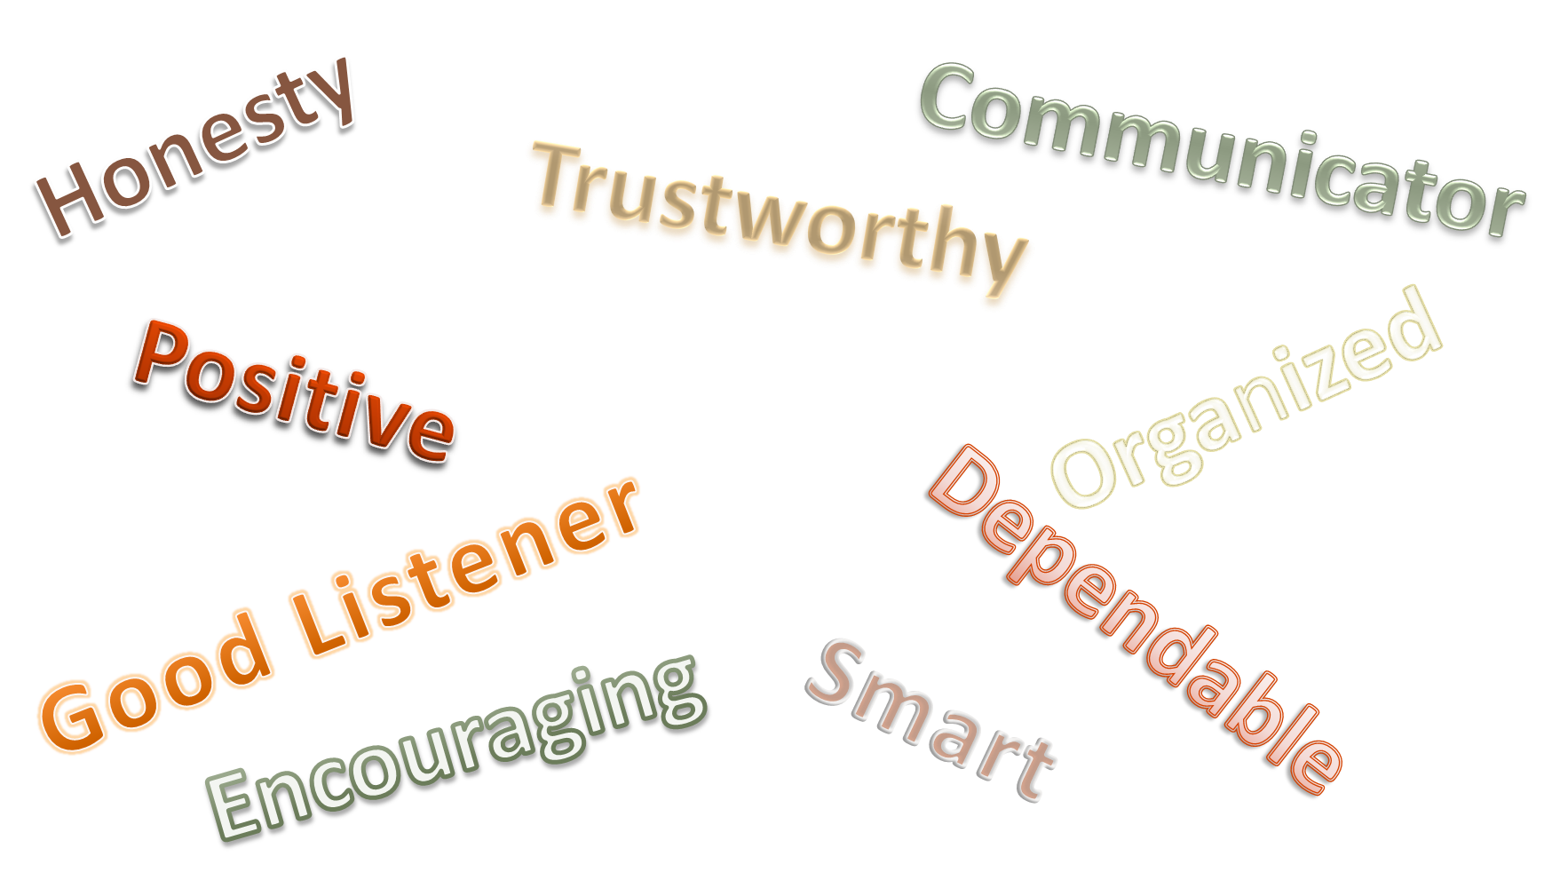
Notes:
Discuss each characteristic and have students brainstorm why those are important.

Slide 5
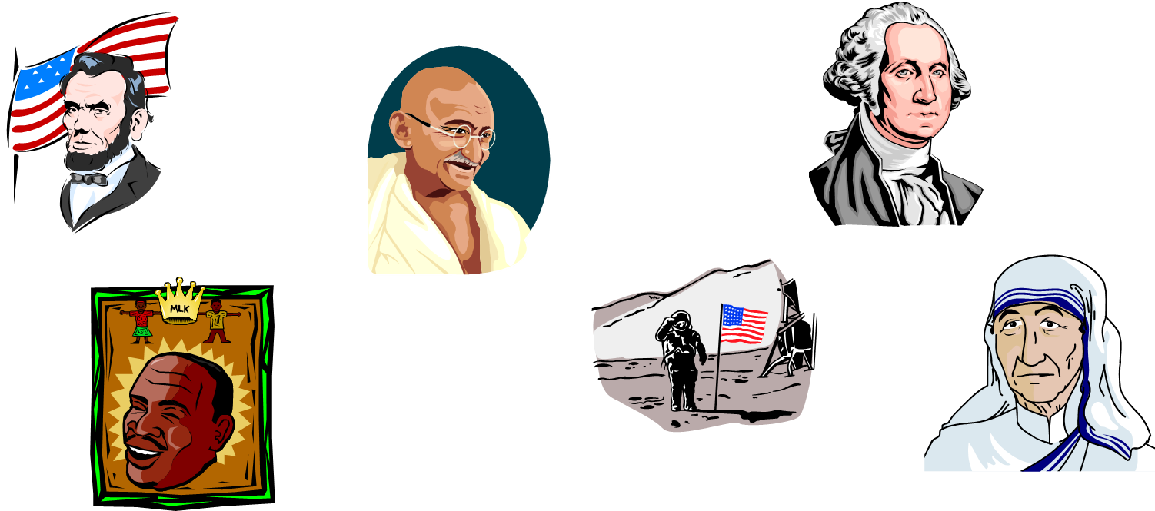
Some Leaders Are Famous
Notes:
Identify each person and what they are famous for.
Neil Armstrong
Mahatma Gandhi
Martin Luther King
Abraham Lincoln
Mother Teresa
George Washington
Can you name any others?

Slide 6

Some Look Just Like You!
Notes:
Ask the class for examples.

Slide 7

What does it take to be a Leader?
  What To Look For In Great Leaders: Gary Bertoline at TEDxPurdueU
Notes:
Ask students to answer the question.
Answers may be written on the board to observe the qualities of a leader.
Click on hyperlink to view video:
What To Look For In Great Leaders: Gary Bertoline at TEDxPurdueU
What are the personal characteristics that connect great leaders throughout history? Dr. Gary Bertoline has identified the 5 attributes of authentic leadership and teaches us how to identify effective leaders, and even how we can become leaders in our own communities!
http://youtu.be/7IHQyEC2GRU

Slide 8
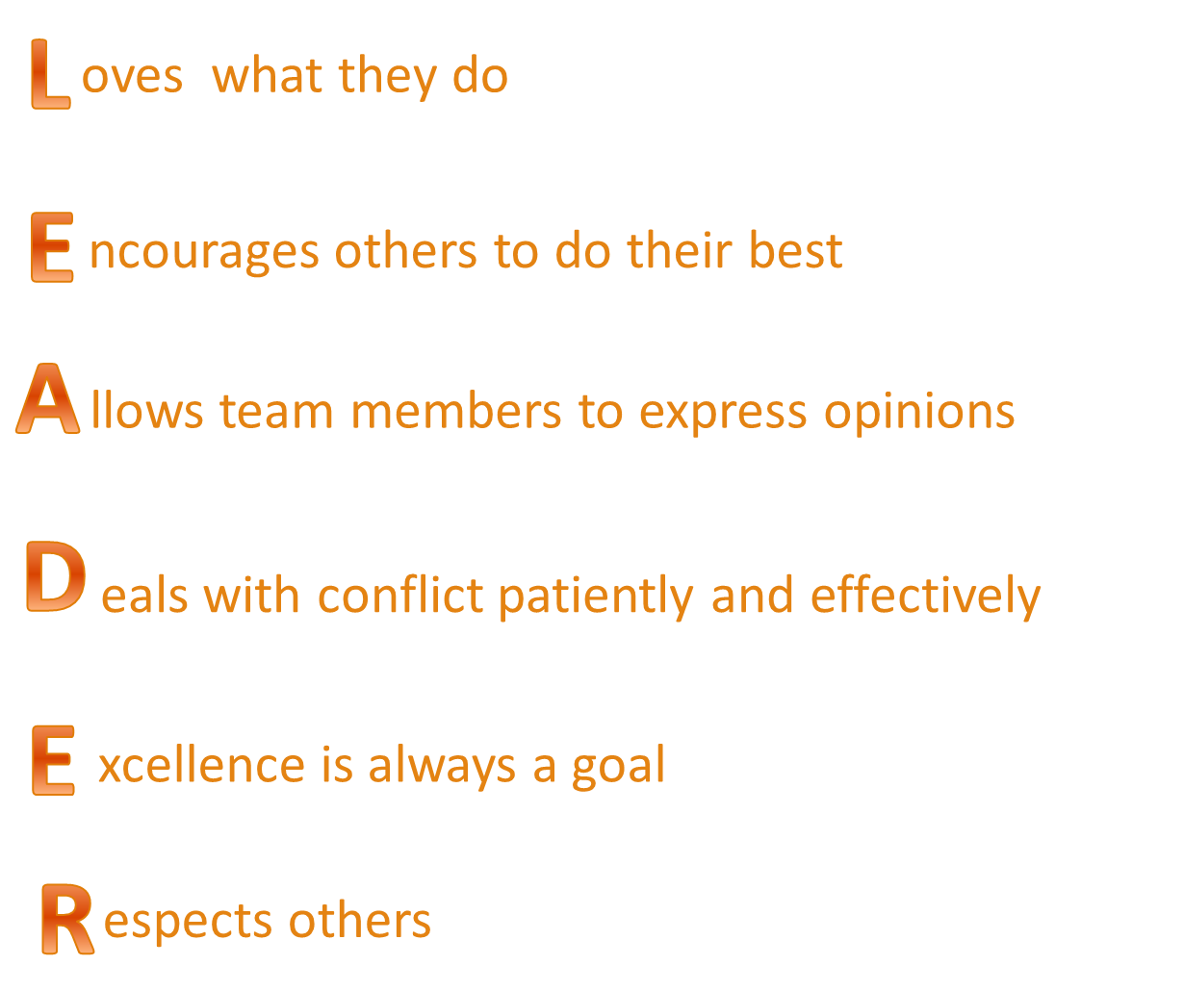
Notes:
Discuss each term for each letter.
Have students give an example of someone they know who exemplifies each phrase.

Slide 9
  The greatest leader is not the one who does the greatest things. It’s the one who gets the people to do the greatest things.
  ~ Ronald Reagan
Notes:
Ask students what they think this quote means.

Slide 10

Notes:
Any questions?

Slide 11
Resources and References
  Images:
    Microsoft Office Clip Art: Used with permission from Microsoft.
  YouTube™:
    What To Look For In Great Leaders: Gary Bertoline at TEDxPurdueU
    What are the personal characteristics that connect great leaders throughout history? Dr. Gary Bertoline has identified the 5 attributes of authentic leadership and teaches us how to identify effective leaders, and even how we can become leaders in our own communities!
    http://youtu.be/7IHQyEC2GRU
  Websites:
    The Curriculum Center for Family and Consumer Sciences
    A Week of Service Learning
    A Joint Project of Service Learning Texas, Texas FCCLA, and The Curriculum Center for Family and Consumer Sciences
    http://www.ccfcs.org/aweekofservicelearning/
  Texas Family, Career, and Community Leaders of America
    Texas FCCLA information and programs
    http://www.texasfccla.org

Slide 12
  Abc
  Abc

Slide 13
  Abc
  Abc

Slide 14
  Abc
  Abc

Slide 15
  Abc
  Abc

Slide 16
  Abc
  Abc

Slide 17
  Abc
  Abc

Slide 18
  Abc
  Abc

Slide 19
  Abc
  Abc

Slide 20
  Abc
  Abc

Slide 21
  Abc
  Abc

Slide 22
  Abc
  Abc

Slide 23
  Abc
  Abc

Slide 24
  Abc
  Abc

Slide 25
  Abc
  Abc

Slide 26
  Abc
  Abc

Slide 27
  Abc
  Abc

Slide 28
  Abc
  Abc

Slide 29
  Abc
  Abc

Slide 30
  Abc
  Abc

