Slide 1
Food Safety Principles: Microorganisms Everywhere!
  Food science

Slide 3

Foodborne Illness
  Each year, 1 in 6 Americans (or 48 million people) gets sick from and 3,000 die of foodborne diseases
  Reducing foodborne illness by just 10% would keep 5 million Americans from getting sick each year
Notes:
The illness may be mild, lasting just a day or two, or even severe enough to require hospitalization. In some cases it can even result in death.

Slide 4
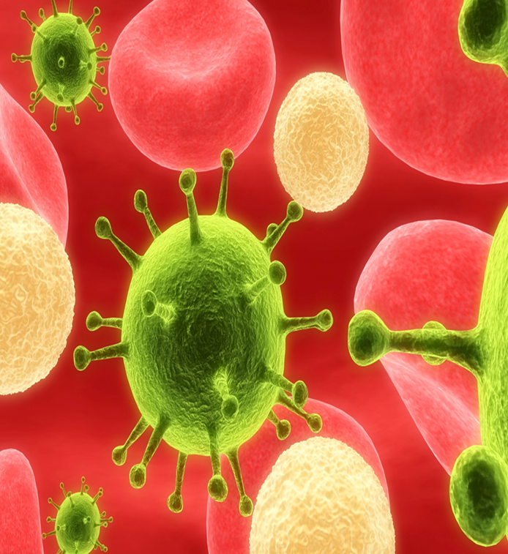
Microorganisms
Notes:
Microorganisms are all around you – in the foods you eat, the air you breathe and the water you drink.
Some are good for you but some are not.
Let’s find out more about them

Slide 5
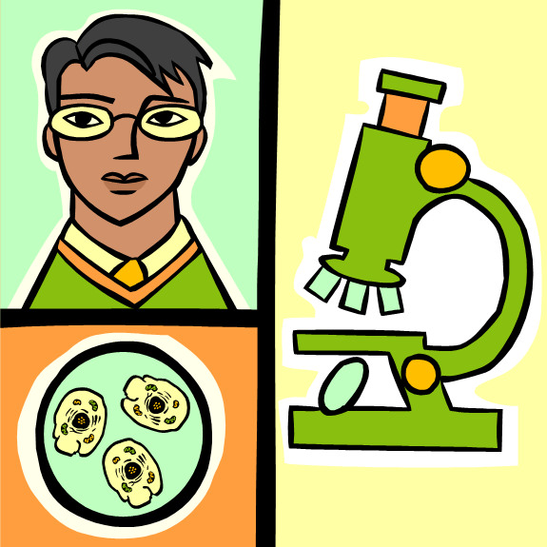
What are Microorganisms?
  A microscopic life form that cannot be seen with the naked eye
Notes:
Microorganisms are also called microbes.

Slide 6

Food Safety Concern
  Food can become contaminated with harmful foodborne microorganisms from:
  Animals
  Humans
  Soil
  Water
Notes:
Food can be contaminated by:
Animals – manure, saliva or disease microorganisms within the animals
Humans – from infected hands that touch the food we eat
Soil – contaminated by animal droppings, which can be transferred to the crops that we eat and also by normal soil residents
Water – contaminated by animal droppings, which can be transferred to humans when the water is consumed or sprayed on crops
Can you think of any other ways food can become contaminated?

Slide 7
Food Infection
  A form of food poisoning caused by ingestion of foods contaminated with living, pathogenic microorganisms
  May be caused by:
    Bacteria
    Parasites
    Viruses
  Most common:
    Hepatitis A
    Listeria monocytogenes
    Norwalk Virus
    Rotavirus
    Salmonella
Notes:
Bacteria – Are extremely small single-celled organisms that multiply through cell division.
Hepatitis A – The strain of hepatitis that can be transmitted through contaminated food.
Listeria monocytogenes - Is harder to kill than many other foodborne pathogens because it can grow and multiply in refrigerator temperatures.
Norwalk virus – Named after the first documented outbreak in Norwalk, Ohio in 1968. Causes flulike illness that lasts one to two days.
Parasites – Organisms that live in and feed on a host.
Rotavirus – Occurs most often in young children and is common during the winter months.
Salmonella – This bacteria attaches to the lining of the intestines and releases digestive enzymes.
Viruses – A microscopic disease-causing agent made up of genetic material surrounded by a protein coating.

Slide 8
Food Intoxication
  A form of food poisoning caused by the ingestion of microbial toxins produced in foods prior to consumption.
  Living microorganisms do not have to be present
  Most common:
    Clostridium botulinum
    Clostridium perfringens
    Staphylococcus aureus
Notes:
Clostridium botulinum - This bacterium lives in the soil and in the bottom of lakes and oceans. It is also sometimes found in moist, low-acid food and stored between 40°F and 120 F. This bacterium produces a toxin that causes botulism, a disease characterized by muscle paralysis.
Clostridium perfringens – A foodborne pathogen that persists as heat-stable spores. If food are only moderately cooked and allowed to remain at room temperature, the spores can germinate and produce a harmful toxin.
Staphylococcal aureus – This bacterium is carried on the skin and in the nasal passages of humans and often found in infected cuts and burns. These wounds should always be covered with a water-proof bandage and plastic gloves to avoid contact with food. It produces a toxin that causes vomiting in as little as 30 minutes after ingestion. It also multiplies rapidly in food that is left out at room temperature.

Slide 9
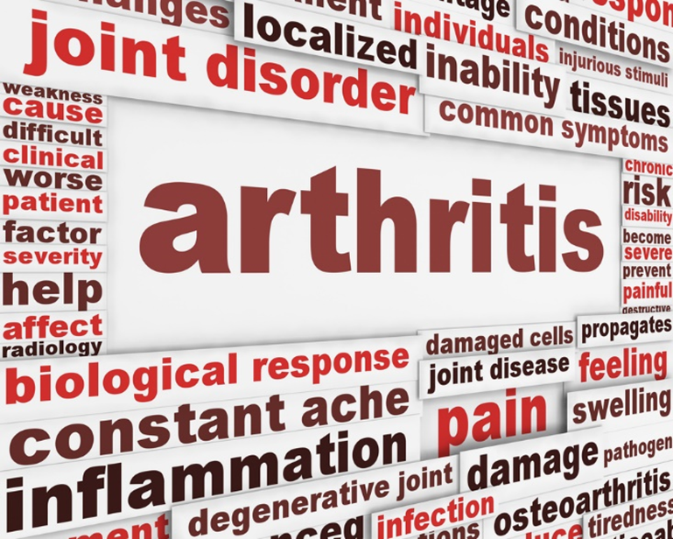
Long Term Effects
  Brain and nerve damage
  Chronic arthritis
  Death
  Kidney failure
Notes:
Brain and nerve damage
A Listeria infection can lead to meningitis, an inflammation of the membranes surrounding the brain. If a newborn infant is infected with Listeria, long-term consequences may include mental retardation, seizures, paralysis, blindness, or deafness.
Guillain-Barré syndrome is a disorder that affects the nerves of the body. This occurs when a person's immune system attacks the body's own nerves. It can result in paralysis that lasts several weeks and usually requires intensive care. As many as 40 percent of Guillain-Barré syndrome cases in this country may be triggered by an infection with Campylobacter.
Chronic arthritis
A small number of persons with Shigella or Salmonella infection develop pain in their joints, irritation of the eyes, and painful urination. This is called reactive arthritis. It can last for months or years, and can lead to chronic arthritis, which is difficult to treat. Persons with Campylobacter infections may also develop chronic arthritis.
Death
In the United States, approximately 3,000 people die each year of illnesses associated with food poisoning. Five types of organisms account for 88 percent of the deaths for which the cause is known: Salmonella, Toxoplasma, Listeria, norovirus, and Campylobacter.
Other types of foodborne illness may cause death as well. For example, some Vibrio infections (usually associated with eating raw shellfish) may infect the bloodstream and cause a severe, life-threatening illness. About half of these infections are fatal, and death can occur within two days.
Kidney failure
Hemolytic-uremic syndrome (HUS) is a serious illness that usually occurs when an infection in the digestive system produces toxic substances that destroy red blood cells, causing kidney injury. HUS may occur after infection with some kinds of E. coli bacteria.
HUS is most common in children. In fact, it is the most common cause of acute kidney failure in children.

Slide 10

Who’s at Risk?
  Older adults
  People with immune systems weakened by disease or medical treatment
  Pregnant women
  Young children
Notes:
Older adults - As people age, their immune system and other organs become sluggish in recognizing and ridding the body of harmful bacteria and other pathogens that cause infections, such as foodborne illness. Many older adults have also been diagnosed with one or more chronic conditions, such as diabetes, arthritis, cancer, or cardiovascular disease, and are taking at least one medication.
People with immune systems weakened by disease or medical treatment - The immune system is the body's natural reaction or response to "foreign invasion." In healthy people, a properly functioning immune system readily fights off harmful bacteria and other pathogens that cause infection.
Pregnant women - Changes during pregnancy alter the mother's immune system, making pregnant women more susceptible to foodborne illness. Harmful bacteria can also cross the placenta and infect an unborn baby whose immune system is under-developed and not able to fight infection. Foodborne illness during pregnancy is serious and can lead to miscarriage, premature delivery, stillbirth, sickness or the death of a newborn baby.
Young children - Young children are more at risk for foodborne illness because their immune systems are still developing.

Slide 11
Helpful Microorganisms
  Some microorganisms play a major role in the foods we eat
  Fermentation allows certain foods to be safely preserved and prepared
  Three positive categories of microorganisms are:
    Bacteria
    Mold
    Yeast
  Some fermented foods include:
    Buttermilk
    Cheese
    Chocolate
    Coffee
    Pickles
    Sauerkraut
    Tea
    Yeast breads
    Yogurt
Notes:
There are helpful microorganisms in some of the foods we eat.
Due to fermentation, which is a biological reaction that slowly splits complex organic compounds into simpler substances and is used to preserve and prepare some foods, we are able to safely eat these microorganisms.

Slide 12


True Story Behind Typhoid Mary | Dark Matters
  The real "Typhoid Mary" was an Irish immigrant who worked as a cook in well to do American households. Though she was connected to several outbreaks of the disease, she never fell ill herself.
Notes:
Have you heard of Typhoid Mary? Mary Mallon was a carrier of Salmonella Typhi.
Click on the image to view the YouTube™ video:
True Story Behind Typhoid Mary | Dark Matters
The real "Typhoid Mary" was an Irish immigrant who worked as a cook in well to do American households. Though she was connected to several outbreaks of the disease, she never fell ill herself.
http://youtu.be/XE8HwwNqHG4
A more detailed, longer version can be seen at:
PBS NOVA - The Most Dangerous Woman in America
Mary Mallot carried the gene to infect Salmonella Typhi
http://youtu.be/8JPCZOb7z2w

Slide 13
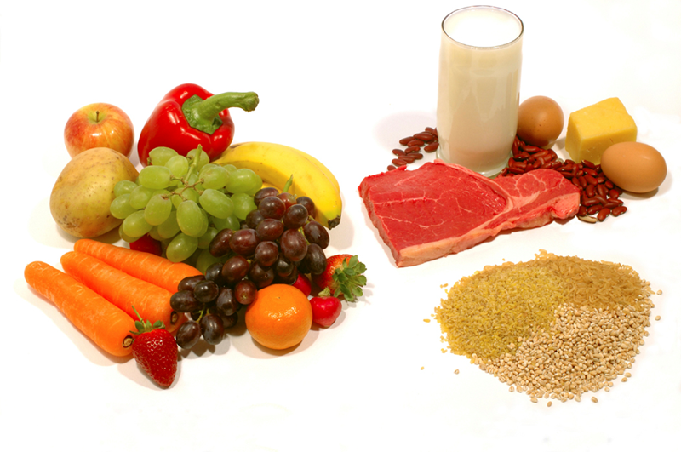
Food Safety
Notes:
Food safety is a scientific discipline describing handling, preparation and storage of food in ways that prevent foodborne illness.

Slide 14
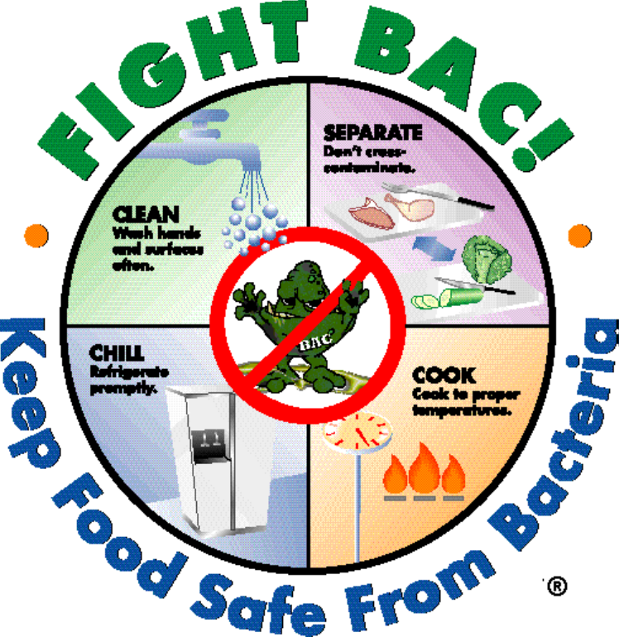
Four Simple Steps
Notes:
CLEAN: Wash hands and surfaces often
SEPARATE: Don't cross-contaminate!
COOK: Cook to proper temperature
CHILL: Refrigerate promptly

Slide 15

Step 1 - Clean
  Wash hands and surfaces often
  Bacteria can be spread throughout the kitchen and get onto hands, cutting boards, utensils, counter tops and food
Notes:
Poor personal hygiene contributes to approximately 50% of all foodborne illness outbreaks.

Slide 16
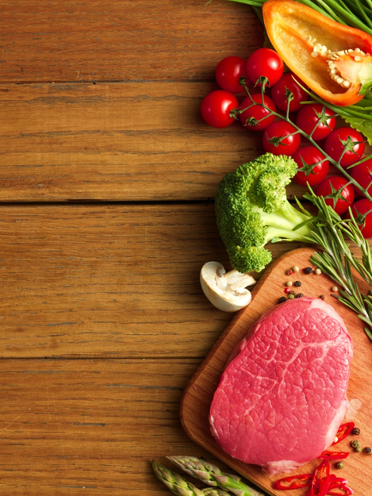
Step 2 - Separate
  Separate raw meats from other foods
  Cross-contamination can occur when bacteria are spread from one food product to another
  This is especially common when handling raw meat, poultry, seafood and eggs
  The key is to keep these foods - and their juices - away from ready-to-eat foods
Notes:
Separating prevents bacteria from spreading from one food to another or to hands and surfaces.

Slide 17
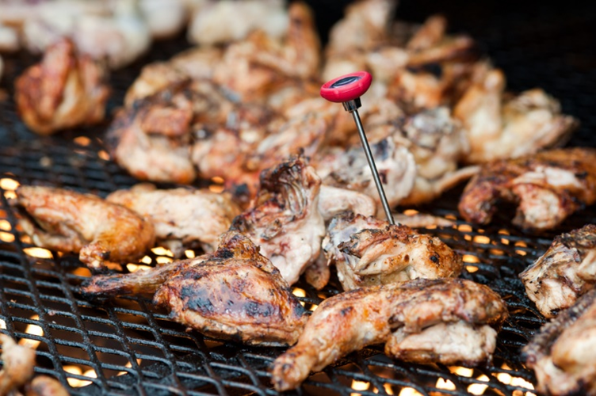
Step 3 - Cook
  Cook to the right temperatures
  Food is safely cooked when it reaches a high enough internal temperature to kill the harmful bacteria that cause illness
  Know the “Danger Zone”
Notes:
Cooking kills bacteria by breaking down their cell walls and destroying enzymes.
The Danger Zone is between 40˚ and 140˚ Fahrenheit.

Slide 18
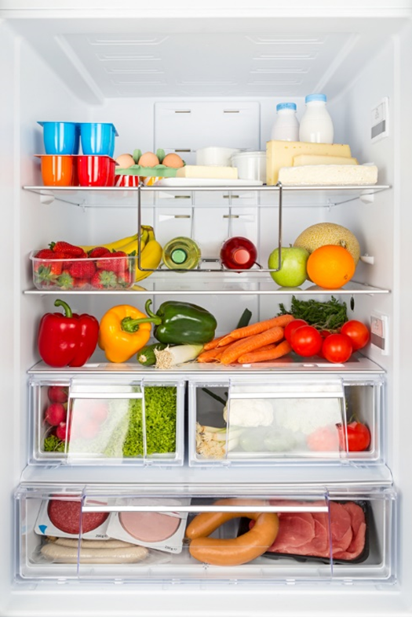
Step 4 - Chill
  Refrigerate foods promptly
  Refrigerate foods quickly because cold temperatures slow the growth of harmful bacteria
  Do not over-stuff the refrigerator. Cold air must circulate to help keep food safe
  Keeping a constant refrigerator temperature of 40ºF or below is one of the most effective ways to reduce the risk of foodborne illness
  Use an appliance thermometer to be sure the temperature is consistently 40ºF or below and the freezer temperature is 0ºF or below
Notes:
Chilling slows down the bacteria’s metabolism slowing their growth.

Slide 19


Recipes for Disaster - Contaminated Carbo Load
  Learn the right food safety steps as Maria does everything wrong.
Notes:
Click on image to view the YouTube™ video:
Recipes for Disaster - Contaminated Carbo Load
Learn the right food safety steps as Maria does everything wrong.
https://www.youtube.com/watch?v=_WFHAZa4PMg
What do you think happened to her nephew?

Slide 20

Questions?

Slide 21
References and Resources
  Guidebook:
    Food Safety A to Z Reference Guide
    A treasure trove of scientific and comprehensive food safety information in one user-friendly, alphabetical format
    http://www.fda.gov/Food/FoodScienceResearch/ToolsMaterials/ucm216150.htm
  Images:
    Fight Bac! Four Steps color logo http://www.fightbac.org/ (Slide 14)
    Microsoft Office Clip Art: Used with permission from Microsoft™. (Slides 1, 3, 4, 5, 6, 10, 13, 20)
    Shutterstock™ images. Photos obtained with subscription. (Slides 9, 15, 16, 17, 18)
  Textbook(s):
    Mehas, K. Y., & Rodgers, S. L. (2002). Food science: The biochemistry of food and nutrition. New York, NY: Glencoe/McGraw-Hill.
    Ward, J. D., & Ward, L. T. (2013). Principles of food science. Tinley Park, IL: Goodheart-Willcox Company.

Slide 22
References and Resources
  Website(s):
    Bad Bug Book (Second Edition)
    Foodborne Pathogenic Microorganisms and Natural Toxins Handbook
    The Bad Bug Book 2nd Edition, released in 2012, provides current information about the major known agents that cause foodborne illness.
    http://www.fda.gov/Food/FoodborneIllnessContaminants/CausesOfIllnessBadBugBook/default.htm
    Fightbac.org
    The Partnership for Food Safety Education’s mission is to end illness and death from foodborne infection in the United States
    http://www.fightbac.org/
    Foodsafety.gov
    The gateway to food safety information provided by government agencies.
    http://www.foodsafety.gov/

Slide 23
References and Resources
  YouTube™:
    Recipes for Disaster – Contaminated Carbo Load
    Learn the right food safety steps as Maria does everything wrong.
    https://www.youtube.com/watch?v=_WFHAZa4PMg
    True Story Behind Typhoid Mary | Dark Matters
    The real “Typhoid Mary” was an Irish immigrant who worked as a cook in well to do American households. Though she was connected to several outbreaks of the disease, she never fell ill herself.
    http://youtu.be/XE8HwwNqHG4

