Slide 1
Food Safety and Sanitation Guidelines
Culinary Arts

Slide 3

Personal Hygiene

Slide 4
Appropriate Work Attire
  Wear
    Apron
    Chef jacket
    Chef pants
    Hair restraint
    Shoes (slip resistant)
  Do Not Wear
    False nails
    Fingernail polish
    Jewelry
      Watches
      Dangling earrings
      Rings
        Except for a plain metal band
Notes:
Aprons Should be clean and removed when leaving the food prep areas.
Clothes Should be clean including chef coats and uniforms.
Hair restraint Always wear a clean hat or other hair covering while prepping food, working in food prep areas, and the dishwashing area. Bobby pins may be provided to keep “bangs” from dangling over food prep areas.
Shoes (slip resistant)Slip resistant shoes are recommended by the Office of Occupational Safety to prevent slips and falls.
Fingernails Keep fingernails short and clean. Do not wear false fingernails or nail polish. Fingernail polish remover may be provided to keep nails clear.
Jewelry Remove all jewelry from hands and arms including watches, dangling earrings, bracelets and rings except for a plain metal band.

Slide 5
Wash Hands Often
  Before
    Eating or drinking
    Handling raw meat, poultry, or seafood
    Prepping food
    Putting on gloves
Notes:
Only a handwashing sink should be used for washing hands in a food establishment.Refer to the TFER Hand Wash Poster from the Texas Department of State Health Services for thecorrect procedure.

Slide 6
Wash Hands
  After
    Cleaning tables or busing dirty dishes
    Handling chemicals
    Handling money
    Handling raw meat, poultry, or seafood (before and after)
    Removing chewing gum with your fingers
    Sneezing, coughing, or using a tissue
    Taking out garbage
    Touching clothing or aprons
    Touching your hair, face, or body
Notes:
Remind students that hand antiseptics should never be used instead of washing hands.

Slide 7
How to Wash Your Hands
    Wet hands and arms
    Apply soap
    Scrub hands and arms vigorously
    Rinse hands and arms thoroughly
    Dry hands and arms
  After Washing Your Hands
    Use a paper towel to turn off faucet
    Use a paper towel to open restroom door
Notes:
Put Your Hands Together from the Centers for Disease Control.
How to Wash Your Hands • Wet hands and arms • use running water as hot as you can comfortably stand • Apply soap • Apply enough to build up a good lather • Scrub hands and arms vigorously • Scrub them for 10 to 15 seconds • Clean under fingernails and between fingers • Rinse hands and arms thoroughly • Use running water • Dry hands and arms • Do NOT use your apron or any part of your uniform • Use a single-use paper towel or hand dryer CDC – Centers for Disease Control and Prevention Put Your Hands Together
https://www.youtube.com/watch?v=SyRtMl4a1FE

Slide 8
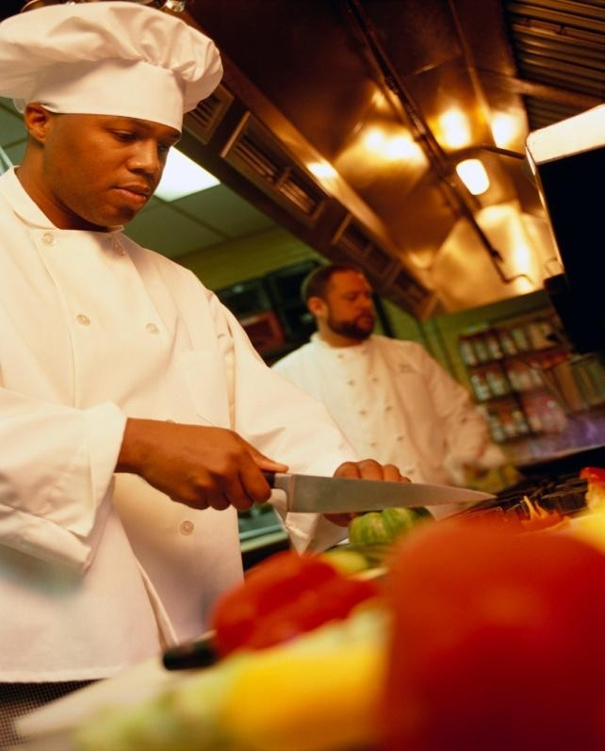
Commercial Kitchen Safety

Slide 9
Commercial Kitchen Hazards
  Burns and Scalds
  Cuts
  Slips and falls
Notes:
General Kitchen Safety to view short video.
General Kitchen Safety
The commercial kitchen is a busy environment that is full of many potential dangers that are both obvious and, in some cases, less obvious to the untrained person. When working in this environment, one must be aware of these potential hazards and how to avoid them.
http://youtu.be/kz-KZGO65DA
Accidents can easily occur in a busy kitchen. Everyone should practice safety in the kitchen atall times.
➢Burns and scalds
➢Tilt pot lids away from your body
➢Use dry pot holders or oven mitts
➢Turn pan handles away from the front of the range
➢Get help to move large hot containers
➢Cuts
➢Always use knives for their intended purpose only
➢Always cut away from your body
➢Always carry a knife down at your side with the blade tip pointed toward the floor
➢Do not try to grab a falling knife
➢Slips and Falls
➢Walk, never run in the kitchen
➢Wipe up spills immediately
➢Wear slip-resistant shoes

Slide 10
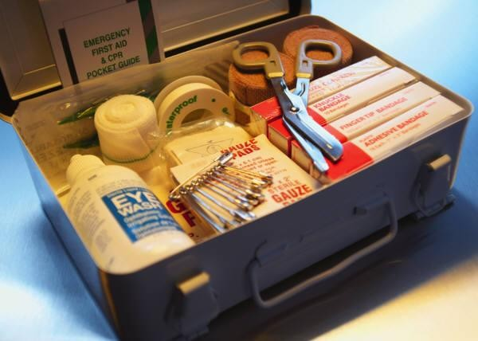
Safety Guidelines
  Be sure to locate:
    Potential dangers
    Emergency exits and routes
    Handwashing stations
    First aid kits
    MSDS information
Notes:
Be aware of your surroundings and locate: • any potential dangers • where to exit in case of emergency • the handwashing station • first aid kits in case of a minor accident • the materials safety data sheets

Slide 11
Commercial Kitchen Safety
  How to Safely Clean Spills in the Kitchen
  Preventing Burns
Notes:
How to Safety Clean Spills in the Kitchen and Preventing Burns to view short videos.
How to Safely Clean Spills in the Kitchen
Within a commercial kitchen one of the most frequent accidents that can occur is slipping on a wet surface. These types of accidents are particularly hazardous because often they can cause back injuries and cause serious lost time. In most cases these injuries are preventable with good safety management of spills.
http://youtu.be/ItTmGSEF0UM
Preventing Burns Within a commercial kitchen you will be exposed to high temperatures that could cause injury to you. Always think safety and have a plan.
http://youtu.be/5_1T0iLmOck

Slide 12
Fire Extinguisher
  How to Use a Fire Extinguisher
    Know how fire extinguishers are classified
    Inspect the fire extinguisher
    Decide if you will evacuate or stay and fight
    Remember the acronym PASS
      Pull the pin
      Aim at the base of the fire
      Squeeze the lever
      Sweep back and forth
Notes:
How to Use a Fire Extinguisher to view the short video. Accidents happen. Be prepared to fight your own fire by learning how to use a fire extinguisher. http://youtu.be/lUojO1HvC8c
You Will Need Courage Calm Fire extinguisher
Step 1: Know how fire extinguishers are classified Know how fire extinguishers are classified. Class A extinguishers are for common combustibles like paper or wood; Class B are for flammable liquids; and Class C are for electrical fires. The Red Cross recommends ABC classified fire extinguishers for home use.
Step 2: Inspect the fire extinguisher Inspect the fire extinguisher before use. Read instructions and warnings; check that the pressure gauge needle is in the green portion of the gauge; and check for a clogged nozzle, a broken seal, or other damage. A fire extinguisher won’t work if it’s not properly charged. The pressure gauge measures the charge.
Step 3: Decide if you'll evacuate or stay and fight Decide if you’ll evacuate or stay and fight the fire. Consider the size of the fire, the amount of smoke in the room, and whether there is a reliable escape route.
Step 4: Remember the acronym PASS
Remember the acronym PASS. It stands for Pull, Aim, Squeeze, and Sweep.
Step 5: Pull the pin that unlocks the operating handle Pull the pin or ring that unlocks the fire extinguishers operating handle, and aim the extinguisher at the base of the fire. Aim at the fire from 6 to 8 feet away.
Step 6: Squeeze extinguisher lever to discharge contents Squeeze the extinguisher lever to discharge its contents, and sweep the hose back and forth until the extinguisher is empty.
Food Network star Alton Brown used a carbon dioxide fire extinguisher, a water cooler bottle, and a tennis racket to make a fruit smoothie on television.

Slide 13
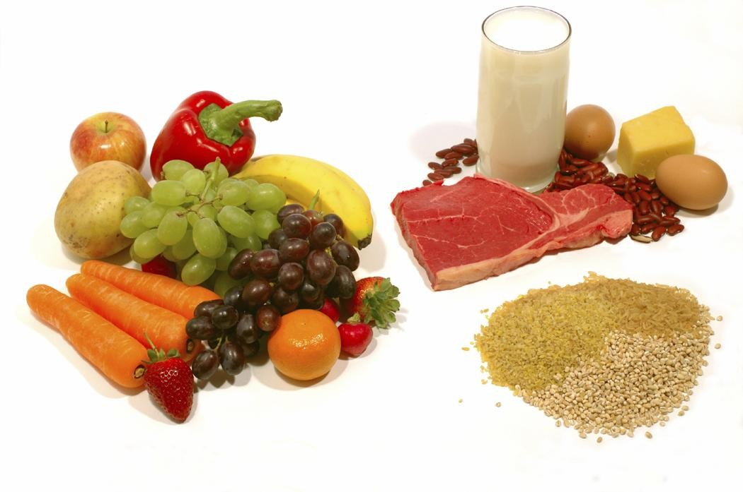
Food Safety

Slide 14
Foodborne Illness
  Each year, 1 in 6 Americans (or 48 million people) get sick from foodborne illnesses.
  3,000 Americans die yearly, from foodborne illness.
  Reducing foodborne illness by just 10% would keep 5 million Americans from getting sick each year.
Notes:
The illness may be mild, lasting just a day or two, or even severe enough to require hospitalization. In some cases, it can even result in death.

Slide 15
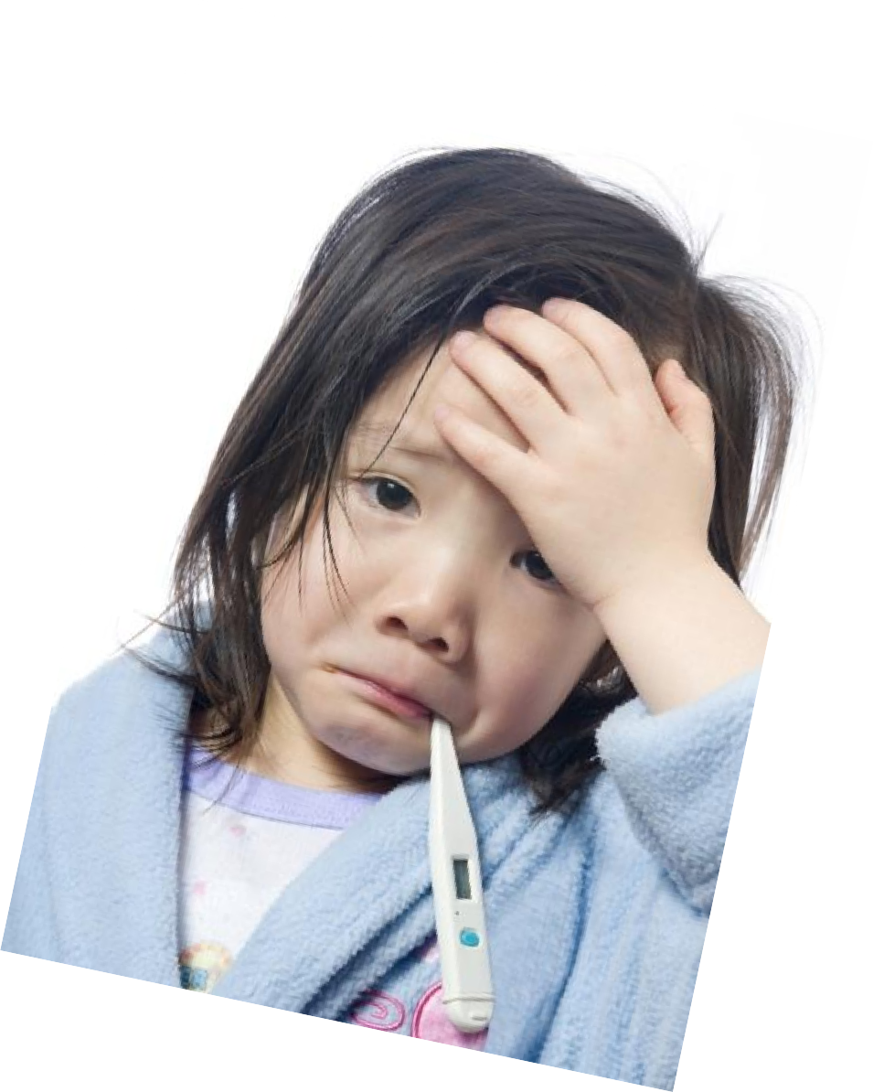
Causes of Food Poisoning
  Bacteria and Viruses
  Parasites
  Mold, Toxins, and Contaminants
  Allergens
Notes:
Bacteria and Viruses
Bacteria and viruses are the most common cause of food poisoning. The symptoms and severity of food poisoning vary, depending on which bacteria or virus has contaminated the food.
Parasites
Parasites are organisms that derive nourishment and protection from other living organisms known as hosts. In the United States, the most common foodborne parasites are protozoa, roundworms, and tapeworms.
Mold, Toxins, and Contaminants
Most food poisoning is caused by bacteria, viruses, and parasites rather than toxic substances in the food. But, some cases of food poisoning can be linked to either natural toxins or chemical toxins.
Allergens
Food allergy is an abnormal response to a food triggered by your body's immune system. Some foods, such as nuts, milk, eggs, or seafood, can cause allergic reactions in people with food allergies.

Slide 16
Least Wanted Foodborne Pathogens
  Campylobactor
  Clostridium botulinum
  E. coli 0157:H7
  Listeria monocytogenes
  Norovirus
  Salmonella
  Staphylococcus aureus
  Shigella
  Toxoplasma gondii
  Vibrio vulnificus
Notes:
Source: Fightbac.org
Campylobacter- Second most common bacterial cause of diarrhea in the United States. Sources: raw and undercooked poultry and other meat, raw milk and untreated water.
Clostridium botulinum- This organism produces a toxin which causes botulism, a life-threatening illness that can prevent the breathing muscles from moving air in and out of the lungs. Sources: improperly prepared home-canned foods; honey should not be fed to children less than 12 months old.
E. coli O157:H7- A bacterium that can produce a deadly toxin and causes approximately 73,000 cases of foodborne illness each year in the U.S. Sources: beef, especially undercooked or raw hamburger; produce; raw milk; and unpasteurized juices and ciders.
Listeria monocytogenes- Causes listeriosis, a serious disease for pregnant women, newborns, and adults with a weakened immune system. Sources: unpasteurized dairy products, including soft cheeses; sliced deli meats; smoked fish; hot dogs; pate'; and deli-prepared salads (i.e. egg, ham, seafood, and chicken salads).
Norovirus- The leading viral cause of diarrhea in the United States. Poor hygiene causes Norovirus to be easily passed from person to person and from infected individuals to food items. Sources: Any food contaminated by someone who is infected with this virus.
Salmonella- Most common bacterial cause of diarrhea in the United States, and the most common cause of foodborne deaths. Responsible for 1.4 million cases of foodborne illness a year. Sources: raw and undercooked eggs, undercooked poultry and meat, fresh fruits and vegetables, and unpasteurized dairy products.
Staphylococcus aureus- This bacterium produces a toxin that causes vomiting shortly after being ingested. Sources: cooked foods high in protein (e.g. cooked ham, salads, bakery products, dairy products) that are held too long at room temperature.
Shigella - Causes an estimated 448,000 cases of diarrhea illnesses per year. Poor hygiene causes Shigella to be easily passed from person to person and from infected individuals to food items. Sources: salads, unclean water, and any food handled by someone who is infected with the bacterium.
Toxoplasma gondii- A parasite that causes toxoplasmosis, a very severe disease that can produce central nervous system disorders particularly mental retardation and visual impairment in children. Pregnant women and people with weakened immune systems are at higher risk. Sources: raw or undercooked pork.
Vibrio vulnificus- Causes gastroenteritis, wound infection, and severe bloodstream infections. People with liver diseases are especially at high risk. Sources: raw or undercooked seafood, particularly shellfish.

Slide 17
Long Term Effects
  Kidney failure
  Chronic arthritis
  Brain and nerve damage
  Death
Notes:
Kidney failure
Hemolytic-uremic syndrome (HUS) is a serious illness that usually occurs when an infection in the digestive system produces toxic substances that destroy red blood cells, causing kidney injury. HUS may occur after infection with some kinds of E. coli bacteria. HUS is most common in children. In fact, it is the most common cause of acute kidney failure in children.
Chronic arthritis
A small number of persons with Shigella or Salmonella infection develop pain in their joints, irritation of the eyes, and painful urination. This is called reactive arthritis. It can last for months or years, and can lead to chronic arthritis, which is difficult to treat. Persons with Campylobacter infections may also develop chronic arthritis.
Brain and nerve damage
A Listeria infection can lead to meningitis, an inflammation of the membranes surrounding the brain. If a newborn infant is infected with Listeria, long-term consequences may include mental retardation, seizures, paralysis, blindness, or deafness. Guillain-Barré syndrome is a disorder that affects the nerves of the body. This occurs when a person's immune system attacks the body's own nerves. It can result in paralysis that lasts several weeks and usually requires intensive care. As many as 40 percent of Guillain-Barré syndrome cases in this country may be triggered by an infection with Campylobacter.
Death
In the United States, approximately 3,000 people die each year of illnesses associated with food poisoning. Five types of organisms account for 88 percent of the deaths for which the cause is known: Salmonella, Toxoplasma, Listeria, norovirus, and Campylobacter. Other types of foodborne illness may cause death as well. For example, some Vibrio infections (usually associated with eating raw shellfish) may infect the bloodstream and cause a severe, life-threatening illness. About half of these infections are fatal, and death can occur within two days.

Slide 18


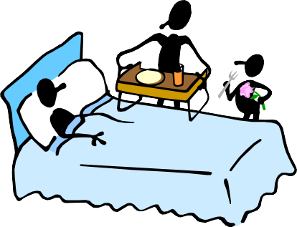
Who’s at risk?
  Pregnant women
  Older adults
  Persons with chronic illnesses
  Young children
Notes:
Pregnant
Women When a woman is pregnant, her immune system is weakened, which makes it harder to fight off harmful microorganisms in food. At the same time, an unborn baby's immune system is not developed enough to fight off dangerous bacteria. In addition, certain toxins in food, such as mercury, can damage an unborn baby’s developing nervous system.
Older Adults
As we age, our immune system and other organs in our bodies become less effective in recognizing and ridding the body of microorganisms that cause foodborne illness. If an older person contracts a foodborne illness, there is a great chance that the effects will be serious or even deadly.
Persons with Chronic Illnesses
If you have a chronic illness such as AIDS, cancer, or diabetes, the illness and sometimes its treatments can weaken your immune system. Similarly, if you are a transplant recipient, you take drugs to prevent your body from rejecting the new organ. These drugs also prevent your immune system from attacking dangerous microorganisms in food. Young Children Have not built up strong immune systems

Slide 19
Cleaning and Sanitizing
  Cleaning removes food and dirt from surface
  Sanitizing reduces pathogens on a surface to safe levels
  Prevents the spread of pathogens to food.
    Steps:
      Clean the surface
      Rinse the surface
      Sanitize the surface
      Allow the surface to air-dry
Notes:
Sanitizing the Kitchen to view the video.
All surfaces must be cleaned and rinsed. Such as: •Walls •Storage shelves •Garbage containers Any surface that touches food must be cleaned and sanitized. Such as: •Knives •Stockpots •Cutting boards
Sanitizing the Kitchen
Consumers can protect themselves by preventing the spread of germs by both cleaning and sanitizing surfaces where food is prepared. This video explains how to make sanitizing solution with ingredients most people already have around the house.
http://youtu.be/_9IhS2jv2OM

Slide 20
References/Resources
  Images:
    Culinary Arts, Harlingen High School South, Harlingen, Texas
    Microsoft Office Clip Art
  Textbook:
    Culinary essentials. (2010). Woodland Hills, CA: Glencoe/McGraw-Hill.
    ServSafe® Manager. 6th. Chicago, IL: National Restaurant Association, 2012. Print.
    ServSafe Starters Employee Guide™, 5th. Chicago, IL: National Restaurant Association, 2010. Print.
  YouTube™:
    General Kitchen Safety
    The commercial kitchen is a busy environment that is full of many potential dangers that are both obvious and, in some cases, less obvious to the untrained person. When working in this environment, one must be aware of these potential hazards and how to avoid them.
    http://youtu.be/kz-KZGO65DA
    Put Your Hands Together
    CDC – Centers for Disease Control and Prevention
    https://www.youtube.com/watch?v=SyRtMl4a1FE

Slide 21
References/Resources
  YouTube™:
    How to Safely Clean Spills in the Kitchen
    Within a commercial kitchen one of the most frequent accidents that can occur is slipping on a wet surface. These types of accidents are particularly hazardous because often they can cause back injuries and cause serious lost time. In most cases these injuries are preventable with good safety management of spills.
    http://youtu.be/ItTmGSEF0UM
    How to Use a Fire Extinguisher Accidents happen.
    Be prepared to fight your own fire by learning how to use a fire extinguisher.
    http://youtu.be/lUojO1HvC8c
    Preventing Burns
    Within a commercial kitchen you will be exposed to high temperatures that could cause injury to you. Always think safety and have a plan.
    http://youtu.be/5_1T0iLmOck
    Sanitizing the Kitchen
    Consumers can protect themselves by preventing the spread of germs by both cleaning and sanitizing surfaces where food is prepared. This video explains how to make sanitizing solution with ingredients most people already have around the house.
    http://youtu.be/_9IhS2jv2OM

