Slide 1
Food Science? Food Scientists?

Slide 3
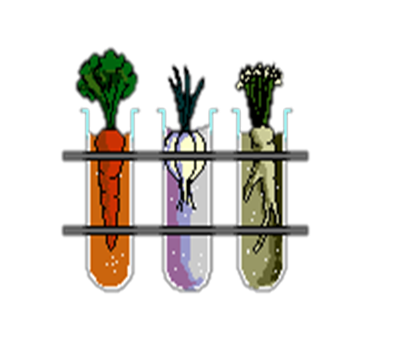
WHAT IS FOOD SCIENCE?
The study of producing, processing, preparing, evaluating, and using food
What does this mean to you?

Slide 4
FOOD SCIENTISTS IN HISTORY
Sir Francis Bacon – Preservation through freezing
Justus von Liebig – Researches on the Chemistry of Foods
Fannie Farmer – Boston Cooking School Cookbook
George Washington Carver – Developed more than 100 products from peanuts, sweet potatoes, and pecans
Clarence Birdseye – Flash freezing

Slide 5
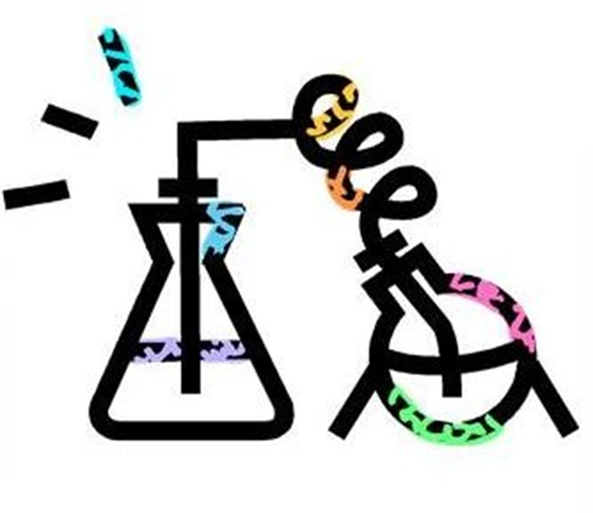
AREAS OF FOOD SCIENCE
Production
Processing
Evaluation
Use

Slide 6
FOOD PRODUCTION
Food Chain – Process in which matter and energy transfer between organisms as food.
Food Production – Techniques for raising crops and animals for
food
*Example: Food scientists discover new ways to treat soil to
produce the most nutritious crops.
Biotechnology - Scientists use the tools of modern genetics in the age-old process of improving plants, animals, and micro- organisms for food production.
*Example: Food scientists improve products by enhancing or eliminating traits that a plant or animal inherits

Slide 7
FOOD PROCESSING
Processing takes food that has been produced and puts it through steps to create a final marketable result.
Researchers in food science help develop more affordable
means of producing foods and retaining nutrients.
Quality control specialists monitor foods through the stages of processing to ensure the foods meet government and industry standards.
*Check storage areas for cleanliness
*Develop food labels after testing foods for nutrient content.

Slide 8
FOOD PREPARATION
Food scientists are responsible for the cooking directions on the back of our food products.
Science is used to determine cooking factors, such as time and temperature. These factors are based on the type of food and how different ingredients will react under certain situations.
*This keeps our food safe and enjoyable!
Food scientists answer the “WHYS” we come across in the kitchen.

Slide 9
EVALUATION OF FOOD
Evaluation is a before and after process.
Test kitchens and evaluation laboratories conduct crucial research to determine whether people will buy a product. They focus on taste, texture, appearance, flavor, and other similar qualities.
Initially, food is evaluated to be cost effective.
Later, evaluation of the product determines two things:
Will people buy the product?
Will people enjoy the product?

Slide 10
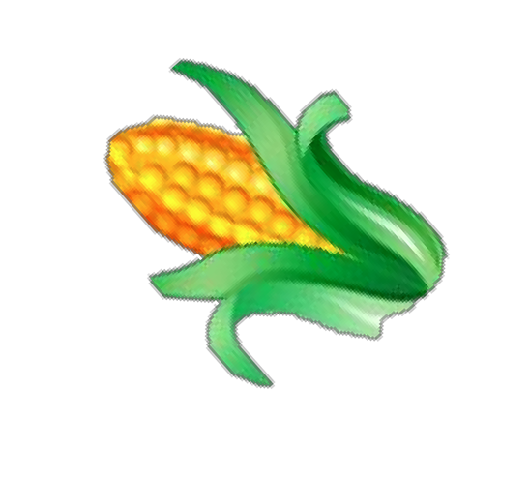
UTILIZATION OF FOOD
Food scientists are always searching to find new uses for food items, but now more than ever before. Why?
* Consumer demands are growing to new levels and putting a strain on our earth’s resources.
-Looking for every possible use of a food has led to soybeans in our newsprint items and corn in our gasoline!

Slide 11
FAMOUS FOOD SCIENTISTS… WHO AM I?
Research each one of these food scientists using the Internet and a textbook (http://www.britannica.com/)
Record facts/discovery/action/innovation the person is best known for in food science

Slide 12
DAY 1 – DISCUSSION/JOURNAL
People need to make thorough use of the foods grown on earth because…

Slide 13
DAY 1 – 90 SECOND SPEECH
Why can we consider cookbooks the first food science “textbooks”?

Slide 14
DAY 2 – JOURNAL/DISCUSSION
People have been interested in understanding the science of food for a long time because…

Slide 15
DAY 2 – 90 SECOND SPEECH
What are the four areas of food science, and how are they interconnected?

Slide 16
DAY 3 – JOURNAL/DISCUSSION
Without technology and the advancements in food science, we would not have…

Slide 17
DAY 3 – 90 SECOND SPEECH
How has food science increased the safety and availability of our food supply?

Slide 18
REFERENCES/RESOURCES
Kay Yockey Mehas & Rodgers, Sharon Lesley . (2002). Food Science: The Biochemistry of Food and Nutrition. Fourth ed. New York, NY: Glencoe McGraw-Hill, pp. 23-33. Print.
Encyclopedia Britannica
Online Encyclopedia
http://www.britannica.com
Microsoft Office Clip Art images

