Slide 1
Building Teamwork
Food Truck Design Project

Slide 3
Food Trucks
  Mobile venues that sell food:
    Ice cream trucks
    Mobile canteens
    Mobile kitchens
    Mobile vendors
    Restaurants on wheels
  Cater events at:
    Carnivals
    Construction
    Farmer’s markets
    Festivals
    Sporting events

Slide 4
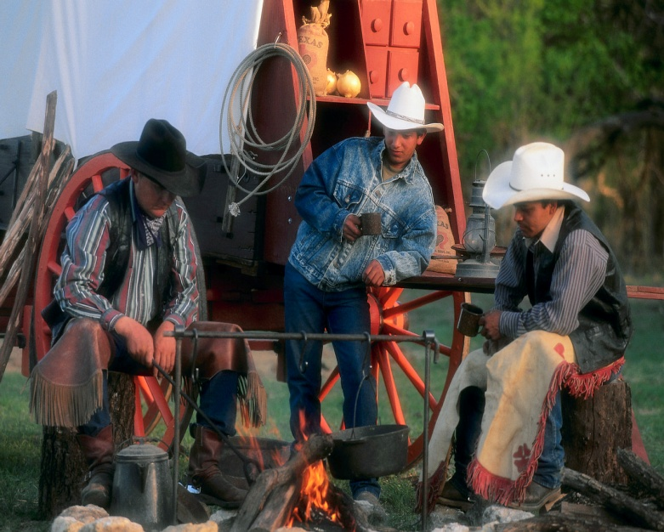
History
  History of Food Trucks
    1866 - Texas Ranger Charles Goodnight
    1910 - Big cities hop on
    1930 - Local grocery stores start delivering

Slide 5
Timeline
  1955 - Good Humor trucks
  1969 - Hot Diggity Dog
  1983 - Expensive gas, cheap food
  1993 - Economy booming

Slide 6
Today
  Food Truck Tech
    2004 - Gourmet to go
    2011 - Fame for Food Trucks becomes popular

Slide 7
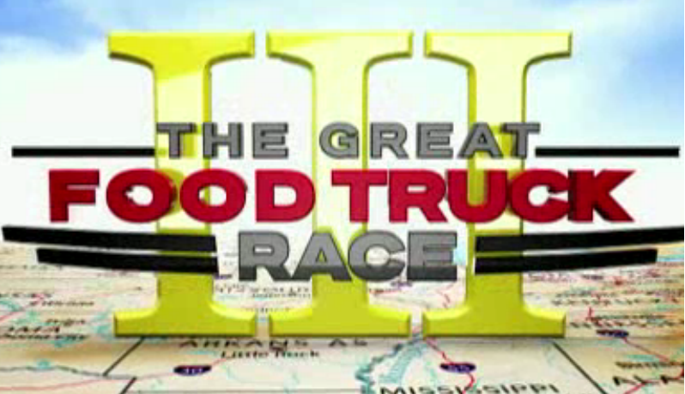
Food Network: The Great Food Truck Race
  Food Trucks are Ready to Roll
  Eight teams of aspiring Food Truck owners arrive in Long Beach, California

Slide 8
References/Resources
  Images:
    Microsoft Office Clip Art: Used with permission from Microsoft.
  Textbook:
    Reynolds, J.S. (2010) Hospitality Services Food & Lodging. Tinley Park IL: The Goodheart-Willcox Company.
  Videos:
    Food Network: The Great Food Truck Race, Season 3
      http://www.foodnetwork.com/the-great-food-truck-race/3559-miles-to-a-dream/index.html
    Modern Marvels, Food Truck Tech
      Designing the average food truck kitchen requires specialized engineering.
      http://www.history.com/shows/modern-marvels/videos/food-truck-tech
    Modern Marvels, History of Food Trucks
      Food trucks have been serving up quick, inexpensive food since the days of cattle drives in the American West.
      http://www.history.com/shows/modern-marvels/videos/history-of-food-trucks
  Websites:
    TimeToast
      The History of Food Trucks
      http://www.timetoast.com/timelines/the-history-of-food-trucks
    U.S. Environmental Protection Agency
      Recycling Basics
      http://www2.epa.gov/recycle/recycling-basics

