Slide 1
Foundations of Safe food
  Purchasing, receiving and storage

Slide 3

Purchasing
  Safe practices
Notes:
Purchasing involves buying products for the foodservice operation.

Slide 4
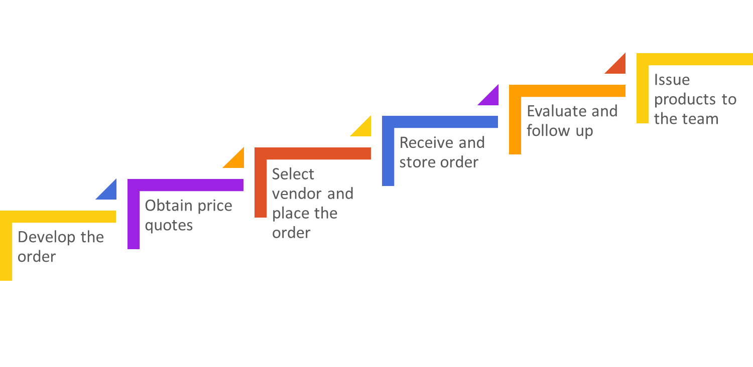
Foodservice purchasing steps
Notes:
Purchasing includes the steps and procedures necessary to procure food products needed to create and prepare food items in the foodservice setting.
It also includes:
establishing product specifications
writing purchase orders
working with vendors to place orders

Slide 5
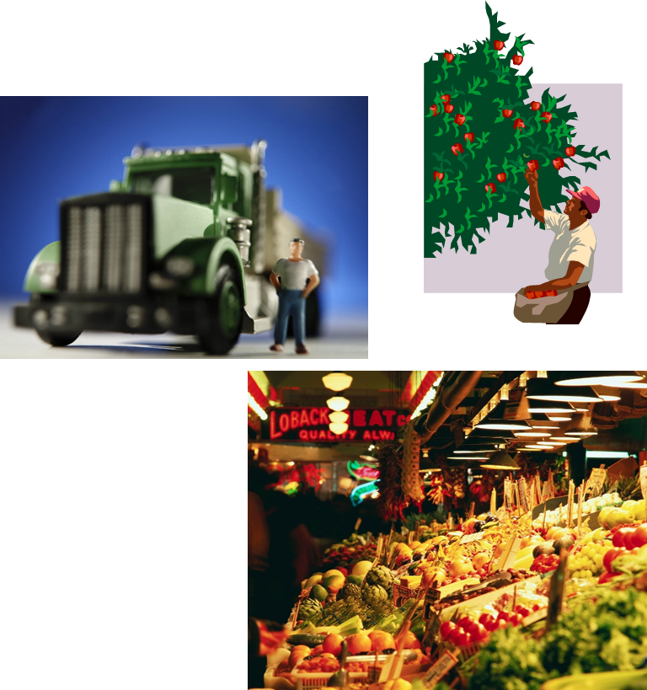
Safe purchasing practices
  Purchase from an approved, reputable supplier
  Suppliers should be:
    Inspected
    Meet local, state and federal laws
  Suppliers include:
    Distributors
    Growers
    Local markets
    Manufacturers
    Packers
    Shippers
Notes:
Always purchase from approved, reputable suppliers. These vendors should show unwavering commitment to providing safe food for the operation.
Get to know the vendors and their safety practices.
In order for food to be safe, it has to start safe.
Arrange deliveries so they arrive one at a time and during off-peak hours.

Slide 6
Products purchased
  Perishable food
    Fresh fruits
    Meat
    Poultry
    Seafood
    Vegetables
  Semi-perishable foods
    Pickled vegetables
    Processed meats
    Smoked fish
  Nonperishable foods
    Canned goods
    Flour
  Nonedible foods
    Cleaning materials
    Paper goods
Notes:
Perishable foods have a short shelf life, spoil quickly and should be used immediately.
Semi-perishable foods contain a substance that slows down the chemical breakdown of the food.
Nonperishable foods have a long shelf life.
Nonedible foods are nonfood products.

Slide 7

Receiving
  Safe practices
Notes:
Receiving involves taking steps necessary to ensure food products are delivered following food safety guidelines.

Slide 8
Safe Receiving practices
  Trained staff should:
    Be available to inspect all deliveries
    Be authorized to accept, reject and sign for deliveries
    Verify order
    Inspect all products
    Check each package for:
      Freshness
      Quality
      Signs of damage
Notes:
Specific staff should be trained to receive and inspect all deliveries.
Supplier should deliver food when staff has enough time to do inspections.

Slide 9
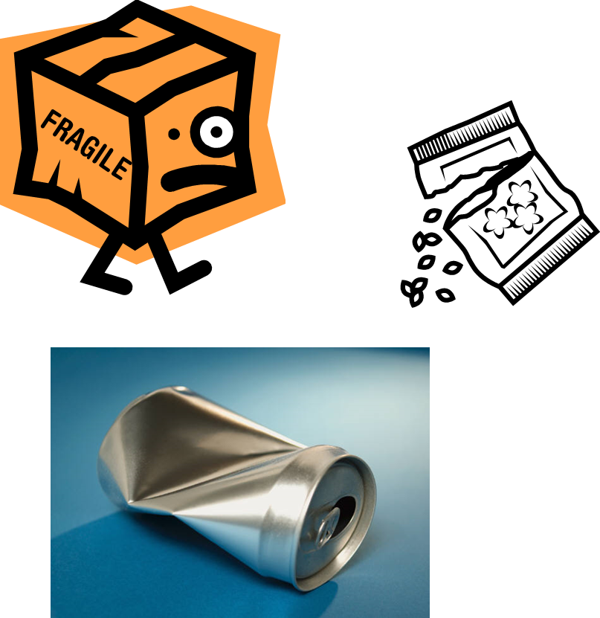
Packaging
  Reject items with:
    Dents or leaks on cans
    Expired dates
    Signs of pest presence
    Strange odors
    Tears and holes in the packaging
    Water spots and leaks
Notes:
If items are rejected, set them aside and make a note on the invoice.
Credit for the items should be given.

Slide 10
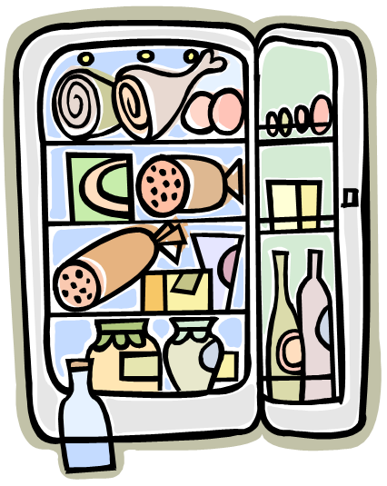
Storage
  Safe practices
Notes:
Storage involves taking steps to store food and nonfood items immediately.

Slide 11
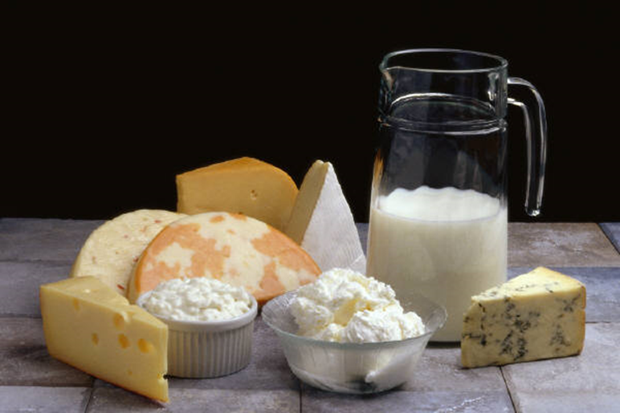
Safe Storage practices
  Store perishable and semi- perishable foods immediately
  Label and date products
  Practice FIFO (first in, first out)
    Place older items in front
    Use older items first
Notes:
Be sure to label foods and date foods to preserve their quality.
Store items away from the walls and six inches off the floor.

Slide 12
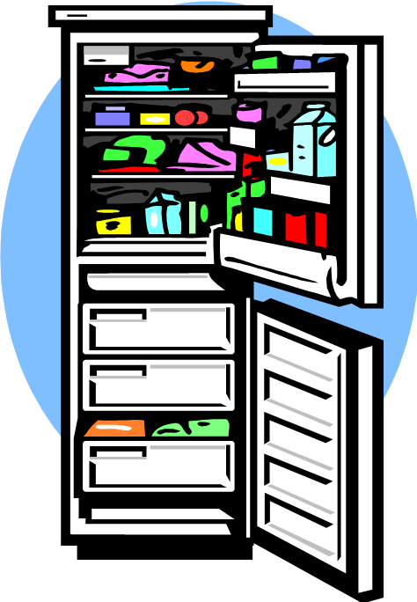
Storage Temperatures
  Monitor storage temperatures regularly
  Dry storage:
    50°F to 70°F
  Refrigeration:
    41°F or lower
  Freezer
    32°F or lower
Notes:
Pathogens can grow if food is not stored at the correct temperature.

Slide 13
Refrigerator Storage
  To prevent cross-contamination:
    Arrange food items in the following order (top to bottom):
      Ready-to-eat food
      Seafood
      Whole cuts of meat
      Ground meat/ground fish
      Whole poultry/ground poultry
  For proper airflow:
    Do NOT overload
    Limit opening refrigerator
    Use open shelving
Notes:
Storing food in the refrigerator with the ready-to-eat food on top and the poultry on the bottom will prevent juices from the raw foods from dripping on the ready-to-eat foods.
Storing too much food in a refrigeration unit makes units work harder to stay cold and could lead to outages.
Opening the refrigerator often raises the temperature inside.
Never line shelves as this limits airflow.

Slide 14
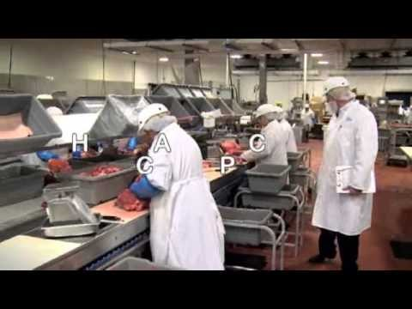

Sysco Quality Assurance
  Insuring food safety is one of the most critical challenges facing the food industry today.
Notes:
Click on image to view YouTube™ video:
Sysco Quality Assurance
Insuring food safety is one of the most critical challenges facing the food industry today.
http://www.youtube.com/watch?v=XXlUfaz7sQI

Slide 15

Questions?

Slide 16
References and Resources
  Images:
    Microsoft Office Clip Art: Used with permission from Microsoft.
  Textbooks:
    Culinary essentials. (2010). Woodland Hills, CA: Glencoe/McGraw Hill.
    ServSafe manager: Updated with the 2013 FDA Food Code. (2014). Chicago, IL: National Restaurant Association.
  YouTube™:
    Sysco Quality Assurance
    Insuring food safety is one of the most critical challenges facing the food industry today.
    http://www.youtube.com/watch?v=XXlUfaz7sQI

