Slide 1
Four Areas of Development - Preschool to School Age
  C H I L D D E V E L O P M E NT

Slide 3

Preschool Years
  Children during the preschool age (three to six years of age) are exploring a wide range of emotions.

Slide 4
Physical Development of Preschoolers
  They are better able to control wrist and finger movements as they practice fine motor skills:
    Cut with scissors
    Scribble with large
    Crayons and pencils
  Gross motor skills improve as large muscles mature.
    Run
    Jump
    Hop
    Walk on tiptoe
    Ride a tricycle
    Skip rope
    Catch ball

Slide 5
Role of Play in Growth and Development of the Preschool Child
  Playing for children is learning.
  They learn from coming in contact with objects, people, and events.
  While children play, they explore the world around them through various types of play such as cooperative, dramatic, and manipulative.

Slide 6
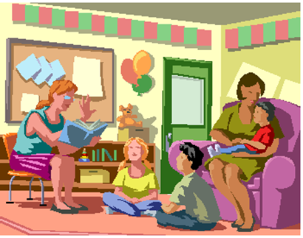
Indoor Activity Centers
  Art
  Blocks
  Computer, Science
  Dramatic Play
  Language Arts
  Manipulative Play
  Math
  Music
  Quiet Time

Slide 7
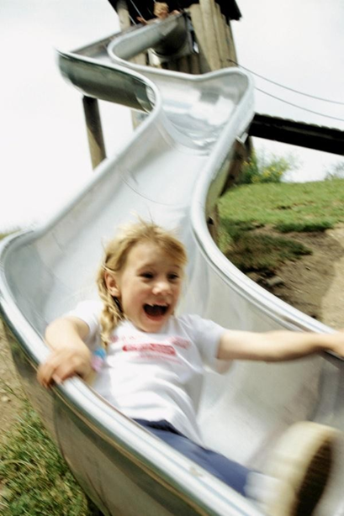
Outdoor Learning Centers
  Wheel Toys.
  Sand and Water.
  Climbing.
  Swinging.
  Quiet Time.
  Ball Games.
  Swing Sets.

Slide 8

Activities for Meeting Developmental Needs
  Vigorous physical exercise.
  Reading development.
  Communication.
  Listening skills.
  Self-reliance.

Slide 9
Meeting Developmental Needs
  Child Development in the Preschool Years
  (click on link)

Slide 10

Growth and Development of the School-Age Child
  Varies significantly between children during this period.
  Proportionally children look more like small adults.

Slide 11
School-Age Years
  Developmental Milestones--School-Age Children
  (click on link)

Slide 12
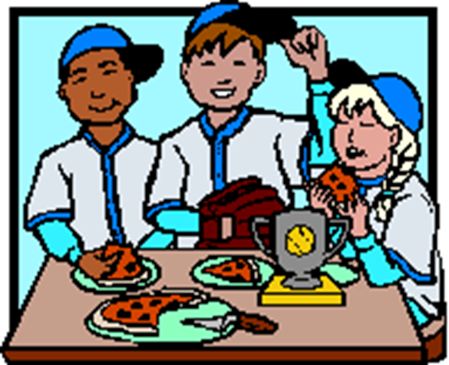
Motor Development of School-age Children
  During these middle years, children gain:
  Quickness
  Balance
  Speed
  Power

Slide 13

Appropriate Development Activities for School- Age Children
  Learning to see things from the viewpoint of others.
  Using deductive and inductive reasoning.
  Noting transformations.
  Focusing on more than one part.

Slide 14

Developmental Tasks
  Developmental tasks take place at an individual rate.
  Each child is unique and proceeds at their own unique pace.

Slide 15
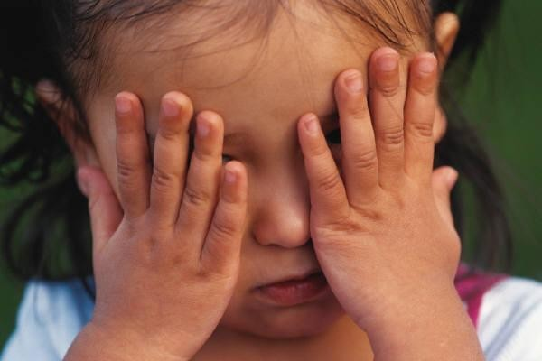
Developmental Lag
  It is defined as a condition which represents a significant delay in the process of development.

Slide 16
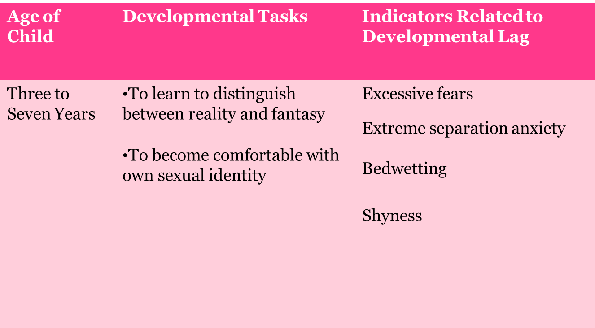
Developmental Tasks

Slide 17
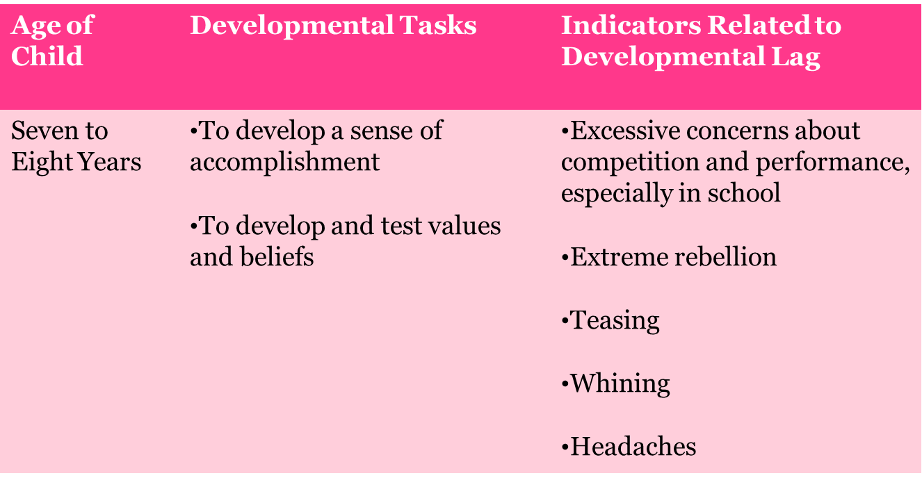
Developmental Tasks

Slide 18
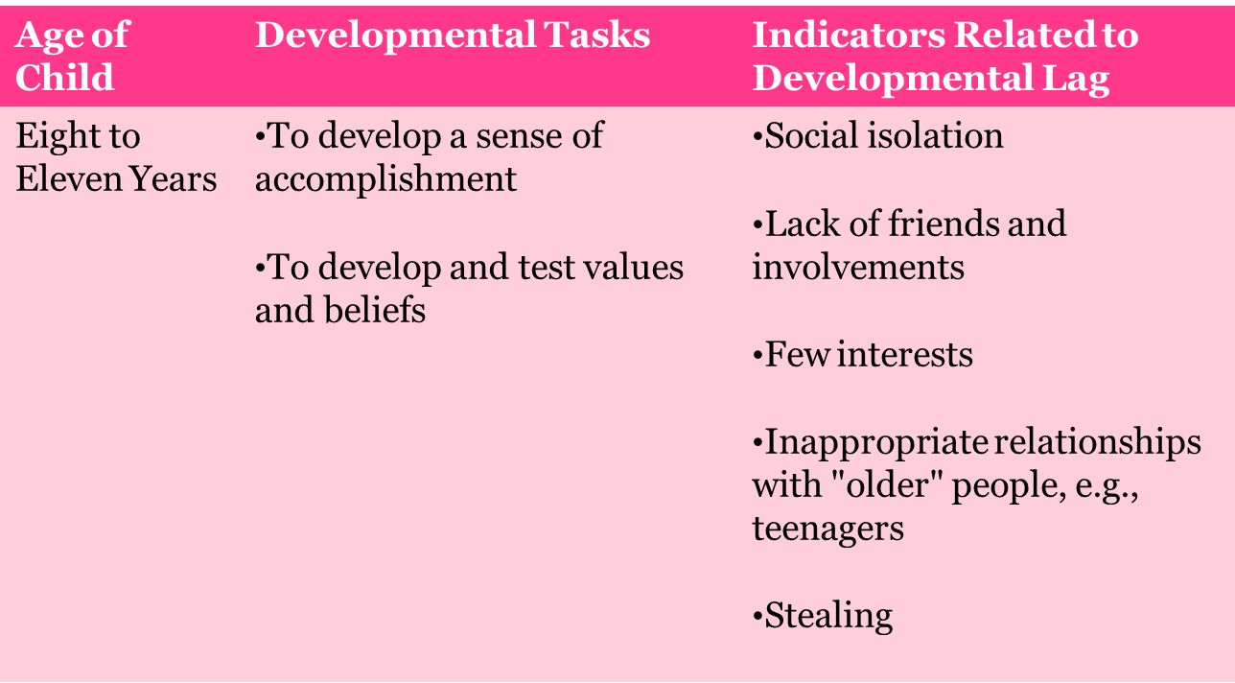
Developmental Tasks

Slide 19
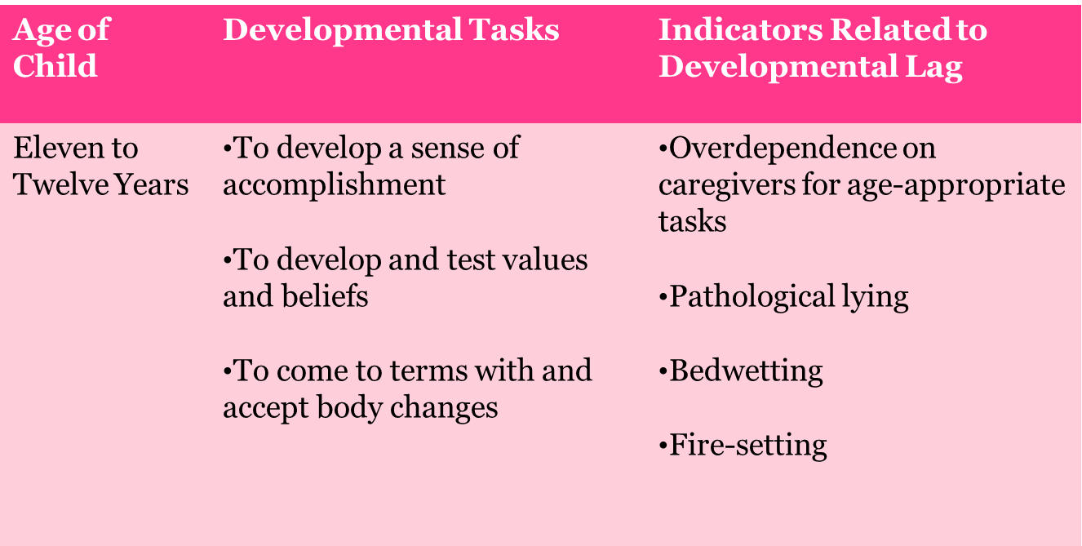
Developmental Tasks

Slide 20

Nutritious Snacks and Meals
  Offer a variety of foods.
  Monitor portion size.
  Maintain balance and control of all of the essential nutrients.

Slide 21

Reducing Dietary Fat for Preschoolers
  Between the ages of 4 and 5 years, parents should reach a level where the child is getting fewer calories from fat (rather than the 50% she had been consuming up to 2 years).

Slide 22
Reducing Dietary Fat for Preschoolers
  Dietary Fat:
    Whole milk
    Fried foods
    Cheese
    Fruit Juice
  Change to:
    Skim or 2% milk
    Grilled or broiled food
    Modest portions
    Limit to 4 to 6 oz. per day

Slide 23
References and Resources
  Microsoft Clip Art: Used with permission from Microsoft
  Textbook:
    Decker, C. (2011). _Child development: Early stages through age 12_. (5th ed.). Tinley Park: Goodheart-Willcox Company.
  Websites:
    Centers for Disease Control and Prevention
    The Child Development Guide will help you determine your child's developmental needs. http://www.dshs.wa.gov/ca/fosterparents/training/chidev/cd06.htm
    Healthy Children
    Reducing Dietary Fat for Preschoolers
    http://www.healthychildren.org/English/ages-stages/preschool/nutrition-fitness/pages/Reducing-Dietary-Fat-for- Preschoolers.aspx
    Nutritious Recipes for Children

Slide 24
References and Resources
    Check out below the suggested Nutritious Recipes for Children cookbook from USDA’s SNAP-ED Connection. These recipes include a nutritional analysis and a cost analysis and are easy to make with limited ingredients.
    http://cte.sfasu.edu/wp-content/uploads/2012/07/Nutritious-Recipes-for-Children.pdf
    StoryBird
    StoryBird is a visual storytelling community. A global hub of readers, writers, and artists of all ages. http://storybird.com/teachers/
    What Should You Know?
    It’s time to change how we view a child’s growth.
    Do you know all the ways you should measure your child’s growth? We naturally think of height and weight, but from birth to 5 years, your child should reach milestones in how he plays, learns, speaks and acts. Track your child’s development and act early if you have a concern. Learn more about milestones. For additional information, visit:
    http://www.cdc.gov/actearly

Slide 25
References and Resources
  YouTube:
    Child Development in the Preschool Years
    This is a video describing the development of the average preschooler according to the current theories. http://youtu.be/Sb74hoJhdqo
    Developmental Milestones—School-Age Children
    Developmental milestones are markers for accomplishments that indicate the department of musical, social, emotional, patenting and language skills.
    http://youtu.be/g9js2_ZsrcU
    StoryBird
    A tutorial on using StoryBird.com including ideas for the classroom. http://youtu.be/T00YjRBIcIw

