Slide 1
Four Areas of Development: Infancy to Toddler

Slide 3

First Years of Life
  Children need:
    Love
    Nutrition
    Health
    Social and emotional security
    Stimulation
Notes:
The first five years of a child's life are a time of tremendous physical, emotional, social and cognitive growth. Children enter the world with many needs in order to grow: love, nutrition, health, social and emotional security and stimulation in the important skills that prepare them for school success. Children also enter the world with a great capacity to learn.

Slide 4

Why Family Support is Vital
  There is a strong connection between the development a child undergoes early in life and the level of success that the child will experience later in life.
Notes:
Research shows clearly that children are more likely to succeed in learning when their families actively support them. Families who involve their children in activities that allow the children to talk, explore, experiment and wonder show that learning is both enjoyable and important. They motivate their children to take pleasure in learning and to want to learn more. They prepare them to be successful in school-and in life. There is a strong connection between the development a child undergoes early in life and the level of success that the child will experience later in life. When young children are provided an environment rich in language and literacy interactions and full of opportunities to listen to and use language constantly, they can begin to acquire the essential building blocks for learning how to read. A child who enters school without these skills runs a significant risk of starting behind and staying behind.

Slide 5

Developmental Milestones
  Developmental milestones are things most children can do by a certain age
Notes:
The first year is critical to the physical, emotional, social and intellectual development of a child’s life. Infants learn with all of their senses by using their eyes, ears, mouth and hands to explore their new world. It is important to understand the aspects of growth during this stage to nurture healthy growth and development of the infant. Most of the developmental mile stones occur in a sequential order and transpire at in specific time frames allowing assistance to be provided to children with special needs as considered necessary. How your child plays, learns, speaks, and acts offers important clues about your child’s development. Developmental milestones are things most children can do by a certain age.

Slide 6
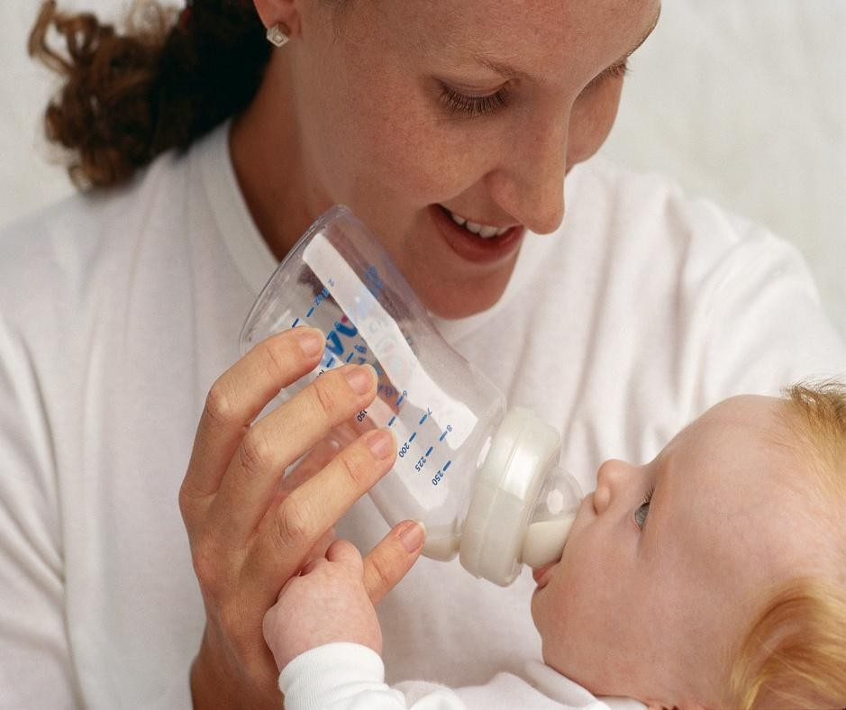
Physical Development of an Infant
  Meals and snacks should be provided to meet the caloric and nutritional needs that include the appropriate portions of protein, lipids, and carbohydrates.
Notes:
The nutritional needs of infants are different for all babies. When the neonate is born, he or she depends on someone to provide the nourishment that is necessary for survival. Many parents may be concerned about what feeding method is best for their infant. Parents also may worry that their infant is not receiving the proper nutrition or not eating enough. Parents can choose to breast-feed or bottle-feed their infant. These options can be discussed with a physician in order to make the best choice for the infant and parents. Their nutritional needs are based on factors such as their height, activity level and how their bodies burn calories. During the first six months feed your child when they show signs of hunger. From six month to a year the infant will gradually be introduced to new foods. During this time the child will began feeding themselves finger foods. Mealtimes and snacks should also begin at the end of the infancy period. Meals and snacks should be provided to meet the caloric and nutritional needs that include the appropriate portions of protein, lipids, and carbohydrates.

Slide 7

Physical Development at Two to Four Months
  Two Months
    Can hold head up and begins to push up when lying on tummy
    Makes smoother movements with arms and legs
  Four Months
    Holds head steady, unsupported
    Pushes down on legs when feet are on a hard surface
    May be able to roll over from tummy to back
    Can hold a toy and shake it and swing at dangling toys
    Brings hands to mouth
    When lying on stomach, pushes up to elbows
Notes:
Babies grow quickly the first year of life. Their weight triples. Babies add 9 to 10 inches during the first year. Good physical development is essential during this time.

Slide 8
Physical Development at Six to Nine Months
  Six Months
    Rolls over in both directions
    Begins to sit without support
    When standing, supports weight on legs and might bounce
    Rocks back and forth, sometimes crawling backward before moving forward
  Nine Months
    Stands, holding on
    Can get into sitting position
    Sits without support
    Pulls to stand
    Crawls
Notes:
Six Months
•rolls over in both directions (front to back, back to front)
•begins to sit without support
•when standing, supports weight on legs and might bounce
•rocks back and forth, sometimes crawling backward before moving forward
Nine Months
•stands, holding on
•can get into sitting position
•sits without support
•pulls to stand
•crawls

Slide 9
Physical Development at Twelve Months
  Twelve Months
    Gets to a sitting position without help
    Pulls up to stand, walks holding on to furniture (“cruising”)
    May take a few steps without holding on
    May stand alone
  Baby Cruising
Notes:
Baby on the Move:
Cruising What cruising looks like, when to expect it, and why it's an important milestone on the way to walking. Plus, tips for keeping it safe and fun.
http://www.babycenter.com/2_baby-on-the-move-cruising_1487416.bc

Slide 10
Social/ Emotional Development at Two to Four Months
  Two Months
    Begins to smile at people if your child:
    Can briefly calm himself (may bring hands to mouth and suck on hand)
    Tries to look at parent
  Four Months
    Smiles spontaneously, especially at people
    Likes to play with people and might cry when playing stops
    Copies some movements and facial expressions, like smiling or frowning
Notes:
By two months old, babies can begin to formulate emotions. Their first two emotional responses are distress, shown by crying and muscle tension. The second is excitement shown by cooing, smiling, wiggling their hands and legs.

Slide 11
Social/ Emotional Development at Six to Nine Months
  Six Months
    Knows familiar faces and begins to know if someone is a stranger
    Likes to play with others, especially parents
    Responds to other people’s emotions and often seems happy
    Likes to look at self in a mirror
  Nine Months
    May be afraid of strangers
    May be clingy with familiar adults
    Has favorite toys

Slide 12
Social/ Emotional Development at Twelve Months
  Twelve Months
    Is shy or nervous with strangers
    Cries when mom or dad leaves
    Has favorite things and people
    Shows fear in some situations
    Hands you a book when he wants to hear a story
    Repeats sounds or actions to get attention
    Puts out arm or leg to help with dressing
    Plays games such as “peek-a-boo” and “pat-a-cake”
Notes:
Is shy or nervous with strangers
Cries when mom or dad leaves
Have favorite things and people
Shows fear in some situations
Hands you a book when he wants to hear a story
Repeats sounds or actions to get attention
Puts out arm or leg to help with dressing
Plays games such as “peek-a-boo” and “pat-a-cake

Slide 13

Intellectual Development at Two to Four Months
  Two Months
    Pays attention to faces
    Begins to follow things with eyes and recognize people at a distance
    Begins to act bored (cries, fussy) if activity doesn’t change
  Four Months
    Lets you know if she is happy or sad
    Responds to affection
    Reaches for toy with one hand
    Uses hands and eyes together, such as seeing a toy and reaching for it
    Follows moving things with eyes from side to side
    Watches faces closely
    Recognizes familiar people and things at a distance
Notes:
Ask students to think of other ways to stimulate a child's mind.
Infants explore their world and learn through touch and taste.
Talking, reading and singing or playing music to infants and toddlers will foster their cognitive growth
Reading helps children learn the sounds of our language.

Slide 14
Intellectual Development at Six to Nine Months
  Six Months
    Looks around at things nearby
    Brings things to mouth
    Shows curiosity about things and tries to get things that are out of reach
    Begins to pass things from one hand to the other
  Nine Months
    Watches the path of something as it falls
    Looks for things he sees you hide
    Plays peek-a-boo
    Puts things in her mouth
    Moves things smoothly from one hand to the other
    Picks up things like cereal’s between thumb and index finger

Slide 15
Intellectual Development at Twelve Months
  Twelve Months
    Explores things in different ways, like shaking, banging, throwing
    Finds hidden things easily
    Looks at the right picture or thing when it’s named
    Copies gestures
    Starts to use things correctly; for example, drinks from a cup, brushes hair
    Bangs two things together
    Puts things in a container, takes things out of a container
    Lets things go without help
    Pokes with index (pointer) finger
    Follows simple directions like “pick up the toy”

Slide 16
Baby Steps: Learn the Signs. Act Early
  Developmental Milestones
Notes:
Centers for Disease Control and Prevention
Early recognition of developmental disabilities such as autism is key for parents and providers. CDC realized the impact on families and invested in a campaign to help parents measure their children's progress by monitoring how they play, learn, speak and act.

Slide 17

Developmental Monitoring and Screening
  At each well-child visit the doctor looks for developmental delays or problems and talks with you about any concerns you might have.
Notes:
Your child’s growth and development are kept track of through a partnership between you and your health professional. At each well-child visit the doctor looks for developmental delays or problems and talks with you about any concerns you might have. This is called developmental monitoring (or surveillance). Any problems noticed during developmental monitoring should be followed-up with developmental screening. Children with special health care needs should have developmental monitoring and screening just like those without special needs. Monitoring healthy development means paying attention not only to symptoms related to the child’s condition, but also to the child’s physical, mental, social, and emotional well-being.

Slide 18

Developmental Screening
  Developmental screening is a short test to tell if a child is learning basic skills when he or she should, or if there are delays.
Notes:
Well-child visits allow doctors and nurses to have regular contact with children to keep track of―or monitor― your child’s health and development through periodic developmental screening. Developmental screening is a short test to tell if a child is learning basic skills when he or she should, or if there are delays. Developmental screening can also be done by other professionals in health care, community, or school settings. The doctor might ask you some questions or talk and play with the child during an examination to see how he or she plays, learns, speaks, behaves, and moves. A delay in any of these areas could be a sign of a problem. The American Academy of Pediatrics recommends that all children be screened for developmental delays and disabilities during regular well-child doctor visits at:9 months18 months24 or 30 months Additional screening might be needed if a child is at high risk for developmental problems due to preterm birth, low birthweight, or other reasons. If your child’s doctor does not routinely check your child with this type of developmental screening test, you can ask that it be done.

Slide 19
Act Early
  Act early by talking to the child’s doctor if a child:
    doesn’t crawl
    can’t stand when supported
    doesn’t search for things that she sees you hide
    doesn’t say single words like “mama” or “dada”
    doesn’t learn gestures like waving or shaking head
    doesn’t point to things
    loses skills he once had
Notes:
Check the milestones a child has reached by his or her 1st birthday. A parent can take this to talk with their child’s doctor at every visit about the milestones their child has reached and what to expect next.
Act early by talking to the child’s doctor if a child:
•doesn’t crawl
•can’t stand when supported
•doesn’t search for things that she sees you hide
•doesn’t say single words like “mama” or “dada”
•doesn’t learn gestures like waving or shaking head
•doesn’t point to things
•loses skills he once had
In order to evaluate the impact of parenting roles and responsibilities parents and child care professionals should have an understanding of the different theorists affecting child development, such as Piaget, Erikson, Skinner, and Kohlberg.

Slide 20

Early Intervention Services
  Research shows that early intervention treatment services can greatly improve a child’s development
Notes:
Many children with developmental delays are not being identified as early as possible. As a result, these children must wait to get the help they need to do well in social and educational settings (for example, in school).In the United States, about 13% of children 3 to 17 years of age have a developmental or behavioral disability such as autism, intellectual disability (also known as mental retardation),and attention-deficit/hyperactivity disorder. In addition, many children have delays in language or other areas that can affect school readiness. However, fewer than half of children with developmental delays are identified before starting school2, by which time significant delays already might have occurred and opportunities for treatment might have been missed. Early Intervention Services Research shows that early intervention treatment services can greatly improve a child’s development. Early intervention services help children from birth through 3 years of age (36months) learn important skills. Services include therapy to help the child talk, walk, and interact with others. The Individuals with Disabilities Education Act (IDEA) says that children younger than 3 years of age (36 months) who are at risk of having developmental delays, might be eligible for early intervention treatment services even if the child has not received a formal diagnosis. These services are provided through an early intervention system in each state. In addition, treatment for particular symptoms, such as speech therapy for language delays, often does not require a formal diagnosis. Although early intervention is extremely important, intervention at any age can be helpful.

Slide 21

Toddler Development
  Toddlers will show:
    greater independence
    begin to show defiant behavior
    recognize themselves in pictures or a mirror
    imitate the behavior of others
Notes:
During the second year, toddlers are moving around more, and are aware of themselves and their surroundings. Their desire to explore new objects and people also is increasing. During this stage, toddlers will show greater independence; begin to show defiant behavior; recognize themselves in pictures or a mirror; and imitate the behavior of others, especially adults and older children. Toddlers also should be able to recognize the names of familiar people and objects, form simple phrases and sentences, and follow simple instructions and directions.

Slide 22

Positive Parenting Tips for Toddlers
  Read to the toddler daily.
  Ask her to find objects for you or name body parts and objects.
  Play matching games
  Encourage him to explore and try new things.
  Help to develop the toddler’s language by talking with her and adding to words she starts.
Notes:
Following are some of the things a parent, can do to help their toddler during this time:
•Read to the toddler daily.
•Ask her to find objects for you or name body parts and objects.
•Play matching games with the toddler, like shape sorting and simple puzzles.
•Encourage him to explore and try new things.
•Help to develop the toddler’s language by talking with her and adding to words she starts.
For example, if your toddler says “baba”, you can respond, “Yes, you are right―that is a bottle.”
•Encourage the child’s growing independence by letting him help with dressing himself and feeding himself.
•Respond to wanted behaviors more than you punish unwanted behaviors (use only very brief time outs). Always tell or show the child what she should do instead.
•encourage the toddler’s curiosity and ability to recognize common objects by taking field trips together to the park or going on a bus ride

Slide 23
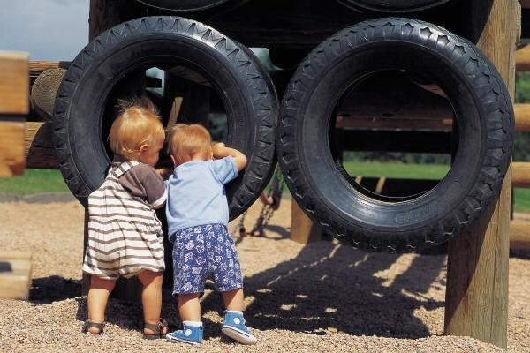
Play, Literacy, and Development
  Provide activities which include:
    Math
    Science
    Physical movement
    Outdoor play
    Art
    Music
Notes:
How can parents and caregivers create play activities that promotes toddler growth and development? These activities should include mathematics, science, physical movement, outdoor play, art and music. Explain the factors that contribute to literacy.
Below are some play activities for a toddler’s growth and development:
Math – Toddlers can learn colors and shapes using puzzles. Science – Toddlers learn to place things in categories (sort and classify)Physical movement – Encourage use of climbing equipment, such as padded inclines, sturdy boxes, etc. Outdoor play – Encourage kicking a ball by providing an area outside to kick the ball in a corner or a cardboard box. Art – Provide markers and paper for the child to make marks. Use art to represent objects, feelings, ideas, etc. Music – Make up rhymes and songs to which toddlers can clap, dance, and sing along to. This helps toddlers develop rhythm and balance

Slide 24

Toddler Growth and Development
  The toddler phase is a very active time in a child’s life.
  They become very mobile and physical
Notes:
The toddler phase is a very active time in the child’s life. They become very mobile and physical. They are exploring their world and developing new skills rapidly. Their appetite may change or fluctuate during this phase. They will grow about two to three inches and gain approximately four pounds during the second year of life. All children come in different shapes and sizes and doctors often chart their growth to determine if there are any trends in the child’s growth that may need attention. Children are developing a sense of self awareness. They are aware of their feelings and thoughts in addition to their likes or dislikes. Their growth begins to slow at the end of this period.

Slide 25

Toddler Growth and Development
  Their language is developing
  Cognitive and language development advances rapidly
Notes:
Their language is developing. They can make short sentences and they can follow instructions. Many changes occur as children move through the years from two to five. Physically they begin to lose their adipose tissue (“baby fat”) and their “pot belly”. As limbs grow longer their bodies begin to become more proportioned. The development of large and small muscle allows for greater motor coordination. Cognitive and language development advances rapidly. Language development is greatly influenced by experiences and parental interaction. Changes in emotional development become evident as secondary emotions emerge: pride, jealousy, guilt, and embarrassment. Preschoolers can develop a variety of fears which requires patience and understanding on the part of parents and caregivers. Preschoolers are gradually moving from being self-centered and egocentric to being able to respond sensitively to others and consider the needs of others.

Slide 26

Nutrition for Toddlers
  Nutrition needs of a toddler are based on their height, activity level and how their bodies burn calories.
Notes:
Nutrition is the final unit in the toddler development module. The nutritional needs of toddlers vary from child to child. Their nutritional needs are based on factors such as their height, activity level and how their bodies burn calories, but in general they should consume 1,000 to1,400 calories per day through a variety of different foods. It is important to offer foods containing all of the essential nutrients to ensure proper growth and development. Variety in food offerings is essential to help them develop a liking for new tastes and textures. Toddler should also continue to consume whole milk to insure that adequate dietary fat is consumed. For additional information on nutritional guidelines for toddlers, visit:
http://kidshealth.org/parent/nutrition_center/healthy_eating/toddler_food.html

Slide 27

Nutritional Guidelines for Toddlers
  Nutritional Guidelines
Notes:
Information on nutritional guidelines for toddlers, visit: Kids Health Nutrition through variety, how much food do they need, milk matters, and meeting iron needs.
http://kidshealth.org/parent/nutrition_center/healthy_eating/toddler_food.html

Slide 28
References/Resources
  Images:
    Microsoft Office Clip Art: Used with permission from Microsoft.
  Textbook:
    Decker, C., & Ryder, V. (2010). Parents and their children. (7th ed., pp. 298-335). Tinley Park: The Goodheart-Willcox Publishing Company.
  Publication:
    Helping Your Preschool Child
    U.S. Department of Education
    Office of Communications and Outreach,
    Helping Your Preschool Child,
    Washington, D.C., 2005
  YouTube™:
    Baby and Toddler Milestones
    In this public service video for parents, Lisa Shulman, M.D., uses video of babies and toddlers to show the communication milestones expected in typically developing children.
    http://youtu.be/pZSjm0drIGM

Slide 29
References/Resources
  Websites:
    Ages and Stages –Infants
    Source: University of Illinois Extension
    Development of infants from ages birth to twelve months
    http://urbanext.illinois.edu/babysitting/age-infant.html
    Baby on the Move: Cruising
    What cruising looks like, when to expect it, and why it's an important milestone on the way to walking. Plus, tips for keeping it safe and fun.
    http://www.babycenter.com/2_baby-on-the-move-cruising_1487416.bc
    Infant and Newborn Development
    Source: Medline Plus, Explains areas of growth in an infant
    http://www.nlm.nih.gov/medlineplus/infantandnewborndevelopment.html
    KidsHealth
    Nutrition through variety, how much food do they need, milk matters, and meeting iron needs.
    http://kidshealth.org/parent/nutrition_center/healthy_eating/toddler_food.html
    Understanding Growth and Development Patterns of Infants
    Source: Virginia Cooperative Extension
    Understanding a child’s growth and development
    http://pubs.ext.vt.edu/350/350-055/350-055.html

