Slide 1
Front of the House
Leadership and Teamwork

Slide 3
Front of the House
  Definition
  Employees

Slide 4
What is Front of the House?
  The area in a hospitality business that guests usually see
  In a restaurant, it includes:
    Entrance
    Dining room
Notes:
Restaurants are divided into two areas – the front-of-the-house and the back-of-the-house.
Each area has its own responsibilities and must work closely together to make the restaurant a success.

Slide 5
Employees
  Main function is to interact with customers include:
    Servers
    Cashiers
    Hosts
    Hostesses
    Parking attendants
Notes:
The front of the house is responsible for:
Seating guests
Selling food
Transmitting orders to the kitchen
Serving customers
Bussing tables
Obtaining payment from customers

Slide 6
Front of the House
  How to Staff the Front of the House - Restaurant Business
  (click on link)
Notes:
Click on hyperlink to view video:
How to Staff the Front of the House | Restaurant Business
Learn how to staff the front of the house with the advice from Paul Bolles-Beaven in this restaurant business video from Howcast.
http://youtu.be/XzTxOvNqppw

Slide 7

Leadership
  Skills
Notes:
Leaders inspire and motivate employees in the workplace.

Slide 8
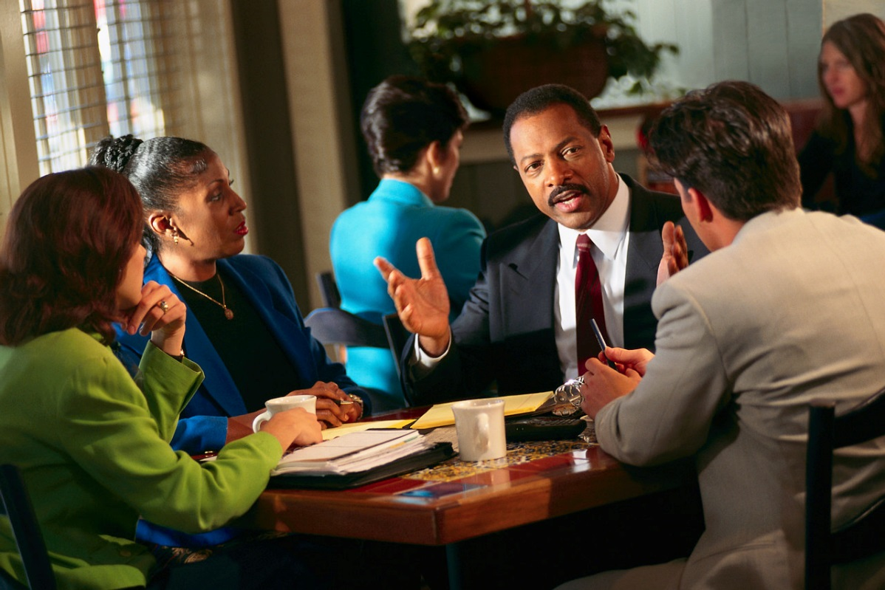
Skills
  Direction
  Lead dependably
  Encourage others
  Inspire others
  Coach
  Expect change
  Nurture teamwork
Notes:
Good leaders demonstrate the following skills:
Direction – leaders communicate clearly and make sure others know what is expected of them
Lead dependably – leaders treat everyone fairly and are accountable for their actions
Encourage others – leaders influence through example and earn employee’s respect
Inspire others – leaders motivate employees, praise their work and guide them to work as a team
Coach – leaders guide their employees as they perform their tasks and praise their successes
Expect change – leaders look for ways to improve and find better ways to do tasks
Nurture teamwork – leaders observe team members as they perform their tasks, assist in improvements and listen attentively

Slide 9
Teamwork
  Skills
  Work Stations
  Conflict Resolution
Notes:
Teamwork is part of every job but much more so in the food industry.

Slide 10

Skills
  Communication
    Verbal
    Non-verbal
  Positive attitude
  Respect
  Empathy
Notes:
The following skills are needed to be successful in the restaurant business:
Communication skills:
Service staff must be able to speak well to both customers and coworkers.
Verbal skills:
speak slowly and clearly
make eye contact
tone of voice should always be professional, pleasant and friendly
Nonverbal skills:
stand straight
do not chew gum, eat or drink while serving customers
write clearly
Positive attitude:
willingness to please the customer
pride in your work
always cheerful
show courtesy to customers and coworkers
Respect yourself and others while on the job and accept responsibility for your actions.
Learn to practice empathy – the skill of thinking about what it would be like in another’s place

Slide 11
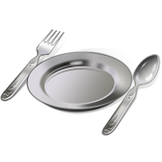

Work Stations
  Beverage Station
    Cold beverages
    Hot beverages
  Service Station
    Dishes
    Glasses
    Eating utensils
    Water
    Bread
Notes:
Beverage station should include prepared beverages such as juice, milk, coffee, tea and soft drinks.
Each member of the staff must know how to operate and clean the beverage machines.
Service stations are where supplies to reset the tables are kept between customers. This includes dishes, glasses and eating utensils and sometimes bread and water for the customers.

Slide 12
Duties
  Side Work
    Refilling:
      salt and pepper shakers
      sugar bowls
      condiments
    Cleaning:
      seats, tables and floors
    Folding napkins
  Sections
    Servers oversee a group of tables
    They are responsible for:
      setting the tables
      taking orders
      delivering food
      clearing the tables
Notes:
Side work is where all service staff members have duties to perform before the customers arrive or before beginning a shift (can also be done at the end of the shift).
This may include:
cleaning and refilling salt and pepper shakers
sugar containers
condiment containers
cleaning seats, tables and floors
folding napkins and setting tables
Sections:
Servers are usually responsible for a set number of tables in a section
Servers are responsible for:
setting the tables
taking orders
delivering food
clearing the tables

Slide 13

Conflict Resolution
  Disputes
  Negotiation
  Focus on problem
  Advise the manager
  Steps to resolving conflict:
    Define the problem
    Suggest a solution
    Evaluate a solution
    Compromise
    Brainstorm
    Mediate
Notes:
Disputes and conflicts are part of being on a team. Not everyone will get along all of the time.
Can you name some disputes that may arise while working in a restaurant? (focus on the front of the house)
Learn to negotiate.
Remember to focus on the problem and not the personalities involved. If you cannot resolve the conflict, be sure to discuss this with the manager.
Students will analyze conflicts in the workplace during the Guided Practice. Remind them that there is a process to resolve conflicts so that all parties are satisfied.

Slide 14
Questions?

Slide 15
References and Resources
  Images:
    Microsoft Office Clip Art: Used with permission from Microsoft.
  Textbooks:
    Culinary essentials. (2010). Woodland Hills, CA: Glencoe/McGraw Hill.
    Foundations of restaurant management & culinary arts: Level one. (2011). Boston, MA: Prentice Hall.
  YouTube™:
    How to Staff the Front of the House | Restaurant Business
    Learn how to staff the front of the house with the advice from Paul Bolles-Beaven in this restaurant business video from Howcast.
    http://youtu.be/XzTxOvNqppw

