Slide 1
Fruitful Discoveries

Slide 3

Fruit Categories
Notes:
Fruits are divided into categories of:
• Summer
• Winter, and
• Tropical
There are six other groups that fruits fit into:
• Pomes
• Berries
• Melons
• Drupes
• Citrus, and
• Tropical
We will discuss each of them in the following slides.

Slide 4
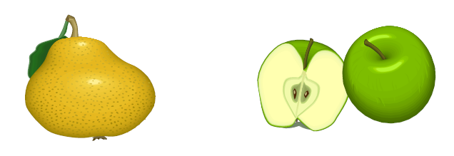
Pomes
  Winter fruit
    These fruits have 5 compartments that contain seeds
    There are only 2 fruits in this category -
    Apples and Pears
Notes:
If you were to cut an apple or pear in half horizontally you would expose a “star” that is divided into 5 sections that contain the seeds. That characteristic sets these 2 fruits apart. These fruits are considered winter fruits.

Slide 5
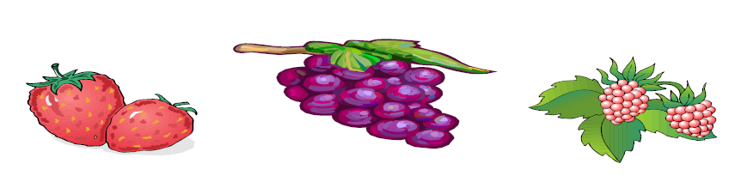
Berries
  Summer fruit
  These fruits typically grow in small clusters
  Examples are grapes, strawberries, and berries
Notes:
Berries seem like a straight forward category. You would think it would just include fruits like: strawberries, blueberries, raspberries and so on. However, since grapes grow in small clusters, they are part of this category. They are also considered summer fruits.

Slide 6

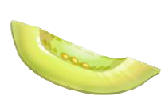
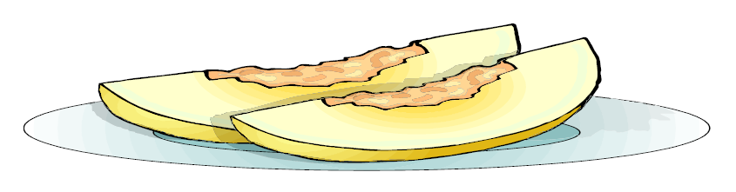
Melons
  Summer fruit
  Melons grow on a vine on the ground
  Most contain seeds
Notes:
Melons come in many varieties. We are familiar with: watermelon, honeydew, and cantaloupe. Other melons you may not be familiar with are: santa clause melons, casaba melons, and crenshaw. No matter the variety, they all grown on vines on the ground and all contain seeds. Because melons need warm weather and lots of water, they are summer fruits.

Slide 7
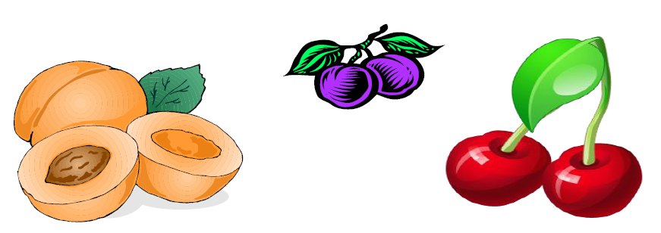
Drupes
  Summer fruit
  Contain a large pit or stone in the center of the fruit
Notes:
To remember the drupe category, think of how these fruits are grown. All of them grow on trees, and as the branches get full of the fruits they “drupe!” These fruits are most often found in the summer.

Slide 8
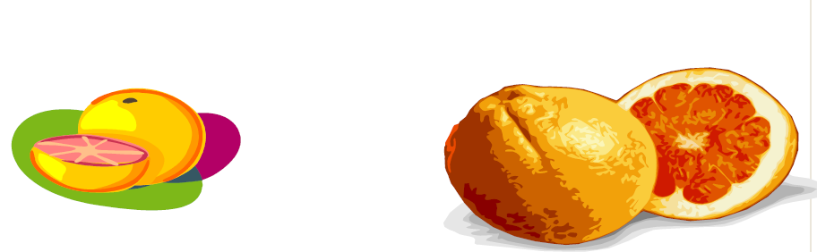
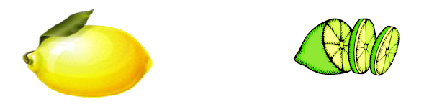
Citrus
  Tropical fruit
  The fruit is divided into sections and contain Ascorbic Acid (Vitamin C)
Notes:
The flesh of this fruit is segmented. Think of an orange when you peel it. Once the orange is peeled, it can be broken into sections. It is the same with all citrus fruits. To grow, these fruits like warm, but not hot weather. Thus, they are considered tropical fruits.

Slide 9
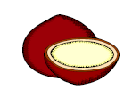
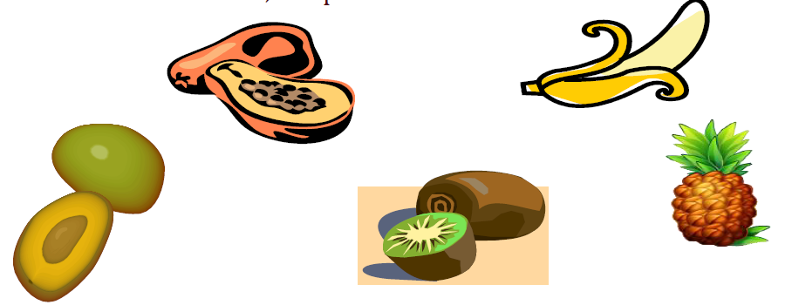
Tropical
  Tropical fruit
  Grow in a warm, temperate climate
Notes:
Tropical fruits need warm climates to grow. Many of these fruits are imported. Thus, they may be picked early and allowed to ripen in transport.

Slide 10
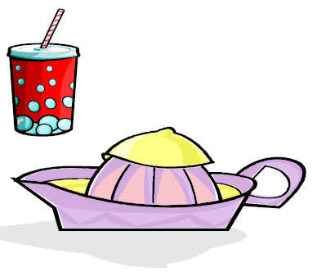
Preventing Oxidation in Fruit
  When exposed to air, some fruits turn brown
  Prevent browning by dipping in an ascorbic acid solution of:
    lemon juice, or
    lime juice, or
    orange juice, or
    lemon-lime soda, or
    a commercial chemical powder
Notes:
When fruits such as apples, bananas, and peaches are cut, a scientific change takes place called, “Enzymatic Browning.” Which means when the fruit is cut and the meat of the fruit is exposed to air (oxygen), it turns brown.
This could be very unappealing in some recipes that may call for fresh apples or bananas.
Several options are available to prevent the browning.
The fruit can be dipped in ascorbic acid solution.
• In a bowl of water, add a citrus juice (lemon, lime, orange) then add the fruit.
• The fruit could also be dipped in lemon-lime soda.
• Commercial chemical powders are available that can be dissolved in water and added to your fruit to prevent the browning.

Slide 11
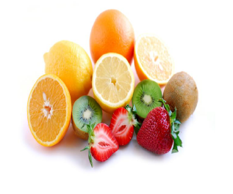
Safe Handling
  Buy right
  Store properly
  Separate for safety
  Prepare safely
  Safe Handling of Raw Produce and Fresh- Squeezed Fruit and Vegetable Juices
Notes:
Buy right
• purchase produce that is not bruised or damaged
• choose items that are refrigerated or surrounded by ice
• separate bagged fresh fruits and vegetables from meat, poultry and seafood products in the grocery cart
Store properly
• store perishable, fresh fruits and vegetables (like strawberries, lettuce, herbs, and mushrooms) in a clean refrigerator at a temperature of 40°F or below
• refrigerate all produce that is purchased pre-cut or peeled to maintain both quality and safety
Separate for safety
• wash cutting boards, dishes, utensils and counter tops with soap and hot water between the preparation of raw meat, poultry and seafood products and the preparation of produce that will not be cooked
• run plastic or other non-porous cutting boards in the dishwasher after use
Prepare safely
• cut away any damaged or bruised areas on fresh fruits and vegetables before preparing and/or eating
• wash all produce thoroughly under running water before eating, cutting or cooking
• scrub firm produce, such as melons and cucumbers, with a clean produce brush
• dry produce with a clean cloth towel or paper towel to further reduce bacteria that may be present
Click on hyperlink: Safe Handling of Raw Produce and Fresh-Squeezed Fruit and Vegetables Juices to view video:
Raw Produce: Selecting and Serving it Safely
Food Facts from the U.S. Food and Drug Administration
http://www.fda.gov/food/resourcesforyou/consumers/ucm114299

Slide 12
Questions?

Slide 13
References and Resources
  Textbook:
    Culinary essentials. (2002). Woodland Hills, CA: Gencoe/McGraw Hill.
    Foundations of restaurant management & culinary arts: Level one (2011). Boston, MA: Prentice Hall.
  YouTube:
    About.com Food
    How to Make Bananas Foster
    http://youtu.be/xoE8hxpOBPk
    Better Homes and Garden
    Grilling Fruit
    http://youtu.be/Kw4_d3LVUwk
  Website:
    Raw Produce: Selecting and Serving it Safely
    Food Facts from the U.S. Food and Drug Administration
    http://www.fda.gov/food/resourcesforyou/consumers/ucm114299

