Slide 1
GIS and GPS
In Transportation, Distribution, and Logistics

Slide 3
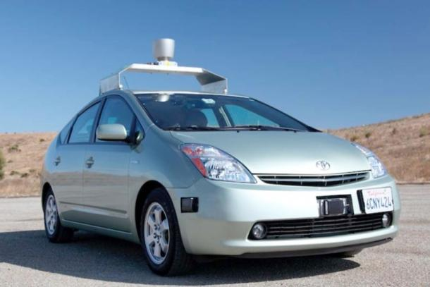
Self-Driving Vehicles
  Nissan has announced that it will have a self-driving car by 2020, Google has said it will do so by 2018.
  Discuss with your neighbor the technological advances that have made this a possibility.

Slide 4
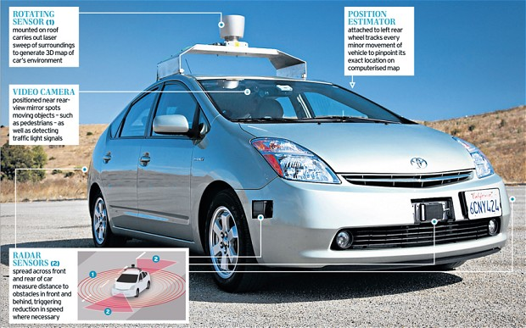
Self-Driving Vehicles

Slide 5
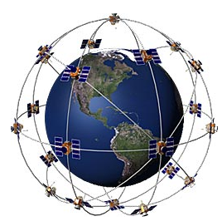
Global Positioning System (GPS)
  What is it?
    a satellite network used to determine a geographic location on the earth’s surface
    Initially developed by the United States Department of Defense, but is now also used for commercial and recreational purposes

Slide 6
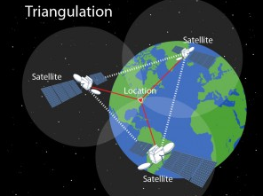
Global Positioning System (GPS)
  How does it work?
    consists of 24 orbiting satellites
    at anytime at least ‘4’ satellites are ‘visible’
    signals from the satellites are picked up by a GPS receiver which calculates the receiver’s geographic location through triangulation
    requires at least 4 satellites to effectively identify location (latitude, longitude, altitude)
    potential errors affecting accuracy
      timing
      receiver
      atmospheric
      orbital
      surroundings / multipath (ex. metal objects)

Slide 7
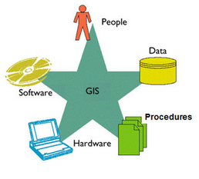
Geographic Information Systems (GIS)
  What is it?
    A system used to store, analyze, and graphically display tabular data that is able to be represented spatially
    GIS Components:
      Hardware: Computer, GPS receivers, etc…
      GIS software
      Data
      GIS Analyst (person to analyze/interpret the data)
      Workflow, Output (map, computation, etc..)

Slide 8
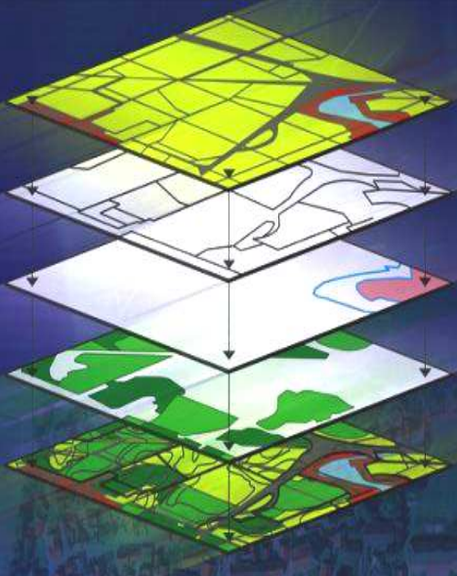
Geographic Information Systems (GIS)
  Data Analysis
    Can arrange layers of spatial data to identify and interpret spatial relationships
    Layer represents a geographic feature
  Relevance to transportation
    Track assets
    Cost-effective routing
    Emission reduction
    Infrastructure management
    Public transit safety
    Regulating airspace

Slide 9
References and Resources
  Images:
    http://www8.garmin.com/aboutGPS/
    http://www.howtechnologywork.com/how-does-a-gps-work/
    www.spatial-ed.com/training/25-gis-basics/345-gis-components.html

