Slide 1
Global Cultures and International Cuisines
Culinary Arts
Notes:
This is a very powerful lesson that can not only teach your students about international foods but can also allow your students to share their passions about the foods they know best.
This will help you learn about your students and get to know them as well.

Slide 3
Cuisines
Cultures
International Cuisines
American Museum of Natural History
Notes:
Click on hyperlink to view video:
Our Global Kitchen: Food, Nature, Culture
American Museum of Natural History
In the new exhibition Our Global Kitchen: Food, Nature, Culture, the American Museum of Natural History explores the complex and intricate food system that brings what we eat from farm to fork.
https://www.youtube.com/watch?v=a1dQlyNVpTI
We will be discussing cuisines, cultures and international cuisines in this lesson.

Slide 4
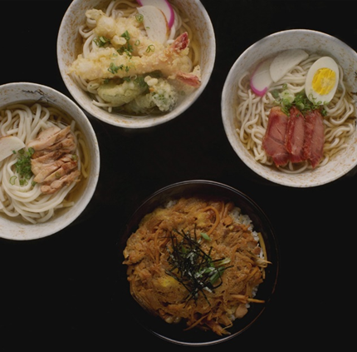
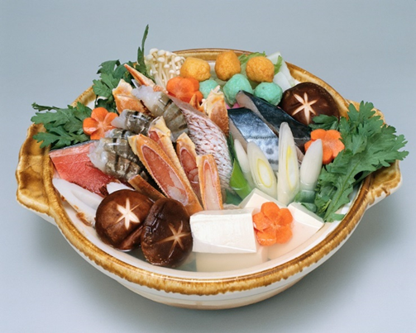
Cuisine
Foods and methods of preparation traditional to a region or population
Notes:
Cuisine is a characteristic style of cooking practices and traditions, often associated with a specific culture.
Cuisines are often named after the geographic areas or regions from which they originate.

Slide 5
Major Factors That Shape Cuisine
Advertising
Availability
Climate
Cost
Economic Conditions
Religion
Notes:
Advertising - encourages people to choose certain foods that often appear on television, Internet, radio, posters, magazines and newspapers
Availability – ingredients that are accessible locally or through trade
Climate - determines the native raw materials that are available to cook
Cost - an amount that has to be paid or spent to buy food items
Economic conditions - regulate trade in delicacies and imported foodstuffs
Religion - certain foods are required or prohibited
Cultural practices and religious beliefs play a major role in the food choices that we make.
Culture is the customary beliefs, social forms and material traits of a racial, religious or social group.

Slide 6
Culture
Behaviors and beliefs characteristic of a particular social, ethnic or age group
Notes:
Cultural practices and religious beliefs play a major role in the food choices that we make.
Culture is the customary beliefs, social forms and material traits of a racial, religious or social group.

Slide 7
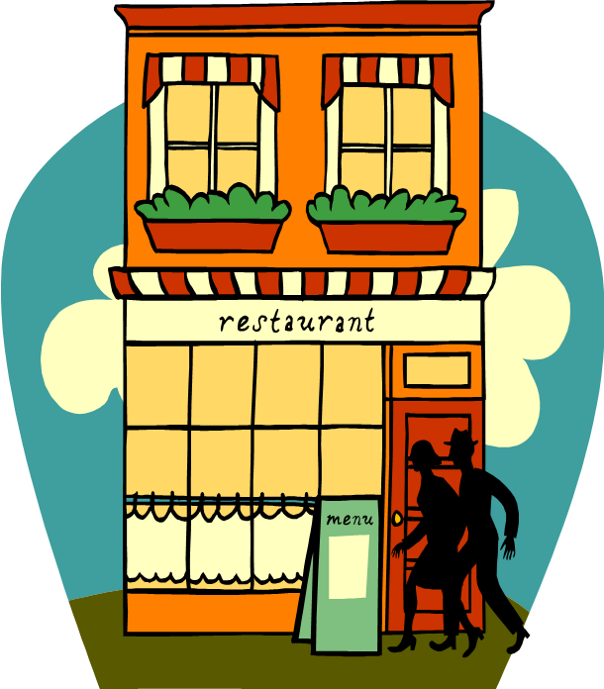
International Cuisines
American
Italian
Japanese
Mexican
Other
Notes:
We will be researching many cuisines in this lesson.

Slide 8
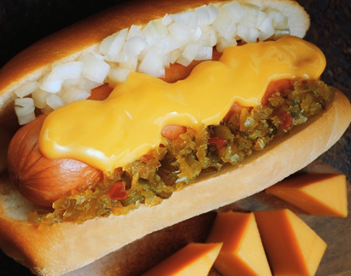
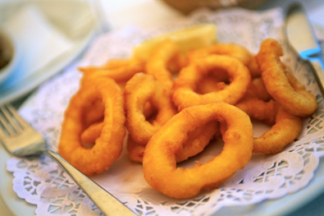
American Cuisine
A combination of all the traditional cuisines of immigrant inhabitants
Notes:
American Cuisine varies from region to region as well as with different regions of the country producing vastly different cuisines.
Dishes such as pizza, hot dogs and tacos are born from dishes of other cultures but have eventually become Americanized and accepted as American Food.
Can you name any other foods in the American cuisine?

Slide 9
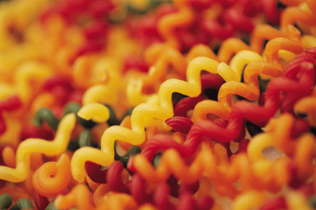
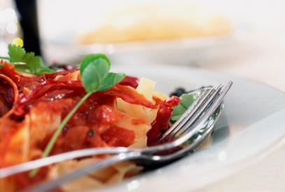
Italian Cuisine
Reflects the cultural variety of its regions and its diverse history
Notes:
Food is an extremely important component of the Japanese culture.
The side dishes often consist of rice, pickled vegetables and vegetables cooked in broth.
Typically fish is the featured protein.

Slide 10
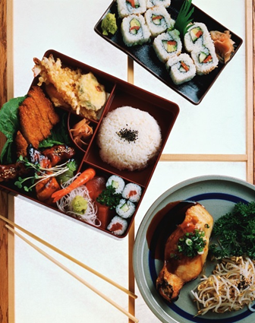
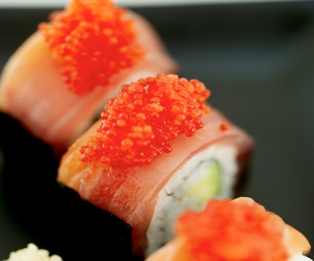
Japanese Cuisines
Known for:
Emphasis on seasonality of food
Quality ingredients
Presentation
Notes:
Italian cuisine is one of the most widely imitated cuisines globally.
Typically, meals are centered around grains and vegetables with meats as an accent.
What foods do you associate with Italian cuisine?

Slide 11
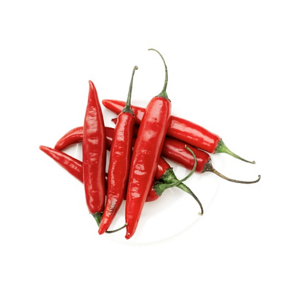
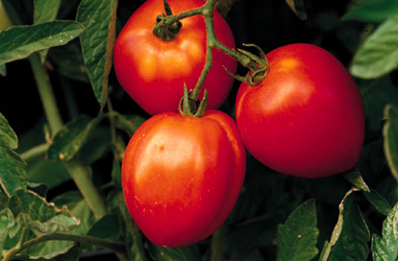
Mexican Cuisine
Known for:
Its intense and varied flavors
Colorful decorations
Variety of spices
Notes:
Mexican cuisine often utilizes fresh vegetable preparation and varying types of peppers in dishes.
Prepared foods use varying flavors, textures and cooking methods that result in a number of unique dishes that are unlike those of other cultures.

Slide 12
Other Identifiable Cuisines
Chinese
French
German
Greek
Indian
Jamaican
Moroccan
Russian
Spanish
Thai
Notes:
Have you tried any of these?
Which is your favorite?
We will find out more about these cuisines as we continue our lesson.

Slide 13
Questions?

Slide 14
References and Resources
Images:
Microsoft Office Clip Art: Used with permission from Microsoft.
Textbook(s):
Culinary essentials. (2010). Woodland Hills, CA: Glencoe/McGraw Hill.
Foundations of restaurant management & culinary arts: Level one. (2011) Boston, MA: Prentice Hill.
Website(s):
Our Global Kitchen: Food, Nature, Culture
Take a journey around the world and through time. Stroll through an ancient market, cook a virtual meal, peek inside the dining rooms of illustrious individuals—and consider some of the most challenging issues of our time.
http://www.amnh.org/exhibitions/past-exhibitions/our-global-kitchen-food-nature-culture

Slide 15
References and Resources
YouTube™:
Our Global Kitchen: Food, Nature, Culture
American Museum of Natural History
In the new exhibition Our Global Kitchen: Food, Nature, Culture, the American Museum of Natural History explores the complex and intricate food system that brings what we eat from farm to fork.
https://www.youtube.com/watch?v=a1dQlyNVpTI

