Slide 1
Guest Services
First Impressions

Slide 3

Guest Services
  Front desk agents are responsible for providing:
    Information
    Requests
    Problem solving
Notes:
They are the first person you see when you register at the hotel. They should greet you with a smile, request your information for the room, and ask if there is anything else you may need.

Slide 4
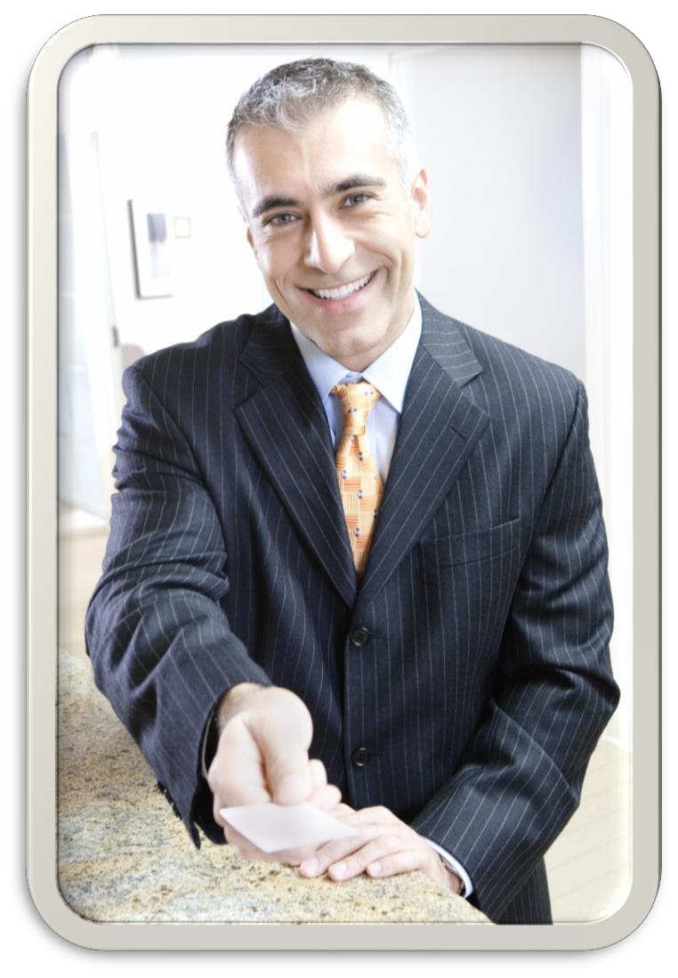
First Impressions
  last a lifetime
  are often the last impression
  may never get a second chance
Notes:
These are a few famous sayings from unknown sources. • The first impression lasts a lifetime. • The first impression is often the last impression. • You never get a second chance to make a first impression. • What do you think they mean? • Are they important for hoteliers? Why? • How do you think this relates to Guest Services? This is the opportunity to explain a “life lesson” to students; how first impressions make a huge impact, not only in the hotel industry, but in all businesses, AND as individuals in presenting themselves to others in any setting. Front Desk First Impressions American Hotel and Lodging Educational Institute The 25 greatest unprofessional Front Desk sins committed by hotel Front Desk associate (as compiled from a survey of front office managers). A scenario out of our award winning Front Desk First Impressions video. http://youtu.be/s3aR3yP4aKg

Slide 5
Reservations
  The main distinction between types of reservations is Transient versus Group
  The type of hotel will often determine the majority of the type of registrations a hotel makes
Notes:
Often the first contact, or first opportunity to make a good impression, is when the guest is placing a reservation for a stay at the hotel. Because of this, it is extremely important to have a good and friendly experience regardless of how the reservation is made, either by phone, internet, fax, email, or especially walk-in. One of the first points to remember is the main distinction between types of reservations - Transient versus Group. Transient simply means that the reservation is made by someone who is not a part of a group or tour. Transient reservations are made generally by the efforts of the front desk (phone reservations) or the internet and are made by individuals. Group reservations are sometimes made by a company requesting 50 rooms for example. The type of hotel will often determine the majority of the type of registrations a hotel makes. For example a budget hotel will most likely have transient reservations and a convention hotel will have group reservations for those traveling together or attending a function.

Slide 6

Registration
  Information gathering:
    Name, address and phone (email)
    Arrival and departure dates
    Room type
    Room rate
    Method of payment
    Special requests
Notes:
The main steps or procedures for registration are virtually the same regardless of where they originate: 1. Information gathering: Name, address and phone (sometimes email) Arrival and departure dates Number of guests and adults in room Room type Room rate Method of payment Special requests

Slide 7
Registration
  Information given:
    Confirmation number to guest
  Additional information recorded:
    Date reservation made
    Person or company making reservation
Notes:
2. Information given: Confirmation number to guest 3. Additional information recorded: Date reservation made Person or company making reservation

Slide 8

Rate Assignment
  Room Rate Factors
    Time of year
    Day of the week
    Room type
    Room location
    Amenities in the room
    Group rate
    Membership rate
    Discounts
Notes:
When guests are making their reservations, one of the things they expect to know is the rate they will be charged for a night’s stay. Room rates are determined by not only the costs for the hotel, but also on the expected demand. High demand can mean an increase in room rates. They will also vary based on many other factors: Ask the students to name examples for each basis of variation – answers should include those shown in parenthesis). •Time of year (high tourist season versus low tourist season) •Day of the week (weekday versus weekend) •Room type (single, double, suite, double suite, duplex, etc.) (Rooms for special needs are required by United States law based on the Americans with Disabilities Act •Room location (with/without views) •Amenities in the room (mini-refrigerator or mini-bar) •Group rate (airline staff, attending an event/convention, negotiated for multiple block of rooms such as for a wedding) •Membership rate (AAA or AARP) •Discounts (enlisted service men or women, travel agents, foreign dignitaries, frequent fliers) It is important not only for the property management system (PMS) to be update regarding rooms that are already reserved, but the reservation agents must also be informed and know about the various room types, locations, and amenities included in order to accommodate and satisfy guests’ needs and requests. Remind the students there will often be a combination of these factors.

Slide 9
Room Assignment
  Front desk check-in
    Locate reservation
      Confirm information
      Assign room in PMS
      Make key and hand to guest
  Self check-in
    Not common
    No personal contact
    Real-time updated systems
    Legal liability issues
Notes:
For most hotels room assignment begins with check-in. There are two types of check-in, front desk check-in and self check-in. Most guests arriving at a hotel want a fast check-in. Many have been traveling and want to get to their room to re-fresh or rest. Typically, guests will walk up to the front desk and present themselves. The front desk personnel will ask for their information such as name, contact information, room type and rate, departure date. Once the information, most hotels will have guests sign the registration card/paper as verification. The front desk agent will then assign the type of room requested (single, double). The actual assignment of the room must be done in the Property Management System (PMS). The PMS will have the status of the room as vacant and either ready for guest or “to be cleaned”. Rooms that are not in the “ready for guest” status should not be assigned. Room assignment may seem like an easy task, but it can sometimes be a complex matter. There are many issues that can alter the “ready status” of rooms. Some examples are: guests arrive early before rooms are ready, maintenance issues make rooms unavailable, single rooms have been cleaned but the guest requires a double or previous guests stay longer. Self check-in is not very common in the United States however, the technology exists to have a kiosk in the lobby for guests to walk up to, type in information, verify it, and have the system assign the requested room and issue a key. However, to date, there have been too many negative concerns for this to become a popular option. Some of the main concerns are: the lack of personal touch for the hospitality industry, the need for a system that updates in real-time and the training needed for staff to keep that system updated constantly, and, finally, there are huge legal concerns for any malfunctions or mistakes if the kiosk were to issue a room and keys for an already occupied room. Ask students “Why do most states require the guest to sign the registration card or registration paper print-out?” Answer: It establishes the relationship between hotel and guest. It is essentially a contract between the parties.

Slide 10
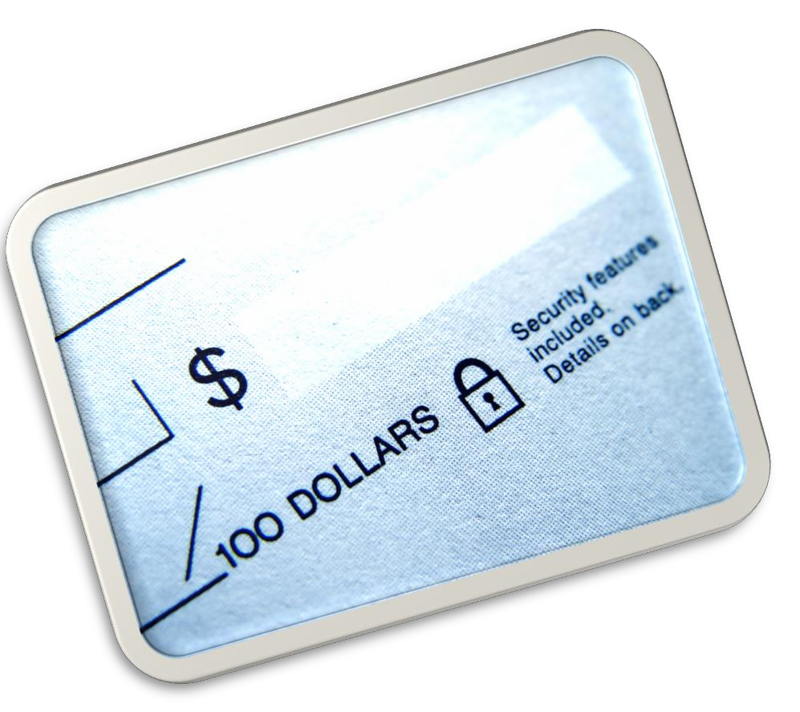
Methods of Payment
  Cash
  Check
    Personal
    Business
  Debit card
  Credit card
  Money order
  Vouchers
  Foreign currency/checks
Notes:
Today’s business and pleasure travelers typically use a credit card to pay for rooms. If other methods are used, such as cash, check, or debit card, the hotel will most likely ask for payment upon check-in. They will also ask for a deposit (refundable if not used) to pay for incidentals such as room movie rentals or phone calls. Cash paying guests are usually not allowed to charge anything to their room and if ordering room service, they must pay for it upon delivery. Credit cards have become the easy methods of payment because the hotel can verify the credit amount allowed on the card upon check-in with credit authorization services. For guests, the check-in, and check-out, becomes quicker and easier. In addition, other services can be simply charged to the room. It is also preferred with foreign travel as the credit card company will compute the exchange and neither hotel nor quest have to deal with exchange rates at time of check-in or check-out. Vouchers are not used often but are sometimes used for frequent traveler marketing programs such as “stay 3 nights and get a free night at your next stay”. Foreign currency and foreign checks present difficulty for most of your smaller hotels as the staff is not usually trained to handle this type of payment. However, the larger hotels and those who cater to foreigner travelers such as convention hotels will have trained the staff on the policies and procedures dealing with foreign exchange.

Slide 11
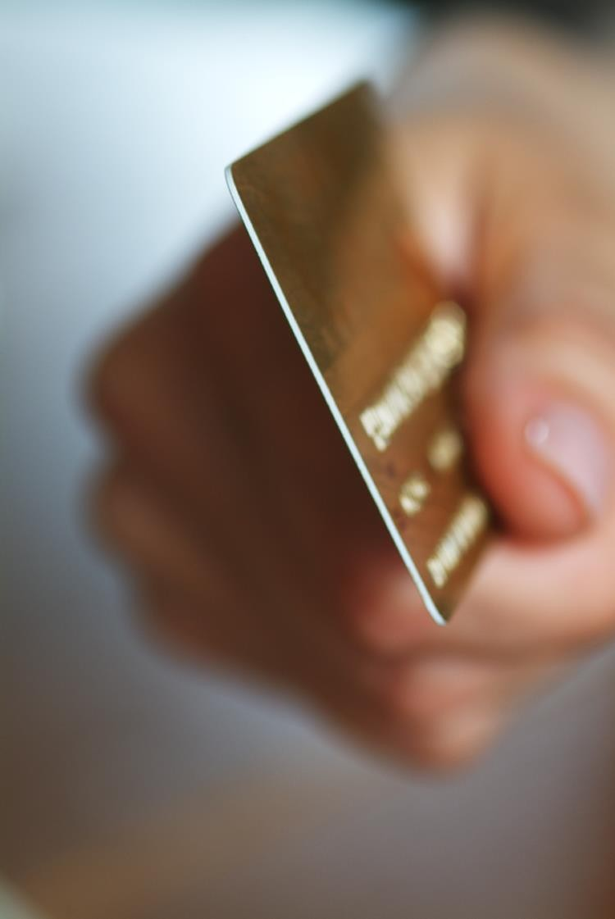
Check-out Procedures
  Presentation of bill
    Early morning copy
    Front desk copy
  Update folio for additional charges
  Final copy presented to guest
  Confirmation of folio
  Processing of payment
  Collect keys
  Update PMS to indicate vacant
Notes:
Also included in Guest Services is Check-out. Check-out procedures are relatively straightforward, especially if the form of payment has been confirmed and checked when the guest checked-in. As with check-in, there are two ways to check-out - by the front desk method and express check-out. Express check-out has become quite popular and does not present the same problems as with self check-in. Step one in the check-out process, regardless of the method used, is presenting the guest with the final bill. Most hotels these days will put a copy of the final bill under the door early in the morning of the departure date. This is for the convenience of the guest. If the guest is in agreement with the charges and no additional charges are made in the morning (room service), then the guest may elect the express method of check-out as long as the method of payment was confirmed during check-in. The guest can simply drop off the keys in the designated area such as a drop box near the front desk or drop them off at the front desk itself. If the guest chooses the front desk method of check-out, the bill presented under the door early in the morning gives the guest an opportunity to review the charges on his folio at his leisure in his room prior to actually checking out. This also speeds up the front desk check-out method. On the front desk check-out method, when the guest presents himself or herself at the front desk, the additional and personalized steps are as follows: • Greet the guest and ask if there were additional charges from that morning and then update the statement for those additional charges if necessary • Print a new a final copy and present the new copy to the guest • Have the guest confirm the charges on their statement • Ask for and process their payment – sometimes a guest will present a credit card at check-in but elect to pay the final bill with another method such as cash • Collect keys from the guest – thank them for staying and ask them for consideration of another stay when they are in town • Update Property Management System (PMS) to indicate their room as vacant The guest taking the time to check-out at the desk is another opportunity to make another good impression upon the guest. The front desk agent should always be polite, friendly, and helpful. Giving the guest a good last impression will often save the day if they have experienced any issues or had any concerns. The last impressions is the last opportunity the hotel has to generate repeat hotel guests and more revenue for the hotel.

Slide 12

Functions of Meeting/Event Planning
  Generate additional revenue for hotel
  Act as liaison between hotel departments and guest
    Banquet services (meals and refreshments)
    Audio visual and technology
    Reservations
    Meeting room bookings and layouts
  Negotiate and manage guest contract
  Negotiate and manage vendor relationships
  Create and manage event timeline and all details associated with event or meeting
Notes:
Meetings and events are a large part of some types of hotels and they can be a big source of additional revenue. Some hotels will recruit events to generate room bookings. Some of the larger hotels that have many events, meetings, and conventions will have meeting and event planners who specialize in coordinating the activities of events. They are responsible for everything, all details, and for making sure those events and meetings are kept running smoothly for the hotel. The meeting or event planner must be a very organized, detailed person who can manage timelines and meet deadlines. The planner must be a good communicator and work well with people as they must rely on other departments for the actual work. The high level functions of an event or meeting planner are: 1. Generate additional revenue for hotel 2. Act as liaison between hotel departments and guest Banquet services (meals and refreshments Audio visual and technology) Reservations Meeting room bookings and layouts 3. Negotiate and manage guest contract 4. Negotiate and manage vendor relationships 5. Create and manage event timeline and all details associated with event or meeting

Slide 13
Technology to Get the Job Done
  Old School
    Credit card verification system
    Check verification system
    Postage scales
    Time stamp machines
    Telephone systems – multiple line transfers
  New School
    Property Management Systems software and computer
      Tied to cash draw in most
    hotels
    Key card encoders
    TV On-demand
    Wi-Fi network connection
    Internet registrations from hotel site and third-parties
Notes:
As with most jobs today, we have technology to help us get the job done. The same goes with the hotel industry and specifically Guest Services. This is a list of some of the technology, both “old school” and “new school” or emerging technology that a hotel uses at the Front Desk to ensure that guests’ needs are met easily and efficiently. Choose a few of these on each side of the list and ask the students why or how the technology would be used. Examples of the third-parties mentioned on the right side are priceline.com, hotels.com, hotwire.com, booking.com, etc. For an added challenge, have the students brainstorm what other technology ideas they can think of that would assist Guest Services. Technology does not have to exist. Have students be creative.

Slide 14

Questions?

Slide 15
References/Resources
  Images
    Microsoft Office Clip Art: Used with permission from Microsoft.
  Textbook:
    Reynolds, J. S. (2010). Hospitality services: Food & lodging. Tinley Park, IL: Goodheart-Willcox Company.
    Hayes, David K., Ninemeier, Jack D., (2007) Hotel Operations Management. Second Edition. Upper Saddle River, New Jersey: Pearson Education, Inc.
  Websites:
    Hospitality School
    World’s Most Popular Free Hotel Management Training Blog
    www.hospitality-school.com
  YouTube™:
    Front Desk First Impressions
    American Hotel and Lodging Educational Institute
    The 25 greatest unprofessional Front Desk sins committed by hotel Front Desk associate (as compiled from a survey of front office managers).
    http://youtu.be/s3aR3yP4aKg

