Slide 1
Here, There, Everywhere:
The Geography of Travel

Slide 3
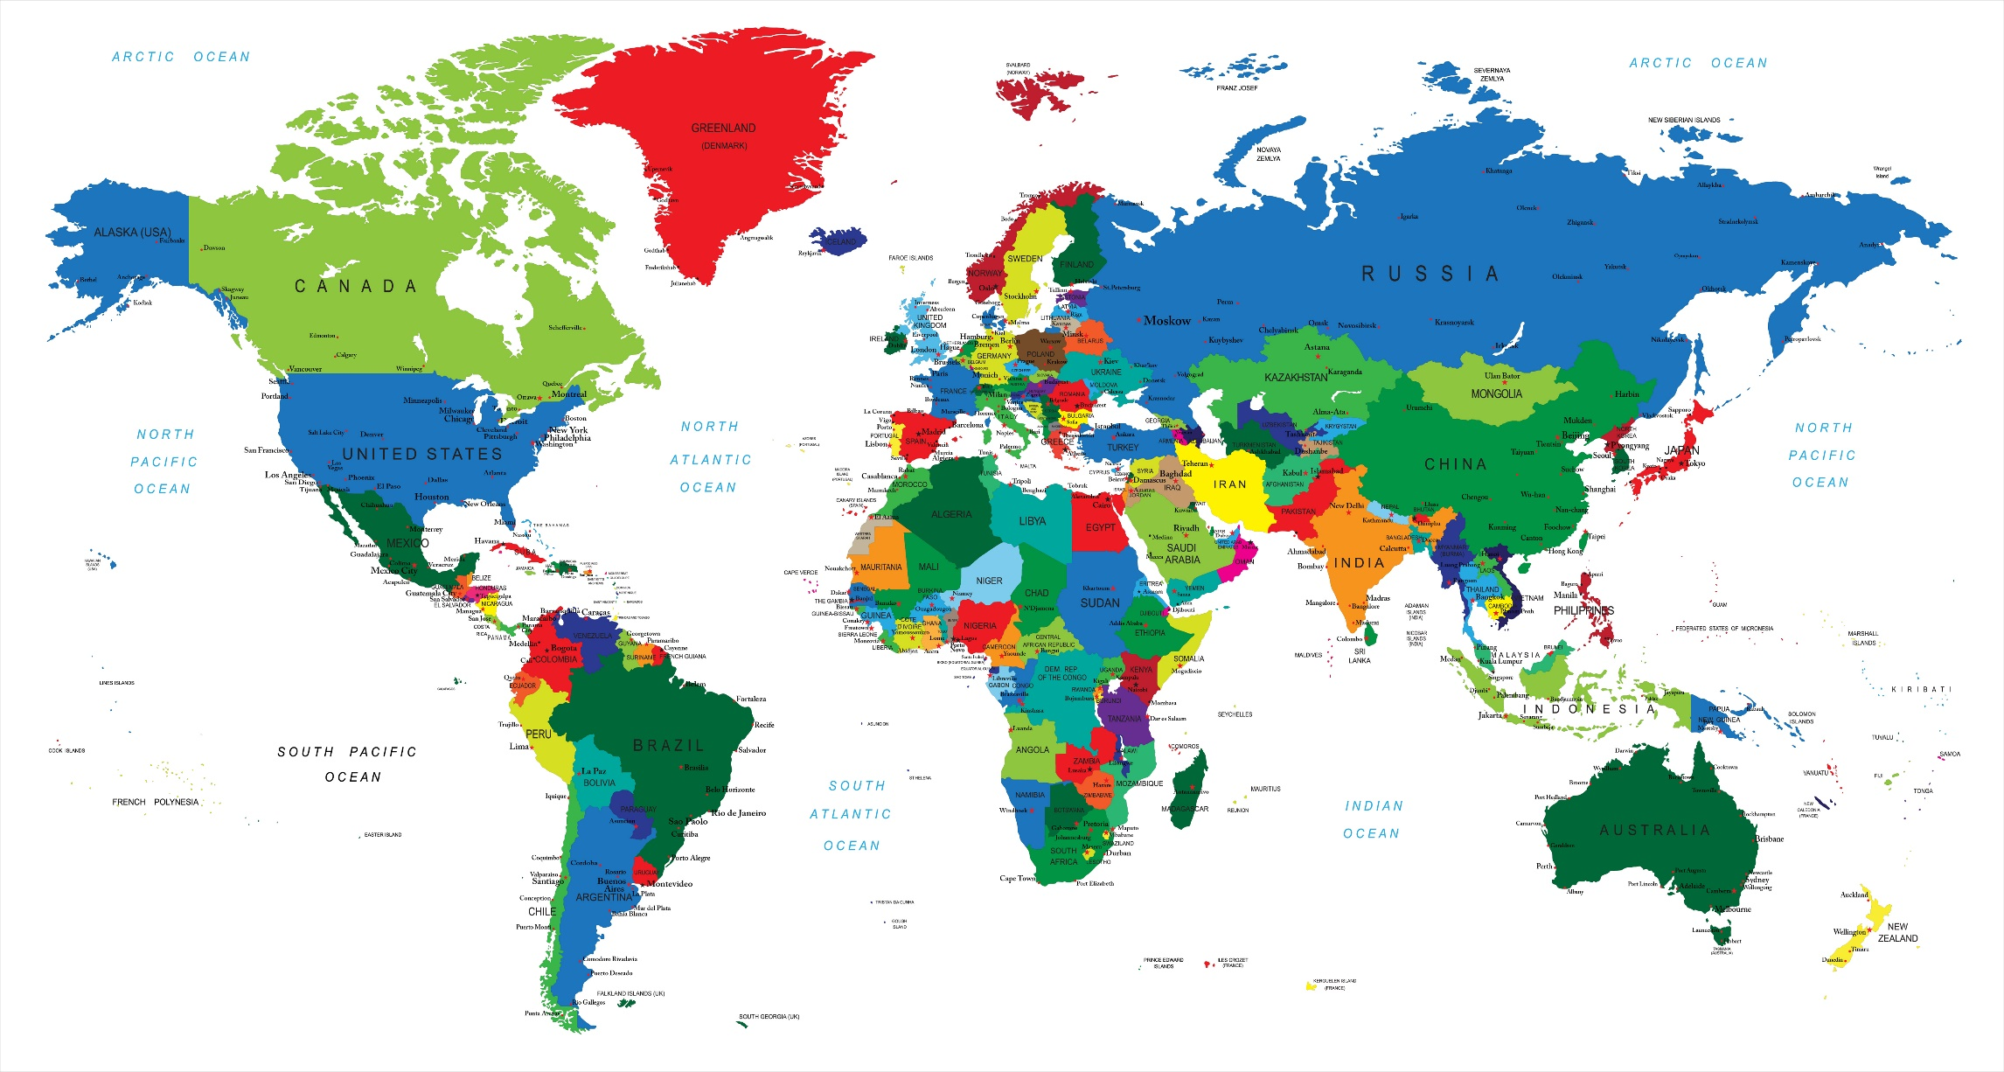
Geography – Places that bring travel alive!
Notes:
Geography - an area of study that deals with the location of countries, cities, rivers, mountains and lakes.
Working in the travel and tourism industry, it is important that you be familiar with travel destinations from around the world.

Slide 4
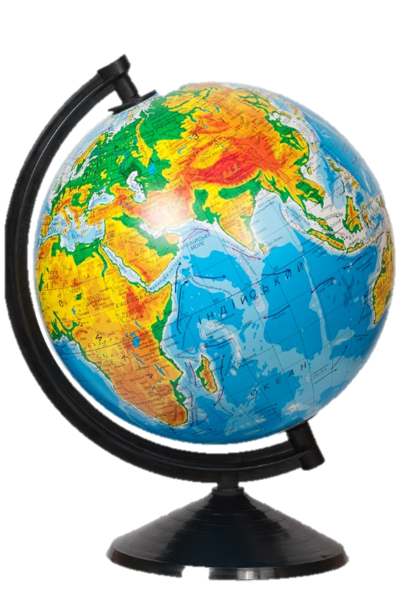
Earth
Equator
Hemispheres
    North
    South
Latitude lines
Longitude lines
Notes:
The best way to look at travel destinations is to look at a globe.
Flat maps distort the world map although we use them the most.
Keep the following basic information in mind when planning travel:
Equator - an imaginary line drawn around the earth equally distant from both poles, dividing the earth into northern and southern hemispheres and constituting the parallel of latitude 0°.
Hemispheres – a half of the earth, usually as divided into northern and southern halves by the equator, or into western and eastern halves by an imaginary line passing through the poles.
Latitude lines - the angular distance of a place north or south of the earth's equator, or of a celestial object north or south of the celestial equator, usually expressed in degrees and minutes.
Longitude lines - the angular distance of a place east or west of the meridian at Greenwich, England, or west of the standard meridian of a celestial object, usually expressed in degrees and minutes.

Slide 5
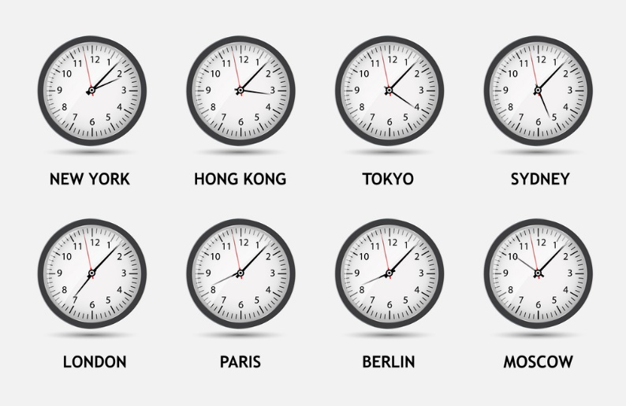
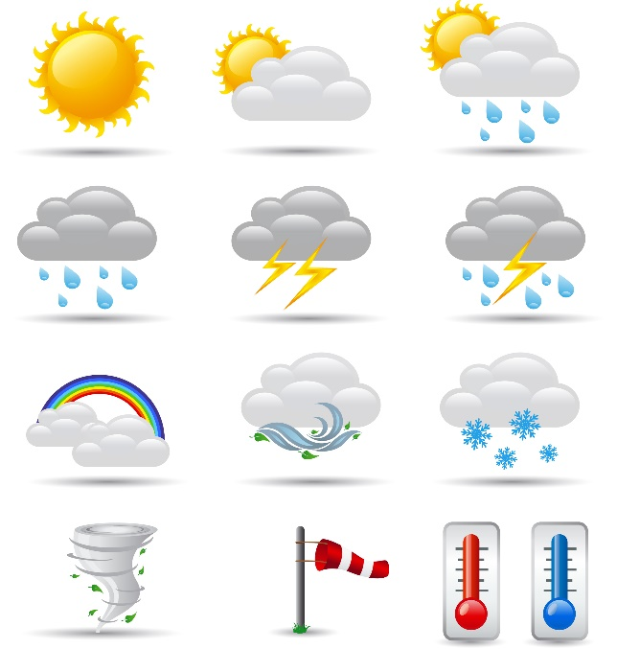
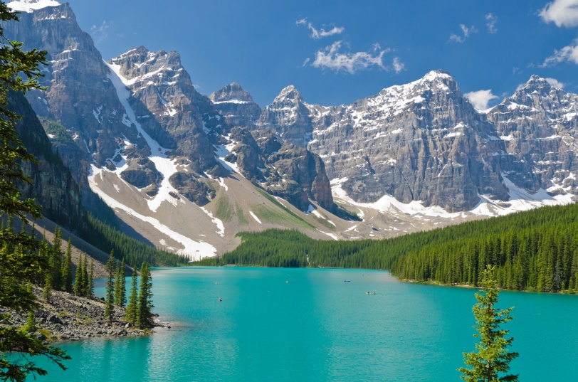
Elements that Affect Travel
Land
Time zones
Water
Weather
Notes:
There are many factors that affect travel.
These are just a few.

Slide 6
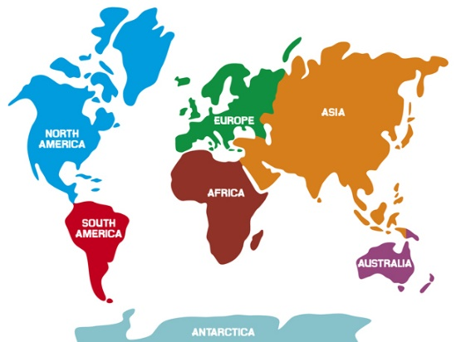
Land
Continents
  Africa
  Antarctica
  Asia
  Australia
  Europe
  North America
  South America
Islands
Mountains
  Alps
  Andes
  Himalaya
  Rockies
Peninsulas and capes
  Baja
  Florida
  Iberia
Notes:
Continents are the largest masses of land on earth.
Islands are land surrounded by water on all sides and are frequent destinations for vacation or pleasure travel. Hawaii and islands in the tropics are popular vacation destinations.
Mountains are high outcropping of rock and soil. The volcanic mountains are among some of the most impressive including Hawaii’s Kilauea. The Kilauea has been erupting continuously for over 20 years.
Peninsulas and capes are projections of land into water and have water on three sides of the projection.
Capes are smaller projections and an example is Cape Cod in Massachusetts.

Slide 7
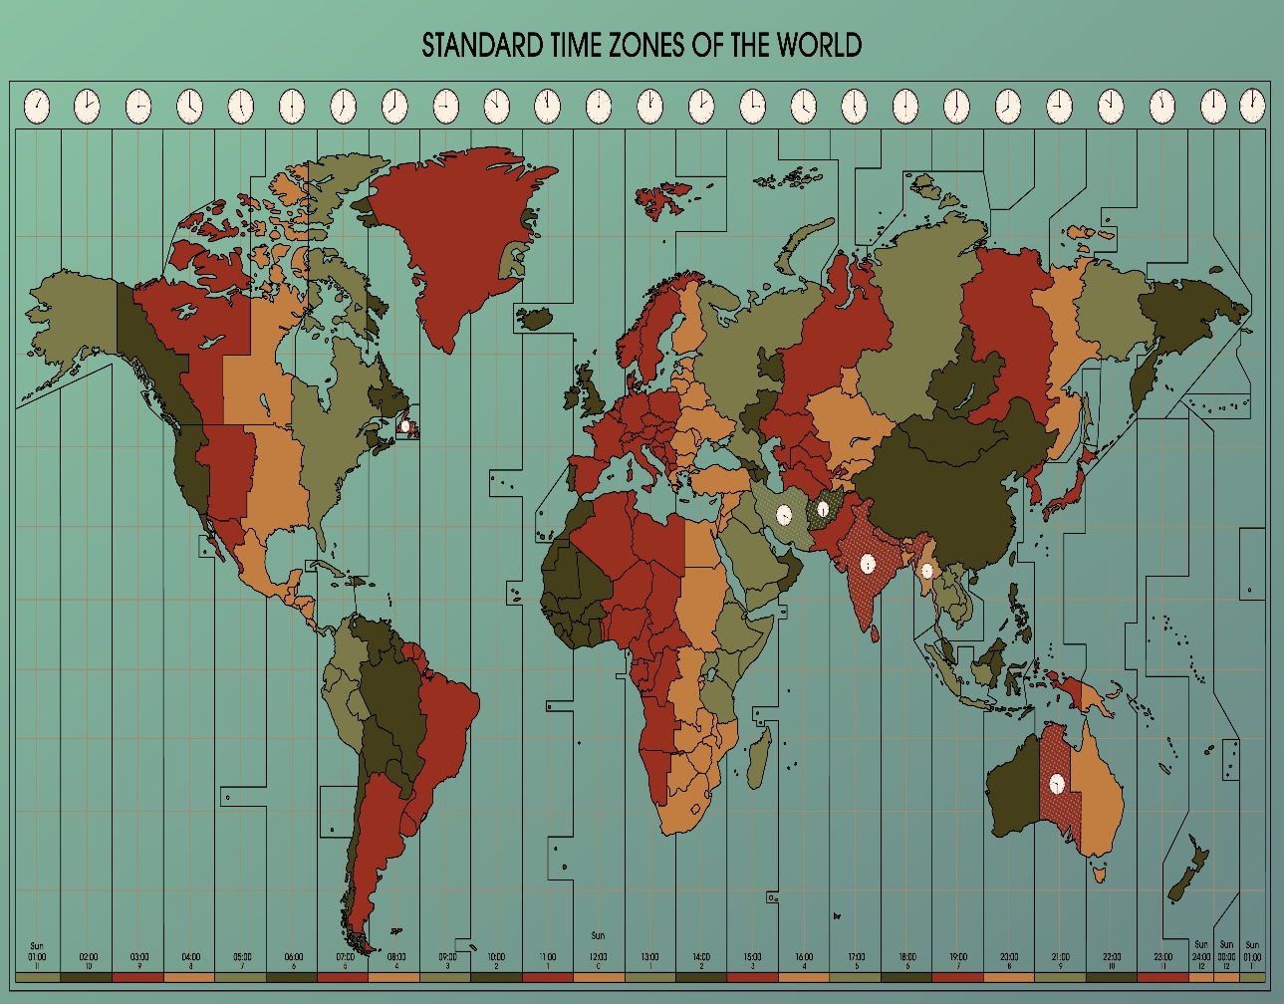
Time Zones
24 time zones
    Parallel longitude lines
International Date Line
Notes:
The world is divided into 24 time zones and will tend to parallel longitude lines.
International date line is an imaginary line that goes north and south through the Pacific Ocean, one day is on the east side of the line and the following day is on the west side.
Ask students to identify the time zones on a globe or map.

Slide 8

Water
60% + of the earth is covered in water
Bodies of water include:
    Gulfs
    Lakes
    Oceans
    Rivers
    Seas
Notes:
More than 60% of the earth is covered in water.
Gulfs – large areas of water that penetrate into land such as the Gulf of Mexico and usually open onto a sea or ocean.
Lakes – smaller than gulfs and seas, usually have fresh water and are usually surrounded by land.
Oceans – largest bodies of water all interconnected
four oceans:
Atlantic
Artic
Indian
Pacific
Rivers – large streams of water that empty into other bodies of water.
Seas – next to the largest, usually salty and open to or sometimes a part of an ocean.

Slide 9
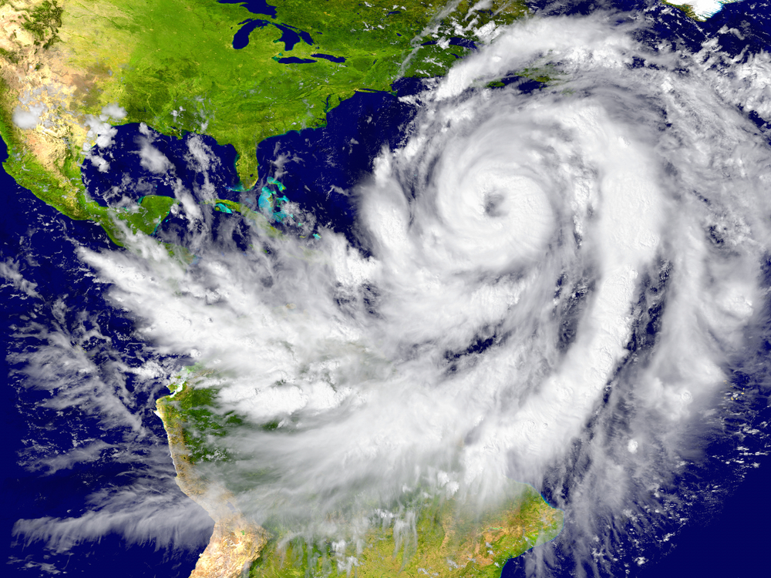
Weather
In general, unpredictable
Predictable:
  Hurricanes
  Temperate zones
  Tropical zones
Notes:
Certain wind patterns are quite predictable and can affect travel.
Hurricanes – storms with winds 74+ miles per hour. 80% occur from August through October and affect travel in Florida, the Caribbean, the Gulf of Mexico and Southeast Asia.
Temperature zones – areas between the Arctic or Antarctic circles and the Tropics – winds blow west to east.
Tropical zones – regions between approximately 23 degrees north of the equator and 23 degrees south of the equator – wind blow from east to west. Most resorts are located in this area.

Slide 10
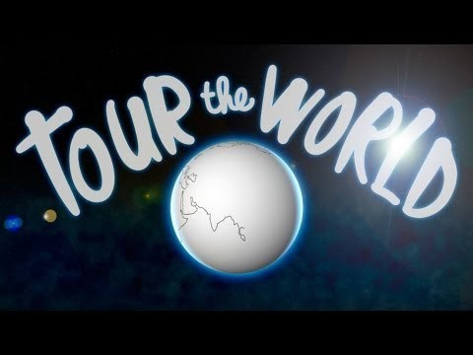
Tour the World
(click on link)
Notes:
Click on hyperlink to view video.
Tour the World - Official Music Video
Tour the World" is track #1 from Brain Beats 2 - the mnemonic CD that features 13 brilliantly catchy songs to help you remember things you've always wanted to learn, but couldn't.
https://youtu.be/LZFF8EuaGjM

Slide 11

Notes:
What does this quote mean to you?

Slide 12
Let’s Review!
What is geography?
What is the best way to look at travel destinations?
Can you identify the equator, hemispheres and latitude and longitude lines on a globe?
What are some elements that can effect travel?
Name the seven continents.
How many time zones do we have?
How much of the earth is covered in water?
Is weather predictable?
Notes:
Answers to the questions are found within the slide presentation or may vary with class discussion.

Slide 13
References and Resources
Images:
Shutterstock™ images. Photos obtained with subscription. (Slides 3, 4, 5, 6, 7, 8, 9, 11, 13)
Textbooks:
Mancini, M. (2013). Access: Introduction to travel and tourism. Clifton Park, NY. Cengage Learning.
Reynolds, J. S. & Chase, D. M. (2014). Hospitality services. Tinley-Park, Illinois: The Goodheart-Willcox Company.
YouTube™:
Tour the World - Official Music Video
Tour the World" is track #1 from Brain Beats 2 - the mnemonic CD that features 13 brilliantly catchy songs to help you remember things you've always wanted to learn, but couldn't.
https://youtu.be/LZFF8EuaGjM

