Slide 1
HOTEL MANAGEMENT AND OWNERSHIP

Slide 3
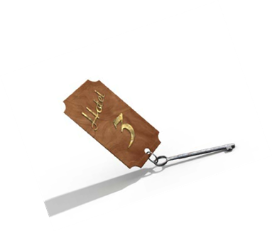
Hotel Management
  Management and ownership are not the same thing.
  Hotel Management is the day-to-day running of the hotel (also called hotel operation).
  One person (or company) can own the hotel, and another person (or company) can manage it.
  The owner can buy the hotel as an investment but not know anything about running a hotel.
  A hotel management company will be hired to manage the hotel.
  It is often difficult to know who actually owns the hotel.

Slide 4

MANAGEMENT CONTRACT
  Management companies operate properties owned by other entities.
  Owner retains the financial and legal responsibility for the property.
  Management company operates the hotel, pays hotel expenses and receives an agreed upon fee.
  After operating expenses and fees have been paid, remaining profit goes to the owner.
  Owner then pays debt, insurance, taxes etc.

Slide 5
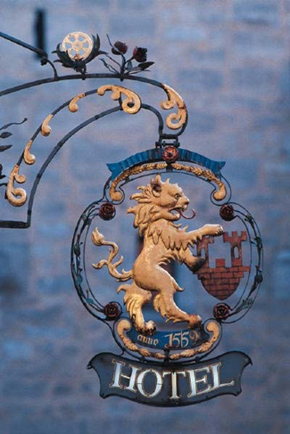
Hotel Management
  Example A:
    Investor (with not hotel experience) builds and owns a hotel.
    Investor hires Hilton Management company to manage the hotel.
    Hotel has Hilton name and must follow Hilton standards.
  Example B:
    Investor (with no hotel experience) buys a Hilton franchise.
    Hotel management company hired to manage the hotel for the investor.
    Hotel has Hilton name and must follow Hilton standards.

Slide 6

  Two basic structures of ownership
    1. Independent Hotel.
    2. Chain Hotel.
      Many chain hotels tend to be a mixture of several types of ownership
        Management Contracts.
        Franchises.
        Referral Groups.

Slide 7

INDEPENDENT HOTEL
  Single-unit business not connected with any other business.
  Examples: Family-owned-and-operated hotels and B&Bs.
  Usually one owner (proprietorship, partnership or corporation).

Slide 8

INDEPENDENT HOTEL
  Advantages
    Autonomy (policies, procedures, marketing and financial obligations).
    Marketing tailored to specific populations/locations.
    Flexibility in management.
    Easy adaptation to changing market conditions.

Slide 9
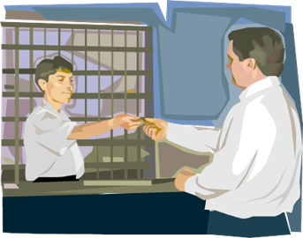
INDEPENDENTHOTEL
  DISADVANTAGES
    More money spent on national advertising.
    No volume purchasing power.
    Travelers prefer to stay with brands they recognize.

Slide 10

CHAIN HOTEL
  Multiple-unit businesses that have the same brand name and possibly the same ownership (proprietorship, partnership or corporation).
  Chain hotels may be:
    Management contract.
    Franchise.
    Referral group.

Slide 11

CHAIN HOTEL
  Advantages
    Brand name; strong brand identity.
    Owner develops brand identity through advertising, public relations & promotions.
    Brand loyalty.
    Frequent guest program.
    Supplies purchased in large quantity.
    Centralized & specialized services (training, site selection & information systems).
    Central Reservations Center.

Slide 12
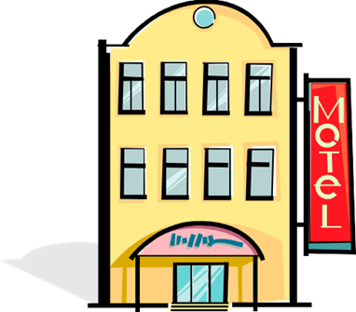
CHAIN HOTEL
  DISADVANTAGES
    Strong control over individual properties (minimum standards, rules, policies and procedures).
    Less flexibility in management procedures.

Slide 13
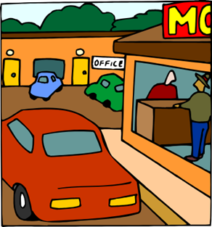
FRANCHISE HOTEL
  A unit of a chain that has been purchased by an outside owner (franchisee).
  The outside owner runs the franchise in the way required by the chain owner (franchisor).
  Established standards for design, décor, equipment and operating procedures.

Slide 14

FRANCHISE HOTEL
  ADVANTAGES
    Strong brand name.
    Travelers prefer to stay with brands they recognize.
    Consistent established product and level of service.
    National or international central reservation system.
    National advertising.
    Management training programs.
    Advanced technology.
    Central purchasing.
    Architectural, construction and interior design consulting.

Slide 15

FRANCHISE HOTEL
  DISADVANTAGES
    Strong control over individual properties (minimum standards, rules, policies and procedures).
    Less flexibility in management procedures.
    Must pay a fee to franchisor.

Slide 16
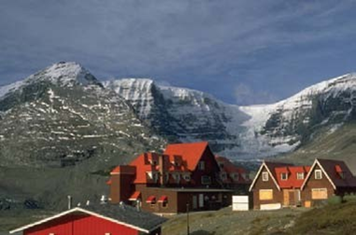
REFERRAL GROUPS
  Advantages
    Independent hotels that have banded together for a common purpose.
    Hotels are not replicas but offer consistency in level of service.
    Hotels within the group refer guests to other affiliated properties.
    Offer central purchasing services (interior furnishings, bath amenities, linen and towels, and restaurant items).

Slide 17

REFERRAL GROUPS
  Disadvantages
    Members must maintain certain operating standards.
    Limited control over members on agreed upon items.
    A member can leave if it becomes dissatisfied.
    The group can ask a member to leave if the member doesn’t meet the requirements or pay dues.
    http://youtu.be/3ioXSUGsHlo
    Cool Careers: Hotel Manager

Slide 18
References/Resources
  Textbooks:
    Reynolds, Johnny Sue. Hospitality Services Food & Lodging. Second. Tinley Park: The Goodheart- Willcox Company, Inc., 2010. Print.
    Lodging Management Program Year One. AHLA Educational Institute
  Websites:
    20 Questions before starting a Business
    Many people dream of having their own business. To see if starting a business is right for you, ask yourself these important 20 questions
    http://www.sba.gov/content/20-questions-before-starting-business
    Is Entrepreneurship for You?

Slide 19
References/Resources
    Becoming a successful entrepreneur requires sound planning, creativity and hard work. http://www.sba.gov/content/entrepreneurship-you
    Master in Management
    Management consists of planning, organizing, staffing, leading or directing, and controlling an organization for achieving a goal and a person handle the entire organization is known to be as a Manager.
    http://www.mastersinmanagement.org/10-famous-managers-who-changed-the-world.html
    Top Hotel Owners & Operators
    A list of ownership and development companies and third-party management companies who focus on the lodging industry.
    http://lhonline.com/hotel-development-resources/top-hotel-owners-operators/

