Slide 1
Hotel Marketing and Communication
The Cornerstones

Slide 3
Marketing Basics
  Marketing Concept
    the idea that businesses must satisfy customer needs and wants in order to make a profit
  Marketing
    the creation, management, and selling of products
Notes:
Imagine that you opened a large resort hotel in a small town in the middle of the desert with no attractions in the area. A few people actually found your hotel and liked it. However, most people do not know your hotel even exists and you eventually go out of business because you have very few guests. The problem is that you have a product that no one wants or needs or even knows about.
Marketing has 4 main functions:
1. learning what customers want or need
2. developing products that meet those wants and needs
3. making sure people know about the product
4. persuading customers to buy the product
The concept is that if a business wants to make a profit, it must satisfy customer’s needs and wants. Identifying and understanding your customer are the first essential steps to a successful business and the first steps in marketing.

Slide 4
Products
  Goods:
    Tangible, hold or touch
    examples: T-shirts, furniture
  Services:
    Intangible, can’t touch
    examples: spa, miniature golf
Notes:
Before we go any further, let’s first understand how to identify a “product”. For our purposes, a product is something which has monetary value and will satisfy customers’ needs and wants.
Products fit into two categories:
- Goods – tangible items you can hold or touch. Examples are clothing, desks, lamps, pens, computers, cell phones, shoes, food, towels, robes, teddy bears, and even toothpaste.
- Services – intangible items, or something that cannot be touched. Examples are miniature golf, a massage or facial, going to the movie theater, and insurance.

Slide 5
Marketing Process
Identify the customer
Determine customer’s wants
Make the right product…
…at the right place…
…at the right price
Communicate to the customer
Market Segmentation
The Marketing Mix
(4 P’s of Marketing)
Target Marketing
Product Management
Place (Distribution)
Price Management
Promotion
Notes:
Over the next week we will be looking at one of the main processes that help make a business successful.
The Marketing Process can be divided into six steps:
- identifying the customer through market segmentation
- determining the target customer’s wants and needs
- developing or obtaining products that will satisfy those needs and wants through product management
- making that product available at the time and place a customer wants or needs it – this step is called “Place” or also called distribution
- charging a price for the product that the target customer is able and willing to afford
- then communicating or promoting your product to the target customer to increase sales
These last four steps are combined and knows as the Marketing Mix or the 4 P’s of Marketing – Product, Price, Place and Promotion. It is these 4 that are used in various combinations or strategies to meeting the customer’s needs and wants.
Let’s break each of these steps down and look at the details.

Slide 6

Identifying the Customer
  Market – All potential customers
    share common needs and wants
    have the ability and willingness to buy
  Marketers can conduct research to identify a target market
  Identifying a target market is achieved through market segmentation
  The strength of a marketing mix depends on two things:
    How well the target market is defined
    How well all marketing decisions are directed toward that target market
Notes:
As we discussed before, marketing begins with identifying your customer. Market segmentation is a way of analyzing a market by its characteristics. A market is defined as all potential people who share needs and wants, AND have the ability and willingness to buy a product (that will meet those common needs and wants). For example, all travelers need a place to stay overnight if traveling a distance away from their home. If those travelers have the ability or a means of paying and the willingness to pay or not staying with friends or relatives, then a lodging market is created.
Satisfying the needs and wants of all of those travelers would be difficult without further defining or dividing up this market. All of those travelers do not want to stay or can afford to stay at the same type of hotel. This dividing of the market is called market segmentation. A market is segmented based on several different characteristics. Examples of those characteristics are:
- income – hotel type (luxury, limited service, resort, Bed and Breakfast)
- who is traveling – individual or family size or a group of people traveling together
- type of travel – vacation, business, convention
- location – resort versus city
- age
Once the market is divided, a business will select the segment it will target. A target market is a very select group at in which all marketing decisions or all of the 4 P’s are directed.
Of course, anyone can stay anywhere, but the strength of your business and marketing is dependent on how well you identify your target and direct all your efforts to persuade them to purchase.

Slide 7

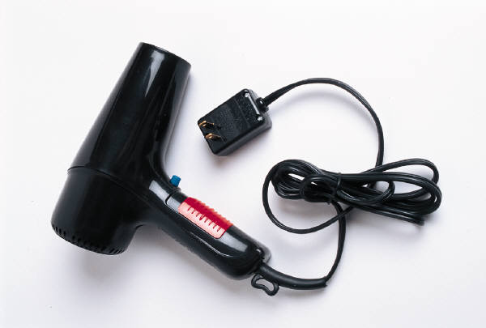
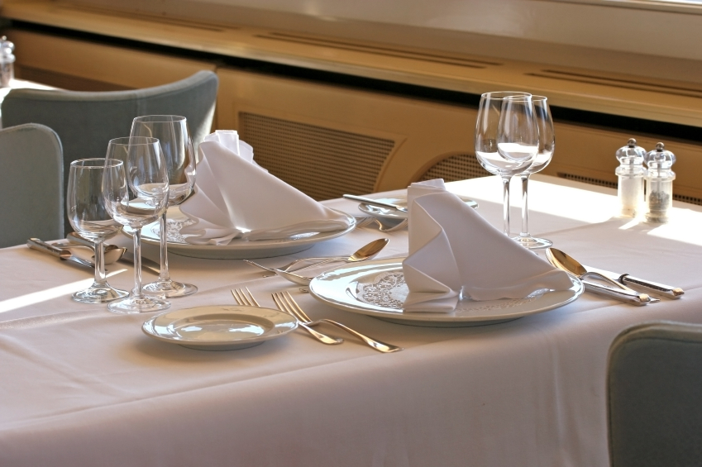
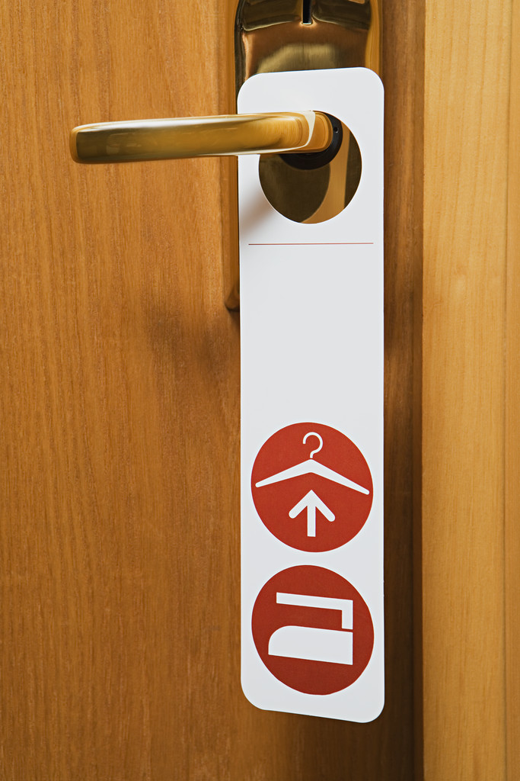

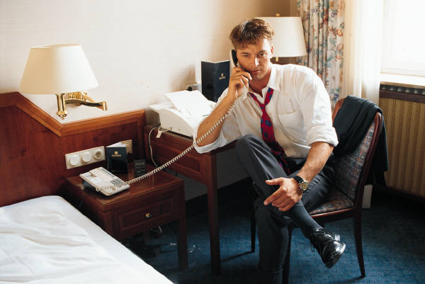
Determine What the Customer Wants
  Wants are determined by segmentation and research
Notes:
Once you have determined your target market, the better you can determine their specific needs through research and surveys of people that fit in your target definition. The needs and wants are different for each market segment.
For example, the needs of a middle income family of four traveling on vacation are very different from that of a target market of an individual business man traveling to a convention. One segment will need easy access to the convention and possibly the airport and someplace with access to business amenities such as fax and internet connections. Another segment might want to be near attractions and most likely want amenities such as a pool.

Slide 8
Marketing Mix
Marketing Mix
Product
Place
(Distribution)
Price
Promotion
Notes:
The combination of four basic marketing strategies is called the Marketing Mix. Collectively they are known as the 4 P’s of Marketing. Product, Price, Place (or distribution), and Promotion. These strategies comprise the marketing decisions a business must make. These decisions are driven around the target market and what those targeted customers need or want. These strategies are interconnected and do not stand alone.
Let’s talk through an example. First we must know the target market. The target market for a large hotel located near a world famous amusement park is a family with children. The Product choice must center around a family and their needs and wants, keeping in mind that most of our guest will be visiting the amusement park. Our hotel should have a family friendly restaurant, a pool, perhaps refrigerators in each room. We would need transportation to and from the amusement park are regular intervals and maybe transportation to and from the nearest airport.
Our Price should reflect how much our customers are willing and able to pay but we also must price our product (or night’s stay) in alignment with our direct competitors, which will be the other hotels in the immediate area that have similar amenities as we do. We could partner with the amusement park to offer bundled pricing to include park tickets and meals with the price of the hotel stay. The bundled price would be more convenient and less expensive for the guests and might attract customers to our hotel.
The Place or distribution is the location of our hotel. The closer our place is to the amusement park and other attractions, the better off we are as long as the noise from the park will not disturb our guests.
Promotion is about how potential customers find out or hear about our hotel. How would you choose to promote the hotel in our example? A website showing the hotel, its rooms and proximity to the amusement park is a start. How about social websites as well? Perhaps billboards on the outskirts of our city to attract customers as they drive into town, or posters in the nearest airport. Magazine ads might work and TV commercials if our pockets are deep enough as they are the most expensive kind of advertising.
Let’s take a more detailed look at each of the four P’s.

Slide 9
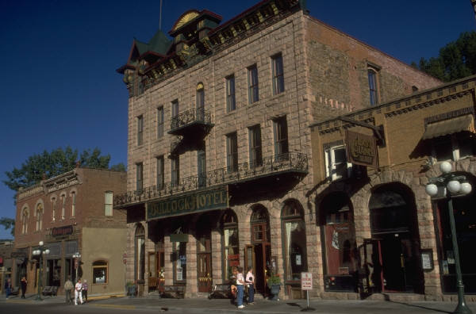
Make the Right Product…
  Obtaining
  Developing
  Maintaining
  Improving
Notes:
The definition for a product is obtaining, developing, maintaining, and improving a product in response to market opportunities.
Products can be obtained for example, an existing hotel can be purchased.
But once it exists, the product, the hotel, must be maintained. In other words, the owners and managers must continually ask themselves, “Does the hotel still meet the needs of our target market?”
The needs and wants of the target market will change over time and the product must keep in alignment with those changes. A long range plan of improvement should be in place as the hotel industry and technology changes as well.

Slide 10
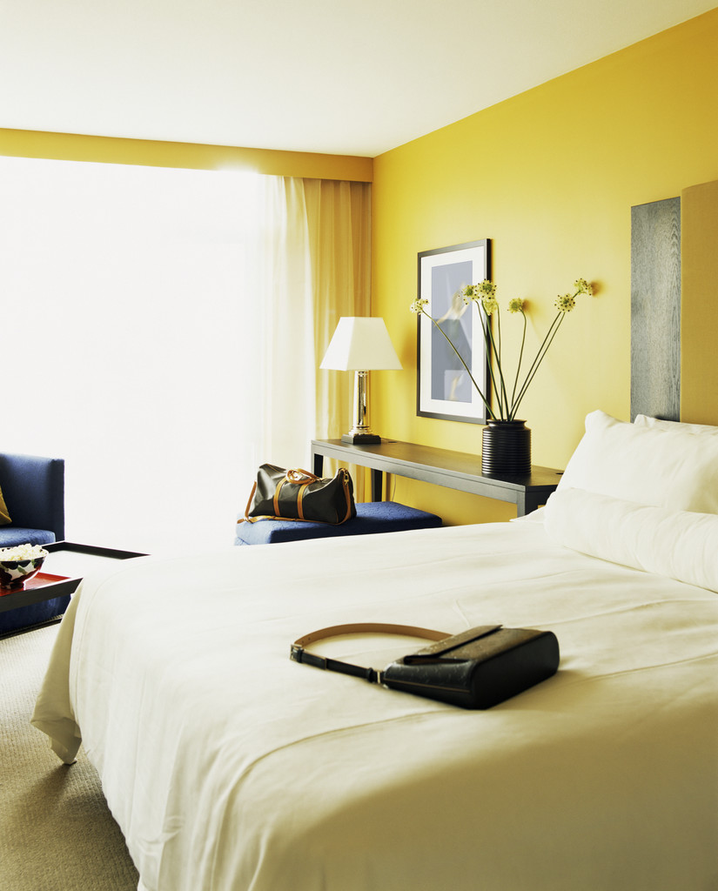
Product Strategies
  Amenities
  Benefits
  Branding
  Features
  Image
  Packaging
  Services
Notes:
Also included in the product strategy are decisions about brand and image.
When you think of a hotel that is known to most people, you will most likely think about an image. Some brand and images will be for high quality and high price; other brands will be thought of as limited service but more affordable.
Other product strategy decisions are packing, amenities, and services.

Slide 11
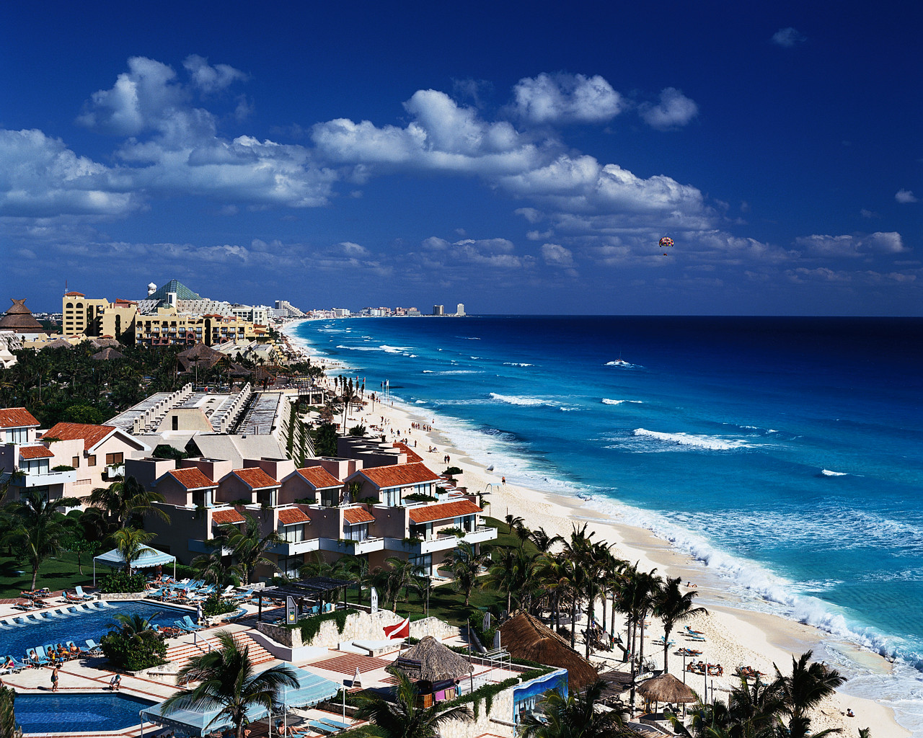
…at the Right Place
  Location, location, location!
Notes:
The first 3 rules of marketing!
Where a product will be sold.
Goods - Path from manufacturing to the end user
Many marketers, especially in the hotel and even restaurant industries, consider location to be THE key factor in determining if a hotel will be successful. Of course, there are many factors to be considered to be successful; but if a hotel is located where people don’t want to travel or don’t want to stay, then other factors simply don’t matter. In the hotel industry, this means you must be in a location where people want to travel.
Place, or distribution, is the decision of where a product will be sold.
For goods, distribution also includes path it takes to get from manufacturing to the end user as well the logistics or transportation to get it there such as by air, truck, ship, railroad or pipeline.

Slide 12
…at the Right Price
  Complex decision
  Non-price
  Revenue Management Software
  Strategies include:
    based on demand
    competitors
    image
Notes:
Pricing for the hotel industry is complex. When top management sets pricing, they are considering several factors.
The image you are trying to portray to the public is important to maintain the perception of quality.
Demand is also a factor because hotels have seasons. Prices will be set higher during the “on season” or when demand is high, and prices will be set lower during the “off season” to try and attract more guests.
We can’t forget the competition when it comes to prices.
Competitors watch each other’s businesses very closely. If two hotels are similar and are located relatively close to each other, pricing may be the deciding factor when a guest chooses which one to stay in. If one hotel lowers its price, other similar hotels in the area may follow. This is the reason hotels will use a strategy called non-price competition; they will offer amenities or services to differentiate themselves rather than compete on price. They will try to set themselves apart by offering things that are not based on price and services that other hotels don’t have, such as better service, spa products, better restaurants, and transportation services.
As you can see, pricing is a very complex decision and changes often. Many hotels will use revenue management software to assist in pricing decisions.

Slide 13
Communicate to the Customer
Advertising
print
broadcast
Sales Promotion
- coupons, rebates, discounts
frequent buyers program
Advertising
Sales Promotion
Interactive
website
social media
Interactive
Public Relations
- press releases/kits
- media relationships
Public Relations
Personal Selling
suggestive and group
telecommunication
Personal Selling
Notes:
The last step in our marketing process is call promotion. Promotion is communication with the customer. Promotion involves informing, persuading and reminding customers about products. There are 2 main types of communication used in promotion; personal and non-personal communication.
Personal communication is two or more people communicating directly, either in person or through telecommunication. Telecommunication is defined as communication through transmission such as through a telephone, cell phone, or internet. Non-personal communication is a message conveyed through mass media. Mass media includes radio, television, websites, newspapers, magazines, fliers, brochures, and billboards.
NOTE TO TEACHER: According to most textbooks, there are only 4 types of promotion; advertising, sales promotion, public relations, and personal selling. A fifth type has been pulled out and focused on because it has become increasingly important to the hotel industry through sites such as Facebook®, Twitter®, Priceline®, Expedia®, Hotwire® and Hotel.com®, and others.
There are 5 types of promotion:
- Advertising which is further divided into broadcast (radio and television) and print. There are many types of print advertising such as magazines, newspapers, fliers, signs on transit such as buses and taxis, brochures, and more.
- Sales promotion is anything that does not fit into the other four categories that also stimulates sales such as coupons, discounts, frequent buyer programs (loyalty marketing), trade shows, premiums (pens, pencils, key chains), and sponsorships.
- Public relations is any activity that is meant to create a favorable image for a business, its products, or its image. A common duty for the public relations department are the press releases and press kits. They are also responsible for building and maintaining relationships with media representatives. They are also the driving force for company sponsored activities such as charity events, scholarship programs, and cultural activities.
- Personal selling is any form of direct contact between a buyer and seller. For a hotel, this can be through suggestion selling sometimes called “upselling” (do you want fries with that?) or group sales through a sales department. Personal contact over a phone or even over the internet, through email, and even texting is also considered personal selling.
- The fifth type of promotion, interactive, is not considered by some experts as a separate type of promotion but is being considered here as a fifth because of its significant growth in the past several years in the hotel industry. Partnerships have been built between web companies and hotels to sell unoccupied rooms at discounted rates is a popular promotion for many travelers. The promotion of hotels through social media web sites is also growing at a rapid pace.

Slide 14
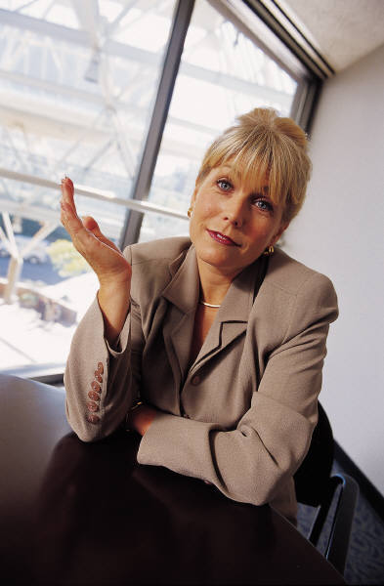

Communication
  Beyond Promotion to direct communication
  Verbal
    face-to-face
    telephone
  Non-verbal
    body language
    facial expressions
    writing – letters, email, text
  Interpreting cues
Notes:
Let’s take communication a step further.
Let’s go beyond typical promotion and talk about communicating directly to the customer.
There are two ways to look at direct communication with customers, verbal and non-verbal.
Most often the first communication with a customer is through the telephone.
First impressions about a hotel are made with one voice. This makes telephone skills extremely important. Tone of voice (upbeat and pleasant), consistent service quality, and clear pronunciation are important skills. Telephone skills are important throughout a hotel, not just the front desk. Can you think of others that need telephone skills? (Answers should include banquet managers, housekeeping, transportation services, or anyone that could have telephone contact with a guest before, during or after their stay.
While guests are staying at a hotel, there are many face-to-face contacts or communications with guests.
The concierge and front desk answers questions, housekeeping cleans rooms or delivers extra towels, room service delivers food, restaurant and lounge wait staff wait on guests, transportation services take and pick up guests, spa services make you feel relaxed, and gift shop associates wait on guests. Virtually everyone in the hotel communicates face-to-face with guests at one time or another and therefore must be trained on communication techniques and skills. They must realize communication is not only the words that are spoken, but communication takes place non-verbally as well. We communicate feelings and thoughts with body language, facial expression, hand gestures, and through eye contact. Cues are taken by guests as well as co-workers and true feelings are sometimes revealed non-verbally.
The written word is also a form of non-verbal communication.
Most people know that written communications for advertising, brochures, and magazines is done professionally, but emailing, online chatting, writing a blog for a hotel, maintaining a social website are all means of communicating through writing. This type of writing is not always done professionally, anyone can write on some of the social websites and not only will guests see it, but also co-workers and suppliers. The written word can be very dangerous and hurtful in today’s interconnected world. Words should always be chosen carefully whether written or spoken.

Slide 15
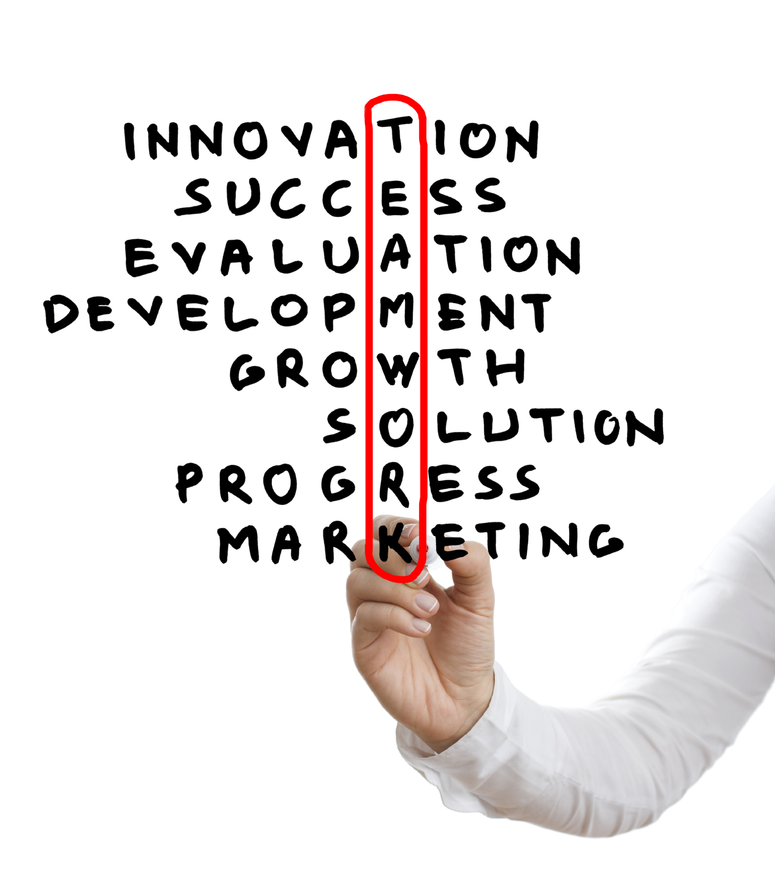
The Marketing Plan
  Marketing goals
  How to achieve the goals
    Strategies
    4 P interaction
  Competitor analysis
Notes:
Putting it all together. Most companies have a plan for communicating with the customers and marketing their business. The more successful ones have it formally documented and use it as a live document called a Marketing Plan.
A Marketing Plan is a document that contains the marketing goals for the business and describes the strategies and tactics of the interaction of the marketing mix or the interaction of the product, price, place, and promotion. Management creates this plan with the use of market research and sales data.
A good marketing plan also includes a thorough analysis of the competition and external factors that might influence a hotel’s success such as the economy or government regulations. In some locations, weather may also be a threat.
Following and maintaining the plan as a live document helps the company accomplish its goals through the analysis and overlapping of the strategies as they are executed.

Slide 16
Questions?

Slide 17
References and Resources
  Images:
    Microsoft Office Clip Art: Used with permission from Microsoft.
  Textbooks:
    Farese, Kimbrell, Woloszyk, (2002) Marketing Essentials, Woodland Hills, California: Glencoe McGraw-Hill, Inc.
    Reynolds, Johnny Sue. (2010) Hospitality Services Food & Lodging. Second. Tinley Park, Illinois: The Goodheart-Willcox Company, Inc.

