Slide 1
Hotel Technology Tools
Hotel Management

Slide 3

Hotel Technology
  Technology is everywhere today
  The larger the property, the more important and complex the technology
Notes:
No matter where we go or where we look, technology is everywhere today. It makes us more efficient and able to do more in less time.
It is the same inside the hotel industry.
Technology has increased significantly in the last 10 years and continues at an exponential rate.
No matter what size of a lodging property, there will be technology.
The larger the property the more important and complex that technology will need to be.

Slide 4
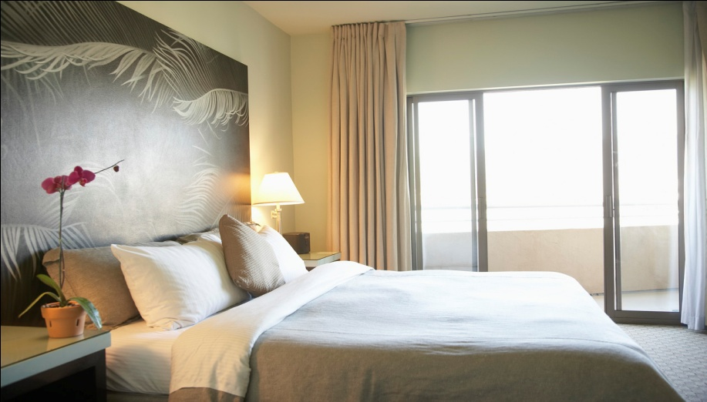
Rooms Division
  The main business of a lodging property is selling sleeping rooms
  The rooms division is the part of the property that handles all tasks in preparing and selling sleeping rooms
Notes:
First, let’s take a look at the rooms division of a hotel as a way of organizing the technology.
As we have learned in previous lessons, the main business of a lodging property is selling sleeping rooms. The rooms division is the part of the property that handles all tasks in preparing and selling sleeping rooms.
Sounds simple enough……What kind of technology do you think would be needed to sell sleeping rooms?
Allow the students to answer and record on the white board or an easel if not already completed.

Slide 5
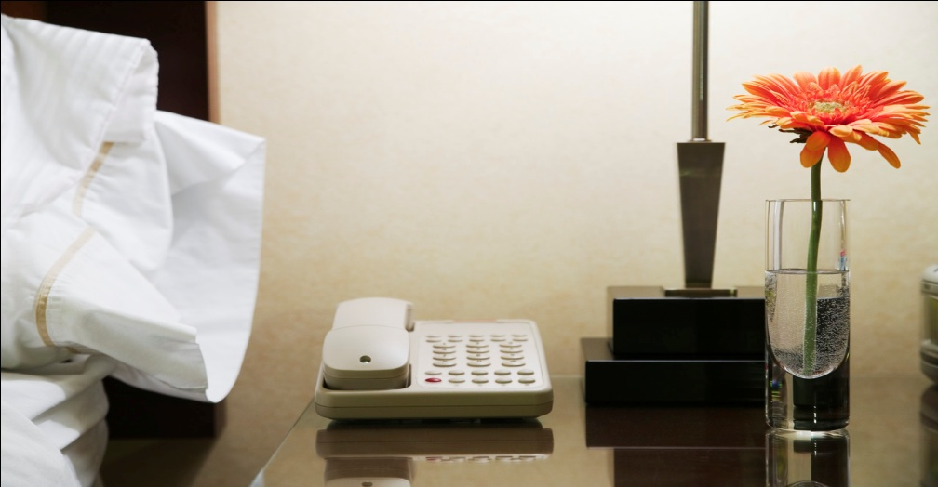
Rooms Division
  Three main functions of the rooms division
    Sell rooms
    Help guests while at the property
    Clean the rooms
Notes:
The rooms division has three main purposes:
to sell rooms
to help guests while at the property
to clean the rooms and prepare for the next guest

Slide 6
Rooms Division
  Divided into 4 departments – working together through technology
    Engineering
    Front office
    Housekeeping
    Security
Notes:
The rooms division is made up of 4 departments:
Engineering
Front office
Housekeeping
Security
Engineering
For the Engineering department, many technological systems are required, again depending on property size.
Systems such as:
complicated HVAC (heating and air conditioning) systems with monitoring controls to maintain efficiencies and minimize downtime
pools systems are also under this department
systems that control humidity and air quality
systems to control the vast number of thermostats involved
Housekeeping
What about Housekeeping? What kind of technology do you think they use? Remember, they are responsible for cleaning the entire property, not just guests’ rooms.
The housekeeping department has a large need for an inventory system.
bed linens
soaps and shampoos
towels
wash cloths
Housekeeping is responsible for keeping an accurate count of all of those assets and more at all times.
They also must keep an accurate count of the rooms and the status of each room.
Housekeeping must know:
how many rooms are occupied
how many are clean and ready for a guest
how many are dirty and in need of cleaning
how many are being cleaned
Security
The technology required to ensure the security of guests of a small property could be simple locks and keys for the main doors as well as guests’ doors.
For larger properties, the technology would be extensive:
alarm systems
cameras
electronic identification of employees (badges)
electronic surveillance
fire detection systems and more
For a large property with several hundred rooms or more, this is a difficult task without computer assisted technology and specific software.
Refer back to the students’ list and check off any they guessed.

Slide 7
Front Office
  Front office is divided into 4 or more departments in a large property
    Reservations
    Front Desk
    Uniformed Services
    Communication
  Front Desk Agent
    Check-in and check-out
    Additional tasks
      Greeting
      Financial tasks
      Guest Security
      Guest Services
      Bucket check
Notes:
The Front Office is perhaps where most people think of technology use as this is where guests reserve rooms and check-in and out. The Front Office is responsible for more activities and requires several technologies.
Front Office is divided into 4 or sometimes even more departments in a really large property. In a small property the same activities take place but are done by fewer people. Each function uses technology of some type.
Efficient hotels will perform a bucket check during the guest’s stay.
First, let’s look at the Reservations Department.
Whether it’s the telephone or the internet, a reservation for a hotel room comes through technology. And of course in order to take a reservation, the inventory of available rooms on the requested nights must be known, even for a relatively small property.
This room inventory is handled efficiently through a computerized system.
Second, the Front Desk is often seen as command central - the place that oversees and runs a hotel. It is the first thing that guests see or interact with and as such, will set the mood of the property.
The front desk agent’s main duties are:
to check the guests in and out of the hotel
greet guests
assist accounting department with financial tasks such as:
guest bill payment by cash, debit, and credit
making change
sometimes even dealing with foreign monetary exchange
The Front Desk agent helps with some light guest services such as:
answering questions
guest security, such as:
issuing and controlling guest door keys
guest privacy
safe deposit boxes behind the front desk
surveillance
emergencies
Third, Uniformed Services includes:
Door Attendants
Bell Attendants
Parking and Transportation Staff
Concierges
They use inventory systems as well to track and maintain uniforms. A large hotel could have to track thousands of uniforms and their state of cleanliness and repair.
The concierge will use the Internet almost non-stop looking up activities, theater times and tickets, maps, and other information for guests.
Fourth, Communications departments have changed quite a bit over the last several years.
They handle the telephone system and specialized software to direct communications, handle guest voice mail and messages.
The Communications department even handles viewing of the guest’s bill over the in-room television.
This department (or the Marketing department) might also be responsible for the communication via the internet. This involves the property's website, the reservations that come over the Internet, and designing their own tablet and smart phone applications or apps.
This department often handles additional communication to guests such as thank you notes or surveys after the stay through email.
Keeping records of the guests’ folio, their stay, and their preferences (single or double room, meal purchases, etc.) are put into a database for marketing purposes as well to enhance the guest’s next stay. This is part of customer relations management.

Slide 8
Front Office Technology
  Rack system
    Reservations kept by hand
    Hand key and mail system
  Property Management System (PMS)
    Computer system with specialized software
    Manage revenue, room rates, reservations, room assignments, and guest folios
Notes:
Prior to computers, hotels managed all of the activities we’ve talked about, such as room availability, room keys, reservations, inventory and accounting by hand.
The keys and mail for guests were handled by what is known as the Rack System. A “rack” of cubby holes, one for each room, sat behind the front desk where the keys, mail, and messages were kept and color coded tags were used for inventory.
This system is still in used in some very old and small lodging properties as well as some Bed and Breakfast Inns.
Today, most properties are handled through a computer system with specialized software packages known as Property Management Systems. This system allows properties to integrate and work together to provide the best service for a guest while maximizing productivity and revenue for the hotel.
PMS systems handle a variety of tasks depending on the hotel size and the amount of money you want to spend on the system. Most of these software packages come in modules and the property can implement the number of modules they deem appropriate for their hotel. Most franchise properties are mandated to use a particular PMS by the franchisor.
Depending on the vendor, the PMS can handle the following tasks and departments:
Reservations
Room inventory
Room pricing (various rates)
Check-in and check-out
Recordable locking system - Door key management
Guest folios
Credit and debit purchases
Credit card checking
Retail purchases (including check and cash)
Video-on-demand and in-room movies management
Concierge services
Accounting
Telecommunications/voicemail/messaging/call accounting (long distance charges to guests)
Food and beverage management
Inventory of all assets (linens, beds, tvs, robes, computers, lamps)
Banquet and event management
Human resources (hiring/firing/payroll/training/taxes)
Building security
In most cases, the PMS will interface with other POS systems such as retail shop systems or restaurant services within the hotel for guest convenience of charging items to their rooms.

Slide 9
  Example of one PMS software:
  OPTIMA: Hotel Genius at Work
  (click on link)
Notes:
Click on hyperlink OPTIMA: Hotel Genius at Work to view an example of a property management software.
Hotel Management System - Complete Hospitality Software
Hotel Management System HMS - Property Management Software PMS - Hotel Point of Sale POS - Hotel Software - Restaurant Software, professional hoteliers secret.
http://youtu.be/E4kkU4R7U5M

Slide 10
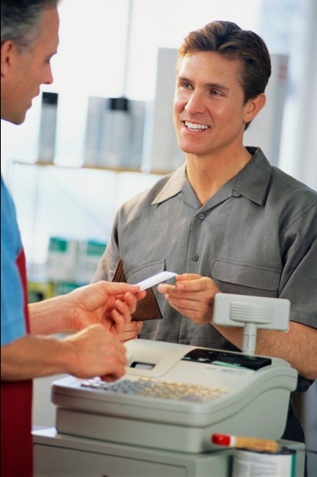
Point-of-Sale Systems
  Any system not located at the front desk
  Examples include:
    Restaurant
    Spa
    Shops
    Business Center
    Valet
    Laundry
    Items in the room refrigerators
Notes:
In most cases, the PMS will interface with other point-of-sale or POS systems such as retail shop systems or Spa services within the hotel even if they are not owned by the hotel.
This is for the convenience of the guest so they can charge items to their rooms and pay all charges on one bill when they check-out.
Technically, anything that is not recorded on the bill at the front desk is a separate POS. These point-of-sale systems can be an actual computerized cash register or a part of the PMS with data entered into a computer. It is the responsibility of the Front Desk agent to make sure all items and recorded purchases from all POS are charged/posted to the proper guest’s folio.
Be sure to continue to refer back to the list the students made at the beginning.

Slide 11
Guest Service Cycle
  Pre-arrival
  Arrival
  Occupancy
  Departure
Notes:
Another way to look at technology as well as activities is by the Guest Service Cycle. There are activities that happen before a guest arrives, upon the arrival of the guest, while the guest is staying on the property known as occupancy, and upon the guest’s departure and after (included with departure).
Allow the students to list 3 to 4 activities and at least one technology for each cycle. This is a good way to review the material.

Slide 12
Questions?

Slide 13
References and Resources
  Images:
    Microsoft Office Clip Art: Used with permission from Microsoft.
  Textbooks:
    Reynolds, Johnny Sue. (2010) Hospitality Services Food & Lodging. Second Edition. Tinley Park, Illinois: The Goodheart-Willcox Company, Inc.
    Hayes, David K., Ninemeier, Jack D., (2007) Hotel Operations Management, Second Edition, Upper Saddle River, New Jersey: Pearson Education, Inc.
  YouTube™:
    Hotel Management System - Complete Hospitality Software
    Hotel Management System HMS - Property Management Software PMS - Hotel Point of Sale POS - Hotel Software - Restaurant Software, professional hoteliers secret.
    http://youtu.be/E4kkU4R7U5M

