Slide 1
How May I Help You? Communication and Telephone Strategies
  Culinary Arts

Slide 3

Communication

Slide 4
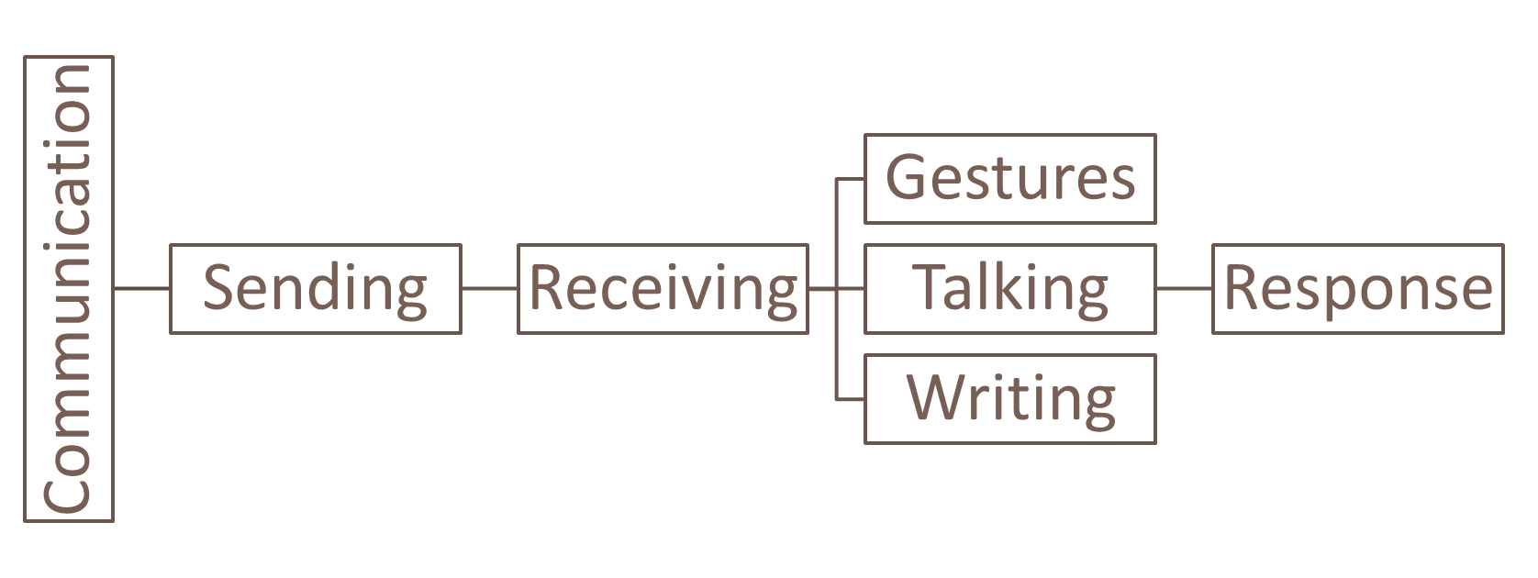
Process
Notes:
Communication is the process of sending and receiving information by gestures, talking or writing for a response or action.

Slide 5
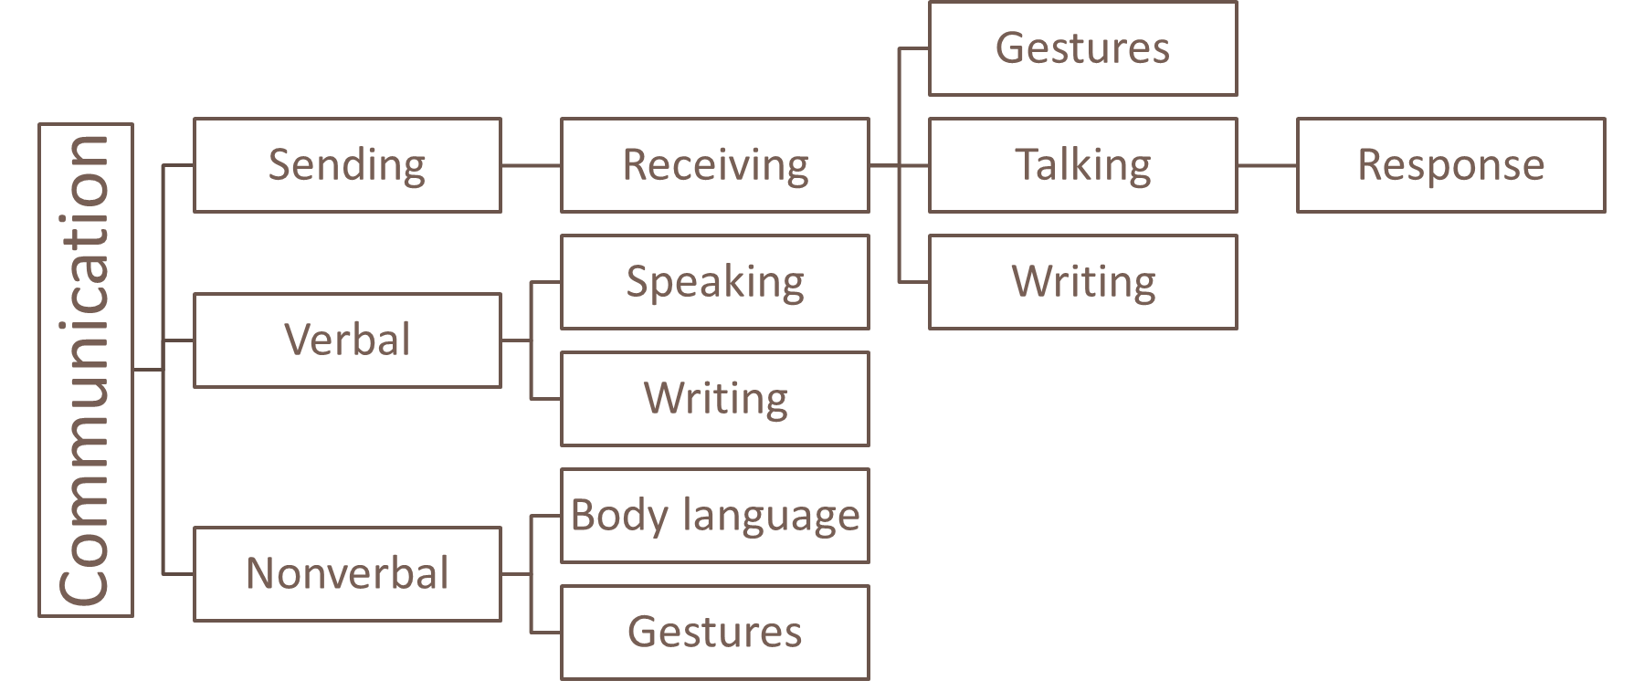
Notes:
Communication also includes both verbal and nonverbal communication.
Verbal communication is the sharing of information between individuals by using speech or writing emails, letters, memos and messages.
Nonverbal communication is the process of communication through sending and receiving wordless (mostly visual) cues between people that includes gestures, facial expressions and body language.

Slide 6
Basic Skills
  Listening
    The ability to focus closely on what another person is saying
    Involves understanding what you hear
    Focus on the speaker’s face and eyes
  Speaking
    Occurs when you say something
    Includes:
    Your posture
    Your tone of voice
    Words you choose
Notes:
Listening:
you must pay attention when you listen to someone
be sure not to interrupt
you may ask questions to clarify
Speaking:
includes how you organize and present your thoughts

Slide 7
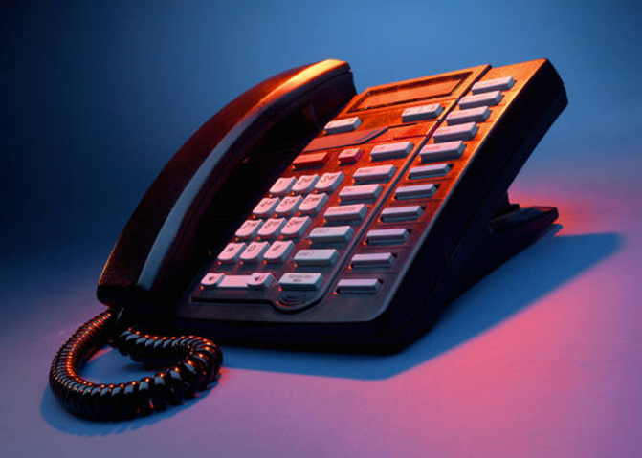
Telephone
Notes:
Telephones are a vital part of a business.

Slide 8
Business Calls
  Customers
    Will call the business for:
    Information
      Catering
      Directions
      Hours of operation
  Vendors
    Will call the business for:
      Delivery times
      New products
      Purchase orders
Notes:
Business calls are usually made by customers and vendors.
Customers will also call to complain about the food.
Vendors can either sell food or equipment to the business.
Can you think of other reasons customers may call the business?

Slide 9
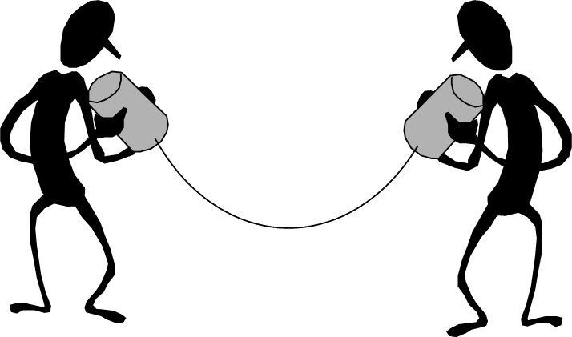
Telephone Techniques
  What is more important?
    What you say or how you say it?
  More Considerations:
    Background noise
    Non-verbal communication
    Service businesses expect
    Voice levels
Notes:
Let’s get back to the first question and consider.… “Is what you say more or less important than how you say it?”
Many people will argue one over the other, that WHAT you say is more important while others will argue the point that HOW you say something is more important.
Truth – They are BOTH important! When on a telephone, neither party has the opportunity to watch or “read” the other person.
The use of nonverbal communication, such as hand gestures and facial expression, is not an option. So, how you say something is as important as what you say.
Other distractions can also interfere such as background noise, phone line issues, a soft-spoken person versus a voice that carries, and most of all, remembering you are in a service business and your business depends on good service.
Customers expect courtesy and that begins at the front of the restaurant and on the phone.

Slide 10
Answering the Telephone
  Smile
  Speak clearly and calmly
  Be polite and helpful
  Be able to:
    Answer most frequently asked questions
    Provide directions to the business
Notes:
The way you communicate over the telephone can make a difference to your employer.
Be sure not to eat, drink or chew gum while speaking on the phone.

Slide 11
Greeting
  Thank the caller for calling
  Depending on the time of day, say:
    Good morning
    Good afternoon
    Good evening
  Identify the name of the business
  Provide your name
Notes:
Be sure to follow the guidelines set forth by your business.

Slide 12

Messages
  Date
  Time of call
  Name of caller
  Name of person who should
  receive message
  Message
Notes:
If you need to take a message, be sure to have pen and paper available.
Repeat the message to the caller, ask how to spell their name and the name of the company if you are not sure.
Be sure to give the message to the intended person.

Slide 13


4 Tips for Better Phone Communication
  When it comes to communicating over the telephone, are you putting your best foot forward or are you just phoning it in?
  Learn how to radiate personality over the phone with the four simple strategies.
Notes:
Click on the image to view the video:
4 Tips for Better Phone Communication
When it comes to communicating over the telephone, are you putting your best foot forward or are you just phoning it in?
Learn how to radiate personality over the phone with the four simple strategies.
http://youtu.be/Kv3q2vcGq74

Slide 14

Questions?

Slide 15
References and Resources
  Images:
    Microsoft Office Clip Art: Used with permission from Microsoft.
  Textbooks:
    Culinary essentials. (2010) Woodland Hills, CA: Glencoe/McGraw Hill.
    Foundations of restaurant management & culinary arts. (2011). Boston: Prentice Hall.
    Littrell, J. J., Clasen, A. H. & Pearson, P. (2004). From school to work. Tinley Park, IL: Goodheart-Willcox.
    Reynolds, J. S. (2010). Hospitality services: Food & lodging. Tinley Park, IL: Goodheart-Willcox.
  YouTube™:
    4 Tips for Better Phone Communication
    When it comes to communicating over the telephone, are you putting your best foot forward or are you just phoning it in?
    Learn how to radiate personality over the phone with the four simple strategies.
    http://youtu.be/Kv3q2vcGq74

