Slide 1
How the Media Influences Consumers
Dollars and Sense

Slide 3
How Does the Media Influence You as a Consumer?
Notes:
How has the media influenced you to make purchases this week? Past month? Past year?
How many of you have made a purchase on the Internet? On your smart phone?
Are you a smart consumer?

Slide 4

Modern Methods of Advertising
  Broadcast
  Cell phone and mobile
  Online
  Outdoor
  Print
  Product Placement
  Public Service
Notes:
Advertising can be found in:
Broadcast advertising – A mass-market form of communication including television and radio, broadcast advertising has, until recently, been the most dominant way to reach a large number of consumers. Television, radio and newspapers frequently provide information comparing various products and services and their sources.
Cell phone and mobile advertising - Uses cell phones, iPads, Kindles, Nooks and other portable electronic devices with Internet connectivity. Current trends in mobile advertising involve major use of social media such as Twitter and Facebook.
Online advertising (Digital) - If you see an advertisement via the Internet (World Wide Web), then it is classified as online advertising. In fact, there are ads on this very page, and most other websites you visit, as they are the primary revenue driver for the Internet.
Outdoor advertising - Also known as out-of-home (OOH) advertising, this is a broad term that describes any type of advertising that reaches the consumer when he or she is outside of the home.
Print – If an advertisement is printed on paper, be it newspapers, magazines, newsletters, booklets, flyers, direct mail or anything else that would be considered a portable printed medium, then it comes under the banner of print advertising.
Product placement advertising - In a nutshell, product placement is the promotion of branded goods and services within the context of a show or movie, rather than as an explicit advertisement.
Public Service advertising - Unlike traditional commercials, Public Service Advertisements (PSA) are primarily designed to inform and educate rather than sell a product or service.
How many methods of advertising have you seen or heard today?
What were the methods?
Did the advertising methods have an impact on you as a consumer? How?

Slide 5
Online Advertising
  Ads based on your interests
  Advergaming
  Banner ads and other web page ads
  E-mail Ads
  Viral Marketing
Notes:
Ads based on your interests: Some online ads you see are placed there based on your interests. But how does an advertiser know what you like? Businesses may track the websites visited and searched for on your computer. Then, they put ads for those products on your computer. However, they can’t tell exactly who is doing the searching. For instance, if your brother searches for sports scores and visits team websites on the family computer, everyone in the family will see more sports-related ads (even family members not interested in sports).
Advergaming: This is a commercial in the form of a game. For example, you may go online and play in a food brand’s made-up world, using codes you get on the package. These ads let you interact with a business’s characters and logo—a symbol used by companies to identify their products.
Banner ads and other web page ads: These ads appear on websites, usually at the top or sides of the page. They direct you to a website for more information about what is being sold.
E-mail Ads: Sometimes, you see ads in your e-mail from a store you’ve shopped at online. Other times, you might sign up to be on a mailing list for a company or a store. Businesses or organizations often use e-mail to send you messages about special sales, promotions, or events. But be careful — e-mail ads also could be spam and contain a virus. Be cautious about opening attachments, downloading files, or clicking links in emails, no matter who sent them.
Viral Marketing: Just like a joke or story spreads from person to person, advertising spreads that way, too. You might get a link to a funny video or message from a friend – and you might send it on to other friends if you like it. If the video or message shows a product (like a soda, movie, new song, gadget), chances are it’s an ad.
What kind of activities do you do online?
What kind of ads have you seen online?
Have you ever participated in Advergaming?

Slide 6
Social Media and the Consumer
  Social Media Influences Consumers
  (click on link)
Notes:
Have you ever purchased anything after seeing it on a social media site?
Do you think social media influences your decision-making as a consumer?
How Does Social Media Influence Buying Decision-making?
Element212 is out on the street interviewing everyday consumers on how social media influences their buying decision-making.
http://youtu.be/pK5KpYv50wg

Slide 7
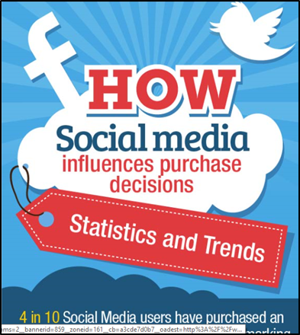
Social Media and the Consumer
  How the Social Media Influences Purchase Decisions
  (click on link)
Notes:
71% more consumers are likely to purchase based on social media referrals. Do you agree that social media posts has an impact on purchases made by consumers?
Have you ever followed a particular brand on social media? Why or why not?
Teacher note: Discuss the information on Infographic (scroll down on the webpage).
How many of you have made a purchase based on a referral on a social media page?
All Twitter
How the Social Media Influences Purchase Decisions
http://www.mediabistro.com/alltwitter/social-media-purchase-decisions_b54296

Slide 8
What Are Some Advertising Techniques?

Slide 9

Advertising Techniques
  Association
  Call to action
  Claim
  Games and activities
  Humor
  Hype
  Must-have
Notes:
Association: Using images (like a cartoon character or the American flag), in the hope you’ll transfer your good feelings about the image to the product.
Call to action: Telling you what to do— “Buy today!” or “Vote now”—removes all doubt about next steps.
Claim: Informing you about how the product works or helps you.
Games and activities: Putting a commercial into the form of a game can be a fun way for you to get to know more about a product and spend more time with it.
Humor: Using ads that make you laugh can catch your attention and be memorable.
Hype: Using words like amazing and incredible make products seem really exciting.
Must-have: Suggesting that you must have the product to be happy, popular, or satisfied

Slide 10

Advertising Techniques
  Fear
  Prizes
  Repetition
  Sales and price
  Sense appeal
  Special ingredients
  Testimonials and endorsements
Notes:
Fear: Using a product to solve something you worry about, like bad breath.
Prizes, sweepstakes and gifts: Using a chance to win a prize to attract attention.
Repetition: Repeating a message or idea so you remember it.
Sales and price: Showing or announcing a discounted price can make a product look better.
Sense appeal: Using sights and sounds to appeal to your senses: sight, touch, taste and so forth.
Special ingredients: Promoting a special ingredient may make you think the product works better than others.
Testimonials and endorsements: Featuring someone, like a celebrity, saying how the product worked for them can be convincing.

Slide 11

Evaluating Advertising Techniques
  You need to ask yourself these questions when evaluating advertising techniques:
    1. Who is responsible for the ad?
    2. What audience is the ad targeting? What makes you think so?
    3. What techniques does the ad use?
    4. What does the ad say or suggest about the product or service?
    5. What does the ad say about the people who buy the product or service?
Notes:
1. Who is responsible for the ad?
2. What audience is the ad targeting? What makes you think so?
3. What techniques does the ad use?
4. What does the ad say or suggest about the product or service?
5. What does the ad say about the people who buy the product or service?
When you are able to make a sound judgment on your purchases, you will be a better consumer.

Slide 12
Evaluating an Ad
(click on picture)
Notes:
Teacher note: Locate an ad on the Internet and ask the students the following questions as they pertain to the ad:
1. Who is responsible for the ad?
2. What audience is the ad targeting? What makes you think so?
3. What techniques does the ad use?
4. What does the ad say or suggest about the product or service?
5. What does the ad say about the people who buy the product or service?
When you are able to make a sound judgment on your purchases, you will be a better consumer.

Slide 13
How can you be a responsible consumer?

Slide 14
Types of Consumer Buying Decisions
  Extensive decision-making
  Impulse shopping
  Limited decision-making
  Routine purchases
Notes:
Extensive Decision-Making – Purchases for high priced electronics, such as a Smart HDTV, laptop computer or digital camera. Other major purchases such as a home or vehicle, require consumers to use broad decision-making. Consumers spend extensive amounts of time researching a high number of prospective options before they buy. They communicate with trustworthy friends, family, colleagues and sales professionals. The may even read reviews and ratings online and in consumer magazines. The decision-making process is more extensive, as the consumer is investing a substantial amount of money.
Impulse shopping – The consumer makes a purchase with little to no thought or planning involved. In most instances, this happens with low-priced items.
Limited Decision-Making – When consumers participate in purchases that necessitate restricted decision-making, they may seek advice or a suggestion from a relative, colleague or friend. For example, if a young teacher is seeking resources for her classroom, she might solicit advice from a mentor to find out which are the best options for purchasing teaching materials. As she researches for resources and activities, she might also ask for suggestions on additional teaching materials.
Routine Purchases – There are objects consumers are used to acquiring
Do you have any impulse shopping mistakes in your closet? Why did you purchase the item?

Slide 15
Being a Responsible Consumer
  Acquired information
  Checked information
  Used the information to compare products before purchasing
  Considered personal wants and needs
  Considered financial resources available for this purchase
Notes:
Acquired information before making a purchase
Checked information to make sure it was reliable
Used the information to compare products before purchasing
Considered personal wants and needs before making the decision to purchase the item
Considered financial resources available for this purchase
How can you acquire information on a product before purchasing it?
How do you check information for reliability?
Do you do comparison shopping?

Slide 16
Being a Responsible Consumer
  Avoided impulse shopping
  Avoided purchasing products that are harmful to the environment
  Considered the impact of the purchase on others
  Refrained from unethical consumer practices
  Shopped with reliable businesses
Notes:
Avoided impulse shopping
Avoided purchasing products that are harmful to the environment
Considered the impact of the purchase (positive or negative) on others (family members)
Refrained from unethical consumer practices (shoplifting, using the item and returning it, or exchanging price tags)
Shopped with reliable businesses
What is the worst mistake you purchased due to impulse shopping?
Have your purchases ever made a negative impact on your family? A positive impact?
How do consumers pay in the long run for unethical consumer practices?
How can some purchases be harmful to the environment?

Slide 17
Being a Responsible Consumer
  Communicated dissatisfaction with the products
  Read and followed the use and care instructions
  Used the products in a way that was safe to themselves as well as others
Notes:
Communicated dissatisfaction with the products in an honest and fair manner to the appropriate businesses and organizations
Read and followed the use and care instructions on products that were purchased
Used the products in a way that was safe to themselves as well as others

Slide 18
Being a Responsible Consumer
  Plan purchases
    Considered needs and wants
    Determined when is the best time to buy
    Resisted impulse purchases
    Worked individually or with others to resolve issues common to many consumers
Notes:
Considered needs and wants, keeping in mind their goals and priorities
Determined when is the best time to buy
Resisted impulse purchases
Worked individually or with others to resolve issues common to many consumers

Slide 19
Effective Consumer Buying
  Be informed
    Make the most of information available to you
    Recognize selling strategies and use them to your advantage
    Understand the marketplace; know about the sources of goods and services
Notes:
Be informed
Make the most of information available to you
Recognize selling strategies and use them to your advantage
Understand the marketplace; know about the sources of goods and services

Slide 20
Effective Consumer Buying
  Make wise shopping decisions – choose wisely
    Compare products and services
    Deal with reputable and reliable sources
    Resist pressure
Notes:
Make wise shopping decisions – choose wisely
Compare products and services, considering prices, quality, performance and/or guarantee/warranty policy
Deal with reputable and reliable sources
Resist pressure

Slide 21
Sources of Information for Wise Shoppers
  Advertising
  Consumer-oriented publications
  Guarantees and warranties
  Labels and hangtags
  Salesperson
Notes:
Advertising – Through advertising, you can learn about new and existing products, find out what is available, compare prices and learn where to shop.
Where do you find advertisements?
Consumer-oriented publications – Magazines and books frequently have articles about new products that are available and sometimes compare several products. Publications such as Consumer Reports and Consumers Research Magazine also report ratings of tested products and services.
Guarantees and warranties – This information provided with many products and services spells out the promises and obligations of the manufacturer or seller.
Labels and hangtags – Through information provided on the actual product, such as labels an hangtags, you can find information such as content, quality, quantity, trade name, price, performance and care instructions.
Salespersons – Trained salespersons or store representatives can provide valuable information regarding products and services. Some are more helpful and knowledgeable than others. Remember that the salesperson’s primary objective is to make the sale.

Slide 22

Sources of Information for Wise Shoppers
  Government bulletins
  Internet
  Media sources
  Professional associations
Notes:
Government bulletins – These are frequently free and are available on a large number of products. They may provide hints on what to look for in a product. A good source for government publications is the Publications.USA.gov http://publications.usa.gov/
Internet – More and more products information can be assessed on the Internet. Be sure, however, to evaluate reliability of information obtained.
Media sources – Television, radio, Internet, smart phones, social media and newspapers frequently provide information comparing various products and services and their sources.
Professional associations – Many professional associations related to specific industries offer information and purchasing guidelines related to products and services within that industry. Information from such organizations is usually available through their websites.

Slide 23
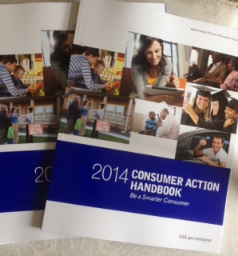
Consumer Action Handbook
Notes:
Use the Consumer Action Handbook (CAH) to get help with consumer purchases, problems and complaints. Find consumer contacts at hundreds of companies and trade associations, local, state, and federal government agencies, national consumer organizations, and more. You may download a free copy or order a free copy at http://publications.usa.gov/USAPubs.php

Slide 24
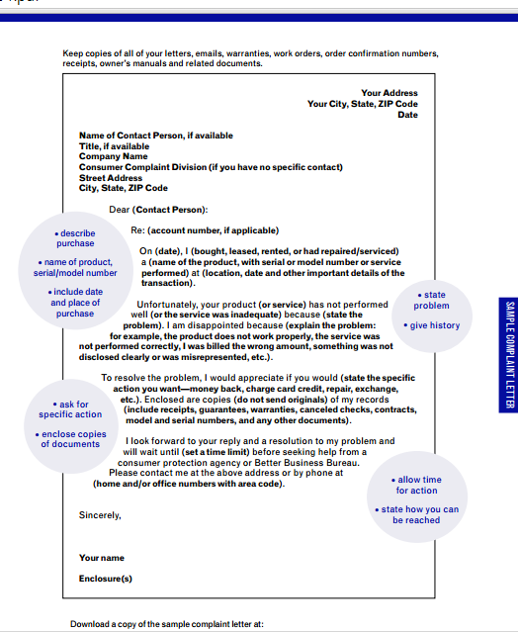
Sample Complaint Letter
Notes:
Being a responsible consumer can include working individually or with others to resolve issues such as writing a complaint letter.
Keys to an effective complaint letter include:
Describe your purchase.
Include the name of the product and serial number.
Include the date and place of purchase.
State your problem.
Give the history of your purchase.
Ask for specific action.
Allow time for action.
State how you can be reached.
Enclose copies of your documents and receipts (but never send originals).
Keep copies of all your letters, faxes, e-mails and related documents.
You can download a sample complaint letter at:
http://www.usa.gov/topics/consumer/complaint/complaint-letter.shtml

Slide 25

Tips for Filing a Complaint
  Remain calm
  State exactly what you want done about the problem
  Document each step
  Start with the seller first
Notes:
When filing a complaint, remember these tips:
Remain calm. The person who can help probably didn't cause the problem.
Don't use an angry, threatening, or sarcastic tone.
State exactly what you want done about the problem.
Document each step, and keep copies.
Start with the seller first. You can resolve many problems by calling a company's toll-free number. Even on the phone, you should know the details of the complaint. You can use the sample letter below to jot down a few notes before you call. If necessary, ask to speak to a manager.
If that doesn't work, send a letter or e-mail to the manufacturer's national headquarters or consumer affairs office. Some experts suggest that a letter is the most effective method for contacting a company, so if e-mails and phone calls don't work, try mailing a letter.

Slide 26

Questions?

Slide 27
References and Resources
  Images:
    Microsoft Clip Art: Used with permission from Microsoft.
  Textbooks:
    Campbell, S. R. (2010). Foundations of personal finance. Tinley Park, IL: Goodheart-Willcox.
    Ross Lowe, 2006. Consumer education & economics, Student Edition. 6 Edition. Glencoe/McGraw-Hill.
  Websites:
    All Twitter
    How the Social Media Influences Purchase Decisions.
    http://www.mediabistro.com/alltwitter/social-media-purchase-decisions_b54296
    USA.gov
    Consumer Guides and Protection
    http://www.usa.gov/Citizen/Topics/Consumer-Safety.shtml

Slide 28
References and Resources
  YouTube™:
    How Does Social Media Influence Buying Decision-making?
    Element212 is out on the street interviewing everyday consumers on how social media influences their buying decision-making.
    http://youtu.be/pK5KpYv50wg

