Slide 1
How to Effectively Communicate
With Clients
  Practicum in Human Services

Slide 3
  The single biggest problem in communication is the illusion that it has taken place.”
  -George Bernard Shaw
Notes:
How does this quote relate to oral and written communication skills?

Slide 4

Human Services Career Pathways
  Consumer Services
  Counseling and Mental Health Services
  Early Childhood Development and Services
  Family and Community Services
  Personal Care Services
Notes:
Practicum in Human Services provides occupational specific training and focuses on the development of consumer services, early childhood development and services, counseling and mental health services, family and community services and personal care services. How can you defuse a client’s anger or skepticism as a customer service representative? As a counselor? As a day care director? As a finance manager? As a cosmetologist at a salon? It is important determine and practice ways to resolve conflicting interests and respond to client objections or complaints to the client’s satisfaction.

Slide 5
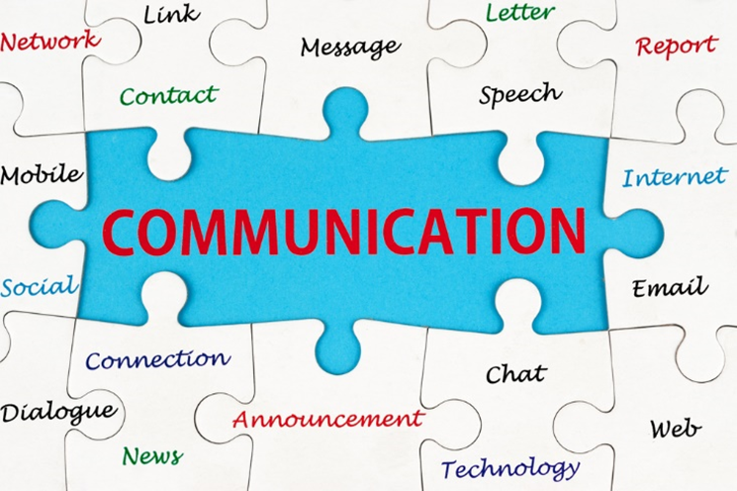
Communication
  An exchange of information between two or more people
  An exchange of information by thoughts, opinions or information by speech, writing or signs
Notes:
Effective communication is vital for developing rewarding relationships with family, friends, co-workers, and clients. Stating your thoughts and ideas clearly will help others understand you. On the other hand, poor communication can cause serious misunderstandings and give the wrong impression. Sometimes the message you send is not always the message that is received.
Developing good communication skills can help you work through problems and improve relationships with family, friends, co-workers and clients.
Communication is an exchange of information between two or more people.
Exchange of information by thoughts, opinions or information by speech, writing or signs.

Slide 6

Communication Involves
Nonverbal and Verbal Skills
Notes:
Communication involves nonverbal and verbal skills each day and both are equally important. Two types of communication are used in sending and receiving messages. The first type is nonverbal communication, which is a way of sending and receiving messages without using words. The second type is verbal communication, which is the use of words to send and receive messages.

Slide 7
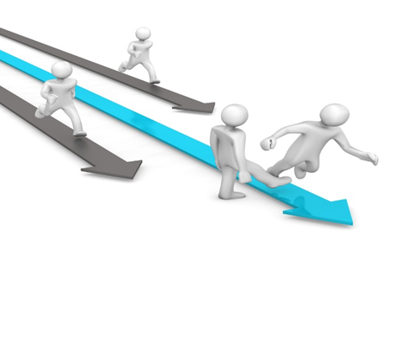
Nonverbal and Verbal Communication Skills
  Nonverbal Communication Skills
    Appearance
    Body language
    Eye contact
    Facial expressions
    Gestures
  Verbal Communication Skills
    Conversational manners
    Grammar
    Inflection
    Power of what you say
Notes:
Nonverbal Communication Skills
We communicate with our body language, by the way we express our thoughts, feelings and emotions. Facial expressions, gestures and body motions convey different meanings and learning how nonverbal messages are sent can help you communicate more effectively.
Effective nonverbal communication
Appearance: Looking professional will get a client’s positive attention.
Body language
Negative: Arms crossed, scowl on your face, not smiling.
Positive: Arms open, standing tall and confident and smiling
Eye Contact: Looking at the person is acknowledgement that you are listening. Do not roll your eyes.
Facial expressions: Worth a thousand words.
Gestures: Body language
Verbal Communication Skills
Heredity and environment are two strong factors affecting our ability to communicate. We learn certain language from our family which is influenced by the regions we live in as words are pronounced differently in regions of any country. Word meanings may also vary from one part of the country to another. Informal language is often used with family and friends and more formal language is used at work. Good communication is needed to be successful at school or at work. Communicating clearly requires active listening and clarity in expressing yourself both verbally and nonverbally. Barriers can impede good communication. Your self-esteem, emotional state and environment can affect the way messages are sent and received. Certain factors can get in the way of good communication, such as a closed mind, mixed messages and prejudice.
Effective verbal communication
Conversational manners: Be sensitive, tactful, honest without offending your clients and co-workers.
Grammar: Using the standard grammar will gain respect from your clients. Using slang will turn them off.
Inflection: Change in pitch or tone of voice
Power of what you say: Be sure to be knowledgeable about what you say to people.
Tone: Pleasant tone of voice communicates the idea that you want to express.

Slide 8

Nonverbal Communication
Notes:
Communication can also be written (letters/flyers/signs) or electronic (e-mail).
Discuss the importance of correct grammar and spelling on business flyers and signage. What does this say to potential clients?

Slide 9

Personal Qualities
  Maintain professional appearance
  Demonstrate correct client care
  Project professionalism with confidence and enthusiasm
Notes:
Your personal qualities play an important role in how your nonverbal communication is perceived by your clients.
Maintain professional appearance, personal hygiene and behavior
Demonstrate correct client care and professionalism at all times
Project professionalism, confidence and enthusiasm when providing information

Slide 10

Keys to Good Listening
  Be aware of strong emotions
  Control your nonverbal messages
  Don’t let silence make you nervous
  Let the sender complete his or her thoughts
  Show interest in what the other person is saying
  Try to block out interruptions
  Yse good verbal skills in giving feedback
Notes:
Keys to good listening include:
be aware of strong emotions
control your nonverbal messages
don’t let silence make you nervous
let the sender complete his or her thoughts
show interest in what the other person is saying
try to block out interruptions
use good verbal skills in giving feedback

Slide 11

Client Relationships
  Good relationship skills will help you succeed on the job.
  Remember, the client is always right so never argue or take up opposition with a client’s view.
Notes:
Customer and Client Relationships
Good relationship skills will help you succeed on the job. Nearly all positions require the interaction with other people, whether they are co-workers, supervisors or clients. It is important to use good relationship skills. When you are serving others, being friendly is key to making someone feel comfortable. Begin by building a relationship through conversation about casual topics such as the weather, news, sports or simple observations of their dress. Sincere complements will show your concern and make them feel welcome.
Remember, the client is always right so never argue or take up opposition with a client’s view. Be helpful. Find out what they need and make it happen.
Successful client relations will get you noticed by the supervisor so make sure you are taking the time to develop client relations skills. A smile and a simple “Hello” are always good first steps to start a conversation and a friendship

Slide 12
Dealing with Difficult Client
Service Situations
  Don’t get defensive or take it personally
  Express empathy/regret
  Inform your supervisor after dealing with a difficult client
  Listen and allow the client to express his or his dissatisfaction
  Never argue with a client
  Provide options for solving the problem/situation
Notes:
Don’t get defensive or take it personally. The client could be upset for many reasons. Don’t try to understand the specifics. Concentrate on diffusing the situation.
Express empathy for the client. Remember the first time you were treated inappropriately by an employee or company. Also show regret. Regret is to feel sad or sorry about something that you did or did not do.
Inform your supervisor after dealing with a difficult client. Be adequately familiar with the company’s protocol for handling a difficult client/situation.
Listen and allow the client to express his or his dissatisfaction. A client will be unable to listen to reason until he or she has had an opportunity to “vent.”
Never argue with a client. If you are unable to resolve the situation, refer the client to your supervisor.
Provide options for solving the problem/situation

Slide 13

Dealing With Difficult Customers
Notes:
Dealing with Difficult Customers
Keeping customers is as important as getting them. This training video demonstrates a simple method for dealing effectively with angry customers. First, deal with the person; then, deal with the problem.
http://youtu.be/a1nrWFCys6A

Slide 14

A Guide to Working With ‘Difficult’ Clients
Notes:
A Guide to Working with ‘Difficult’ Clients
We love our clients! This indeed is a true statement for without clients, there can be no success or even a business in the first place. However, once in a while a client comes along that is not so easy to work with.
http://www.searchenginejournal.com/a-guide-to-working-with-difficult-clients/54036/

Slide 15
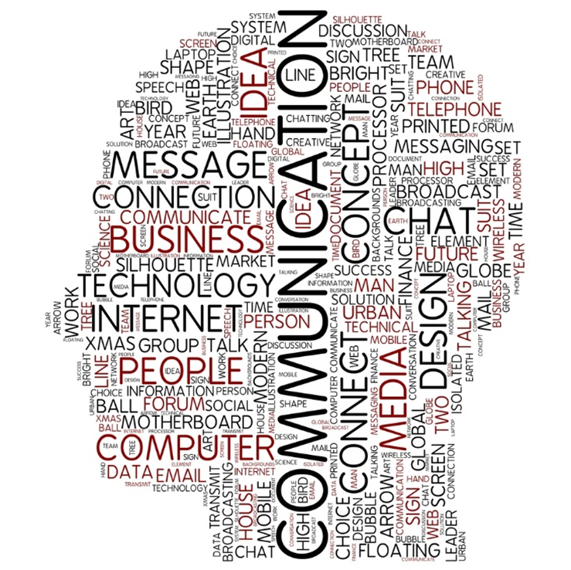
Keys to Working with Difficult Clients in Counseling and Mental Health Services
Notes:
VideoBlog Keys to Working with Difficult Clients
Sarah Bonkrude board certified music therapist and licensed professional counselor talks about how to deal with difficult clients.
http://youtu.be/GYVHZAiKlxg

Slide 16
The Effects of a Bad Customer
Service Experience
  On average, loyal customers are worth up to ten times as much as their first purchase.
  It is 6 to 7 times more expensive to acquire a new customer than it is to keep a current one.
  Take the time to address unhappy customers and do everything in your power to remedy the situation. It's not only worth keeping their business, but also avoiding any negative word of mouth exposure.
  91% of unhappy customers will not willingly do business with you again.
Notes:
According to Helpscout.com, a bad customer service experience can effect a business in a multitude of ways.
Teacher note: You may opt to assign the students to read the information on customer service. There are eight chapters containing facts, quotes and statistics at:
75 Customer Service Facts, Quotes and Statistics
Learn how your business can deliver with the best of the best.
http://www.helpscout.net/75-customer-service-facts-quotes-statistics/

Slide 17

Top Six Ways to Get An Angry
Customer to Back Down
Notes:
Top Six Ways to Get an Angry Customer to Back Down
Six quick tips to help you diffuse anger and create calm with unhappy customers. This video is part of the “Golden Method” e-learning course for handling difficult customers.
https://youtu.be/ACKbkmO9rLg

Slide 18

Job Interview Questions
Notes:
Have students brainstorm additional job interview questions which are client-based. Allow time for class discussion.
Job Interview Questions
How do you deal with difficult customers? How to answer interview questions.
http://youtu.be/-KOn9KMl0NI

Slide 19
Review
  Compare and contrast nonverbal and verbal communication skills.
  What do conversational manners include?
  Explain three keys to good listening.
  Describe four techniques in dealing with difficult client
  service situations.
  How can bad customer service effect a business?

Slide 20


Slide 21
References and Resources
  Images:
    Photos obtained through a license with Shutterstock.com™.
  Infographic:
    A Guide to Working With ‘Difficult’ Clients
    We love our clients! This indeed is a true statement for without clients, there can be no success or even a business in the first place. However, once in a while a client comes along that is not so easy to work with.
    http://www.searchenginejournal.com/a-guide-to-working-with-difficult-clients/54036/
  Textbook:
    Newberry, Betsy. Life skills for the 21st century: building a foundation for success. Boston: Prentice Hall, 2010. Print.

Slide 22
References and Resources
  Websites:
    Babson College
    Customer Service Guidelines
    http://www.babson.edu/offices-services/human-resources/employment/students/policies/Pages/student-employee-policies.aspx
    75 Customer Service Facts, Quotes and Statistics
    Learn how your business can deliver with the best of the best.
    http://www.helpscout.net/75-customer-service-facts-quotes-statistics/

Slide 23
References and Resources
  YouTube™:
    Dealing With Difficult Customers
    Keeping customers is as important as getting them. This training video demonstrates a simple method for dealing effectively with angry customers. First, deal with the person; then, deal with the problem.
    http://youtu.be/a1nrWFCys6A
    Job Interview Questions
    How do you deal with difficult customers? How to answer interview questions.
    http://youtu.be/-KOn9KMl0NI
    Top Six Ways to Get An Angry Customer to Back Down
    Six quick tips to help you diffuse anger and create calm with unhappy customers. This video is part of the “Golden Method” e-learning course for handling difficult customers.
    https://youtu.be/ACKbkmO9rLg
    VideoBlog Keys to Working with Difficult Clients
    Sarah Bonkrude board certified music therapist and licensed professional counselor talks about how to deal with difficult clients.
    http://youtu.be/GYVHZAiKlxg

Slide 24
  Abc
  Abc

Slide 25
  Abc
  Abc

Slide 26
  Abc
  Abc

Slide 27
  Abc
  Abc

Slide 28
  Abc
  Abc

Slide 29
  Abc
  Abc

Slide 30
  Abc
  Abc

