Slide 1
How to Teach TEXAS Style

Slide 3
Assignment
Develop a lesson using approved curriculum
Include the TEKS and instructional objectives
Make sure it is engaging
Notes:
Students, today you will create lessons which includes the Texas Essential Knowledge and Skills (TEKS) with corresponding instructional objectives. Be sure that your lesson is engaging and is related to the grade level or content area of your selected TEKS.
Teacher note: This is just to grab students’ attention and help them understand why this lesson is important.
Ask the following: Do you feel nervous right now? What are you thinking? Allow for some discussion and questions. Then inform students that for the rest of the semester, they will be required to write lesson plans that meet certain criteria. They will continue doing this throughout their teaching careers. The information included in this lesson will prepare them for that. Today, we will begin discussing how and where to locate the TEKS, what they are and how to use them in the classroom.
You will not be creating a lesson today, but you will be learning how to use the TEKS when developing instructional objectives. You will have an opportunity to develop your own lesson plans later in the semester.
You may opt to share your personal teacher story about teaching and developing lesson plans.

Slide 4
What are TEKS?
Notes:
Do you know what these letters stand for? Texas Essential Knowledge and Skills.

Slide 5
Texas Essential Knowledge and Skills
also referred to as TEKS
official K-12 curriculum for the state of Texas
details the curriculum requirements for every course
developed by the state of Texas to clarify what all students should know and be able to do (per course) by the conclusion of the school year
Notes:
The Texas Essential Knowledge and Skills, also known as TEKS, is the official K-12 curriculum for the state of Texas. TEKS dictate what the instructor must teach during the course of the school year. Have students view the TEKS for this course using the handout Locating TEKS (see All Lesson Attachments tab). TEKS are used as a set of minimum guidelines for what teachers are required to teach throughout the school year. A teacher may, and should, teach beyond the TEKS. Ask the following:
What does it mean to teach beyond the TEKS?
What would happen if teachers only taught to the TEKS or taught the bare minimum?
Why is it necessary for educators to teach beyond the TEKS? What is the significance in this?
What would happen if teachers were given free reign to teach whatever they wanted?
What would happen to the state test (STAAR) results or SAT scores?
What would happen to students who transferred school districts during the course of the year?

Slide 6
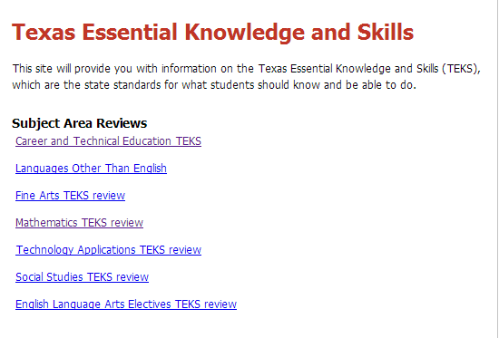
Where are they located?
http://www.tea.state.tx.us/
On the left, click Curriculum
On the left, scroll down and click Curriculum Standards/TEKS
Then click TEKS by Grade Level
(click on box)
Notes:
The Texas Education Agency (TEA) website contains all of the educational standards, or TEKS, for each course for all grade levels and content areas. At this time, click on the link and show students as a group how to access the TEKS.
The TEKS can be downloaded in printable format, free of charge, via the Texas Education Agency website.
If you are in a lab setting, allow students to access the TEA website and locate the TEKS. If time permits, allow them to explore the site. Allow time for students to familiarize themselves with locating the TEKS for various courses. Distribute Locating TEKS (see All Lesson Attachments tab), and allow students to use the handout.

Slide 7
Course TEKS
Knowledge and Skills Statement
Example:
  (3) The student analyzes the responsibilities that promote health and wellness of children. The student is expected to:
(A) identify signs of good health and symptoms of illness in children
(B) describe child guidance practices for rest, exercise, obesity prevention, public and personal safety and sanitation
(D) prepare nutritious snacks or meals for children following the food guidelines in promoting children’s health such as portion control, caloric requirements and nutrient needs
Student Expectation
Notes:
These are the components of all TEKS: Knowledge and Skills Statement and the specific Student Expectations. Each course TEKS outlines what the teacher is required by the state of Texas to teach to each student, but it does not outline how the TEKS must be taught – this is up to the instructor. Teachers across the state will most likely choose to teach the TEKS in a variety of formats. There is not one correct way to teach a lesson. Each lesson must be unique to the classroom of students you have and their learning styles and abilities. You will learn more about this part of lesson planning later in the course.

Slide 8
Other Important Terms
Curriculum- what is being taught, content, a course of studies
Instructional Objectives- the main “point(s)” of the lesson, what you want the students to accomplish or be able to do
    Students will…
Notes:
Clarify all terms and definitions. On the graphic organizer Teaching Texas Style Note-taking (see All Lesson Attachments tab), have students write examples of components of a curriculum.

Slide 9
Learning Objectives
(click on picture)
Notes:
SMART method for writing the instructional objective:
Specific – Be specific in the task to be done
Measureable - How will the success be determined?
Attainable – Include the necessary resources to get the job accomplished
Relevant – Is it realistic?
Time-bound – Set time limits and deadlines
Writing Competency-based Learning Objectives
Mark Winegar explains how to make learning objectives based on the state competencies (TEKS) for a specific course.
http://youtu.be/zm0TEsstc_E

Slide 10
Instructional Objectives
The action verb is the most important part of an instructional objective and must never be omitted. It states exactly what the student will be able to do following instruction.
Analyze
Define
Demonstrate
Notes:
Instructional objectives are specific, measurable, short-term, observable student behaviors.
An objective is a description of a performance you want learners to be able to exhibit before you consider them competent.
Note to teacher: An objective describes an intended result of instruction, rather than the process of instruction itself.

Slide 11
Why have instructional objectives?
To provide direction to instruction
To provide guidelines for assessment
To convey instructional intent to others
Notes:
Instructional objectives provide direction to both the teacher and student.

Slide 12
Types of Instructional Objectives
There are three types of objectives:
Affective – for attitudes
Cognitive – for mental skills
Psychomotor – for physical skills
Notes:
Instructional objectives determine different methods that can be used to help a learner. What is learned depends on what is taught, the student’s level of development, his or her interests, and the methods used to teach. All students do not learn in the same way.
Affective: Attitudes, appreciations and relationships
Cognitive: Understandings, awareness and insights (for example: List and explain...), including information recall, conceptual understanding and problem-solving
Psychomotor: Special skills (such as "create a personal résumé"; "in collaboration with a partner, create a story book depicted from the point of view of either a preschooler or school-age child")

Slide 13
The ABCD’s of Instructional Objectives
Objectives should include the ABCD’s:
Audience – Who will do it?
Behavior – What will they do? This should include action verbs that can be measured, such as demonstrate, list, compare or summarize.
Conditions – How will learning occur?
Degree – How much information is required to determine success?
Notes:
Objectives should include the ABCD’s:
Audience – Who will do it?
Behavior – What will they do? This should include action verbs that can be measured, such as demonstrate, list, compare or summarize.
Conditions – How will learning occur?
Degree – How much information is required to determine success?
An example is: The Practicum in Education and Training student (audience) will develop materials that align with the TEKS (behavior) when assigned as a course project (condition) as measured by the lesson plan rubric (degree).

Slide 14
Cognitive Development –
Bloom’s Taxonomy
Creating
Understanding
Remembering
Applying
Analyzing
Evaluating
Notes:
Verbs are categorized by domains of learning and various hierarchies. Benjamin Bloom was a pioneer in categorizing the domains and levels known as Bloom’s Taxonomy. If you have covered this concept already, this is a perfect time to review. If not, this may serve as a brief introduction to the topic.
Bloom’s Taxonomy was developed in the 1950’s and is still used today to categorize ways of learning and thinking in a hierarchical structure. During the 1990's, a former student of Bloom's, Lorin Anderson, led a new assembly which met for the purpose of updating the taxonomy, hoping to add relevance for 21st century students and teachers. Bloom’s Taxonomy lends itself to multimedia presentations to enhance cognitive development.
Remembering: Retrieving, recognizing and recalling relevant knowledge from long-term memory
Understanding: Constructing meaning from oral, written and graphic messages through interpreting, exemplifying, classifying, summarizing, inferring, comparing and explaining
Applying: Carrying out or using a procedure through executing or implementing
Analyzing: Breaking material into constituent parts, determining how the parts relate to one another and to an overall structure or purpose through differentiating, organizing and attributing
Evaluating: Making judgments based on criteria and standards through checking and critiquing
Creating: Putting elements together to form a coherent or functional whole; reorganizing elements into a new pattern or structure through generating, planning or producing

Slide 15
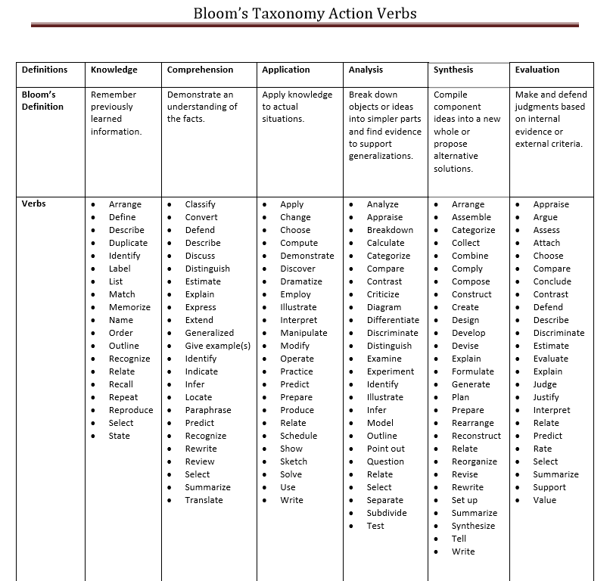
Bloom’s Taxonomy
Notes:
Here are some verbs you can use to develop instructional objectives. Ideally, each of these levels should be covered in each course, and at least one objective should be written for each level. Depending on the nature of the course, a few of these levels may need to be given more emphasis than the others.

Slide 16
Instructional Objectives
Level | Level Attributes | Keywords | Example Objective | Example Activity | Example Assessment
Application | Carrying out or using a procedure through executing or implementing | Apply Build Choose Construct Develop Identify Interview Make use of Model Organize Plan Select Solve Utilize | “By the end of this course, The Practicum in Education and Training student will develop instructional objectives using Bloom’s Taxonomy that align with the TEKS when assigned as a course project as measured by the lesson plan rubric. | With a partner, have students apply the TEKS and Bloom’s Taxonomy to develop instructional objectives. | Use the following question on an exam or homework: “Identify the steps to developing instructional objectives.”
Notes:
Here is an example of an instructional objective using the TEKS for this course.
(4) The student plans and develops effective instruction. The student is expected to:
(E) create clear short- and long-term learning objectives that are developmentally appropriate for students
As you can see, the level from Bloom’s Taxonomy is application. What key words did I use in the objective, activity and assessment?
Identify the ABCD’s in the instructional objective:
The Practicum in Education and Training student (audience) will develop instructional objectives using Bloom’s Taxonomy that align with the TEKS (behavior) when assigned as a course project (condition) as measured by the lesson plan rubric (degree.)
Teacher note: You may opt, at this time, to have students retrieve the CTE – TEKS Instructional Practices in Education and Training handout to practice converting more TEKS to instructional objectives.

Slide 17
TEKS/Student Expectations
Your turn: Use the TEKS/Student Expectations to develop an instructional objective
TEKS/Student Expectations
  (1) The student analyzes roles and responsibilities of parenting. The student is expected to:
    (D) demonstrate first aid and cardiopulmonary resuscitation skills
Notes:
Here is a TEKS and Student Expectation from the CTE Child Development course. On your paper, practice writing an instructional objective for the TEKS using the ABCD method.
Teacher note: Allow time for the students to write an instructional objective. Ask for volunteers to share their ideas. Assign a scribe to write students’ ideas on the board. Analyze the instructional objectives. Make corrections and suggestions if necessary.
A possible answer might be:
Child Development students (audience) will demonstrate first aid and cardiopulmonary resuscitation skills (behavior) with the school nurse, physical education instructor or other certified CPR skilled professional (condition) and pass a final exam with an 80 or better (degree).
Use this example to explain the importance of being knowledgeable within your subject area. Explain that as an educator, you are required to teach all of the TEKS standards for the courses you teach. As a teacher, you don’t have one subject area, so it’s even more important to pay attention in ALL classes NOW. What would happen if you were assigned a subject area that you didn’t understand? How effective would you be?

Slide 18
Tips for Writing Instructional Objectives
How detailed and specific the instructional objectives are depends on what they are used for.
Keep the instructional objectives simple, precise and clearly focused.
Express them in terms of student performance, behavior and achievement.
Notes:
How specific and detailed should objectives be?
It depends on what they are used for. Objectives for sequencing a unit plan will be more general than for specifying a lesson plan.
Don't make writing objectives tedious, trivial, time-consuming or mechanical. Keep them simple, precise and clearly focused as a guide to learning.
The purpose of objectives is not to restrict spontaneity or constrain the vision of education in the discipline but to ensure that learning is focused clearly enough that both students and teacher know what is going on.
Express them in terms of student performance, behavior and achievement, not teacher activity.
Remember the three components of an instructional objective:
Identify the type of activity in which competence is required by using a verb (for example, “create...").
Specify the criteria or standards by which competence in the activity will be assessed (for example, “create a personal résumé...").
List any conditions or circumstances required for students to meet the objective (for example, "...given two class periods working with the résumé templates on the computer").

Slide 19
Questions?

Slide 20
References and Resources
Images:
Microsoft Clip Art: Used with permission from Microsoft.
Books:
Early Childhood Education Today, Twelfth Edition by George S. Morrison
This book is a great resource on early childhood education. It covers the foundation of education, programs and resources for children and families, educational needs of infants through the primary grades and the special needs of children and families.
Exploring Teaching: An Introduction to Education by Richard Arends, Nancy E. Winitzky and Margaret D Tannenbaum
This book encourages students to explore what teaching is and how to become an educator.
Instructional Strategies: How to Teach for Rigor and Relevance by the International Center for Leadership in Education, Inc.
The most successful teachers use methods that promote student learning through a variety of instructional strategies. This book gives teachers ideas and strategies for teaching rigorous and relevant lessons that engage students and promote learning.
Introduction to Teaching: Becoming a Professional, Fifth Edition. by Don Kauchak & Paul Eggen
For any student going into the teaching profession, this is an excellent choice. It is an easy read for students on all levels. It covers the changing teaching profession, the foundations of education and how to become an effective teacher.
Teaching by Sharleen Kato
Students will learn about the history of education and what it means to be a teacher with this textbook.
Websites:
Articulate Your Learning Objectives
Before you can decide how you will teach a lesson, you must determine what your educational goals and objectives will be for your students. The Eberly Center for Teaching Excellence & Educational Innovation at Carnegie Melon University explains how to create and align objects with classroom instruction.
http://www.cmu.edu/teaching/designteach/design/learningobjectives.html
New Teacher Academy: Lesson Planning
Lisa Dabbs explains the importance of effective lesson planning for new teachers.
http://www.edutopia.org/blog/new-teacher-lesson-planning-lisa-dabbs

Slide 21
References and Resources
Planning a Lesson
The National Capital Language Resource Center gives detailed explanations and examples of how to write a lesson plan from beginning to end.
http://www.nclrc.org/essentials/planning/plindex.htm
Strategies for Effective Lesson Planning
Effective lesson planning can be tricky, but with this website from the University of Michigan, lesson planning can be a stress-free encounter.
http://www.crlt.umich.edu/gsis/p2_5
Texas Essential Knowledge and Skills (TEKS)
Texas Education Agency’s list of TEKS for each grade level and subject area.
http://www.tea.state.tx.us/
The Center for Teaching and Learning
Writing goals and objectives is easy with this site! It outlines how to use Bloom’s Taxonomy action verbs, ask rigorous and relevant questions and write objectives.
https://teaching.uncc.edu/learning-resources/articles-books/best-practice/goals-objectives
YouTube™:
How to Write Lesson Plan Step #1: Objectives and Goals
The first step in lesson planning is writing objectives and goals, which will set the tone and pace for the entire lesson.
http://video.about.com/k6educators/How-to-Write-Lesson-Plan-Step--1--Objectives-and-Goals.htm#vdTrn
New Teacher Academy: Lesson Planning
Lesson plans are the cornerstone of a teacher’s day. Learn about the key elements of any lesson plan, and watch as a new teacher creates a lesson plan step-by-step with her coach.
http://youtu.be/lQynxXbzHvw
Writing Competency-based Learning Objectives
Mark Winegar explains how to make learning objectives based on the state competencies (TEKS) for a specific course.
http://youtu.be/zm0TEsstc_E

