Slide 1
I Got the Job! Now What?

Slide 3
Career Success in Foodservice
Job satisfaction for those who love good food and enjoy sharing that passion with others
Notes:
A job in foodservice offers the chance to be creative.
There is also pleasure from the hospitality in satisfying customers.

Slide 4
Health
Balance
Mental Health
Physical Health
Notes:
The energy and skills demanded in foodservice can be best achieved when you are in good physical and mental health.
Recommendations for personal health:
get enough sleep and rest
exercise regularly to increase strength
see a doctor when ill
return to work when completely well

Slide 5
Foodservice Careers
Often involves:
Lifting heavy objects
Long hours on your feet
Risks of burns, cuts, falls and slips
Stress
Notes:
Burnout is high in the foodservice profession.
The work can be physically and mentally overwhelming.

Slide 6
Balance
Is the key to achieving and maintaining success
Include activities such as:
Community involvement
Family events
Hobbies
Reading
Notes:
Work and family must be balanced in order to avoid burnout.
Start a hobby, volunteer in the community and spend more time with your family to avoid leaving the job.

Slide 7
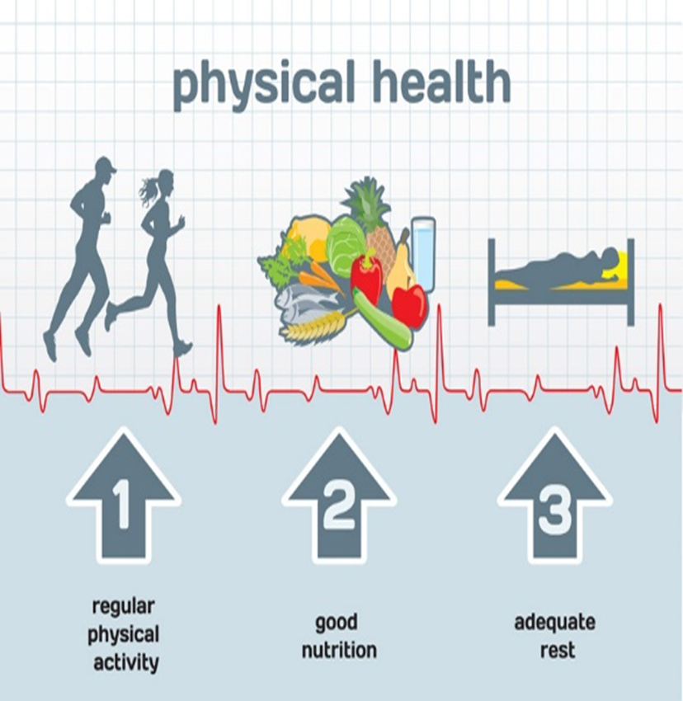
Physical Health
Eat nutritious food
Exercise regularly
Get enough sleep
Notes:
Eating a well-balanced diet can combat the effects of stress on the body.
Be sure to exercise regularly to increase your strength.
Not enough sleep can weaken your body’s immune system and may cause you to become ill.

Slide 8
Mental Health
A state of well-being in which the individual realizes:
His or her own abilities
They can cope with the normal stresses of life
They an work productively and fruitfully
Are able to make a contribution to his or her community
Notes:
Mental health definition is from the Centers for Disease Control and Prevention.

Slide 9
Mental Health Indicators
Emotional well-being
Psychological well-being
Social well-being
Notes:
Emotional well-being - such as perceived life satisfaction, happiness, cheerfulness, peacefulness.
Psychological well-being - such as self-acceptance, personal growth including openness to new experiences, optimism, hopefulness, purpose in life, control of one’s environment, spirituality, self-direction and positive relationships.
Social well-being - social acceptance, beliefs in the potential of people and society as a whole, personal self-worth and usefulness to society, sense of community

Slide 10
Stress
A state of mental tension and worry caused by problems in your life, work or other situations
Can lead to health problems such as:
Depression
High blood pressure
Insomnia
Notes:
Abusing drugs, drinking alcohol and smoking are unhealthy ways to relieve stress.
What are some ways to manage stress?
Allow time for discussion.

Slide 11
Managing Stress
Healthy ways include:
Exercise
Hobbies
Meditation
Reading
Talking to a friend
Notes:
Classes in stress management are also helpful.

Slide 12
Global Workplace
Advancement
Retention
Notes:
The foodservice industry is a global industry and workers need to understand and respect others from diverse cultures.

Slide 13
Advancement
Industry is a great training ground for other careers
Opportunities to move up to management quickly
Hard work pays more
Notes:
There is plenty of room for advancement in the foodservice industry as the industry has grown.
Many foodservice employees advance from entry-level positions to managers and then owners.

Slide 14
Retention
Once employed, be sure to be:
Dependable
Flexible
Punctual
Productive
Respectful
Notes:
Dependable – an employee is expected to work when scheduled unless he or she is physically ill and cannot work.
Flexible – the foodservice industry can be unpredictable such as serving more people than expected.
Punctual – being on time and ready to work is necessary to keep your job and succeed.
Productive – demonstrating a combination of accuracy, safety and speed so that customers receive their meals in a timely manner.
Respectful – demonstrates an admiration for coworkers, customers and the kitchen facilities.

Slide 15
Notes:
Quote
What does this statement mean to you?

Slide 16
America's Restaurants - Industry of Opportunity
Notes:
Click on hyperlink to view video:
America's Restaurants - Industry of Opportunity
As the second largest private-sector employer in the country, America's restaurants are an economic force, but that statistic doesn't fully tell the story of the millions of individuals who are living the American Dream by working in our industry. This video captures a few poignant stories that help tell the 'Industry of Opportunity' story.
http://www.americaworkshere.org/video/americas-restaurants-industry-of-opportunity

Slide 17
Let’s Review!
How can a career in foodservice be stressful?
What is the key to maintaining success?
How can you be successful in your career?
How can you retain your job?
How can you advance in your job?
How do you manage stress?
Notes:
Answers are found within the slide presentation or will vary with class discussion.

Slide 19
References and Resources
Images:
Shutterstock™ images. Photos obtained with subscription. (Slides 1, 3, 4, 5, 6, 7, 8, 9, 10, 11, 12, 13, 14, 15, 17)
Textbooks:
Culinary essentials. (2010). Woodland Hills, CA: Glencoe/McGraw-Hill.
Draz, J., & Koetke, C. (2014). The culinary professional. Tinley Park, IL: Goodheart-Willcox Company.
Websites:
Mental Health Basics
Centers for Disease Control and Prevention
http://www.cdc.gov/mentalhealth/basics.htm
Opportunity
America Works Here
http://www.americaworkshere.org/opportunity

Slide 20
References and Resources
Video:
America's Restaurants - Industry of Opportunity
As the second largest private-sector employer in the country, America's restaurants are an economic force, but that statistic doesn't fully tell the story of the millions of individuals who are living the American Dream by working in our industry. This video captures a few poignant stories that help tell the 'Industry of Opportunity' story.
http://www.americaworkshere.org/video/americas-restaurants-industry-of-opportunity

