Slide 1
Integrating Technology
in the Classroom
  Practicum in Education and Training

Slide 3
  The number one benefit of information technology is that it empowers people to do what they want to do. It lets people be creative. It lets people be productive. It lets people learn things they didn't think they could learn before, and so in a sense it is all about potential. -Steve Ballmer
Notes:
Steven Ballmer is an American businessman who was CEO of Microsoft Corporation for 14 years before stepping down in 2014 to purchase the Los Angeles Clippers, an NBA basketball team.
How does technology empower people to do what they want to do?
How has technology allowed us to be creative? (creating music, designing graphics)
More productive? (anytime, anywhere)
Learn more things? (YouTube™ videos)

Slide 4

What is Technology?
  Machinery and equipment developed from the application of scientific knowledge
Notes:
How often do you think we have to upgrade technology?

Slide 5
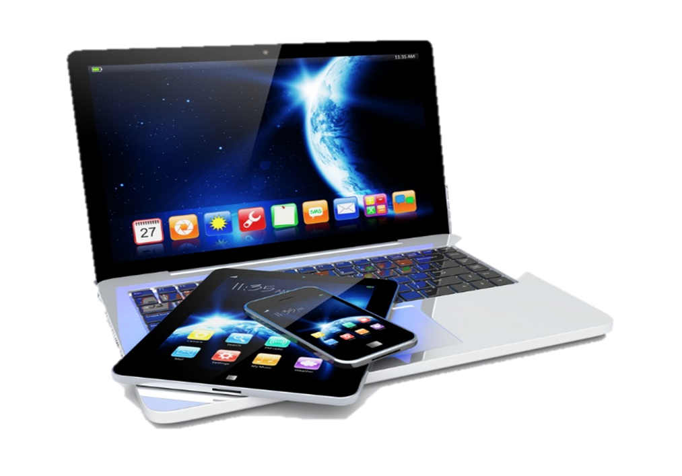
Technology may Include:
  Computers
  iPads
  iPhones
  Laptops
  Smart boards
  Smart phones
  Tablets
  And much more!
Notes:
These are a few of the items considered to be technology.
Refer to word cloud from Anticipatory Set.

Slide 6

Technology Integration
Notes:
Technology integration may be a 1 to 1 or BYOD (see definitions).
1:1 Technology - Providing each student with a laptop or tablet to make learning more individualized, increase independence and extend academics beyond the classroom
Bring your own device (BYOD) - The practice of allowing the employees of an organization to use their own computers, smartphones or other devices for work purposes

Slide 7

Key Components
  Active engagement
  Participation in groups
  Frequent interaction and feedback
  Connection to real-world experts
Notes:
Effective technology integration is achieved when the use of technology is routine and transparent and when technology supports curricular goals.

Slide 8

Projects Equipped with Technology
  Allows students to:
  Be intellectually challenged
  Acquire and refine analysis and problem solving-skills
  Find, process and synthesize information found online
Notes:
This will also provide students with a realistic view of what the modern office may look like.

Slide 9

Benefits
  Students:
    Are more engaged
    Behave better
    Stay on task
Notes:
The use of technology in the classroom has the added benefits of students being more engaged and staying on task.
It has also reduced the behavioral problems.

Slide 10

Technology Applications
Notes:
What are technology applications?
Curriculum that includes the teaching and learning of technology skills and the use of computers and other related electronic tools.
Refer to the following:
TEKS for Technology Applications – Elementary
TEKS for Technology Applications – Middle Schools
TEKS for Technology Applications – High School
TEKS for Technology Applications – Other Technology Application Courses
(see All Lesson Attachments tab)
These documents may be placed on a light projector as you discuss the standards.

Slide 11

Technology Standards in Texas
  Ensure that students, teachers and librarians gain and apply critical 21st Century digital knowledge and skills
  Teachers and librarians use technology standards to document meeting expectations for teaching and learning with technology
Notes:
Refer to the document from the Texas Education Agency:
Technology Application Standards
This document was approved in May of 2000. How do you think technology has changed in since then?
We will look at the first five standards as they pertain to ALL teachers.

Slide 12
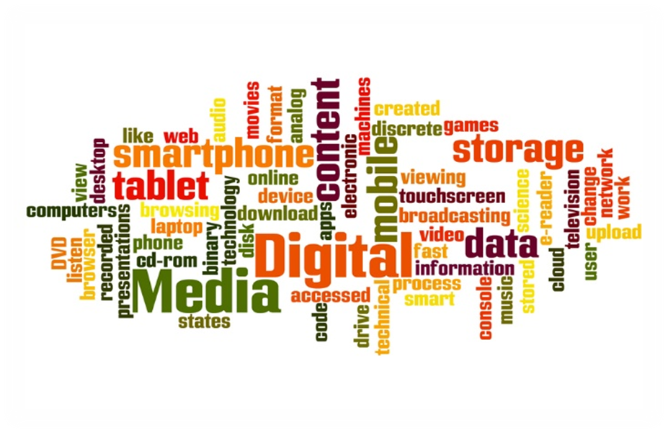
Standard I
  All teachers use technology-related terms, concepts, data input strategies and ethical practices to make informed decisions about current technologies and their applications
Notes:
Review page 1 and 2 and the components for:
Teacher Knowledge: What All Teachers Know
Application: What All Teachers Can Do
Is there anything listed that surprises you?

Slide 13

Standard II
  All teachers identify task requirements, apply search strategies and use current technology to efficiently acquire, analyze and evaluate a variety of electronic information
Notes:
Review page 3 and the components for:
Teacher Knowledge: What All Teachers Know
Application: What All Teachers Can Do
Is there anything listed that surprises you?

Slide 14

Standard III
  All teachers use task-appropriate tools to synthesize knowledge, create and modify solutions and evaluate results in a way that supports the work of individuals and groups in problem-solving situations
Notes:
Review page 4 and 5 and the components for:
Teacher Knowledge: What All Teachers Know
Application: What All Teachers Can Do
Is there anything listed that surprises you?

Slide 15

Standard IV
  All teachers communicate information in different formats and for diverse audiences
Notes:
Review page 6 and 7 and the components for:
Teacher Knowledge: What All Teachers Know
Application: What All Teachers Can Do
Is there anything listed that surprises you?

Slide 16

Standard V
  All teachers know how to plan, organize, deliver and evaluate instruction for all students that incorporates the effective use of current technology for teaching and integrating the Technology Applications Texas Essential Knowledge and Skills (TEKS) into the curriculum
Notes:
Review page 8 and 9 and the components for:
Teacher Knowledge: What All Teachers Know
Application: What All Teachers Can Do
Is there anything listed that surprises you?

Slide 17

Enhancing Education Through Technology
  No Child Left Behind Title II, Part D
  Two goals address Technology Application Standards
    Technology Literacy
    Curriculum Integration
Notes:
According to the No Child Left Behind – Enhancing Education Through Technology Act of 2001, two goals were addressed:
Goal: Technology Literacy - Assist every student in crossing the digital divide by ensuring that every student is technology literate by the time the student finishes the eighth grade, regardless of the student's race, ethnicity, gender, family income, geographic location, or disability.
The state defines a “technology literate” student as one who has mastered the Technology Applications TEKS for grades K-8 (19 TAC, Chapter 126).
Goal: Curriculum Integration - Ensure ongoing integration of technology into school curricula and instructional strategies in all schools in the State so that technology will be fully integrated into the curricula and instruction of the schools.
Teachers and librarians use technology standards (for students, teachers, and librarians) to document meeting expectations for teaching and learning with technology. The Long-Range Plan for Technology (LRPT), 2006-2010, references technology standards as well. The LRPT is described below.
Are we meeting those goals?

Slide 18
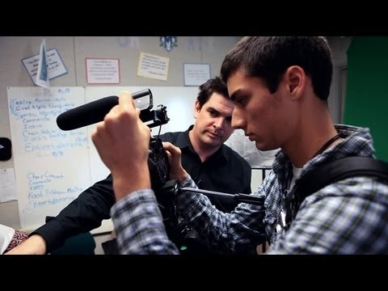

An Introduction to Technology Integration
  Integrating technology with classroom practice can be a great way to strengthen engagement by linking students to a global audience, turning them into creators of digital media, and helping them practice collaboration skills that will prepare them for the future.
Notes:
An Introduction to Technology Integration
Integrating technology with classroom practice can be a great way to strengthen engagement by linking students to a global audience, turning them into creators of digital media, and helping them practice collaboration skills that will prepare them for the future.
http://youtu.be/d59eG1_Tt-Q

Slide 19


Slide 20
References and Resources
  Images:
    Shutterstock™ images. Photos obtained with subscription. (Slides 4, 5, 6, 7, 8, 9, 10, 11, 12, 13, 14, 15, 16, 17, 18, 19)
  Websites:
    Steven Ballmer. (2015). In Encyclopædia Britannica. Retrieved from
    http://www.britannica.com/EBchecked/topic/1780135/Steven-Ballmer
    Texas Education Agency
    Technology Standards for Students, Teachers, and Librarians
    http://tea.texas.gov/Curriculum_and_Instructional_Programs/Learning_Support_and_Programs/Technology_Resources/Technology_Standards_for_Students,_Teachers,_and_Librarians/
    U.S. Department of Education

Slide 21
References and Resources
    Part D — Enhancing Education Through Technology
    http://www2.ed.gov/policy/elsec/leg/esea02/pg34.html
    Why Integrate Technology into the Curriculum?: The Reasons Are Many
    There's a place for tech in every classroom.
    http://www.edutopia.org/technology-integration-introduction
  YouTube™:
    An Introduction to Technology Integration
    Integrating technology with classroom practice can be a great way to strengthen engagement by linking students to a global audience, turning them into creators of digital media, and helping them practice collaboration skills that will prepare them for the future.
    http://youtu.be/d59eG1_Tt-Q

