Slide 1
Interest: What Does It Mean?
Part II
Notes:
We will be using this PowerPoint™ in conjunction with lessons we will be doing to increase your understanding of interest. Have you ever been confused about whether interest is good or bad?

Slide 3

Credit Cards, Vehicle and Mortgage Loans
Notes:
This next lesson is on credit cards, vehicle loans and mortgage loans.
How many of you have credit cards? Your parents?
Do you have a vehicle loan? What is the interest rate?
Why is purchasing a home a good investment?

Slide 4
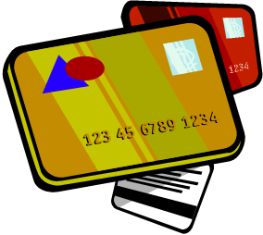
Your Credit Cards
Notes:
How often do you use your credit cards?
Do you know how much it is costing you in interest to use the cards on a monthly basis? Yearly basis?
Why is this important to know and understand?

Slide 5
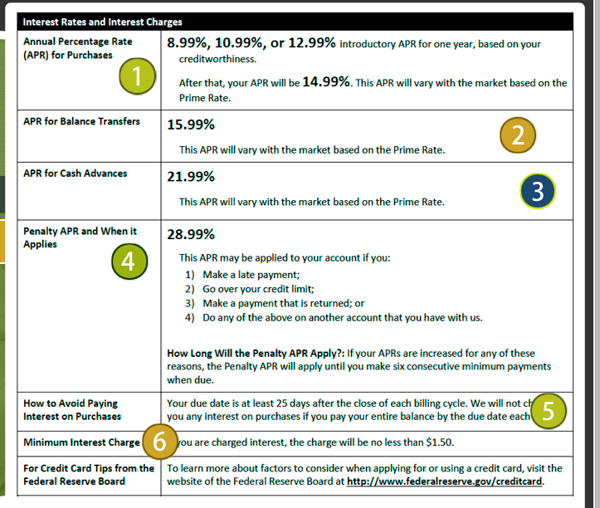
Sample of a Credit Card
Click on picture
Notes:
Roll over the numbers to get more information on what will appear on credit card offers. There are two parts to the information. Discuss points 1-12 so the students understand all the fees and interest rates pertaining to a credit card.
Federal Reserve.gov
Sample of a Credit Card
http://www.federalreserve.gov/creditcard/flash/offerflash.html

Slide 6

Using a Credit Card Calculator
  Using the handout “Using a Credit Card Calculator,” you will use a credit card calculator to find out how much less interest you will pay when you increase your credit card payment.
  How much faster can you pay off the loan when you make larger payments?
  How can you be smart about credit card usage?
Notes:
This lesson is designed to help you understand how you can reduce the interest you pay by making more than the minimum payment on your credit card. Understanding how much interest you pay helps you make wiser decisions about credit.

Slide 7

Buying a Home
Notes:
Buying a home is a big step. You do pay a great deal of interest when you buy a home, but there are benefits. You can receive a tax break from the interest you pay, which will save you money. This tax break will decrease the interest you are paying. Over a period of time, you build equity in the home, so it can be a great investment. You can also decorate and remodel a home to your liking.

Slide 8

Five Tips for Shopping for a Mortgage
  Know what you can afford
  Shop around--compare loans from lenders and brokers
  Understand loan prices and fees
  Know the risks and benefits of loan options
  Get advice from trusted sources
Notes:
Know what you can afford.
Review your monthly spending plan to estimate what you can afford to pay for a home, including the mortgage, property taxes, insurance and monthly maintenance and utilities. Make sure you save for emergencies. Plan ahead to be sure you will be able to afford your monthly payments for several years. Check your credit report to make sure that the information in it is accurate. A higher credit score may help you get a lower interest rate on your mortgage.
Shop around--compare loans from lenders and brokers.
Shopping takes time and energy, but not shopping around can cost you thousands of dollars. You can get a mortgage loan from mortgage lenders or mortgage brokers. Brokers arrange mortgage loans with a lender rather than lend money directly; in other words, brokers sell you a loan from a lender. Neither lenders nor brokers have to find the best loan for you--to find the best loan, you have to do the shopping.
Understand loan prices and fees.
Many consumers accept the first loan offered and don't realize that they may be able to get a better loan. On any given day, lenders and brokers may offer different interest rates and fees to different consumers for the same loan, even when those consumers have the same loan qualifications. Keep in mind that lenders and brokers also consider the profit they receive if you agree to the terms of a loan with higher fees, higher points, or a higher interest rate. Shopping around is your best way to avoid more expensive loans.
Know the risks and benefits of loan options.
Mortgages have many features--some have fixed interest rates and some have adjustable rates; some have payment adjustments; on some you pay only the interest on the loan for a while and then you pay down the principal (the loan amount); some charge you a penalty for paying the loan off early; and some have a large payment due at the end of the loan (a balloon payment). Consider all mortgage features, the APR (annual percentage rate), and the settlement costs. Ask your lender to calculate how much your monthly payments could be a year from now, and five or ten years from now. A mortgage shopping worksheet (click on picture) can help you identify the features of different loans. Mortgage calculators can help you compare payments and the equity you could build with different mortgage loans.
Get advice from trusted sources.
A mortgage loan is one of the most complex, most expensive financial commitments you will ever assume--it’s okay to ask for help. Talk with a trusted housing counselor or a real estate attorney that you hire to review your documents before you sign them.
Board of Governors of the Federal Reserve Board
Five Tips: Shopping for a Mortgage
http://www.federalreserve.gov/consumerinfo/fivetips_mortgageshop.htm

Slide 9

Using a Spreadsheet
  The best tool to use for figuring interest on a home is a spreadsheet.
  Homes are purchased over 15 or 30 years, and a spreadsheet allows you to look at the whole picture.
  You can use any spreadsheet to examine the numbers. Excel is a popular one.
Notes:
Note to Teacher: You may have students create their own spreadsheets or give them the one on file to use to answer questions and help them understand interest on a home. You may opt to have the students create a spreadsheet to determine the payments of a mortgage. See Enrichment Activity.
You will create a spreadsheet and use it to answer questions. Understand that at the beginning of a mortgage you pay a great deal of interest; therefore, you will not build much equity in your home until you have lived in it for some time. If you only plan to live in an area three years, it might be best not to buy because you do not have much time to build equity.

Slide 10

Learn to Crunch the Numbers
Click on Picture
Notes:
We are going to watch this video before we create our own spreadsheets. It helps us understand a great deal about a home mortgage.
The beauty of a spreadsheet is once you figure out the formulas, you can fill down, and the numbers will automatically populate.
The tough part is figuring out the formulas
You will use the “Setting Up a Spreadsheet” handout to walk you through the process of financing a home.
Teacher note: This video is 18 minutes long.
Introduction to Mortgage Loans
Khan Academy teaches you how to understanding the financial aspect of mortgage loans.
https://www.khanacademy.org/science/core-finance/housing/mortgages-tutorial/v/introduction-to-mortgage-loans

Slide 11
After Looking at the Interest on the Spreadsheet
  You might think “WOW! That is a lot of money I am paying in interest. Is it worth it to buy a house?”
  The answer is yes if—
  You plan on living in the house more than five years so you have time to build equity.
  You keep in mind mortgage interest is tax deductible so you can get some of that money back.
  You consider that your rent payment can increase while your mortgage payment remains constant.
Notes:
The important part is to understand some basic concepts about mortgage interest. The longer you live in your home, the smaller the portion of payment goes to interest. This means a larger portion goes to the principal and translates into more equity or ownership in your home.

Slide 12

Auto Loans
Notes:
Most individuals cannot afford to pay cash for a vehicle, so the alternative is obtaining a loan. The total amount of interest paid is determined by the interest rate, your credit history and employment history.

Slide 13

Purchasing a Vehicle
  Research prices and features
  Check the trade-in value of your vehicle
  Do not sign any blank papers
  Do your homework; know what you want and how much you can afford before you begin
Click on picture
Notes:
Purchasing a vehicle is a large investment. You need to shop around for the best deal and the lowest interest rate.
Research prices and features available for the vehicle(s) you are interested in purchasing before visiting a dealership.
Have your research and prices with you when you visit a dealership to help negotiate the price and available features.
If you have a trade-in vehicle, check the value in the NADA Guide (available on the web at www.nadaguides.com) so you know the value of your vehicle before visiting a dealership.
Do not sign any blank papers.
When purchasing a used vehicle, request to see the prior title. The dealer should have the title in his possession before selling the vehicle.
Most car dealers are honest businessmen, but remember that their business is selling vehicles. The best protection against being "ripped off" is to be an educated consumer. Do your homework; know what you want and how much you can afford before you begin.
Suggest to students it is a good idea to look at an auto loan calculator and use it as a tool to figure out what they can afford before they go shopping for a car. We are all drawn to the cars with all the bells and whistles. It makes it easier to know what we can afford before we get drawn into purchasing a vehicle that stretches the budget. We need to be able to afford the gasoline and insurance to use the vehicle.
Scenario: You purchased a vehicle for $16,000.00 with a 4% interest rate and a monthly payment of $250.00. How long will it take you to pay off the vehicle?
Teacher note: Click on the picture and enter the information from the scenario to obtain the answer.
Answer: It is going to take you six years to pay off the vehicle. The payoff amount is $18,026.00. How much interest did you pay? The answer is $2,026.00.
Myarmyonesource.com
Debt Payoff Calculator
http://www.myarmyonesource.com/data/Calculators/Debt_Payoff/DebtPayoff.html

Slide 14

Using a Credit Calculator to Figure out a Car Payment
  In this activity, you will use the auto calculator to fill in the chart and then compare the numbers.
  The important part of the lesson is the conclusions you come to from studying the numbers.
  Your lifestyle choices concerning responsibility of paying loans on time can translate into money in your pocket.
Notes:
Make good decisions when making large purchases. You don’t want to have regrets later.
Teacher note: The students will complete “Using a Credit Calculator to Figure a Car Payment” to determine a car payment for a $25,000.00 loan. Use “Using a Credit Calculator to Figure a Car Payment (Key)” to check students' answers.

Slide 15

In Conclusion…
  Interest can make you or break you. If you make sound financial decisions, you will be on your way to a happy, worry-free life!
Notes:
Proceed with Guided Practice Activity 3.

Slide 16

Questions:

Slide 17
References and Resources
  Images:
    Microsoft Clip Art: Used with permission from Microsoft.
  Textbooks:
    Campbell, S. R. (2010). Foundations of personal finance. Tinley Park, IL: Goodheart-Willcox.
  Websites:
    BankRate
    Use our calculators to finesse your monthly budget, compare borrowing costs and plan for your future. See our full list of calculator and decision tools.
    http://www.bankrate.com/calculators.aspx
    Board of Governors of the Federal Reserve System
    Consumer guide on interest rates and credit card information.
    http://www.federalreserve.gov/creditcard/rates.html

Slide 18
References and Resources
    Creditcards.com
    The set of calculators on the website are designed to help you find answers to your financial questions.
    http://www.creditcards.com/calculators/
    Federal Deposit Insurance Corporation (FDIC)
    Preserves and promotes public confidence in the U.S. financial system by insuring deposits in banks and thrift institutions for at least $250,000; by identifying, monitoring and addressing risks to the deposit Insurance funds; and by limiting the effect on the economy and the financial system when a bank or thrift institution fails.
    http://www.fdic.gov/
    Federal Reserve.gov
    Sample of a Credit Card
    http://www.federalreserve.gov/creditcard/flash/offerflash.html
    Myarmyonesource.com
    Debt Payoff Calculator
    http://www.myarmyonesource.com/data/Calculators/Debt_Payoff/DebtPayoff.html

Slide 19
References and Resources
    MyMoney.gov
    Save and invest your money.
    http://www.mymoney.gov/save-invest/Pages/saveandinvest.aspx
    Practical Money Skills for Life
    To help consumers and students of all ages learn the essentials of personal finance, Visa has partnered with leading consumer advocates, educators and financial institutions to develop the Practical Money Skills program.
    https://www.practicalmoneyskills.com/foreducators/lesson_plans/lev9-12/SA_Lesson10.pdf
  Videos:
    Khan Academy
    Introduction to Mortgage Loans
    https://www.khanacademy.org/science/core-finance/housing/mortgages-tutorial/v/introduction-to-mortgage-loans
    How to Teach the Rule of 72 to Children
    Teaching Children about the Rule of 72
    http://youtu.be/ShwCeTeKWOI

