Slide 1
Introductory Lesson:
Food Science
Notes:
This lesson will provide you with a brief overview of this course.

Slide 3
Career and Technical Education (CTE)
  Definition #1:
    Career and technical education (CTE) instruction aims at developing foundational skills, core workplace competencies, and specific skill competencies in various occupational areas.
  Definition #2:
    CTE instruction prepares young people to manage the dual roles of family member and wage earner and enable students to gain entry-level employment in a high-skill, high-wage job and/or to continue their education.
Notes:
Allow a student to read the definitions for Career and Technical Education. Provide students with an index card and have them write a definition for CTE in their own words. Share responses.
If you choose to further explore the topic of Career and Technical Education, please see About CTE Presentation http://cte.unt.edu/home/about.html

Slide 4
Career and Technical Education (CTE)
  Internships, practicum courses, career preparation courses, dual enrollment programs, and apprenticeships are a few venues that deliver career and technical education by providing meaningful opportunities for learners to apply their academic and technical skills.
Notes:
Allow student a few moments to read the information on the slide and on the back of their index card write down all unfamiliar terms.
Lead a brief class discussion on the contents of the slide. Define and provide examples of all unfamiliar terms. Inform students of CTE venues available in your district, your campus and your program.

Slide 5
Career and Technical Education (CTE)
  Historical Side Notes:
    In the past, Career and Technical Education (CTE) was organized by program areas, but is now organized by career clusters.
  Example:
    Family and Consumer Sciences (program area) courses are now located in five career clusters:
      Arts, AV Technology and Communication (Fashion Design courses)
      Architecture and Construction (Interior Design courses)
      Education and Training
      Hospitality and Tourism
      Human Services

Slide 6
Notes:
Provide a copy of this slide to the students.
The 16 clusters identified by the U.S. Department of Education, classify workforce preparation programs that are obtained through career and technical education.
What cluster do you think Food Science falls under? Have students read the descriptors for each cluster?
The course Food Science is in the Hospitality and Tourism Cluster.
If time permits, allow students to discuss other CTE courses available at your campus and determine their career clusters.

Slide 7
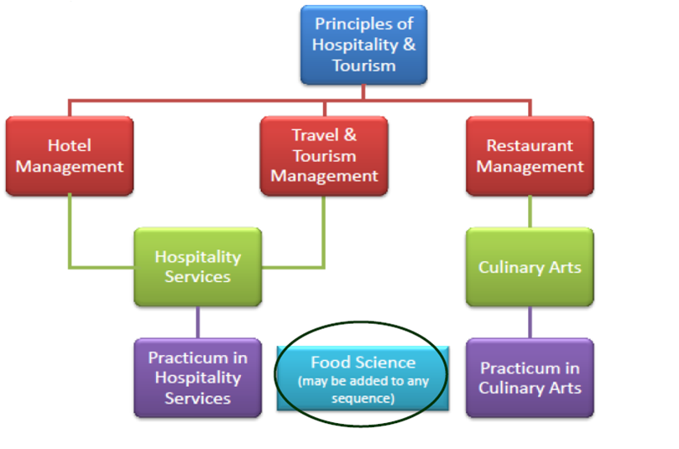
Hospitality and Tourism
  TEA recommended coherent sequence of courses
Notes:
The Texas Education Agency has approved 9 high school courses in Hospitality and Tourism. Not all high schools offer all courses.
What is a sequence?
The goal of CTE in high school is to progress through a sequence of courses that lead to the attainment of academic and technical skills.
Discuss the sequence for Hospitality and Tourism on your campus/district.
If applicable, discuss other courses/sequences offered at your campus and in your district.
Inform students that it is possible to incorporate courses from other sequences or clusters into their personal program of study.
Example:
Sandra wants to be a high school coach. In addition to her education and training courses, she asks her counselor to enroll her in the course DOLLARS and SENSE (Human Services cluster) so that she can learn about handling finances.
In the future, Juan would like to become an elementary school principal. In addition to his education and training courses, Juan asked his counselor to enroll him in CHILD DEVELOPMENT, (Human Services cluster) so he can learn as much as he can about children.

Slide 8

Career and Technical Education (CTE)
  Career Cluster: Hospitality and Tourism
  Course Title: Food Science
  Hospitality and Tourism Career Cluster® TEKS
  Programs of Study:
    Chef Head Cook
    Food Beverage Manager
  Description:
    In Food Science students conduct laboratory and field investigations, use scientific methods during investigations, and make informed decisions using critical thinking and scientific problem solving. Food Science is the study of the nature of foods, the causes of deterioration in food products, the principles underlying food processing, and the improvement of foods for the consuming public.
Notes:
Each cluster has various Programs of Study.
We have already established that Food Science is in the Hospitality and Tourism career cluster.
What Program of Study/Career Pathway interests you?
Use the hyperlinks to reach the TCRC website, to access the actual document with details.

Slide 9
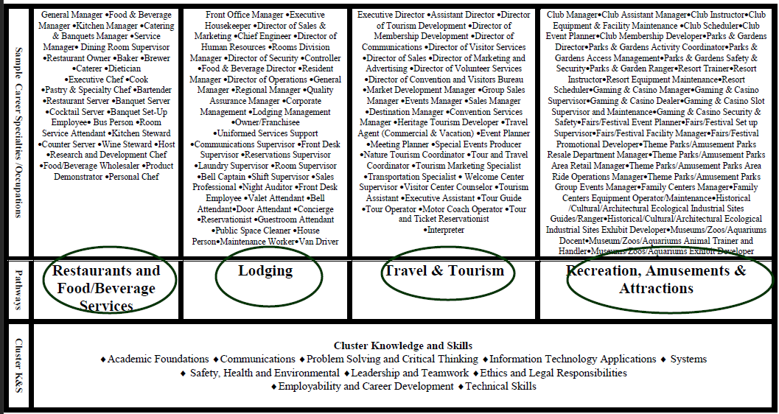
Planning, managing and providing education and training services, and related learning support services
Notes:
Review the contents of this chart with students, helping them make a connection between the cluster, selected program of study/pathway and possible career/occupations available to them.

Slide 10

Questions

Slide 11
Resources and References
  Websites:
    Texas CTE Resouce Centre
    https://www.txcte.org/

