Slide 1
Introductory Lesson:
Practicum in Education and Training
Notes:
This lesson will provide you with a brief overview of this course.

Slide 3
Career and Technical Education (CTE)
  Definition #1:
    Career and technical education (CTE) instruction aims at developing foundational skills, core workplace competencies, and specific skill competencies in various occupational areas.
  Definition #2:
    CTE instruction prepares young people to manage the dual roles of family member and wage earner and enable students to gain entry-level employment in a high-skill, high-wage job and/or to continue their education.
Notes:
Allow a student to read the definitions for Career and Technical Education. Provide students with an index card and have them write a definition for CTE in their own words. Share responses.
If you choose to further explore the topic of Career and Technical Education, please see About CTE Presentation http://cte.unt.edu/home/about.html

Slide 4
Career and Technical Education (CTE)
  Internships, practicum courses, career preparation courses, dual enrollment programs, and apprenticeships are a few venues that deliver career and technical education by providing meaningful opportunities for learners to apply their academic and technical skills.
Notes:
Allow student a few moments to read the information on the slide and on the back of their index card write down all unfamiliar terms.
Lead a brief class discussion on the contents of the slide. Define and provide examples of all unfamiliar terms. Inform students of CTE venues available in your district, your campus and your program.

Slide 5
Career and Technical Education (CTE)
  Historical Side Notes:
    In the past, Career and Technical Education (CTE) was organized by program areas, but is now organized by career clusters.
  Example:
    Family and Consumer Sciences (program area) courses are now located in five career clusters:
      Arts, AV Technology and Communication (Fashion Design courses)
      Architecture and Construction (Interior Design courses)
      Education and Training
      Hospitality and Tourism
      Human Services

Slide 6
Notes:
Provide a copy of this slide to the students.
The 16 clusters identified by the U.S. Department of Education, classify workforce preparation programs that are obtained through career and technical education.
What cluster do you think Principles of Education and Training falls under? Have students read the descriptors for each cluster?
The course Practicum in Education and Training is in the Education and Training Clusters.
If time permits, allow students to discuss other CTE courses available at your campus and determine their career clusters.

Slide 7
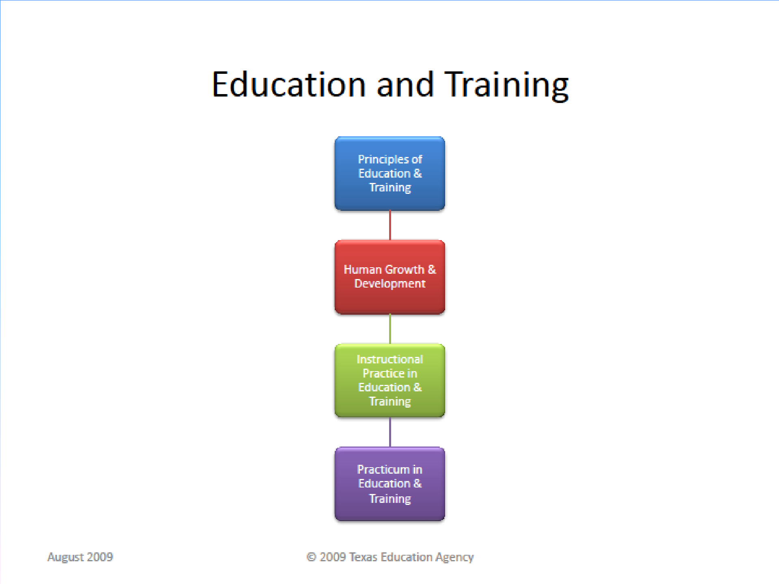
Education and Training
  TEA recommended coherent sequence of courses
Notes:
The Texas Education Agency has approved 4 high school courses in Education and Training. Not all high schools offer all courses. What is a coherent sequence?
The goal of CTE in high school is to progress through a sequence of courses that lead to the attainment of academic and technical skills.
Discuss the sequence for Education and Training on your campus/district.
If applicable, discuss other courses/sequences offered at your campus and in your district.
Inform students that it is possible to incorporate courses from other sequences or clusters into their personal program of study.
Encourage students to speak to their counselors.
Recommended sequences for all cluster courses can be found at: http://www.tea.state.tx.us/index2.aspx?id=5415

Slide 8

Career and Technical Education (CTE)
  Career Cluster: Education and Training
  Course Title: Practicum in Education and Training
  Education and Training Career Cluster® TEKS
  Programs of Study:
    Education and Training
  Description:
    Practicum in Education and Training is a field-based internship that provides students background knowledge of child and adolescent development principles as well as principles of effective teaching and training practices. Students learn to plan and direct individualized instruction and group activities, prepare instructional materials, assist with record keeping, make physical arrangements, and complete other responsibilities of classroom teachers, trainers, paraprofessionals, or other educational personnel.
Notes:
Each cluster has various Programs of Study.
We have already established that Education Practicum and Training is in the Education and Training career cluster.
What Program of Study/Career Pathway interests you?
Use the hyperlinks to reach the TCRC website, to access the actual document with details.

Slide 9
Planning, managing and providing education and training services, and related learning support services
Psychologists- Clinical, Developmental, Social
Social Workers
Parent Educators
Counselors
Program Advisors
Financial Aid Advisors
Career Counselors/ Advisors
Career and Employment Placement Counselors
Speech-Language Pathologists and Audiologists
Instructional Resources Coordinator
Technology Support Administrator Database Administrators/AV Specialists
Distance Education Coordinator Human Resources Manager
Organization Development Specialist
Training Manager/Coordinator Instructional Coordinators Museum Coordinators/Technicians Media Coordinators/Specialists Instructional Media Designer
Preschool, Kindergarten Teachers, Aides
Elementary Teachers, Aides
Secondary/CTE Teachers, Aides
Special Education Teachers, Aides
College/University Lecturers
Professors Human Resource Trainers
Physical Trainers
Professional Coaches
Preschool & Child Care Program Directors
Child Care Assistants/Workers
Child Life Specialist
Nanny
Early Childhood Teachers and Assistants
Instructional Systems Specialist Corporate Trainers and Educators
Adult Literacy Teachers
Librarians/Assistants/ Technicians
Elementary and Secondary Superintendents, Principals, Administrators
Supervisors and Instructional Coordinators
Education Researchers, Test Measurement Specialists/ Assessment Specialists
College Presidents, Deans, Department Chairs, Program Coordinators
Post-Secondary Administrators
Curriculum Developers
Instructional Media Designers Education and Training Technician Labor Relations Managers/Specialists
Sample Career Specialties / Occupations
Pathways
Administration and Administrative Support
Professional Support Services
Teaching/Training
Cluster K&S
Cluster Knowledge and Skills
Academic Foundations Communications ◻Problem Solving and Critical Thinking ◻Information Technology Applications ◻ Systems
  Safety, Health and Environmental ◻Leadership and Teamwork ◻Ethics and Legal Responsibilities
    Employability and Career Development ◻Technical Skills
Notes:
Review the contents of this chart with students, helping them make a connection between the cluster, selected program of study/pathway and possible career/occupations available to them.

Slide 10

Questions

Slide 11
Resources and References
  Websites:
    Texas CTE Resouce Centre
    https://www.txcte.org/

