Slide 1
Introductory Lesson:
Introduction to Cosmetology
Notes:
This lesson will provide you with a brief overview of this course.

Slide 3
Career and Technical Education (CTE)
  Definition #1:
    Career and technical education (CTE) instruction aims at developing foundational skills, core workplace competencies, and specific skill competencies in various occupational areas.
  Definition #2:
    CTE instruction prepares young people to manage the dual roles of family member and wage earner and enable students to gain entry-level employment in a high-skill, high-wage job and/or to continue their education.
Notes:
Allow a student to read the definitions for Career and Technical Education. Provide students with an index card and have them write a definition for CTE in their own words. Share responses.
If you choose to further explore the topic of Career and Technical Education, please see About CTE Presentation http://cte.unt.edu/home/about.html

Slide 4
Career and Technical Education (CTE)
  Internships, practicum courses, career preparation courses, dual enrollment programs, and apprenticeships are a few venues that deliver career and technical education by providing meaningful opportunities for learners to apply their academic and technical skills.
Notes:
Allow student a few moments to read the information on the slide and on the back of their index card write down all unfamiliar terms.
Lead a brief class discussion on the contents of the slide. Define and provide examples of all unfamiliar terms. Inform students of CTE venues available in your district, your campus and your program.

Slide 5
Career and Technical Education (CTE)
  Historical Side Notes:
    In the past, Career and Technical Education (CTE) was organized by program areas, but is now organized by career clusters.
  Example:
    Family and Consumer Sciences (program area) courses are now located in five career clusters:
      Arts, AV Technology and Communication (Fashion Design courses)
      Architecture and Construction (Interior Design courses)
      Education and Training
      Hospitality and Tourism
      Human Services

Slide 6
Notes:
Provide a copy of this slide to the students.
The 16 clusters identified by the U.S. Department of Education, classify workforce preparation programs that are obtained through career and technical education.
What cluster do you think Introduction to Cosmetology falls under? Have students read the descriptors for each cluster?
The course Introduction to Cosmetology is in the Human Services Cluster.
If time permits, allow students to discuss other CTE courses available at your campus and determine their career clusters.

Slide 7
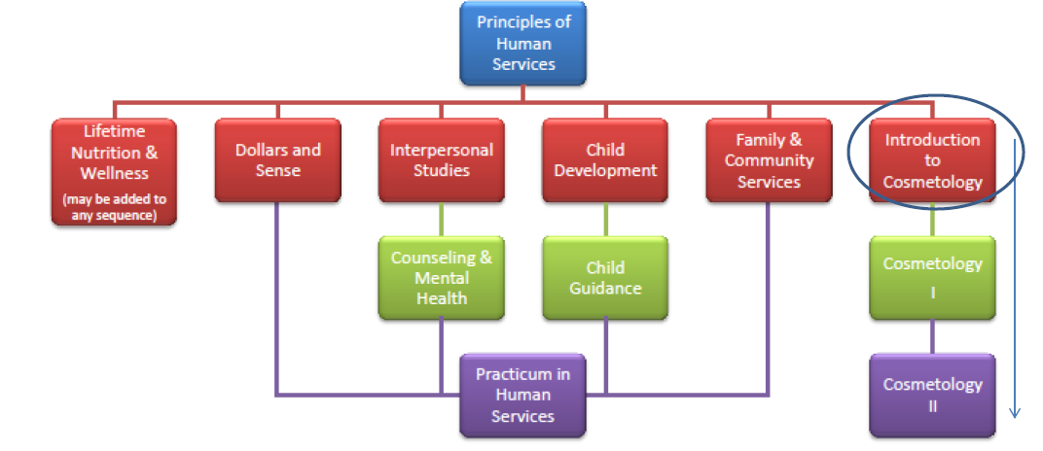
Human Services
  TEA recommended coherent sequence of courses
Notes:
The Texas Education Agency has approved 12 high school courses in Human Services. Not all high schools offer all courses.
What is meant by coherent sequence? The goal of CTE in high school is to progress through a sequence of courses that lead to the attainment of academic and technical skills. Discuss the sequence of Human Services on your campus/district.
If applicable, discuss other Human Services courses/sequences offered at your campus and in your district.
Inform students that it is possible to incorporate courses from other sequences or clusters into their personal program of study.
Example:
Sandra wants to someday own a hair salon. In addition to her cosmetology courses, she asks her counselor to enroll her in the course DOLLARS and SENSE (another Human Services course) so that she can learn about handling finances.
In the future, Juan would like to work in a salon and eventually provide for a family of his own. In addition to his cosmetology courses, Juan asks his counselor to enroll him in CHILD DEVELOPMENT, so he can learn as much as he can about children.
Encourage students to speak to their counselors.

Slide 8

Career and Technical Education (CTE)
  Career Cluster: Human Services
  Course Title: Introduction to Cosmetology
  Human Services Career Cluster® TEKS
  Programs of Study:
    Sales Manager Apparel
    Cosmetologist
  Description:
    In Introduction to Cosmetology, students explore careers in the cosmetology industry. To prepare for success, students must have academic and technical knowledge and skills relative to the industry. Students may begin to earn hours toward state licensing requirements.
Notes:
Each cluster has various Programs of Study.
We have already established that Introduction to Cosmetology is in the Human Services Cluster.
There are 5 Programs of Study in Education and Training, as mentioned in the slide. What Program of Study/Career Pathway interests you?
Use the hyperlinks to reach the TCRC website, to access the actual document with details.

Slide 9
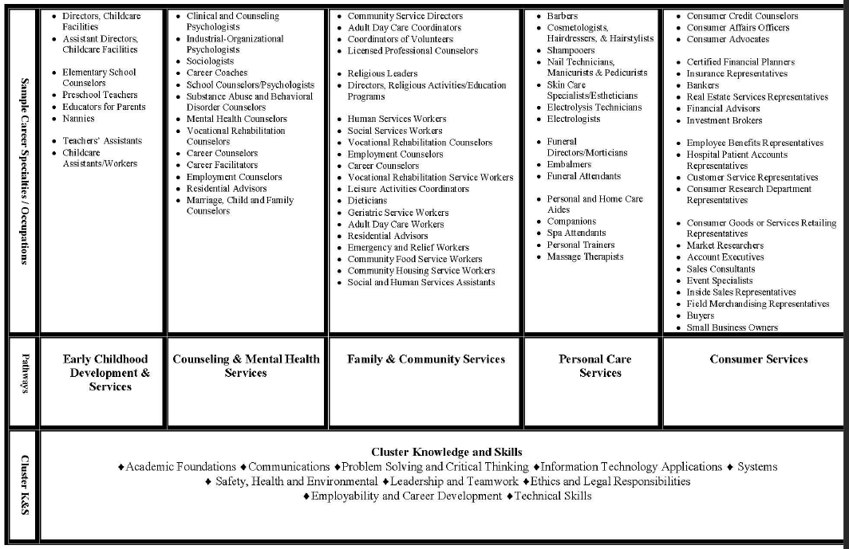
Planning, managing and providing education and training services, and related learning support services
Notes:
Review the contents of this chart with students, helping them make a connection between the cluster, selected program of study/pathway and possible career/occupations available to them.

Slide 10

Questions

Slide 11
Resources and References
  Websites:
    Texas CTE Resouce Centre
    https://www.txcte.org/

