Slide 1
It Takes Teamwork!
Notes:
Review the instructional objectives, vocabulary words and definitions.

Slide 3
TEAM
Notes:
Writing Strategy: Ask students to list other words or phrases to describe a team or work in groups to develop another acrostic. You may opt to assign a scribe to record all the words or phrases on the board. Lead students to give examples of characteristics cited and to list additional characteristics and practices of an effective team member.
Teacher note: You may opt to create a Wordle “word cloud” from words or phrases the students used to describe a team at www.wordle.net.

Slide 4
Teamwork
Notes:
What is a team? What are other terms for “team”?
Group
Committee
Board (of directors)
Assembly
Unit
Allow for a class discussion on the definition.

Slide 5
Why work in teams or groups?
Why work in teams or groups?
Notes:
Allow students to brainstorm.
ideas may include:
More people = more ideas
Members can help each other
More can get accomplished in a group than just one person doing all of the work
Allow time for students to discuss the answer.

Slide 6
Why work in teams?
We all can learn from each other
Teams can be more effective than individuals when working on complex projects
Teamwork helps develop interpersonal skills
Notes:
Teamwork is necessary in education and the workplace. It allows members to learn from each other, become more effective by collaborating with one another and helps team members to develop interpersonal skills.

Slide 7
Characteristics of Effective Team Members
Cooperate and contribute
Expect success - have a positive “Can do” attitude
Good communicators
Reliable
Respectful of other team members
Work to find solutions to problems
Notes:
Provide opportunity for students to add other ideas to the list.
effort
ideas
suggestions
Listens to other team members’ ideas
Provides encouragement to other team members
Resolves differences for the benefit of the team
United States Department of Labor
Soft Skills – Communication
http://youtu.be/X0voPlW2pSs

Slide 8
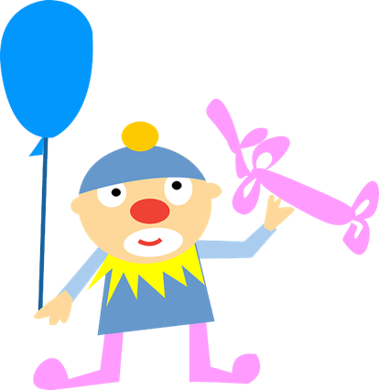
Characteristics of Ineffective Team Members
Aggressive
Continuously interrupt others
Disruptive
Dominating
Do not take projects/tasks seriously
Not dependable
Withdrawn and/or afraid to contribute
Notes:
What is the difference between an effective team member and an ineffective team member?
Enrichment activity: Divide the class into groups. Give each group poster paper and markers. Have groups develop a list of items that create a successful team and present their posters to the class. These could be placed in the hall to share with the school.

Slide 9
Leadership Skills
Learning to Lead
Notes:
What is a leader?
Allow students to discuss the answer.

Slide 10
Boss versus Leader
Are a boss and leader always the same?
Notes:
Have students discuss the difference between someone who just tells everyone what do to and someone who inspires people do to their best. List characteristics of each.

Slide 11
Skills of Effective Leaders
Building and sustaining relationships
Developing and communicating a vision
Influencing people
Making decisions
Overcoming setbacks and adversity
Understanding people’s needs
Notes:
Do you possess these skills as a leader?
You may refer to the full article which provides more of an explanation of these skills at:
Community Tool Box
Core Functions in Leadership
http://ctb.ku.edu/en/table-of-contents/leadership/leadership-functions

Slide 12
Characteristics of a Good Leader
Challenge people to think
Communicate clear expectations
Lead by example
Make decisions
Make others feel safe to speak up
Measure and reward performance
Properly allocate and deploy talent
Provide continuous feedback-positive and negative
Notes:
A good leader will possess the qualities on the board. What qualities do you feel is missing from the list? Allow for a short discussion.
This link below is to the full article and will provide additional information of the listed characteristics of leaders.
Forbes
The Most Successful Leaders Do 15 Things Automatically, Every Day
http://www.forbes.com/sites/glennllopis/2013/02/18/the-most-successful-leaders-do-15-things-automatically-every-day/

Slide 13
Characteristics of a Good Leader
Are accountable to others
Are great teachers
Ask questions and seek counsel
Create a positive, energetic atmosphere
Genuinely enjoy responsibility
Invest in relationships
Problem solve without procrastinating
Are professional
Notes:
Think about the great leaders of our country or the world. What are some examples of how they exhibit(ed) good leadership skills?
Allow for a short discussion.
United States Department of Labor Soft Skills – Professionalism http://youtu.be/7dPWVjQSad4

Slide 14
Leadership and learning are indispensable. - John F. Kennedy
Notes:
What do you think this means?
Discussion starters: Leadership must be learned because it is more than telling someone what to do. Leaders must be knowledgeable of their fields and keep up with new information. Leaders learn about the wants and needs of their employees. Leaders must know where they want to go (vision) and learn techniques to reach those goals.

Slide 15
Problem Solving
Notes:
What does it mean to problem solve? How do you solve problems?
Allow for a short discussion.

Slide 16
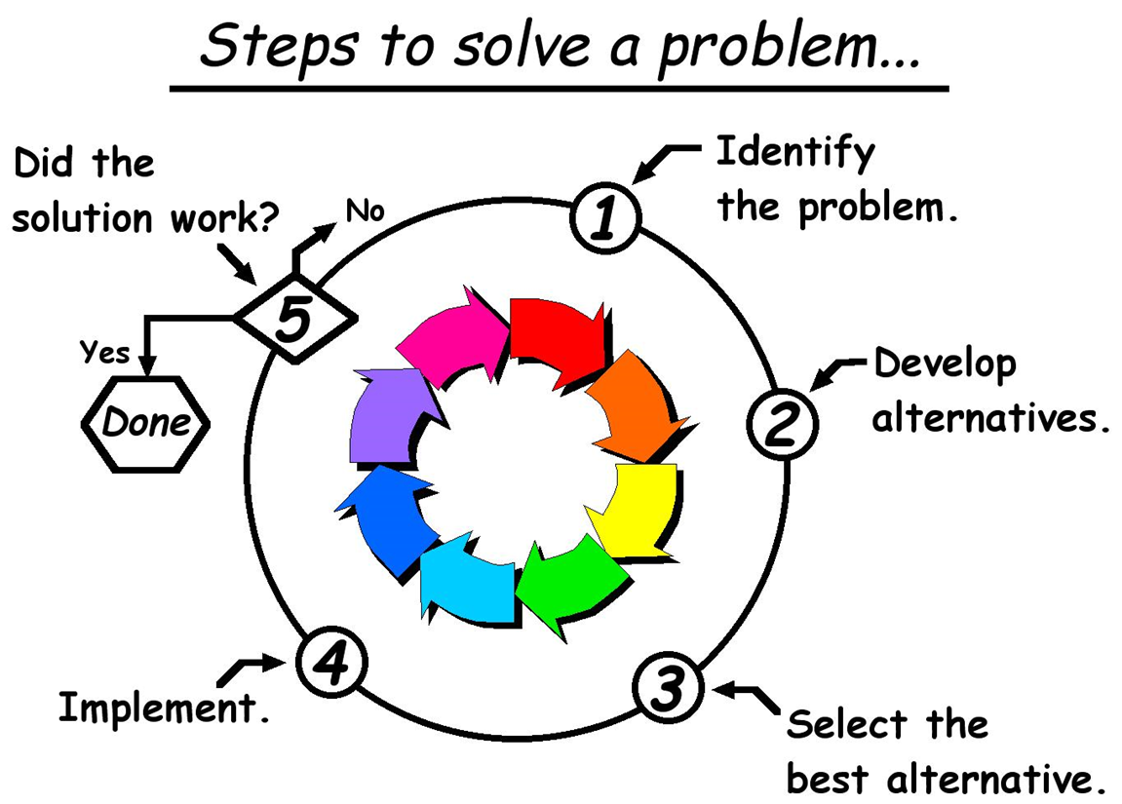
Steps To Problem Solving
Notes:
There are five simple steps to problem solving:
Identify the problem
Develop alternative solutions
Select the best choice
Implement the plan
Evaluate the outcome
This is the FCCLA Planning Process.

Slide 17
Identify The Problem
Define the problem to be solved
Ask others for input
Notes:
When looking at the problem at hand, ask yourself the following questions:
What can you see that causes you to think there's a problem?
Where is it happening?
How is it happening?
When is it happening?
With whom is it happening? (HINT: Don't jump to "Who is causing the problem?" When we're stressed, blaming is often one of our first reactions. To be an effective manager, you need to address issues more than people.)
Why is it happening?

Slide 18
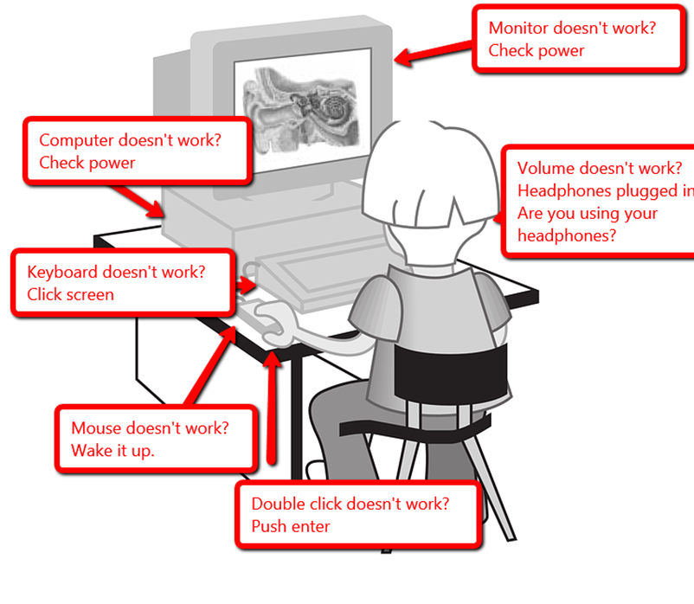
Develop Alternative Solutions
Brainstorm a variety of solutions to the problem
Notes:
Explore options for solving the problem. Continue to seek advice from others – it is possible that friends or family members may see a potential solution that you do not see. Don’t worry if your solutions to the problems are not realistic, practical or effective. Sometimes a solution could be derived from one you might eliminate too quickly.

Slide 19
Select the Best Alternative
Write down the advantages and disadvantages of each solution
Discuss each alternative in detail
Notes:
When weighing the possibilities, consider the following questions:
Which approach is the most likely to solve the problem for the long term?
Which approach is the most realistic to accomplish for now? Do you have the resources? Are they affordable? Do you have enough time to implement the approach?
What is the extent of risk associated with each alternative?
Is it relevant to my situation?
Is it realistic?
Is it manageable?
What are the consequences – both good and bad?
What is the likelihood that it is going to help me reach my goal?

Slide 20
Implement A Solution
Notes:
After weighing all the possible choices, pick one solution and implement it.

Slide 21
Evaluate the Outcome
Look over the solution – did it work?
Notes:
The last step in problem solving is to evaluate the outcome – How effective is the solution? Did it achieve what I wanted? What consequences (good and bad) did it have in my situation? Are you seeing what you would expect from the indicators?
Will the plan be done according to schedule?
If you find the solution does not work, then it is back to the drawing board! Select a new solution and gage its effectiveness.

Slide 23
References and Resources
Images:
Microsoft Clip Art: Used with permission from Microsoft.
Textbooks:
Newberry, B. (2010). Life skills for the 21st century: Building a foundation for success. Boston: Prentice Hall.
Websites:
Community Tool Box Core Functions in Leadership http://ctb.ku.edu/en/table-of-contents/leadership/leadership-functions
Forbes Ten Steps You Can Take to Become a Successful Young Leader at Work http://www.forbes.com/pictures/elhm45edee/10-establish-relationships-with-superiors-and-find-a-mentor/

Slide 24
References and Resources
Forbes The Most Successful Leaders Do 15 Things Automatically, Every Day http://www.forbes.com/sites/glennllopis/2013/02/18/the-most-successful-leaders-do-15-things-automatically-every-day
Problem Solving and Decision Making
Free Management Library
http://managementhelp.org/personalproductivity/problem-solving.htm
Problem Solving
Lorain Community College
http://www.lorainccc.edu/Current+Students/Advising+and+Counseling/Counseling/Problem+Solving+-+2.htm

