Slide 1
It’s All About Customer Service
  Travel and tourism management

Slide 3
Customer Service
  The total customer experience with that business
  “There is only one boss.
  The customer.
  And he can fire everybody in the company from the chairman on down, simply by spending his money somewhere else.”
  - Sam Walton
Notes:
Samuel Moore "Sam" Walton was an American businessman and entrepreneur born in Kingfisher, Oklahoma. He is best known for founding the retailers Walmart and Sam's Club.
Have students discuss what they believe Sam Walton meant by this statement.

Slide 4
Guest Needs
  Abraham Maslow
Notes:
Abraham Maslow was a psychologist who studied the needs that affect human behavior.

Slide 5
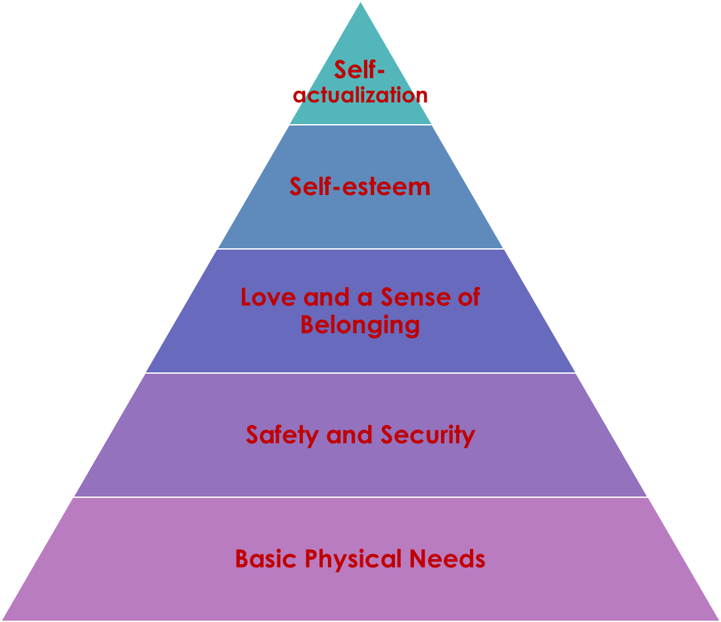
Maslow’s Hierarchy of Needs in Travel and Tourism
  The needs of the lower level of the pyramid must be met before the next higher need on the pyramid can be met
Notes:
Maslow identified five levels of human needs and placed them in a pyramid.
Most travel and tourism businesses are able to fulfill guests’ basic physical and safety needs (the first two levels).
What are some examples of guests’ needs at the lower levels?
Physical Needs – food, water, shelter, warmth and physical activity
Safety and Security – protection from harm or injury and for security from threats

Slide 6
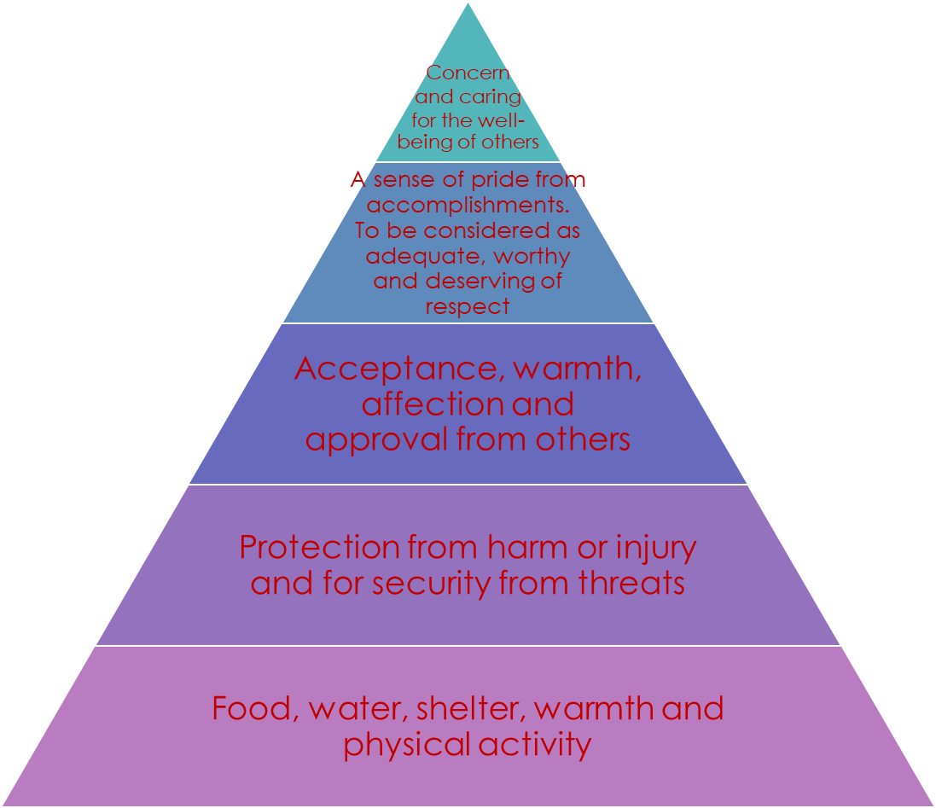
Basic Needs
  The high-level needs are more complex but are as important for human development
Notes:
Many travel and tourism businesses also provide ways to meet the higher level needs of their guests.
Can you think of some examples for the upper level needs?
Sense of belonging – eating with friends at a restaurant, attending a conference and going to family functions
Self-esteem – staying at a luxury hotel, eating at a five-star restaurant and traveling to major destinations
Self-actualization – traveling to foreign countries or taking educational tours

Slide 7
Quality Service
Notes:
Travel and tourism businesses can also meet the higher levels of the hierarchy by providing guests with quality service.
Quality service is service that meets or exceeds customer satisfaction.

Slide 8
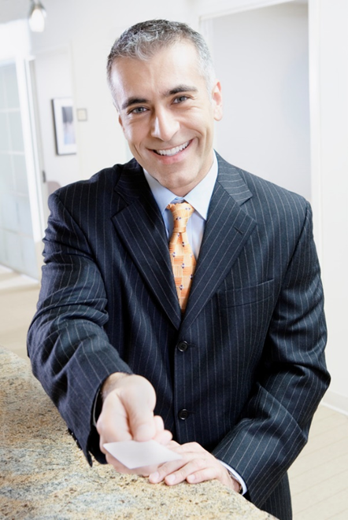
Travel and Tourism Employees
  Employees who are focused on guest needs have these characteristics:
    Address guests by name
    Are well-groomed
    Have good posture
    Make eye contact
    Respond quickly to requests
    Smile
Notes:
If guests have a great experience in traveling on a tour, they are more likely to return and become repeat customers.
They will also talk about this experience with their family and friends, thus increasing the business customer base.

Slide 9

Guest’s Name
  Use the guest’s name whenever possible
  Guests feel important and welcome
  Are more likely to return
Notes:
Using a guest's name acknowledges their identity and boosts their self-esteem.

Slide 10
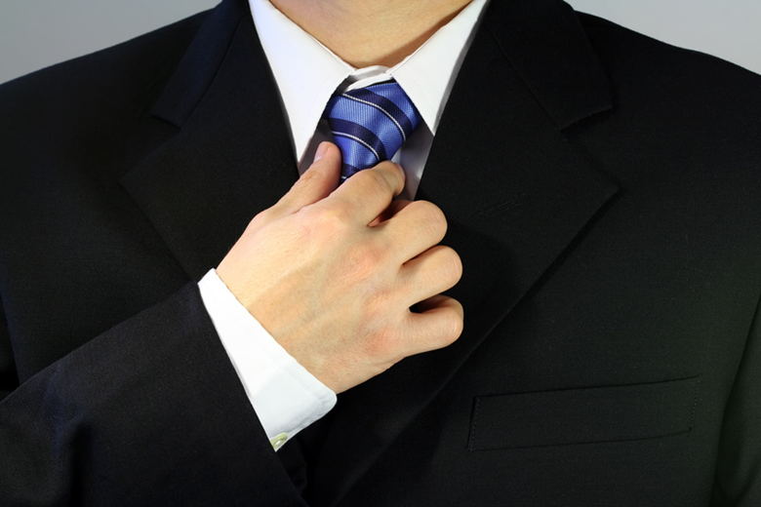
Well-groomed
  Image is important
  Employees seen by the public should have:
    A clean uniform
    A good appearance
    Good grooming
Notes:
Many travel and tourism businesses have uniform guidelines that employees must follow.

Slide 11

Eye Contact
  A powerful act of communication
  Indicates a willingness to serve
  Shows interest
Notes:
Making eye contact with the guest lets them know that you are giving them your total attention.

Slide 12

Posture
  Should be relaxed, but alert
  Head up
  Face should look interested
  Project a positive attitude
Notes:
Good posture is important to all employees.

Slide 13
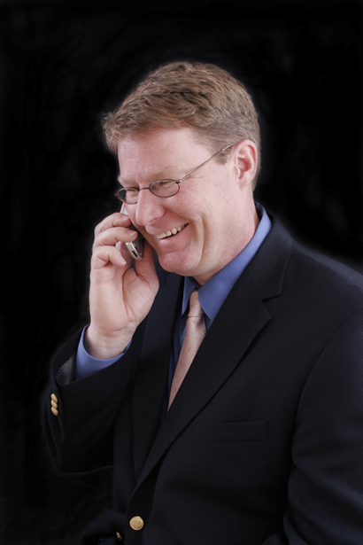
Respond quickly
  Attitude should be positive
  Demonstrate willingness to help
  Response should be competent
  Show concern
Notes:
Be sure to respond quickly when a guest has a question.

Slide 14

Smile
  Demonstrates:
    An eagerness to help
    Care and warmth
    Friendliness
    Respect
  Also shows you enjoy your job!
Notes:
All travel and tourism employees should have a smile as part of their uniform.

Slide 15

  Beauty and the Beast
  Be Our Guest
Notes:
Click on image to view video:
Beauty and the Beast - Be Our Guest
Be Our Guest song from Beauty and the Beast
http://youtu.be/afzmwAKUppU

Slide 16


Slide 17
References and Resources
  Abc
  Abc

Slide 18
References and Resources
  Book:
    Remarkable service: a guide to winning and keeping customers for servers, managers and restaurant owners. (2009). Hoboken, NJ: John Wiley & Sons.
  Images:
    Microsoft Office Clip Art: Used with permission from Microsoft
  Textbooks:
    Hospitality services reference book. (2001). The Curriculum Center for Family and Consumer Sciences. Lubbock, TX.
    Reynolds, J. S. (2010). Hospitality services: Food & lodging. Tinley Park, IL: Goodheart-Wilcox Company.

Slide 19
References and Resources
  Website:
    Texas A & M Agrilife Extension
    Online courses and programs
    For everyday people interested in learning more about a variety of topics
    https://extensiononline.tamu.edu/secure_index.php
  YouTube(tm) video:
    Beauty and the Beast - Be Our Guest
    Be Our Guest song from Beauty and the Beast
    http://youtu.be/afzmwAKUppU

