Slide 1
It’s My Life!

Slide 3
Terms
  Academic Goal: A goal that relates to your education or training.
  Career Preparation: Core activities that help youth become prepared for a successful future in careers or post secondary education institutions including career awareness activities that expose young people to information about the job market, job related skills, the wide variety of jobs that exist and the education and training they require, as well as the work environment where they are performed.
  Goal: A statement of something a person wants or needs to do.
  Lifestyle: The typical way of life of an individual, group, or culture.

Slide 4
Terms
  Long-term Goal: A goal that will take more than a year to achieve.
  Personal Goal: A goal that is related to your individual interests.
  Priorities: Something given or meriting attention before competing alternatives.
  Realism: Concern for fact or reality and rejection of the impractical and visionary.
  Short-term Goal: A goal that can be achieved within a year.
  Values: Relative worth, utility, or importance.

Slide 5

Long Term Vs. Short Term Goals
  Long Term
    A goal that will take more than a year to achieve.
    Ex: go to college, save for your dream car
  Short Term
    A goal that can be achieved within a year.
    Ex: study for a test, finish an essay, do chores, plan for the summer
    *can be a stepping stone for a long term goal
Notes:
Goals need to be realistic, specific and measurable. A person cannot expect to lose 100 pounds in a month. Make sure the goal is something you can realistically attain within a set time period. Short goals can be reached within a short time period, usually within one year. A short-term goal can be a stepping stone toward a long-term goal – a goal that takes more than a year to accomplish.

Slide 6

Terms
  Jot down 3 short-term goals and 3 long-term goals
  Make at least 1 short-term goal lead to a long-term goal
  Share your goals with a partner
    Answer the following:
      Do the goals fit in the right categories?
      Are the goals realistic? Why or why not?
      If not, what can be done to make the goal(s) realistic?
Notes:
Give the students 10 minutes to write down their goals. Then have them pair up to discuss the goals by answering the questions above.

Slide 7

Believe To Achieve!
  In order to Reach your goals, you must Believe in yourself!
  Write down a list of things you think you cannot do.
  Then, cross out “I cannot” and write “I can”
    Ex: I Cannot I can be a great cook!
    Ex: I Cannot I can run a marathon!
    Ex: I Cannot I can ace the math test!
Notes:
Play the song “I Believe I Can Fly” by R. Kelly

Slide 8


Remember!
  Always work toward your goal! If not, you’re working against your goal.
  Believe in yourself!
  There will always be obstacles! The way to determine success is by the way you handle them!
Notes:
What are some obstacles in your life? Give students time to reflect and share personal stories.
Everyone has obstacles at one time or another during their lifetime. Obstacles teach you to how to face adversity. The key to overcoming difficulties in your path is to believe in yourself! You must have the drive, perseverance and ambition to continue going and reach your goals.
People around you will see the way you handle obstacles in your life and will learn about your character by your actions. At some point in your life, you will have an obstacle, from challenging school work, to challenges at work to medical concerns. Think about the way you choose to handle each obstacle that comes your way. If you choose to handle it with confidence, determination and willpower, you will over come the obstacle. If you avoid the obstacle, you will never overcome the adversity. Either way, the manner in which you handle the obstacle will teach you about yourself.

Slide 9

Individuals Who Overcame Adversity
  Celebrity
    Thomas Edison
    Edgar Allan Poe
    Helen Keller
    Albert Einstein
    Beethoven
    Stevie Wonder
    Maya Angelou
    Oprah Winfrey
    Julius Caesar
    Johann Sebastian Bach
Notes:
There are many individuals who were either born into adversity or who experienced it during their lifetime. Obstacles are events we all must go through before attaining our goals.

Slide 10
Individuals Who Overcame Adversity
  Celebrity
    Thomas Edison
    Edgar Allan Poe
    Helen Keller
    Albert Einstein
    Beethoven
    Stevie Wonder
    Maya Angelou
    Julius Caesar
    Johann Sebastian Bach
  Obstacle
    ADHD
    Death of loved ones
    Deaf and blind
    Dyslexia
    Deaf
    Blind
    Molestation
    Epilepsy
    Orphaned at age 8
Notes:
Never let anyone discourage you from aiming for or achieving your life goals. Many individuals have overcome adversity and achieved greatness – you can TOO!
Individuals/Obstacles
Thomas Edison: ADHD
Edgar Allan Poe: Death of loved ones
Helen Keller: Deaf and blind
Albert Einstein: Dyslexia
Beethoven: Deaf
Stevie Wonder: Blind
Maya Angelou: Molestation
Julius Caesar: Epilepsy
Johann Sebastian Bach: Orphaned at age 8
All of these individuals overcame adversities in their lives to become famous for different reasons.

Slide 11

Goals
  Academic – relates to your education and training
  Personal – relates to your individual interests
Notes:
There are many areas in your life in which to make goals. Today we will plan our academic and personal goals.

Slide 12
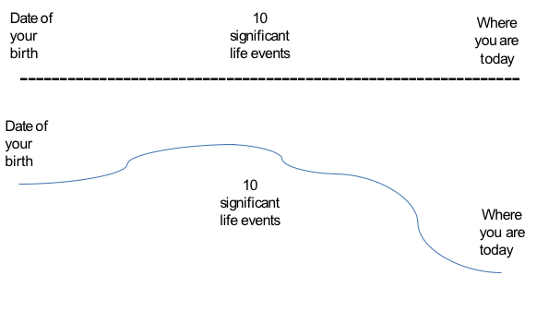
My Personal Timeline
Notes:
My Personal Timeline (see All Lesson Attachments tab)

Slide 13
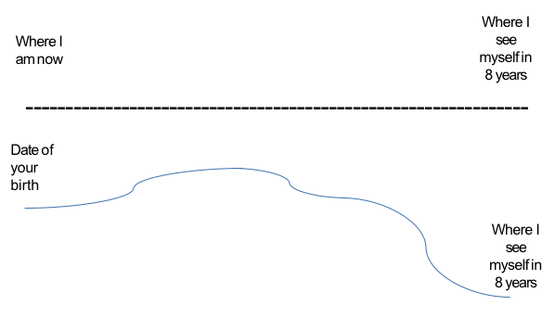

My Eight Year Plan
Notes:
Explain Eight Year Plan Project and Project Rubric

Slide 14
Questions?

Slide 15
References/Resources
  Images:
    Microsoft Office Clip Art: Used with permission from Microsoft.
  Websites:
    Collier-Brannin, S. (2012). Great teaching ideas. Retrieved from
    http://www.successlink.org/GTI/lesson_unit-viewer.asp?lid=8116
    Institute for Educational Leadership. (n.d.). Glossary & terms. Retrieved from
    http://ncld-youth.info/index.php?id=18
    Lifestyle. 2012. In Merriam-Webster.com. Retrieved June 4, 2012, from
    http://www.merriam-webster.com/dictionary/lifestyle
    Personal. 2012. In Merriam-Webster.com. Retrieved June 4, 2012, from
    http://www.merriam-webster.com/dictionary/personal

Slide 16
References/Resources
  Websites:
    Realism. 2012. In Merriam-Webster.com. Retrieved June 4, 2012, from
    http://www.merriam-webster.com/dictionary/realism
    Utah Education Network. (2011, Aug. 05). Goals. Retrieved from
    http://www.uen.org/Lessonplan/preview.cgi?LPid=29142
    Value. 2012. In Merriam-Webster.com. Retrieved June 4, 2012, from
    http://www.merriam-webster.com/dictionary/value

