Slide 1
Keeping it Safe in the Food Science Lab
Notes:
Before we begin any lab experiments, we must first learn about safety.
We need to make sure that you will be safe during the lab experiments and that everyone around you will be safe.

Slide 3
Safety
The condition of being protected from or unlikely to cause danger, risk or injury
Notes:
Safety is the freedom from danger or risk of injury.
What do you think safety means to you?

Slide 4
Basic Rules
Do
Act responsibly
Know the location of all safety equipment
Read lab procedures ahead of time
Report accidents , spills and injuries to your instructor
Do Not
Eat
Drink
Chew gum
Throw items
Work alone
Remove chemicals or equipment from the lab
Notes:
Working in the lab is serious business.
Behave in a responsible manner at all times.

Slide 5
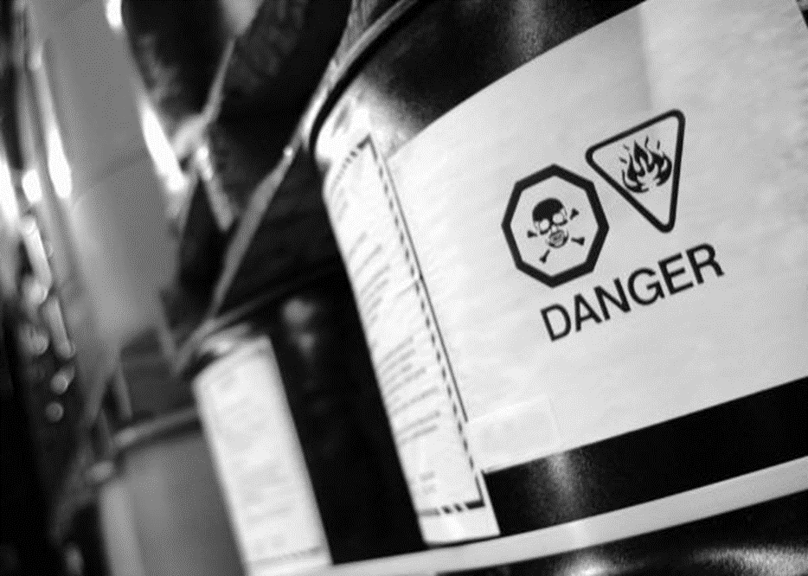
Safety Symbols
Chemical
Clothing
Electrical
Equipment
Eye
Fire
Hand
Personal Hygiene
Sharp Objects
Waste Disposal
Notes:
Safety is the condition of being protected from or unlikely to cause danger, risk or injury.
A symbol is a thing that represents or stands for something else, especially a material object representing something abstract
Safety symbols should be easily recognized.

Slide 6
Chemical Symbol
Alerts you that substances used in the experiment require special handling and precautions
Notes:
Toxic chemicals may bear a symbol similar to this.
Be sure to handle chemicals with this symbol carefully.

Slide 7
Chemical Safety
Follow specific instructions
Use chemicals from labeled containers only
Wear safety goggles
Notes:
Always:
use the exact amount of a chemical needed
read the chemical labels twice to make sure you have the correct container
wear safety goggles if working with dangerous chemicals

Slide 8
Clothing Symbol
Reminds you to take certain precautions to protect yourself and your clothing while working in the lab
Notes:
A symbol like this will remind you to wear protective clothing while performing experiments.

Slide 9
Clothing Safety
Dress appropriately
Remove loose or baggy clothing and dangling earrings
Tie hair back
Wear closed-toe shoes
Wear a lab apron when working in the lab
Notes:
Appropriate dress will include:
Tying back long hair
Wearing closed-toe shoes to protect your feet from falling objects or spills
Removing loose-fitting jackets and dangling earrings
Wearing an apron or lab coat to protect you while working on experiments

Slide 10
Electrical Symbol
Alerts you that the procedure requires electrical equipment and electrical safety practices
Notes:
A symbol similar to this will remind you to use caution with electrical appliances.

Slide 11
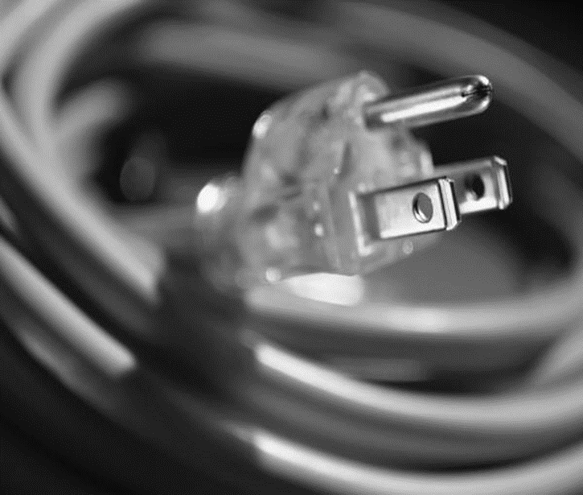
Electrical Safety
Check all equipment before use
Keep cords clear of hazards such as heat or water sources
Never leave appliances or equipment unattended
Notes:
Electrical equipment with frayed cords or exposed wires should not be used.
Remember to handle electrical equipment with dry hands.

Slide 12
Equipment Symbol
Reminds you of general rules for using the specialized equipment of a lab
Notes:
A symbol similar to this will remind you of using specialized equipment safely.

Slide 13
Equipment Safety
Be familiar with all equipment before using it in the lab
Transport equipment properly
Use equipment only for its designated purpose
Notes:
Use only the equipment required for the lab and be sure to return it to its proper location after use.

Slide 14
Eye Symbol
Alerts you that some conditions of the experiment require extra attention to eye safety
Notes:
A symbol similar to this reminds us to keep our eyes covered during an experiment.

Slide 15
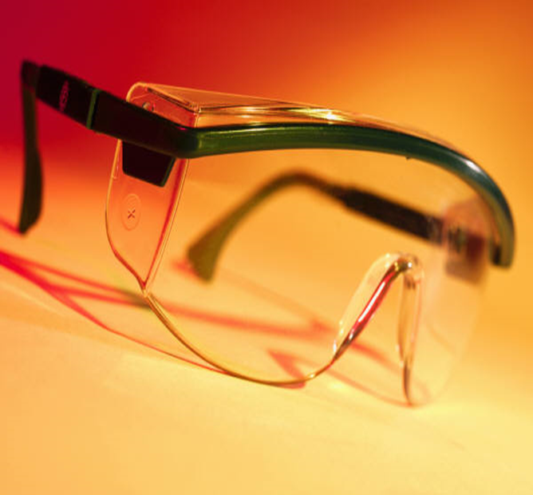
Eye Safety
Avoid wearing contacts, if possible
Know the location of the emergency eye wash station
Wear approved safety goggles
Notes:
Safety goggles should be worn when heating substances or working with chemicals.
Wearing contacts may absorb vapors under the safety goggles and could be difficult to remove in an emergency.

Slide 16
Fire Symbol
Alerts you that the procedure involves the use of a burner or other source of heat
Notes:
A symbol similar to this reminds us that fire may be used as a source of heat in the experiment.

Slide 17
Fire Safety
Never reach across an open flame
Turn off burners when not in use
Never use an open flame when working with volatile liquids, such as alcohol
Know how to use the fire extinguisher, fire blanket and safety shower.
Notes:
Keep flammable objects such as paper towels and pot holders away from open flames.
Never leave an open flame unattended.
Take a look around the room and locate the following:
fire alarm
fire blanket
fire extinguisher
safety shower

Slide 18
Hand Symbol
Tells you that some steps in the experiment call for particular attention to hand safety
Notes:
A symbol similar to this reminds us that our hands can easily be hurt or contaminated with bacteria.

Slide 19
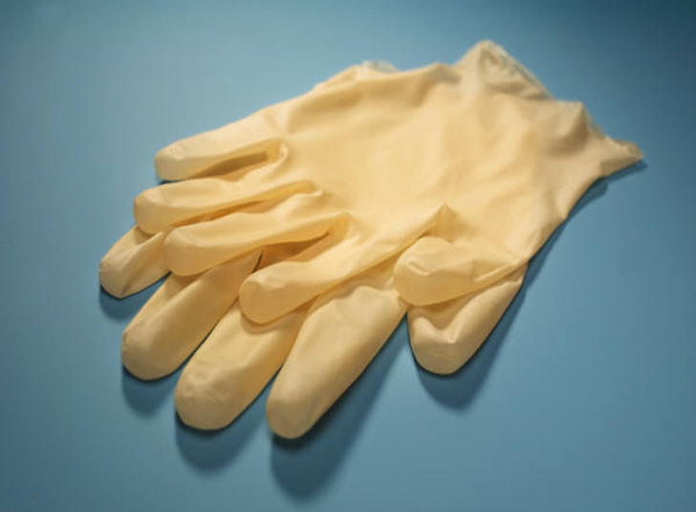
Hand Safety
Wear approved gloves and equipment to protect yourself from heat and sharp objects
Use caution when working with knives and other sharp objects
Notes:
Allow items that have been heated to cool before handling.
Use tongs to handle hot containers.
Knife safety:
carry with point turned down and away from others
cut away from your body when slicing food
store knives safely
use only for intended purpose
Never:
try to catch a falling knife
point with a knife

Slide 20
Personal Hygiene Symbol
Serves as a reminder for safe personal habits in the lab
Notes:
A symbol similar to this reminds us of safe personal habits.

Slide 21
Personal Hygiene Safety
Wash hands with soap and water before and after lab
Handle microorganisms grown in a petri dish or test tube with care
Avoid touching your eyes, face or mouth with your hands
Notes:
Be sure to wash your hands after:
handling chemicals
handling containers that hold chemicals
cleanup

Slide 22
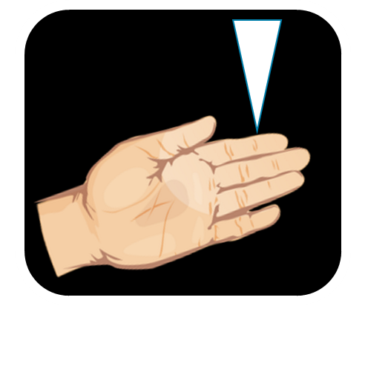
Sharp Object Symbol
Reminds you to take precautions when using lab glassware
Notes:
A symbol similar to this reminds us to be careful with glass equipment.

Slide 23
Sharp Object Safety
Do not use broken, chipped or cracked glassware
Keep glassware away from the edge of the table
Use precautions when handling heated glassware
Notes:
To clean up broken glassware, use a damp paper towel. Never use your bare hands.

Slide 24
Waste Disposal Symbol
Refers to the appropriate disposal of chemicals or waste
Notes:
A symbol similar to this reminds us of proper disposal of all chemicals or waste.

Slide 25
Waste Disposal
Follow teacher’s instructions for:
Broken glass and substances
Chemical and microbial materials
Paper toweling and other disposable cleaning supplies
Notes:
Proper disposal of chemicals or waste is very important as chemicals can be corrosive.
Never discard any materials in a sink.
Note to teacher: Check with your school district for specific information on how to properly dispose of potentially hazardous materials.

Slide 26
Flinn Scientific Laboratory Safety Challenge
Notes:
Click on the image to view the video:
Flinn Scientific Laboratory Safety Challenge
Witnessing lab procedures gone awry may make students think twice about some of their own safety shortcomings. Featuring Sue Bober, Schaumburg High School, IL. This video is part of the Flinn Scientific Teaching Chemistry video series.
http://youtu.be/V-fNpaOX0-g
Optional video:
The (Lab) Safety Dance
An homage to the infamous Chemistry Lab Safety Video produced by the Quigg Lab and set to the dulcet tones of Men Without Hats!
http://youtu.be/1_HBM_NwrRE

Slide 27
Questions?

Slide 28
References and Resources
Images:
Microsoft Office Clip Art: Used with permission from Microsoft.
Textbook(s):
Mehas, K. Y., & Rodgers, S. L. (2002). Food science: The biochemistry of food and nutrition. New York, NY: Glenco/McGraw-Hill.
Ward, J. D., & Ward, L. T. (2013). Principles of food science. Tinley Park, IL: Goodheart-Wilcox Company.
Website:
Centers for Disease Control
Handwashing: Clean Hands Save Lives
http://www.cdc.gov/handwashing/when-how-handwashing.html
National Science Teachers Association
NSTA works with other science teaching and education professionals
http://www.nsta.org/

Slide 29
References and Resources
YouTube™:
Flinn Scientific Laboratory Safety Challenge
Witnessing lab procedures gone awry may make students think twice about some of their own safety shortcomings. Featuring Sue Bober, Schaumburg High School, IL. This video is part of the Flinn Scientific Teaching Chemistry video series.
http://youtu.be/V-fNpaOX0-g

