Slide 1
Knowledge Is Power:
Why Study Food Science?

Slide 3
Is this just a brown paper bag?

Slide 4
Why Study Food Science?
Individual advantages
Improve the world
Protect the environment

Slide 5
Individual Advantages
Securing a Healthy Future
Knowing the facts about food can lead to a healthier lifestyle
Understanding Safe Food
Identify good food safety habits
Food Science Application
Comprehend food science concepts relating to food production

Slide 6
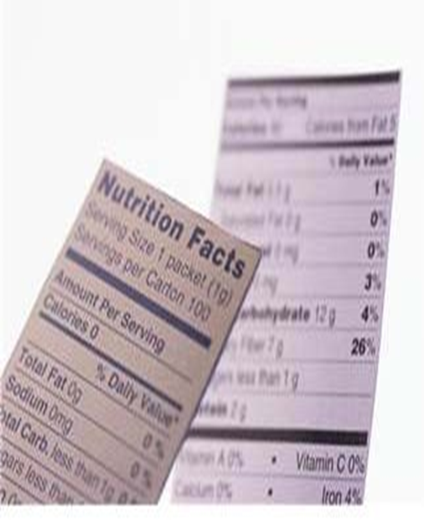
Lab: Comparing Food Labels
Time: 15-20 Minutes
Objective: Students will compare nutrition fact panels found on food labels.
Materials:
Food labels
Handout: Comparing Food Labels
Directions: Use the food labels to completely fill in the handout.
Use your observations to answer the “Analyzing Results” questions.

Slide 7
Improve the World
Hunger
Using biotechnology to make better use of our food sources and to decrease the number of people suffering from hunger
Genetic Engineering
Improving a variety of plants and animals by altering genetic traits
Community Health
Food scientists work to ensure food safety and nutritional content.
Effects on Families
Providing healthy foods for busy families

Slide 8
Protect the Environment
Things to think about: reducing waste, using less energy, producing new packaging, creating hardier plants that require less water and chemicals
Sustainable farming: producing food by methods that preserve the structure of the soil and reduce erosion
Example: growing plants that require less water
Integrated pest management: controlling pests with plant modifications to be pest resistant
Example: Farmers use helpful insects that will keep harmful insects away from crops

Slide 9
Video: Food Science at WSU
Taste tomorrow. Everybody has to eat. And that means that there are more jobs for food scientists than there are graduates with a food science degree. A Washington State University alumnus with a food science degree explains the duties of a food scientist.
<http://www.teachertube.com/viewVideo.php?video_i d=77226&title =Food_Science_at_WSU >

Slide 10
Assignment: Where to Study Food Science?
Use the Internet to research three higher education schools that offer a degree in food science. Recommended website: www.ift.org
Use the assignment handout “Where to Study Food Science?” to gather the necessary information from the schools’ websites.
Create a presentation of one of the school’s food science degree program.
Write a professional letter to the school’s food science department requesting brochures and additional information about the program.

Slide 11
Day 1 – Journal Entry
Food Science can help solve global issues by…

Slide 12
Day 1 – 90 Second Speech Topic
How does population growth affect our food supply?

Slide 13
Day 2 – Journal Entry
Food Science promotes environmental protection through…

Slide 14
Day 2 – 90 Second Speech Topic
How can the knowledge you gain in food science improve your health?

Slide 15
Day 3 – Journal Entry
I can better manage my health using food science principles by…

Slide 16
Day 3 – 90 Second Speech Topic
Discuss sustainable farming and how it has impacted agriculture around the world.

Slide 17
Day 4 – Journal Entry
One thing I have learned from this lesson that I can apply to my eating habits is…

Slide 18
Day 4 – 90 Second Speech Topic
How has food science improved public safety?

Slide 19
References/Resources
Mehas, Kay Yockey & Rodgers, Sharon Lesley. (2002). Food Science: The Biochemistry of Food and Nutrition. Fourth. New York, NY: Glencoe McGraw- Hill, pp. 35-45. Print.
Food Science at WSU Source: TeacherTube.com Running Time: 3:24 minutes
Release Date: January 30, 2009
Taste tomorrow. Everybody has to eat. And that means that there are more jobs for Food Scientists than there are graduates with food science degrees. A WSU alumnus with a food science degree explains the duties of a food scientist.
http://www.teachertube.com/viewVideo.php?video_id=77226&title
=Food_Science_at_WSU
Approved Undergraduate Programs (Food Science) The Institute of Food Technology http://www.ift.org/knowledge-center/

Slide 20
References/Resources Cont.
Food Scientist Quotations
Bringing over 18,000 quotes to you everyday www.Proverbia.net http://en.proverbia.net/citastema.asp?tematica=482
Quote World-Famous Food Quotes
Over 15,000 quotations and famous quotes www.QuoteWorld.org
http://www.quoteworld.org/quotes/10318 http://www.quoteworld.org/quotes/5122 http://www.quoteworld.org/quotes/4117
Microsoft Office Clip Art images: Used with permission from Microsoft.

