Slide 1
Leadership with Style
Hotel Management

Slide 3
Lesson Objectives
  At the end of this lesson students will be able to:
    List four basic duties of hospitality management
    State the main responsibility of a hospitality general manager
    Know the eight tasks of a manager
    Identify and demonstrate positive work behaviors
    Understand and demonstrate self-responsibility and self-management
    Analyze the effects of health and wellness on employee performance
Notes:
At the end of this lesson students will be able to: - List four basic duties of hospitality management - State the main responsibility of a hospitality general manager - Know the eight tasks of a manager - Identify and demonstrate positive work behaviors - Understand and demonstrate self-responsibility and self-management - Analyze the effects of health and wellness on employee performance

Slide 4
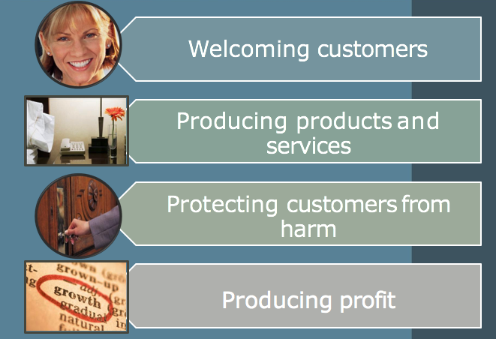
Hospitality Management
Notes:
All hospitality businesses have managers. Managers are responsible for the entire daily operation of the business. The basic duties of hospitality management are: • To make customers feel welcome by the staff as well as the facility itself. For example, the staff must be friendly and the facility should be clean and inviting. • To produce product and services that meet the customer’s needs and wants, when they want them. • To protect customers from being harmed while they are with you. • To sell the hotel’s products and services in a profitable and legal manner.

Slide 5
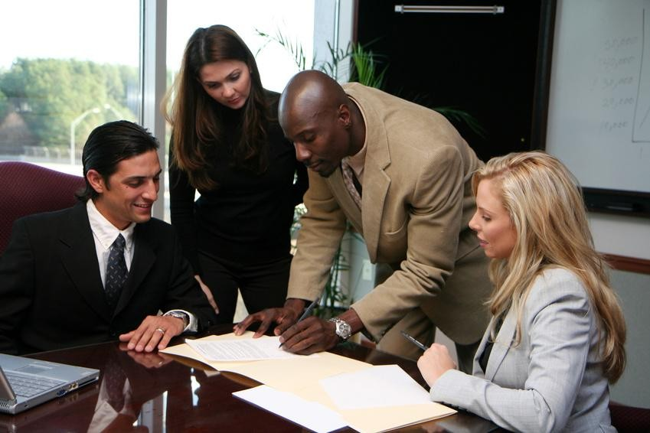
The General Manager
  The person responsible for the entire operation
  Knowledge and experience
    Management
    Sales
    Marketing
    Design
    Finance
    Safety
Notes:
The General Manager of a hotel, sometimes called the managing director, is the one person that is responsible for the entire business; not only for the daily operation but for the hotel meeting all of the goals set for the business. As such, the General Manager (or GM) will usually have knowledge and experience in multiple areas including general management skills, sales, marketing, design, finance and accounting, sanitation, safety, and of course, customer service. Some hotel general managers will also have training in nutrition or knowledge of food and beverage operations. In a small business, the general manager is often the owner.

Slide 6
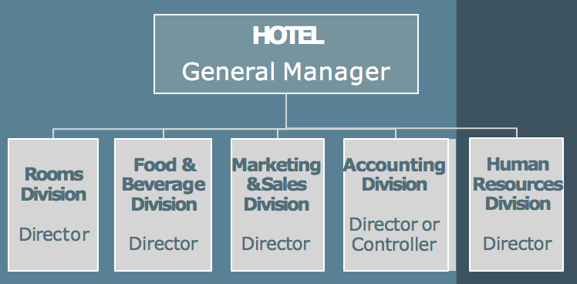
The Management Organization
Notes:
However, a large hotel will typically have a general manager and at least five divisions. Sometimes the rooms division (front desk, housekeeping, security, and engineering) will be divided into separate divisions especially in very large hotels. Each division will have a director or manager reporting to the general manager with specific management tasks and responsibilities to ensure each division gets their job done. Each of these directors will delegate responsibilities, duties, and tasks down to the department and supervisory management within their divisions. These division managers are considered middle management.

Slide 7

Management Tasks
  Set goals
  Oversee customer satisfaction
  Control costs
    set budgets
    monitor purchasing, receiving, and inventory
    cut costs
  Keep records
Notes:
Now that we have identified the managers and directors of a hotel, let’s look at the tasks that are a part of their daily job. 1. Set goals – The general manager will set the top goals for the business. For example, a goal might be to increase profit by 1 percent. The division managers will then figure out how to break down that goal and set individual goals for their department, for example the food and beverage department might have a goal to cut costs by 4% and increase sales by 5%. 2. Oversee customer satisfaction – Every manager needs to know if customers are happy. It is satisfied customers that will be repeat business and that leads to increased business. 3. Control costs – One way to increase profit is by controlling costs. Managers will do this by setting a budget not only for the overall business, but a budget for each division. They will then monitor the purchasing, receiving and inventory to make sure the budgets are being met and adjust by cutting costs where necessary. 4. Keep records – Records and reports are an essential part of every business. They are needed for tax purposes and to monitor business against the sales and goals of the company as well as determining profit or loss for the business. For a large hotel, the accounting division is responsible for maintaining the financial records. There are also employee personnel files to be kept, usually by the human resources department. Records are also needed for planning for the future of the company. Organization is fundamental to keeping accurate records.

Slide 8
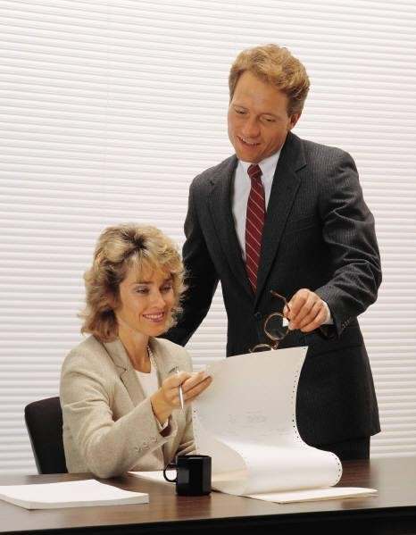
Management Tasks
  Manage human resources
    hire and train
    supervise
    plan shifts
    Evaluating
  Maintain the facility
  Oversee Sanitation and Safety
  Market the business
Notes:
Manager’s tasks continued: 5. Manage human resources – Of course, every division manager must oversee and supervise its employees. There are 4 main tasks to managing employees. These are to hire and train employees, supervise their activities on a daily basis, to plan the employee shifts so the hotel is covered on a 24 hour basis, and to evaluate each employee’s performance. 6. Maintain the facility – The general manager is responsible for ensuring the building, equipment and grounds are working and properly maintained. In large hotels, this is delegated to an engineering division and the division manager reports to the general manager. The division manager not only is responsible for making sure equipment is working but also must ensure there is a regular maintenance program to prevent breakdowns. 7. Oversee sanitation and safety – The general manager is responsible for the health and safety of all guests and employees. They must make sure that employees are trained to use proper sanitation practices. This involves several divisions; the first of course is the housekeeping department which is responsible for ensuring sanitation of all rooms including sleeping rooms, bathrooms, and public areas such as lobbies. If the hotel has a restaurant, the food and beverage division manager will also have responsibilities to ensure the health and sanitation procedures are properly followed. 8. Market the business – All businesses need customers and the responsibility of increasing sales falls to the general manager. Marketing includes all of the activities that a business does to increase sales. This includes not only advertising, but pricing, bundling amenities such as breakfast included, and creating marketing materials like brochures. A large hotel will have a marketing and sales division.

Slide 9
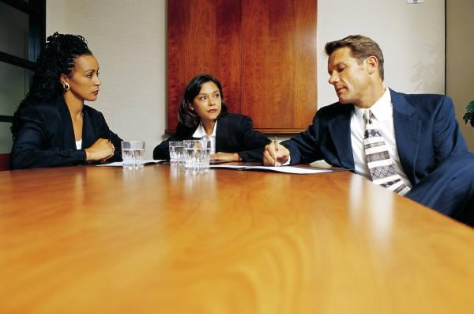


Management Skills
  Delegation
  Motivation
  Communication
  Technical
  Computer
  Organizational
Notes:
Let’s take a look at some of the skills a manager needs to be successful. Refer back to the lists the students made at the beginning of class. • Delegation Skills – Delegation means to give power or responsibility to someone else. Many new managers and some experienced managers find it difficult to delegate; they want to do everything themselves. This is not practical or efficient. The most productive departments will have efficient managers that know the importance of delegating the right job to the right people. • Motivation Skills – Another skill a successful manager will posses is how to motivate employees and develop team atmosphere. A motivated employee is more satisfied and willingly puts forth effort in their job and is more productive. What are some ways a manager can motivate employees? Answers will vary but should include recognition, rewards, responsibility (versus tasks), advancement, work/life balance, professional development, and flexible scheduling. • Communication Skills – Managers must have excellent communications skills. They have to supervise and train employees and communication is required to accomplish these tasks. A successful manager will be able to speak in public, make presentations, and talk to employees one-on-one with ease.
Technical Skills – Many departments such as food and beverage, housekeeping, engineering, and security have specialized equipment in their jobs and managers must have the knowledge in order to operate them properly and train others to operate them as well. Some of the equipment is sophisticated and can also be dangerous. Managers must also be able to read and comprehend complicated manuals and understand how to maintain equipment to reduce repair costs. • Computer Skills – Computer systems have been integrated into every aspect and division of a hotel business and as such it is imperative to be able to use computers. What are some of the manager tasks that a computer will handle or assist a manager with? Answers will vary but should include employee scheduling, inventory management, order supplies, collecting sales information, keeping financial records, and forecasting customer sales. • Organizational Skills – Organizational skills are essential for managers because of the many responsibilities, activities, and tasks that are associated with a management position. Managers must be organized to be able to keep the tools, reports, and other information in order. Time management is also a form of organization and managers must be able to use their time efficiently in order to accomplish their many tasks and duties.

Slide 10


Management Styles
  Autocratic style
  Bureaucratic style
  Democratic style
  Laissez-faire style
Notes:
Even with the skills of a good manager, it is important to note there are different styles of successful management. One style is called Autocratic. It means a manager will not seek input from employees and the manager makes all decisions independently and tells employees exactly what is to be done and how to do it. This style was used in most businesses 30 to 40 years ago. This is a useful style of management with new employees who are learning the job. Another style is called Bureaucratic. It means a manager will seek input from employees before making the final decision. Democratic style means everyone has a say; the manager may even take a vote on a matter and let the majority rule in the decision. This type of manager is often a good communicator and team leader. This manager builds trust, respect, and commitment among the team. Laissez-faire style of management is the fourth style. Laissez-faire is a French term meaning let it be or hands-off. This management style is appropriate when the employees are very experienced, know what they are doing (called self-management), and can be trusted to get the job done on time and without supervision.

Slide 11

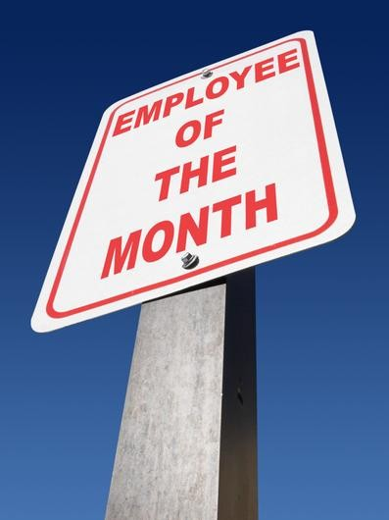
Health and Wellness
  Enhanced productivity
  Reduced absenteeism
  Build employee morale
  Saves money for employee
  Saves money for employer
  Improves company image
Notes:
One of the growing trends in the workplace is employers offering health and wellness programs for their employees. Why do you think employers do this? Have the students come up with some ideas. It’s because of the benefits for both the employer as well as the employee. Many studies and lots of research has been done and the benefits outweigh the cost of these programs. These are just a few of the benefits: - Employees, everyone, are happier when they are healthier - People work better and faster when they are healthy - Absenteeism is reduced - Morale is boosted when a company shows concern and puts programs in place to help employees - Saves money for employee and employer by cutting healthcare costs and doctor bills - Just having a program can improve the company image What happens when people are sick and call in that they are unable to work? Someone else has to step in and do that person’s job. They have more work to do and not enough time in which to do it. That makes for an unhappy and stressed employee. It might eventually have an effect on the hotel’s success as a business. These are the reasons that everyone, not just management, should be responsible for themselves.

Slide 12
References/Resources
  Images
    Microsoft Office Clip Art: Used with permission from Microsoft.
  Textbook:
    Reynolds, J. S. (2010). Hospitality services: Food & lodging. Tinley Park, IL: Goodheart-Willcox Company.

