Slide 1
Leaving on a Jet Plane
Notes:
Should you choose a career in the Hospitality and Tourism industry, you may service clients who wish to visit foreign countries. This type of travel is not packing your bags, heading out for wherever and if you need anything, go to the store and purchase it. This type of travel involves pre-planning, research and can include specific guidelines.

Slide 3

Time is Nothing
(click on image)
Notes:
Teacher note: As students watch, have them write three “I wonder” statements about traveling abroad. If students wish, they may volunteer to share their statements. Allow time for classroom discussion.
Time is Nothing
A five minute trip around the world.
https://youtu.be/UGnrT0F-Igs`

Slide 4
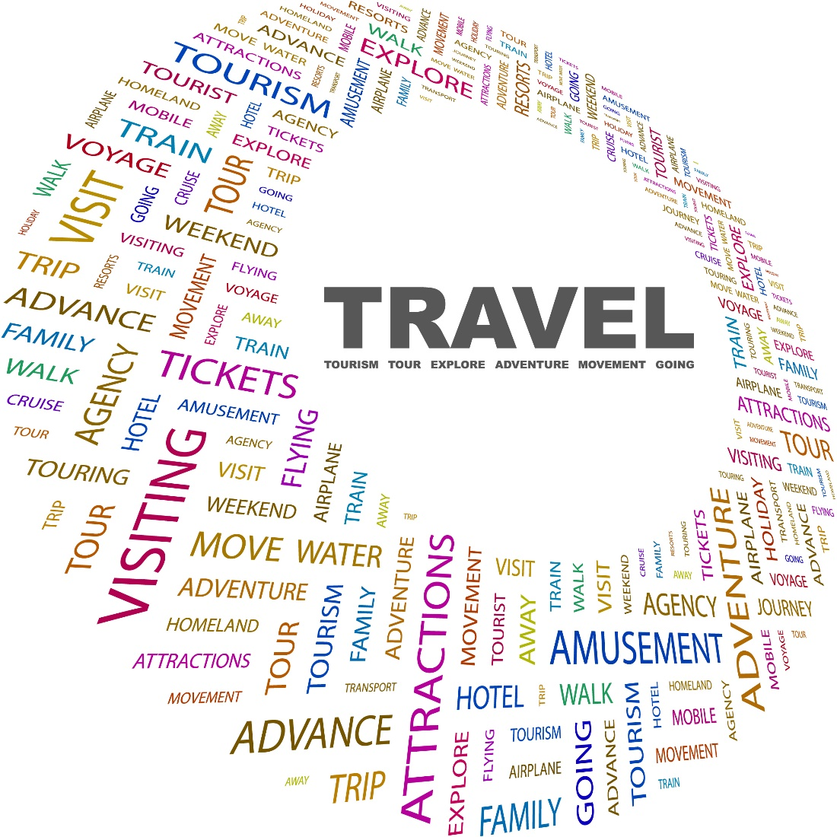
Domestic Travel
(click on image)
Notes:
What is domestic travel? Domestic travel is considered to be travel to one of the 50 contiguous states.
Since the terror attacks in New York City in 2001, domestic air travel within the United States has been subject to new security rules and regulations. Before a domestic flight, you must take certain steps to protect yourself and others. According to USA Today, domestic travelers must be aware of the following:
Checked baggage
Flight information
Health preparations
Proper identification documents
Rules for carry-on baggage
Teacher note: Click on the image on the slide and discussion each section of the article. Allow time for class discussion.
USA Today
Preparations for Domestic Air Travel
http://traveltips.usatoday.com/preparations-domestic-air-travel-12515.html

Slide 5
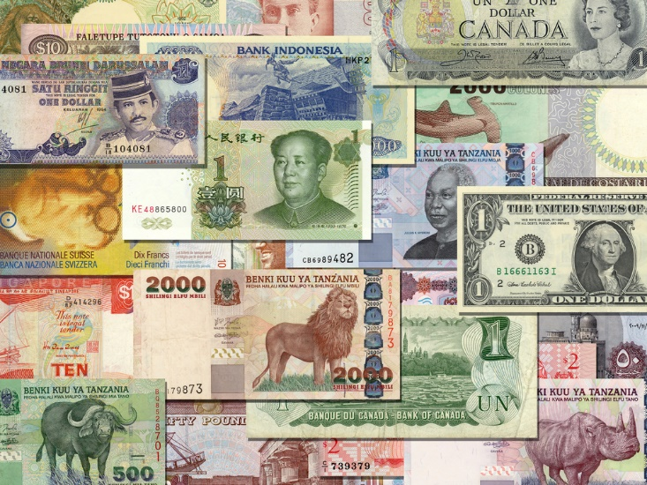
International Travel
Notes:
What is international travel? International travel is considered departure from the legal boundaries of the United States to visit other countries. What are the requirements to travel abroad? It would depend on the country you were visiting. Every country is different. All persons traveling abroad should possess a valid, unexpired U.S. passport.

Slide 6
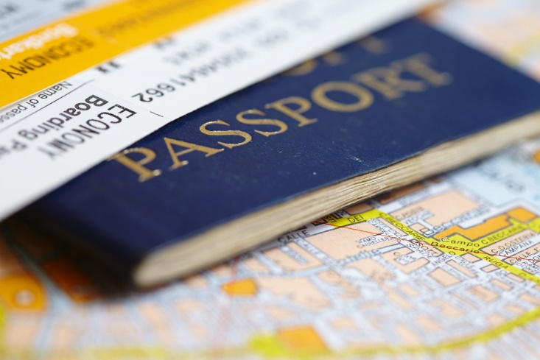
Applying for a U.S. Passport
(click on image)
Notes:
A Recipe for Applying in Person for a U.S. Passport
Applying in person for a U.S. passport is as easy as following a recipe. With this step by step video guide, we give you all of the ingredients you’ll need to make a passport so you can get out and enjoy a tasty, travel treat!
https://youtu.be/SDeJqRyL3JY

Slide 7
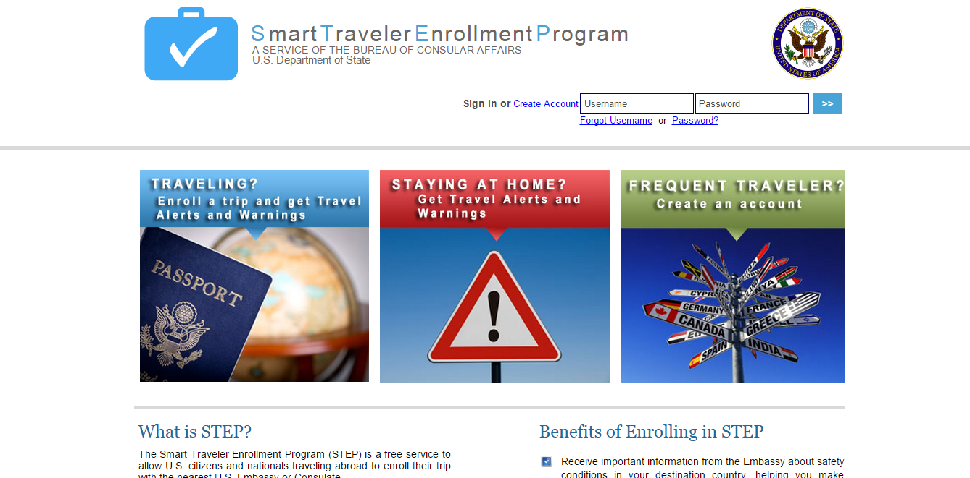
Smart Traveler Enrollment Program (STEP)
(click on image)
Notes:
We live in a different world today. A world traveler needs to be conscious of threat levels. Enrolling in the free STEP allows the United States government to contact you in case of an emergency, or if they need to evacuate U.S. citizens. The benefits of enrolling in the program are:
Receiving important information from the Embassy about safety conditions in your destination country, helping you make informed decisions about your travel plans
Helping the U.S. Embassy contact you in an emergency, whether natural disaster, civil unrest, or family emergency
Helping family and friends get in touch with you in an emergency
Smart Traveler Enrollment Program (STEP)
The Smart Traveler Enrollment Program (STEP) is a free service to allow U.S. citizens and nationals traveling abroad to enroll their trip with the nearest U.S. Embassy or Consulate.
https://step.state.gov/step/

Slide 8

Traveler’s Checklist
Travel documents can include:
Airline ticket
Credit cards brought on the trip
Driver's license
Foreign visa (if applicable)
Hotel confirmation
Itinerary
Passport ID page
Traveler's check serial numbers
Notes:
According to Travel.state.gov, a trip requires careful planning. There are important steps an individual can take to prepare for a safe trip anywhere outside the United States. Search for a destination to view more specific information about that country or area. The steps include:
Getting there
Be aware of any travel alerts and warnings for the destination
Do you have all required travel documents?
Are you prepared for an emergency?
Do you plan to drive overseas?
Pack smart
Do you have photocopies of your itinerary and travel documents?
Your Safety
Prepare to handle money overseas
Learn about local laws and customs
Your Health
Do you need any new vaccinations?
Do you know how to find medical help abroad?
Does your health insurance cover you outside the U.S.?
Are you taking any prescriptions or other medications?

Slide 9
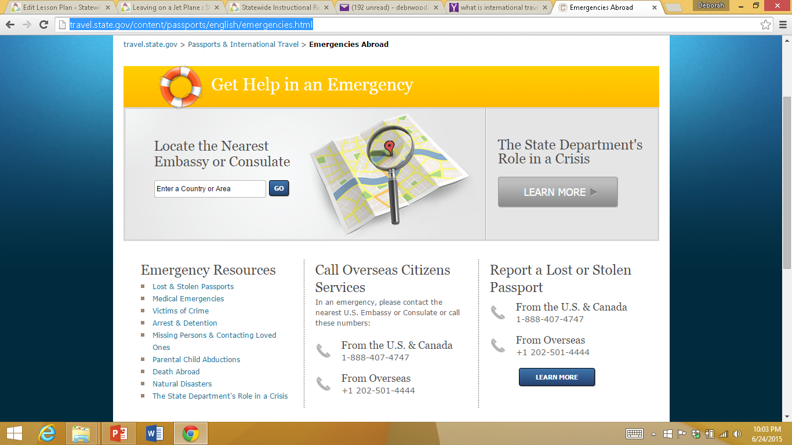
Getting Help in an Emergency
(click on image)
Notes:
What kind of emergencies can occur when traveling abroad? Emergencies can include:
Arrests and detentions
Death abroad
Lost or stolen passports
Medical emergencies
Missing persons and contacting love ones
Natural disasters
Parental child abductions
Victims of crimes
It is always important to know how to locate the nearest embassy or consulate in each country you are visiting.
U.S. Passports and International Travel
To Get Help in an Emergency.
http://travel.state.gov/content/passports/english/emergencies.html

Slide 10
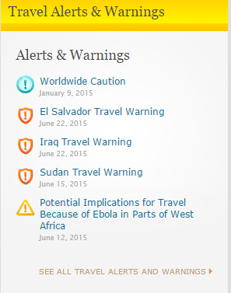
Travel Alerts and Warnings
Notes:
Before you plan on visiting a country, find out about any travel alerts and warnings that might be associated with the country. What is the difference between an alert and a warning? According to the U.S. Department of State, they issue a Travel Warning when they want you to consider very carefully whether you should go to a country at all. Examples of reasons for issuing a Travel Warning might include unstable government, civil war, ongoing intense crime or violence, or frequent terrorist attacks. They want you to know the risks of traveling to these places and to strongly consider not going to them at all. Travel Warnings remain in place until the situation changes; some have been in effect for years.
They can issue a Travel Alert for short-term events they think you should know about when planning travel to a country. Examples of reasons for issuing a Travel Alert might include an election season that is bound to have many strikes, demonstrations or disturbances; a health alert like an outbreak of H1N1; or evidence of an elevated risk of terrorist attacks. When these short-term events are over, they will cancel the Travel Alert.
For additional information, visit:
U.S. Department of State
Travel alerts and warnings for travelers.
http://travel.state.gov/content/passports/english/alertswarnings.html

Slide 11
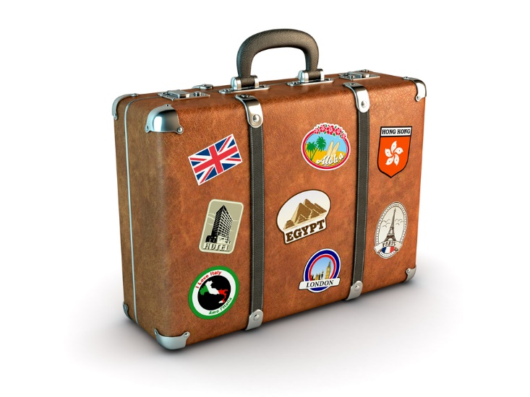
How to Travel Abroad
(click on image)
Notes:
How to Travel Abroad: Encountering New Cultures With Courtesy when Traveling Abroad
How to research and get along with different cultures when traveling abroad in foreign countries; get expert tips and advice on international travel in this free instructional video.
https://youtu.be/is4_plTQYQI
Introduce the importance of knowing cultures and travel tips. As a class watch a short video then have a brief discussion on what differences other countries might have, and what are some tips they can think of that might make travel easier.

Slide 12
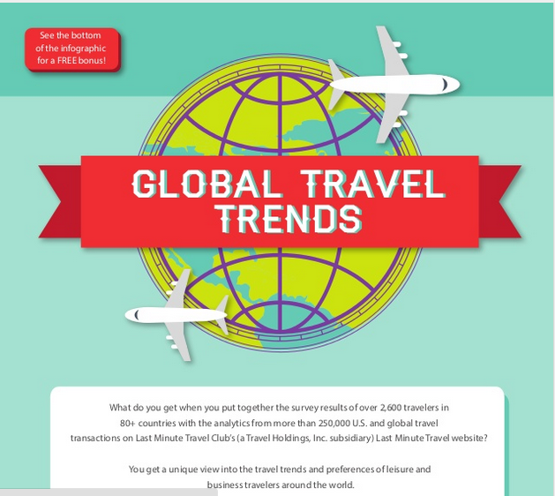
Infographic – Global Travel Trends
(click on image)
Notes:
The infographic below is related to this lesson. Allow students to view the image on a projector and lead a discussion concerning the information provided.
Global Travel Trends
Get a unique view into travel trends and preferences of leisure and business travelers around the world.
http://www.slideshare.net/KenHerron/global-travel-trends-infographic

Slide 13
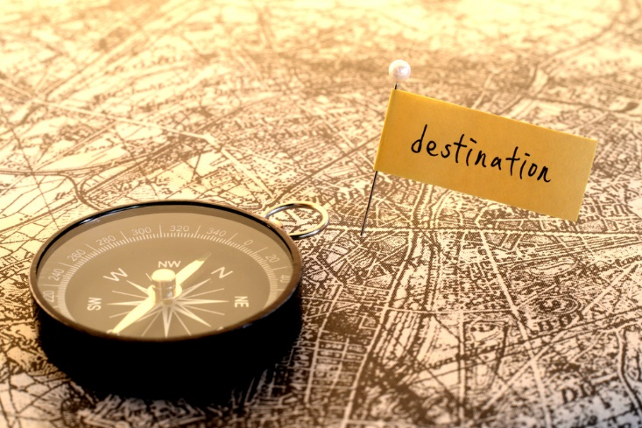
Language Barriers
Notes:
Plan ahead to hire an English speaking guide. In some countries the traveler may encounter some English speakers. However, in countries like China, very few people speak English. It would be worth the investment to hire someone to interpret for you. Some countries consider it a sign of respect if you try to speak some simple words in their language. The cost might average $15.00 to $20.00 per day.

Slide 14

Food and Drink
Notes:
Be careful of what you eat and drink. In the United States we are fortunate to have treated and clean water available for our use. This is not the case in all countries. Food and drinks may be prepared with contaminated water. It would include ice cubes, rinsing fresh produce and drinking water. To prevent any related health issues, eat only cooked food and don’t use ice cubes. Some countries don’t even use ice in their drinks and consider it an insult for someone to ask.

Slide 15

Where is my bag?
Notes:
Have you ever traveled in the United States and had your luggage lost? It is difficult enough to get your luggage returned when you speak the same language. Imagine the challenge of trying to retrieve lost luggage if you don’t speak the same language. If you have a photo of your luggage available, it may make it easier to locate your luggage.

Slide 16
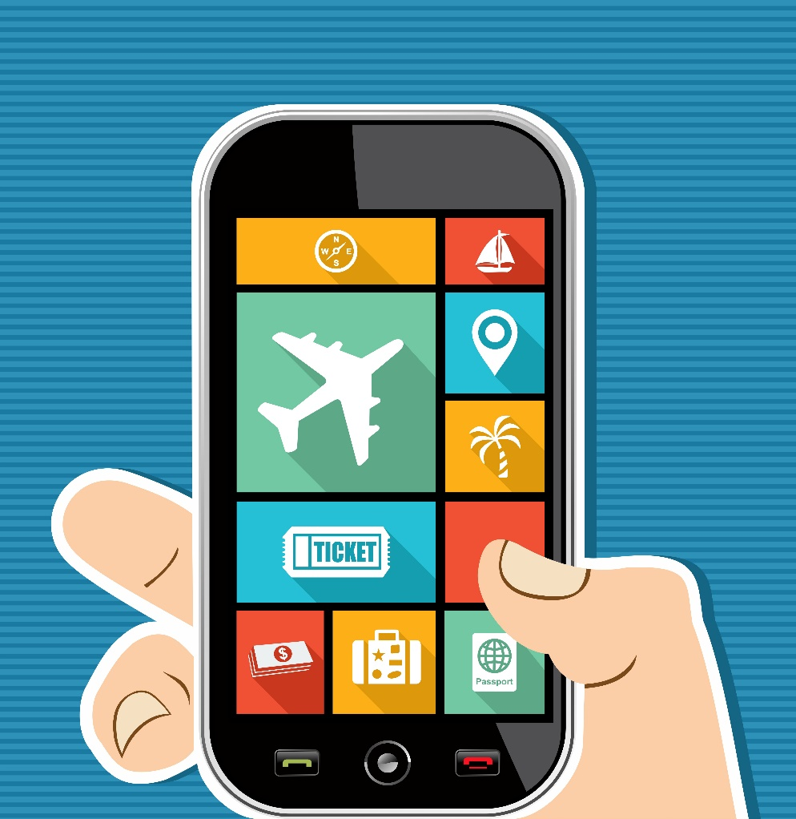
Day by Day
Notes:
Make a daily itinerary of your travel plans. It should include flight information, methods of traveling (bus or train) information, confirmation numbers for hotels, scheduled tours, any pre-paid services, the name, address and phone number of the hotel or lodging you will be using. You should also leave a copy of the itinerary with family or a friend in case you need to be reached in an emergency.

Slide 17
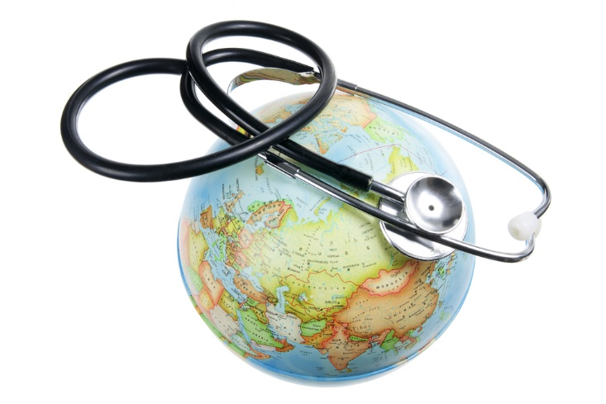
Travel Insurance
Notes:
Many of us have health insurance here at home, but it may not cover medical needs in a different country. It is a good idea to purchase travel health insurance for any medical emergencies, and consider medical evacuation protection. If you were to get hurt, or in a natural disaster and need to be evacuated, you would have to pay for it out of your pocket. The evacuation protection would offset these costs.

Slide 18
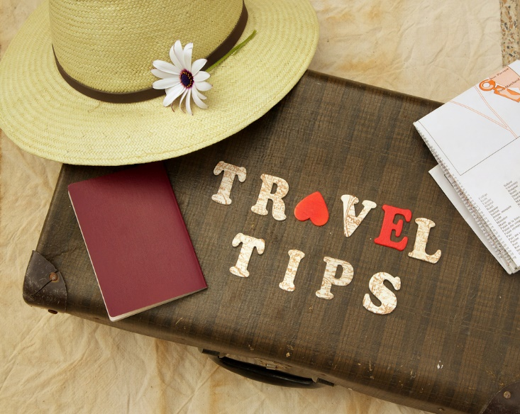
Medicine Bag
Notes:
If you take prescription medicine on a regular basis, be sure to bring your medicine with you in the prescription container it comes in. Also, plan ahead for other illness that may creep their way into your system. Bring medication:
Anti-biotic medicine
Indigestion medicine
Motion sickness medicine
Prescription drugs in labeled bottles

Slide 19

Personal Identification
Notes:
Bring multiple copies of your passport in case your original is lost or stolen.
Alert your credit card companies of your travel plans.

Slide 20

Travel Doctor
Notes:
If you are traveling to Europe you probably won’t need to visit a travel doctor. However, if you are going somewhere like the Middle East, Africa or South America you will want to see a travel doctor so they may research any health issues and properly prepare you for your travels. Your physician can research diseases and health issues for the country you are visiting. They can also issue any vaccinations you may be required to have before entering another country.

Slide 21
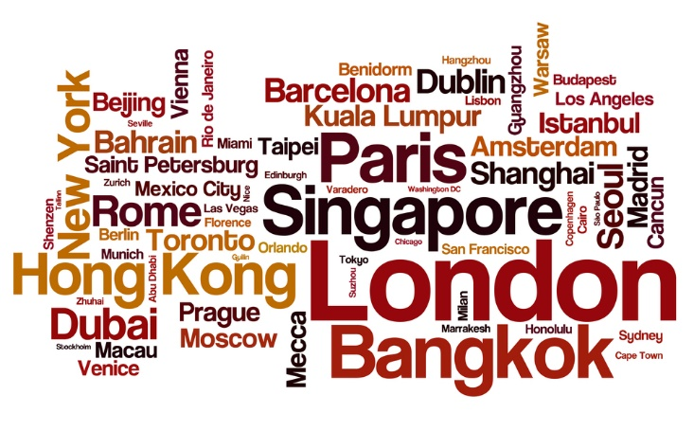
Research Your Travel Destination
Notes:
Before you go on your trip, do a little research about your travel destination. If you were traveling to a foreign country, what information would be important to know beforehand? Allow time for students to brainstorm. You may opt to assign a scribe to write the responses on the board. Allow time for class discussion. Possible questions might include:
Are there customs you need to be aware of?
Are their meal times the same, and what about food served at the meals?
Once you are at your destination, how do you get around town – walk, train, bike, car?
What is considered everyday etiquette?

Slide 22

Bon Voyage
Notes:
With a little research, precautionary measures and a lot of planning, international traveling can be a positive, memorable experience.

Slide 23
References and Resources
Images:
Infographic – Global Travel Trends
Photos obtained through a license with Shutterstock.com™.
Travel.state.gov
Textbook:
Reynolds, J. (2010). Hospitality services food and lodging. (Second ed.). Tinley Park, Illinois: Glenco, McGraw-Hill.
Websites:
Independent Traveler.com
Ten things you should never wear when traveling abroad.
http://www.independenttraveler.com/travel-tips/passports-and-international-travel/10-things-you-should-never-wear-when-traveling-abroad
USA Today
Preparations for Domestic Air Travel.
http://traveltips.usatoday.com/preparations-domestic-air-travel-12515.html
U.S Department of State
Learn about your destination.
http://travel.state.gov/content/passports/english/country.html

Slide 24
References and Resources
U.S Department of State
Traveler’s checklist and tips.
http://travel.state.gov/content/passports/english/go/checklist.html
USA.Gov.com
International travel information
http://www.usa.gov/Citizen/Topics/Travel/International.shtml
YouTube™:
How to Travel Abroad: Encountering New Cultures With Courtesy when Traveling Abroad
How to research and get along with different cultures when traveling abroad in foreign countries; get expert tips and advice on international travel in this free instructional video.
https://youtu.be/is4_plTQYQI
Time is Nothing
A five minute trip around the world.
https://youtu.be/UGnrT0F-Igs

