Slide 1
Let’s Work It Out – Applying Conflict Resolution Skills
Hotel Management

Slide 3

Pleasant Working Environment
  Conflict Resolution Skills
Notes:
Wouldn’t it be nice if we could all get along in the workplace?

Slide 4

Working Environment
  Leadership Skills
  Teamwork
  Pleasant atmosphere
Notes:
The working environment should be a pleasant atmosphere where employees work as a team and management takes leadership.

Slide 5
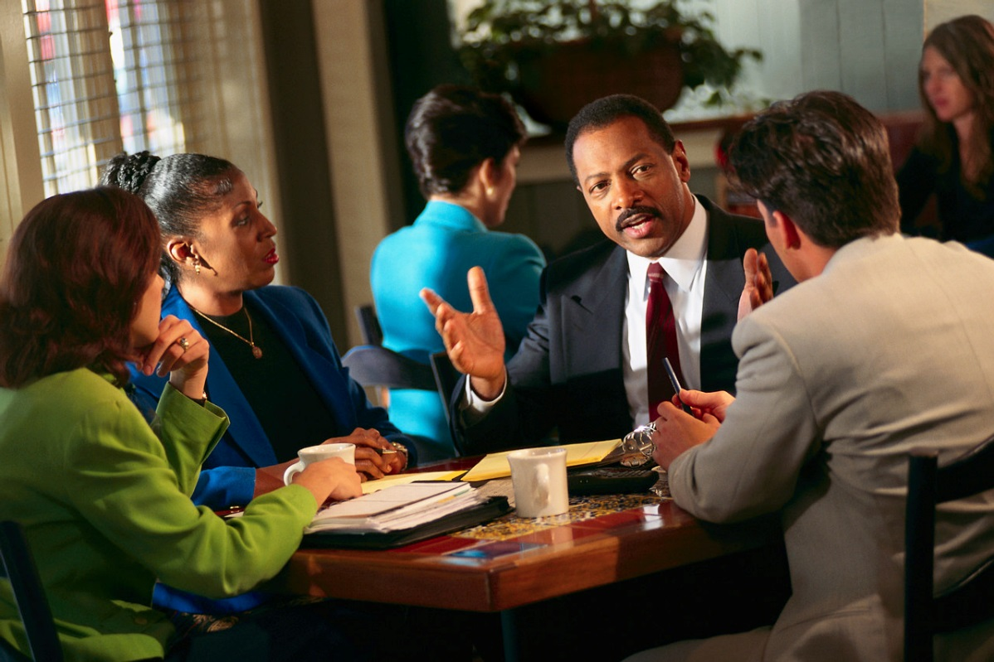
Leadership Skills
  Coach
  Direction
  Encourage others
  Expect change
  Inspire others
  Lead dependably
  Nurture teamwork
Notes:
Good leaders demonstrate the following skills:
Coach – leaders guide their employees as they perform their tasks and praise their successes
Direction – leaders communicate clearly and make sure others know what is expected of them
Encourage others – leaders influence through example and earn employee’s respect
Expect change – leaders look for ways to improve and find better ways to do tasks
Inspire others – leaders motivate employees, praise their work and guide them to work as a team
Lead dependably – leaders treat everyone fairly and are accountable for their actions
Nurture teamwork – leaders observe team members as they perform their tasks, assist in improvements and listen attentively

Slide 6

Teamwork Skills
  Communication
    Verbal
    Nonverbal
  Empathy
  Positive attitude
  Respect
Notes:
The following skills are needed to be successful in the hotel industry:
Communication skills:
Service staff must be able to speak well to both customers and coworkers.
Verbal skills:
speak slowly and clearly
make eye contact
tone of voice should always be professional, pleasant and friendly
Nonverbal skills:
stand straight
do not chew gum, eat or drink while serving customers
write clearly
Learn to practice empathy – the skill of thinking about what it would be like in another’s place
Positive attitude:
willingness to please the customer
pride in your work
always cheerful
show courtesy to customers and coworkers
Respect yourself and others while on the job and accept responsibility for your actions.

Slide 7
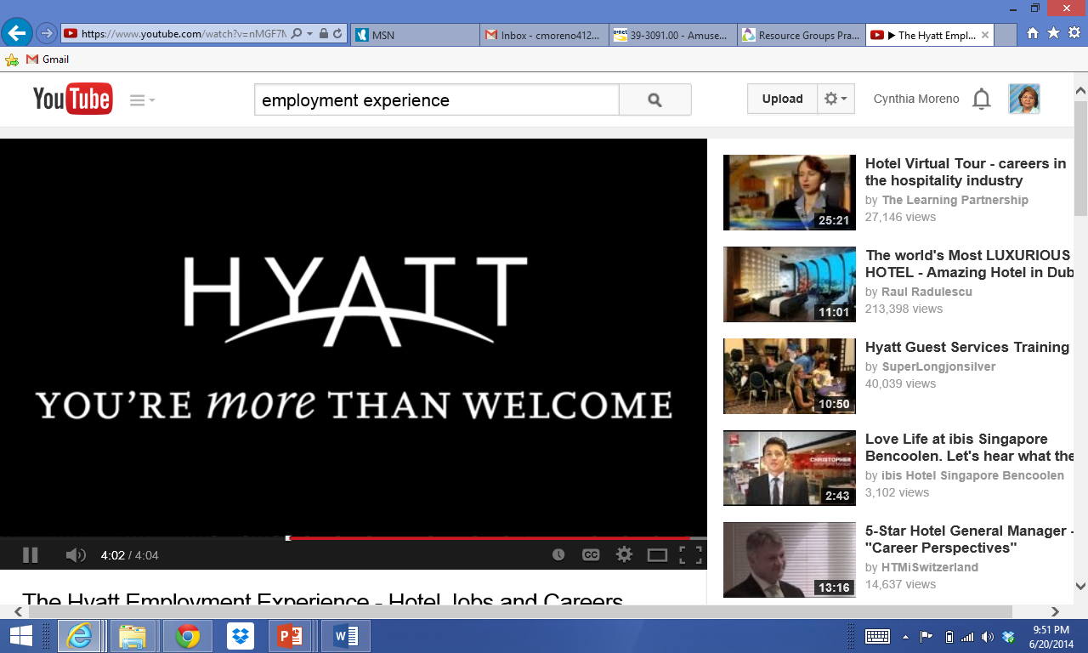
Pleasant Atmosphere
  Celebrate successes
  Communication
  Diverse
  Focus on employees
  The Hyatt Employment Experience - Hotel Jobs and Careers
  (click on link)
Notes:
A pleasant working atmosphere includes:
Celebrate successes – improve the workplace by recognizing goals reached, finished projects and positive teamwork
Communication – open communication between employees and management is needed to create a positive workplace
Diverse – follow up on harassment or discrimination claims that may occur
Focus on employees – one-to-one training sessions and performance reviews result in improved work climate
Click on the hyperlink to view video:
The Hyatt Employment Experience - Hotel Jobs and Careers
Video of Hyatt employees speaking about their work experience
http://youtu.be/nMGF7MnoZBs

Slide 8
What is Conflict?
  A disagreement, dispute or fight between people with opposing points of view
Notes:
Ask students to give some examples of conflict that may occur in the hotel workplace.

Slide 9

Causes of Conflict
  Authority issues
  Competition for resources
  Differences over style
  Lack of cooperation
  Low performance
  Misunderstanding
  Personality clashes
  Value or goal differences
Notes:
Causes of conflict:
Authority issues - when employees lack confidence in their leaders or perceive overuse of authority
Competition for resources - when employees believe they are better off competing for resources rather than cooperating
Differences over style - when agreement does not exist on standard ways of completing a task
Lack of cooperation - when one person does not share information with the whole group
Low performance - when individuals are not working to their potential
Misunderstanding – when individuals do not hear what is being said
Personality clashes - when individuals do not value “people just like me”
Value or goal differences - when individuals value different outcomes and objectives

Slide 10

Conflict Resolution
  Disputes
  Negotiation
  Focus on problem
  Advise the manager
  Steps to resolving conflict:
    Define the problem
    Suggest a solution
    Evaluate a solution
    Compromise
    Brainstorm
    Mediate
Notes:
Disputes and conflicts are part of being on a team. Not everyone will get along all of the time.
Can you name some disputes that may arise while working in a hotel?
Learn to negotiate.
Remember to focus on the problem and not the personalities involved. If you cannot resolve the conflict, be sure to discuss this with the manager.
Steps in Conflict Resolution:
Define the problem – describe the conflict
Suggest a solution – propose a possible answer
Evaluate a solution – assess the answer
Compromise – agree to settle conflict
Brainstorm – seek other solutions
Mediate – consult a third party if necessary

Slide 11

Questions?

Slide 12
References and Resources
  Images:
    Microsoft Office Clip Art: Used with permission from Microsoft.
  Textbooks:
    Hospitality and restaurant management. (2013). Upper Saddle River, NJ: Pearson.
    Reynolds, J.S. (2010). Hospitality services: Food & lodging. Tinley Park, IL: Goodheart-Willcox Company.
  YouTube™:
    The Hyatt Employment Experience - Hotel Jobs and Careers
    Video of Hyatt employees speaking about their work experience
    http://youtu.be/nMGF7MnoZBs

