Slide 1

Let’s Work It Out – Applying Conflict Resolution Skills
Hospitality Services

Slide 2
Copyright
Copyright © Texas Education Agency, 2014. These Materials are copyrighted © and trademarked ™ as the property of the Texas Education Agency (TEA) and may not be reproduced without the express written permission of TEA, except under the following conditions:
1) Texas public school districts, charter schools, and Education Service Centers may reproduce and use copies of the Materials and Related Materials for the districts’ and schools’ educational use without obtaining permission from TEA.
2) Residents of the state of Texas may reproduce and use copies of the Materials and Related Materials for individual personal use only, without obtaining written permission of TEA.
3) Any portion reproduced must be reproduced in its entirety and remain unedited, unaltered and unchanged in any way.
4) No monetary charge can be made for the reproduced materials or any document containing them; however, a reasonable charge to cover only the cost of reproduction and distribution may be charged.
Private entities or persons located in Texas that are not Texas public school districts, Texas Education Service Centers, or Texas charter schools or any entity, whether public or private, educational or non-educational, located outside the state of Texas MUST obtain written approval from TEA and will be required to enter into a license agreement that may involve the payment of a licensing fee or a royalty.
For information contact: Office of Copyrights, Trademarks, License Agreements, and Royalties, Texas Education Agency, 1701 N. Congress Ave., Austin, TX 78701-1494; phone 512-463-7004; email: copyrights@tea.state.tx.us.
Copyright © Texas Education Agency, 2014. All rights reserved.

Slide 3

Pleasant Working Environment
Conflict Resolution Skills
Copyright © Texas Education Agency, 2014. All rights reserved.
Notes:
Wouldn’t it be nice if we could all get along in the workplace?

Slide 4

Working Environment
Leadership Skills
Teamwork
Pleasant atmosphere
Copyright © Texas Education Agency, 2014. All rights reserved.
Notes:
The working environment should be a pleasant atmosphere where employees work as a team and management takes leadership.

Slide 5

Leadership Skills
Coach
Direction
Encourage others
Expect change
Inspire others
Lead dependably
Nurture teamwork
Copyright © Texas Education Agency, 2014. All rights reserved.
Notes:
Good leaders demonstrate the following skills:
Coach – leaders guide their employees as they perform their tasks and praise their successes
Direction – leaders communicate clearly and make sure others know what is expected of them
Encourage others – leaders influence through example and earn employee’s respect
Expect change – leaders look for ways to improve and find better ways to do tasks
Inspire others – leaders motivate employees, praise their work and guide them to work as a team
Lead dependably – leaders treat everyone fairly and are accountable for their actions
Nurture teamwork – leaders observe team members as they perform their tasks, assist in improvements and listen attentively

Slide 6

Teamwork Skills
Communication
  Verbal
  Nonverbal
Empathy
Positive attitude
Respect
Copyright © Texas Education Agency, 2013. All rights reserved.
Notes:
The following skills are needed to be successful in the hospitality industry:
Communication skills:
Service staff must be able to speak well to both customers and coworkers.
Verbal skills:
speak slowly and clearly
make eye contact
tone of voice should always be professional, pleasant and friendly
Nonverbal skills:
stand straight
do not chew gum, eat or drink while serving customers
write clearly
Learn to practice empathy – the skill of thinking about what it would be like in another’s place
Positive attitude:
willingness to please the customer
pride in your work
always cheerful
show courtesy to customers and coworkers
Respect yourself and others while on the job and accept responsibility for your actions.

Slide 7
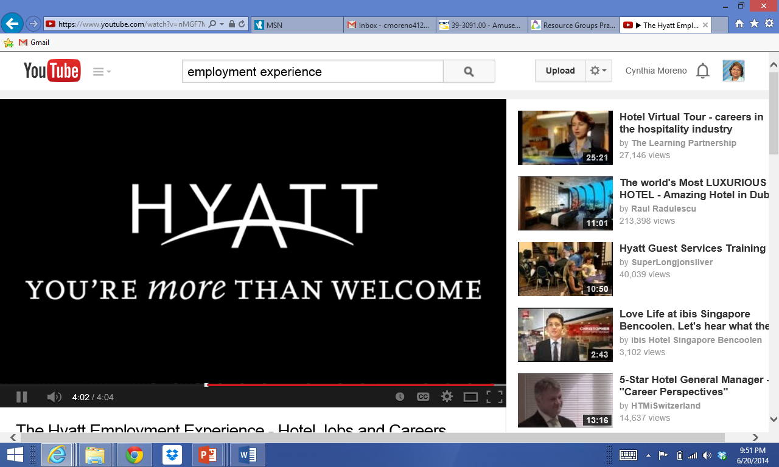
Pleasant Atmosphere
Celebrate successes
Communication
Diverse
Focus is on employees
Image from video
The Hyatt Employment Experience - Hotel Jobs and Careers
(click on link)
Copyright © Texas Education Agency, 2014. All rights reserved.
Notes:
A pleasant working atmosphere includes:
Celebrate successes – improve the workplace by recognizing goals reached, finished projects and positive teamwork
Communication – open communication between employees and management is needed to create a positive workplace
Diverse – follow up on harassment or discrimination claims that may occur
Focus on employees – one-to-one training sessions and performance reviews result in improved work climate
Click on the hyperlink to view video:
The Hyatt Employment Experience - Hotel Jobs and Careers
Video of Hyatt employees speaking about their work experience
http://youtu.be/nMGF7MnoZBs

Slide 8
What is Conflict?
A disagreement, dispute or fight between people with opposing points of view
Copyright © Texas Education Agency, 2014. All rights reserved.
Notes:
Ask students to give some examples of conflict that may occur in the workplace.

Slide 9
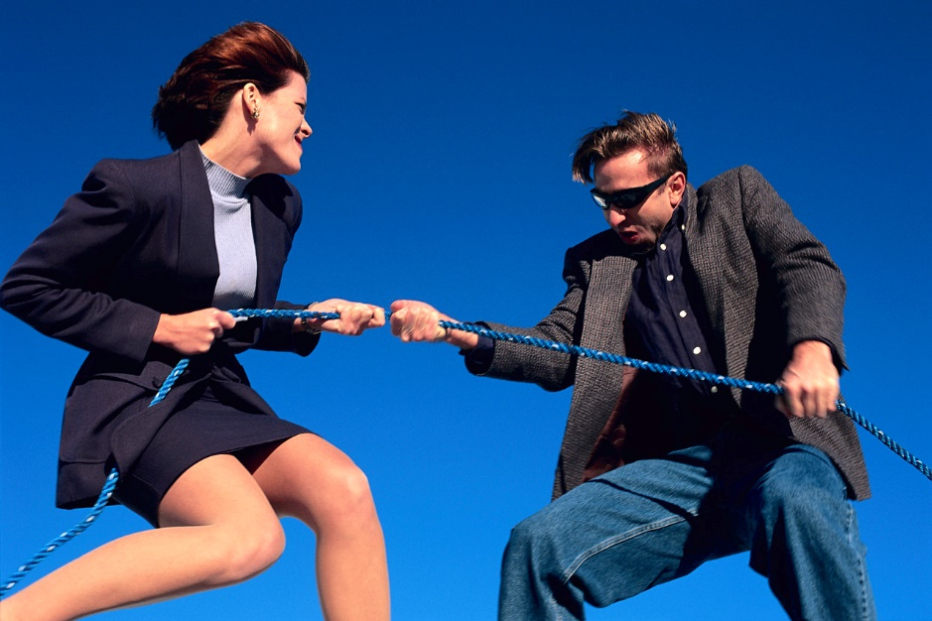
Causes of Conflict
Authority issues
Competition for resources
Differences over style
Lack of cooperation
Low performance
Misunderstanding
Personality clashes
Value or goal differences
Copyright © Texas Education Agency, 2014. All rights reserved.
Notes:
Causes of conflict:
Authority issues - when employees lack confidence in their leaders or perceive overuse of authority
Competition for resources - when employees believe they are better off competing for resources rather than cooperating
Differences over style - when agreement does not exist on standard ways of completing a task
Lack of cooperation - when one person does not share information with the whole group
Low performance - when individuals are not working to their potential
Misunderstanding – when individuals do not hear what is being said
Personality clashes - when individuals do not value “people just like me”
Value or goal differences - when individuals value different outcomes and objectives

Slide 10

Conflict Resolution
Disputes
Negotiation
Focus on problem
Advise the manager
Steps to resolving conflict:
  Define the problem
  Suggest a solution
  Evaluate a solution
  Compromise
  Brainstorm
  Mediate
Copyright © Texas Education Agency, 2014. All rights reserved.
Notes:
Disputes and conflicts are part of being on a team. Not everyone will get along all of the time.
Can you name some disputes that may arise while working in hospitality?
Learn to negotiate.
Remember to focus on the problem and not the personalities involved. If you cannot resolve the conflict, be sure to discuss this with the manager.
Steps in Conflict Resolution:
Define the problem – describe the conflict
Suggest a solution – propose a possible answer
Evaluate a solution – assess the answer
Compromise – agree to settle conflict
Brainstorm – seek other solutions
Mediate – consult a third party if necessary

Slide 11
Questions?
Copyright © Texas Education Agency, 2014. All rights reserved.

Slide 12
References and Resources
Images:
Microsoft Office Clip Art: Used with permission from Microsoft.
Textbooks:
Hospitality and restaurant management. (2013). Upper Saddle River, NJ: Pearson.
Reynolds, J.S. (2010). Hospitality services: Food & lodging. Tinley Park, IL: Goodheart-Willcox Company.
YouTube™:
The Hyatt Employment Experience - Hotel Jobs and Careers
Video of Hyatt employees speaking about their work experience
http://youtu.be/nMGF7MnoZBs
Copyright © Texas Education Agency, 2014. All rights reserved.

