Slide 1
Maintaining Your Health and Well-Being
Notes:
The World Health Organization defines health as a “state of complete physical, mental, and social well-being, and not merely the absence of disease or infirmity.”
Are you healthy according to this definition? Why or why not?

Slide 3
What are some indicators of well-being?
Notes:
Ask the students this question and allow for a discussion.
Possible answers might include:
Avoiding illegal drugs
Being free of a life-threatening disease or illness
Displaying positive behaviors
Exercising at least three times a week
Getting a least seven to eight hours of sleep each night
Getting regular checkups
Having access to adequate health care
Having fulfillment from your job
Having peace and harmony in your life
Having strong positive family and social influences
Maintaining healthy relationships
Making smart food choices
Staying physically and mentally healthy

Slide 4
Indicators of Well-Being
Adequate health care
Proper and acceptable behavior
Secure parental employment
Strong family structure
Physical environment and safety
Food security
Education
Notes:
According to “America’s Children in Brief: Key National Indicators of Well-Being, 2012,” indicators of well-being can include:
Adequate health care - Health care comprises the prevention, treatment and management of illness and the preservation of mental and physical well-being through services offered by health professionals. Effective health care is an important aspect of promoting good health. Health care for children includes physical examinations, preventive care, health education, observations, screening, immunizations and sick care.
Education - The extent and content of students’ knowledge, as well as their ability to think, learn and communicate, affect their likelihood of becoming productive adults and active citizens.
Food security - A family’s ability to provide for its children’s nutritional needs is linked to the family’s food security—that is, to its access at all times to adequate food for an active, healthy life for all household members. The food security status of households is based on self-reports of difficulty in obtaining enough food, reduced food intake, reduced diet quality and anxiety about an adequate food supply.
Physical environment and safety - The environment in which children live plays an important role in their health and development. Children may be more vulnerable than adults to the adverse effects of environmental contaminants in air, food, drinking water and other sources because their bodies are still developing.
Proper and acceptable behaviors - The well-being of young people can be affected by aspects of their behavior and social environments.
Secure parental employment - The well-being of children depends greatly on the economic circumstances and material well-being of their families. Children living in poverty are vulnerable to environmental, educational, health and safety risks. Compared with their peers, children living in poverty, especially young children, are more likely to have cognitive, behavioral and socio-emotional difficulties. Throughout their lifetimes they are more likely to complete fewer years of school and experience more years of unemployment. Secure parental employment reduces the incidence of poverty and its attendant risks to children. Secure parental employment is associated with higher family income and greater access to private health insurance.
Strong family structure - The composition of families is dynamic and has implications for critical parental and economic resources. A long-term shift in family composition has decreased the share of children living with two married parents, while single-parent households have become more common for children. Children are at greater risk for adverse consequences when born to a single mother because the social, emotional and financial resources available to the family may be limited.
All these indicators can also be applied to adolescents, young adults, adults and elderly individuals.

Slide 5
Adequate Health Care
Notes:
Adequate health care - Health care comprises the prevention, treatment and management of illness and the preservation of mental and physical well-being through services
offered by health professionals. Effective health care is an important aspect of promoting good health. Health care for children includes physical examinations, preventive care, health education, observations, screening, immunizations and sick care.

Slide 6

Physical Health
Taking care of your health is of the utmost importance to well-being
Control weight
Don’t abuse alcohol or other drugs
Eat healthy foods
Exercise regularly
Get plenty of rest
Stop smoking
Notes:
Physical health
The old saying “a healthy mind depends on a healthy body” is true. Feeling good about oneself is easier when physically fit.
Control weight
Don’t abuse alcohol or other drugs
Eat healthy foods
Exercise regularly
Get plenty of rest
Stop smoking

Slide 7

Applications for Health
Classes and trainers
Cyclists
Eating healthy
Fitness
Health
Interval timers
Meditation and mindfulness
Runners
Sleeping better
Staying on track
Stress relievers
Weight loss programs
(click on picture)
Notes:
Discuss all the health applications features that are available for mobile devices to help you keep track of your health and fitness regimen.
Apple.com
Health: An entirely new way to use your health and ﬁtness information.
https://www.apple.com/ios/whats-new/health

Slide 8
Education
Notes:
Education - The extent and content of students’ knowledge, as well as their ability to think, learn and communicate, affect their likelihood of becoming productive adults and active citizens.

Slide 9

Benefits of Higher Education
According to the College Board, there are many benefits to a higher education such as:
Earnings
Health benefits
Health insurance
Individual and societal benefits
Job satisfaction
Pension plans
Social mobility
Notes:
Educational attainment is associated with many other measures, including income, employment and political participation and is an indicator of how young adults are shaping their future prospects. Educational attainment refers to the highest level of education completed regardless of current enrollment in school. Over time, there have been increases in the percentages of young adults ages 18–24 who have attained higher levels of education.
According to the College Board, there are many benefits to a higher education such as:
Earnings - Median earnings of bachelor’s degree recipients with no advanced degree working full time in 2011 were $56,500, $21,100 more than median earnings of high school graduates. Individuals with some college but no degree earned 14% more than high school graduates working full time. Their median after-tax earnings were 13% higher.
Health benefits - Within each age group, college-educated adults are less likely than others to be obese. In addition, children living in households with more educated parents are less likely than other children to be obese.
Health insurance - In 2011, employers provided health insurance to 55% of fulltime workers with high school diplomas, 69% of those with bachelor’s degrees, and 73% of those with advanced degrees.
Individual and societal benefits – In 2012, 42% of four-year college graduates, 29% of adults with some college or an associate degree, and 17% of high school graduates volunteered for organizations. Among adults ages 45 to 64, 59% of high school graduates and 80% of bachelor’s degree recipients voted in the 2012 election.
Job satisfaction - The unemployment rate for individuals with at least a bachelor’s degree has consistently been about half the unemployment rate for high school graduates. Among workers ages 30 to 45 with a bachelor’s degree or higher, 56% strongly agree that their jobs require them to keep learning new things.
Pension plans - In 2011, employers provided pension plans to 52% of full-time workers with high school diplomas, 65% of those with bachelor’s degrees, and 73% of those with advanced degrees.
Social mobility - Of adults who grew up in the middle family income quintile, 31% of those with a four-year college degree moved up to the top income quintile between 2000 and 2008, compared with just 12% of those without a four-year college degree. A quintile is any of five equal groups into which a population can be divided according to the distribution of values of a particular variable.
College Board
Education Pays 2013: The Benefits of Higher Education for Individuals and Society
http://trends.collegeboard.org/sites/default/files/education-pays-2013-full-report.pdf

Slide 10
Food Security
Notes:
What is food security? Food security is the state of having reliable access to a sufficient quantity of affordable, nutritious food.

Slide 11
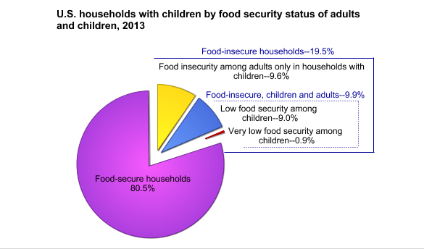
Food Security Status of U.S. Households with Children in 2013
Notes:
Among U.S. households with children under age 18:
80.5 percent were food secure in 2013.
In 9.6 percent of households with children, only adults were food insecure.
Both children and adults were food insecure in 9.9 percent of households with children (3.8 million households).
Although children are usually protected from substantial reductions in food intake even in households with very low food security, nevertheless, in about 0.9 percent of households with children (360,000 households), one or more child also experienced reduced food intake and disrupted eating patterns at some time during the year.
United States Department of Agriculture
Food security status of United States households with children in 2013.
http://www.ers.usda.gov/topics/food-nutrition-assistance/food-security-in-the-us/key-statistics-graphics.aspx#children

Slide 12
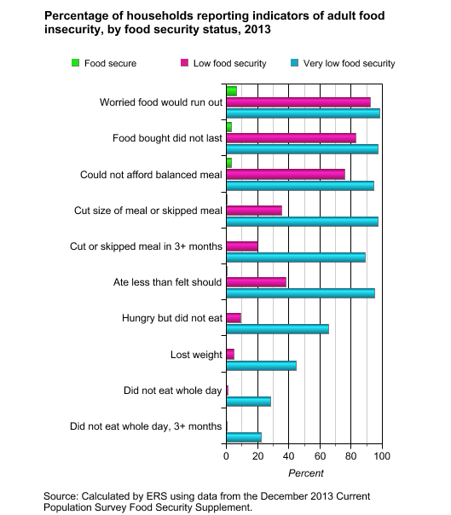
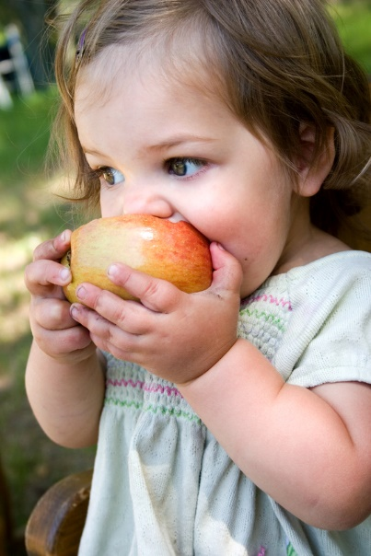
Food Insecurity
Hunger exists everywhere in America – in rural and urban communities and in every county. In fact, the USDA reports that one in six Americans faces hunger, including 16 million children.
Notes:
In cities, food insecurity can lead to crime when people are driven to steal or sell drugs to avoid hunger or homelessness. Food insecure households are not necessarily food insecure all the time. Food insecurity may reflect a household’s need to make trade-offs between important basic needs, such as housing or medical bills, and purchasing nutritionally adequate food.
How can food insecurity affect the elderly? According to feedingamerica.org, a study revealed that senior food insecurity is associated with lower nutrient intake and an increased risk for chronic health conditions. Compared to food secure seniors, food insecure seniors are:
60 percent more likely to experience depression
53 percent more likely to report a heart attack
52 percent more likely to develop asthma
40 percent more likely to report an experience of congestive heart failure
Does food insecurity exist in our community?
Teacher note: You may opt to assign a project where the students research if food insecurity exists in their community and develop a plan to provide assistance to individuals experiencing food insecurity.
Source of chart: United States Department of Agriculture (USDA) at http://www.ers.usda.gov/topics/food-nutrition-assistance/food-security-in-the-us/definitions-of-food-security.aspx

Slide 13

Food Security Versus Food Insecurity
Notes:
Thought About Food?
A workbook on food security and influencing policy.
http://www.foodthoughtful.ca/pdf/insecurity.pdf

Slide 14

Effects of Good Nutrition
Appearance
Fitness
Emotional strength
Future health
Healing
Protection from illness
Weight
Notes:
Effect of good nutrition:
Appearance - helps give you shiny hair, bright eyes, healthy nails and teeth and smooth clear skin
Fitness - helps you stay energetic and alert throughout the day
Emotional strength - helps your body and mind deal with stress
Future health - helps you stay healthy as you grow older
Healing - helps the body build new cells, repair breaks and sprains and heal after illness or surgery
Protection from illness - helps your body defend against disease
Weight - helps you reach and maintain a healthy weight

Slide 15

Nutrients
Nutrients keep our body healthy. They Include:
Carbohydrates
Fats
Fat-soluble vitamins
Minerals
Proteins
Vitamins
Water
Water-soluble vitamins
Notes:
Nutrients
Build and repair body cells
Give you energy
Regulate body processes

Slide 16


CHOOSEMYPLATE
(click on picture)
(click on picture)
Notes:
In June, 2011, the United States Department of Agriculture introduced the new food guide –MyPlate, based on the 2010 Dietary Guidelines for Americans.
The different plate shape is designed to help grab consumers’ attention with a new visual cue that is a familiar mealtime symbol. Adopting healthy eating habits is a key to wellness.
Click on MyPlate Icon for view video:
Introducing the New Food Icon: MyPlate
The Department of Agriculture introduces the new food icon, MyPlate, to replace the MyPyramid image as the government's primary food group symbol. An easy-to-understand visual cue to help consumers adopt healthy eating habits, MyPlate is consistent with the 2010 Dietary Guidelines for Americans.
http://youtu.be/SEFmSk08LIE
Learn how to get a plan using SuperTracker, an online tool where you can get a personalized nutrition and activity plan, track your foods and activities to see how they stack up and get tips and support to help you make healthier choices.
ChooseMyPlate SuperTracker – Getting Started: How to get My Plan
USDA Food and Nutrition
Learn how to get a plan using SuperTracker, an online tool where you can get a personalized nutrition and activity plan, track your foods and activities to see how they stack up and get tips and support to help you make healthier choices.
http://youtu.be/MukLDO5kGh8

Slide 17
Physical Environment and Safety
Notes:
How can your physical environment effect your health and well-being?

Slide 18

Environment and Safety
The environment in which children live plays an important role in their health and development.
Children may be more vulnerable than adults to the adverse effects of environmental contaminants in the air, food, drinking water and other sources because their bodies are still developing.
Violence has a long-lasting effect on individuals.
Unintentional injuries may result in death for children.
Notes:
Physical environment and safety - The environment in which children live plays an important role in their health and development. Children may be more vulnerable than adults to the adverse effects of environmental contaminants in the air, food, drinking water and other sources because their bodies are still developing.
Children who are exposed to environmental tobacco smoke, also known as secondhand smoke, have an increased probability of experiencing such adverse health effects as infections of the lower respiratory tract, bronchitis, pneumonia, middle ear disease, sudden infant death syndrome (SIDS) and respiratory symptoms.
Inadequate, crowded or too costly housing can pose serious problems to children’s physical, psychological and material well-being. Housing cost burdens, especially at high levels, are a risk factor for negative outcomes for children, including homelessness, overcrowding, poor nutrition, frequent moving and lack of supervision while parents are at work.
Violence frequently has dire and long-lasting impacts on young people who experience, witness or feel threatened by it. In addition to causing direct physical harm to young victims, serious violence can adversely affect their mental health and development and increase the likelihood that they themselves will commit acts of serious violence.
Although injury death rates have declined over the past two decades, unintentional injuries remain the leading cause of death for children ages 1–4 and ages 5–14. In addition, nonfatal injuries continue to be important causes of child morbidity, disability and reduced quality of life.
Injury accounts for nearly 75 percent of adolescent deaths. Compared with younger children, adolescents ages 15–19 have much higher death rates overall from injuries. Adolescents are much more likely to die from injuries sustained from motor vehicle traffic crashes and firearms than are younger children.

Slide 19
Proper and Acceptable Behavior
Notes:
Many behaviors such as drug abuse and addictions, can affect your health and well-being. If you know of someone with a drug or addiction problem, there are many resources and information to assist them such as:
National Institute on Drug Abuse (NIDA)
http://www.drugabuse.gov/
Combination Therapy Most Effective for Helping Smokers Quit
http://www.drugabuse.gov/news-events/nida-notes/2011/03/combination-therapy-most-effective-helping-smokers-quit

Slide 20
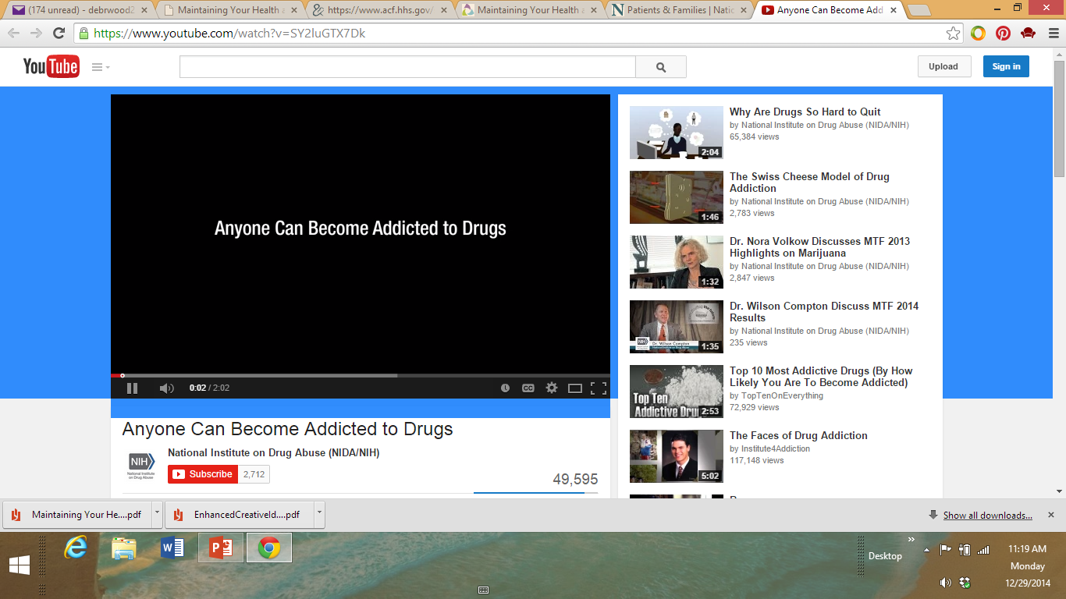
Proper and Acceptable Behaviors
Individuals should avoid participating in:
Alcohol use
Criminal activity
Illicit drug use
Regular use of tobacco
Risky sexual activity
(click on picture)
Notes:
Proper and acceptable behaviors - The well-being of individuals can be affected by aspects of their behavior and social environments.
Individuals should avoid participating in:
Alcohol use - Alcohol is the most common psychoactive substance used during adolescence. Its use is associated with motor vehicle accidents, injuries and deaths, problems in school and in the workplace, and fighting, crime and other serious consequences.
Criminal activity - The level of youth violence in society can be viewed as an indicator of youths’ ability to control their behavior and the adequacy of socializing agents such as families, peers, schools and religious institutions to supervise or channel youth behavior to acceptable norms.
Illicit drug use - Drug use by adolescents can have immediate as well as long-term health and social consequences. Marijuana use poses both cognitive and health risks, particularly damage to pulmonary functions as a result of chronic use. The abuse of prescription and over-the-counter drugs can be addictive and put abusers at risk for other adverse health effects, including overdose—especially when taken along with other drugs or alcohol.
Regular use of tobacco - Smoking has serious long-term consequences, including the risk of smoking-related diseases and premature death, as well as the increased health care costs with treating associated illnesses. Over 443,000 annual deaths are attributable to tobacco use, making tobacco more lethal than all other addictive drugs.
Sexual activity - Early sexual activity is associated with emotional and physical health risks. Youth who engage in sexual activity are at risk of contracting sexually transmitted infections (STIs) and becoming pregnant. STIs, including HIV, can infect a person for a lifetime and have consequences including disability and early death. Meanwhile, delaying sexual initiation is associated with a decrease in the number of lifetime sexual partners, and decreasing the number of lifetime partners is associated with a decrease in the rate of STIs.
National Institute on Drug Abuse (NIDA)
Anyone Can Become Addicted to Drugs - You might think that only some types of people can get addicted to drugs. The truth is, it can happen to anyone, whether you're young or old, rich or poor, male or female. This video from NIDA explains addiction in simple terms and offers a hotline to help you or a loved one find treatment.
http://youtu.be/SY2luGTX7Dk

Slide 21
Secure Parental Employment
Notes:
If a parent is working, it impacts the family in positive ways such as:
Able to provide the family with needs and wants
Job may provide good benefits and competitive pay
Provides a sense of security
What are some other benefits of secure parental employment?

Slide 22
What is a workplace health program, and how can employers benefit from this program? Employees?
Notes:
The term workplace health programs often refer to a coordinated and comprehensive set of strategies which include programs, policies, benefits, environmental supports and links to the surrounding community designed to meet the health and safety needs of all employees.
How do employers benefit from a workplace health program? Employees?

Slide 23
Overview of Potential Benefits of Workplace Health Programs to Employers
The benefits for employers include:
Decreased rates of illness and injuries
Enhanced corporate image
Enhanced employee productivity
Improved employee morale
Improved employee recruitment and retention
Increased organizational commitment and creation of a culture of health
Lower health care and disability costs
Reduced employee absenteeism
Notes:
The benefits for employers include:
Decreased rates of illness and injuries
Enhanced corporate image
Enhanced employee productivity
Improved employee morale
Improved employee recruitment and retention
Increased organizational commitment and creation of a culture of health
Lower health care and disability costs
Reduced employee absenteeism
Centers for Disease Control and Prevention
Benefits of Health Promotion Programs.
http://www.cdc.gov/workplacehealthpromotion/businesscase/benefits

Slide 24
Overview of Potential Benefits of Workplace Health Programs to Employees
The benefits for employees include:
Improved coping skills with stress or other factors affecting health
Improved health status
Improved job satisfaction
Increased access to health promotion resources and social support
Increased well-being, self-image and self-esteem
Lower costs for acute health issues
Lower out-of-pocket costs for health care services
Safer and more supportive work environment
Notes:
The benefits for employees include:
Improved coping skills for handling stress or other factors affecting health
Improved health status
Improved job satisfaction
Increased access to health promotion resources and social support
Increased well-being, self-image and self-esteem
Lower costs for acute health issues
Lower out-of-pocket costs for health care services (e.g., reduced premiums; deductibles; co-payments)
Safer and more supportive work environment
Centers for Disease Control and Prevention
Benefits of Health Promotion Programs.
http://www.cdc.gov/workplacehealthpromotion/businesscase/benefits

Slide 25
Strong Family Structure
Notes:
The composition of families is dynamic and has implications for critical parental and economic resources. The family is considered the basic unit in our society. Understanding the functions, roles and responsibilities of family members, as well as societal, cultural, demographic and economic factors that affect families, will enable us to manage our multiple roles, make effective decisions and become responsible, functional family members ourselves. It is important to be able to define family because so many social and legal resources, such as health insurance, life insurance, social security benefits, inheritance rights and government subsidized housing and health care are based on family membership. Each person’s definition of family may differ because we base our definitions on our own personal experiences of family life.
What do family members do for each other? They support each other, learn from each other, love each other and grow together.

Slide 26

Roles and Responsibilities of Family Members
Individuals within the family provide the following:
Basic needs (such as food, clothing and shelter)
Economic support
Education
Love and affection
Nurturance
Opportunities to have fun
Protection
Religious background
Notes:
Families take on many forms and shapes, and yet they perform some of the same basic functions from culture to culture. Individuals within the family provide the following:
Basic needs (such as food, clothing, and shelter)
Economic support
Education
Love and affection
Nurturance
Opportunities to have fun
Protection
Religious background
Each individual in the family has certain roles. Your role as a son, daughter, sister, brother, niece, nephew, aunt or uncle is a given role that you acquired when you were born into the family. When you marry, you will assume a chosen role as husband or wife. Roles are defined by age and responsibilities. Parents are usually responsible for providing food and shelter. As children get older and enter the workforce, these responsibilities might fall partly on their shoulders. In relationships, it is important to communicate the roles you will be sharing or expected to fulfill to meet the needs of the family.

Slide 27

Benefits of a Family
Maslow’s Hierarchy of Needs
Provides for physical needs (food, shelter, clothing, protection and security)
Satisfies one’s emotional needs (encouragement, support, belonging, companionship, love, self-esteem and self-actualization)
Notes:
Maslow’s Hierarchy of Needs – Abram Maslow, a scientist, created a pyramid diagram to show the way in which human needs are met.

Slide 28

Preparing for the Next Decade: A 2020 Vision for Healthy People
(click on picture)
Notes:
Preparing for the Next Decade: A 2020 Vision for Healthy People
Healthy People provides science-based, ten-year national objectives for improving the health of all Americans. Featuring Assistant Secretary for Health, Dr. Howard Koh, this presentation demonstrates how public health professionals and educators should use Healthy People.
http://youtu.be/zZG94c7xQmE
What can you do as an individual to promote the 2020 Vision for Healthy People? As a community?

Slide 29
What are examples of generally unhealthy lifestyles?
Notes:
Ask the students this question, and allow for a discussion.
Possible answers might include:
Excessive drinking
Failure to seek medical treatment for illnesses/diseases
Having health issues
Inactivity
Obesity
Being overworked and lacking proper rest/relaxation
Poor diet
Using tobacco or illegal drugs

Slide 30

Adverse Experiences
Nearly one in eight children (12 percent) has had three or more negative life experiences associated with levels of stress that can harm his or her health and development.
These experiences may include:
abuse or neglect
chronic economic hardship
living with someone who has a mental illness or substance abuse problem
parental divorce or separation
social exclusion by peers
the death of a parent
witnessing domestic violence
Notes:
According to the Child Trends data bank, nearly one in eight children (12 percent) have had three or more negative life experiences associated with levels of stress that can harm their health and development. More than the experience of any one of these traumas, the cumulative burden over time of these threats is particularly damaging to physical and mental health. See more at: http://www.childtrends.org/?indicators=adverse-experiences#sthash.1vUzcOhZ.dpuf

Slide 31
What is stress, and what are some effects of stress associated in each area?
Body
Mind
Emotions
Behavior
Notes:
Ask the students this question, and allow for a discussion.
Stress is a state of mental or emotional strain or tension resulting from adverse or very demanding circumstances. Do you have stress in your life?

Slide 32
The Effects of Stress
Body
Headaches
Mind
Emotions
Behavior
Excessive drinking or use of illegal drugs
Tight muscles
Fatigue
Skin irritations
Impaired judgment
Indecisiveness
Negativity
Depression
Loss of confidence
Apprehension
Loss of appetite
Restlessness
Accident prone
Worrying
Apathy
Notes:
How would the effects of stress deter an individual from achieving and maintaining good health and well-being? How would stress effect an individual at the workplace?
Some stress in life is not only natural, but also necessary. It helps the mind and body prepare for and meet challenges. Stress increases the heart rate and breathing, rushes adrenalin to the muscles and enhances mental alertness. But too much stress can be harmful, especially if it remains after the challenge has subsided. It can lead to ulcers, heart disease, depression and anxiety. Remaining mentally healthy requires learning to cope with stress. Strategies for coping with stress include:
Learn to avoid unnecessary stress by avoiding situations that cause it
Learn to relax
Organize available time to do what needs to be done
Talk with other people, and don’t keep problems and anger bottled up inside

Slide 33
Ways to Cope with Stress and Depression
Mental health resources include:
Community mental health centers
Employee assistance programs
Family services, social agencies, or clergy
Health maintenance organizations
Hospital psychiatry departments and outpatient clinics
Local medical and/or psychiatric societies
Mental health programs at universities or medical schools
Mental health specialists, such as psychiatrists, psychologists, social workers or mental health counselors
Peer support groups
Private clinics and facilities
State hospital outpatient clinics
Notes:
Ways to cope with stress and depression
Special problems such as divorce, family violence or illness or death in the family can strongly impact children. During very difficult family changes, a child may have developmental regressions. Such behavior is not a selfish way to get attention. It may be a sign that the child is under great stress and needs help from parents and caregivers in order to cope with the stress. Understanding how various factors may influence children helps the parents and caregivers know how best to relate to them.
Mental health resources include:
Community mental health centers
Employee assistance programs
Family services, social agencies or clergy
Health maintenance organizations
Hospital psychiatry departments and outpatient clinics
Local medical and/or psychiatric societies
Mental health programs at universities or medical schools
Mental health specialists, such as psychiatrists, psychologists, social workers or mental health counselors
Peer support groups
Private clinics and facilities
State hospital outpatient clinics
Refer to this website for information: “15 Ways to Help Your Kid through Crisis”
http://www.kidspeace.org/uploadedFiles/15_Ways_parenting_008_0010_flier.pdf

Slide 34

How to Construct a Diorama
(click on picture)
Notes:
During the Independent Practice activity, students will be constructing a three-dimensional diorama display that will promote health and wellness.
Note to teacher: Become familiar with how to construct a diorama by viewing How to Make a Four-Door Diorama at:
http://snapguide.com/guides/make-a-four-door-diorama/

Slide 35
Questions?

Slide 36
References and Resources
Images:
Microsoft Clip Art: Used with permission from Microsoft™.
Textbooks:
Ryder, V., & Harter, M. B. (2010). Contemporary living. Tinley Park, IL: Goodheart-Willcox
Websites:
Centers for Disease Control and Prevention
Benefits of Health Promotion Programs.
http://www.cdc.gov/workplacehealthpromotion/businesscase/benefits
Centers for Disease Control and Prevention
The early years of a child’s life are very important for his or her health and development.
http://www.cdc.gov/ncbddd/childdevelopment/index.html
Childstats.gov
America’s Children in Brief: Key National Indicators of Well-Being, 2012.
http://www.childstats.gov/pdf/ac2012/ac_12.pdf
College Board
Education Pays 2013: The Benefits of Higher Education for Individuals and Society.
http://trends.collegeboard.org/sites/default/files/education-pays-2013-full-report.pdf
Healthy.gov
Home of the Office of Disease Prevention and Health Promotion.
http://health.gov/our-work/healthy-people

Slide 37
References and Resources
MyPlate.gov
MyPlate, the government’s newest symbol for healthy eating, uses a dinner plate icon as a simple visual reminder of what to serve yourself, and your family for meals and at snack time.
http://wwwchoosemyplate.gov
National Dairy Council
The Dairy Connection.
http://www.nationaldairycouncil.org/HealthandWellness/FutureofFood/Pages/Future-of-Food.aspx
United States Department of Agriculture
Food security status of United States households with children in 2013.
http://www.ers.usda.gov/topics/food-nutrition-assistance/food-security-in-the-us/key-statistics-graphics.aspx#children
U.S. Department of Health and Human Services
Health topics to help you and your loved ones stay healthy.
http://healthfinder.gov/Default.aspx
Technology:
How to Make a Four-Door Diorama
http://snapguide.com/guides/make-a-four-door-diorama
Introducing the New Food Icon: MyPlate
The Department of Agriculture introduces the new food icon, MyPlate, to replace the MyPyramid image as the government’s primary food group symbol. An easy-to-understand visual cue to help consumers adopt healthy eating habits, MyPlate is consistent with the 2010 Dietary Guidelines for Americans.
http://youtu.be/SEFmSk08LIE
National Institute on Drug Abuse (NIDA)
Anyone Can Become Addicted to Drugs - You might think that only some types of people can get addicted to drugs. The truth is, it can happen to anyone, whether young or old, rich or poor, male or female. This video from NIDA explains addiction in simple terms and offers a hotline to help you or a loved one find treatment.
http://youtu.be/SY2luGTX7Dk
Preparing for the Next Decade: A 2020 Vision for Healthy People
Healthy People provides science-based, 10-year national objectives for improving the health of all Americans. Featuring Assistant Secretary for Health, Dr. Howard Koh, this presentation demonstrates how public health professionals and educators should use Healthy People.
http://youtu.be/zZG94c7xQmE

