Slide 1
Maintaining a Healthy Digestive System

Slide 3
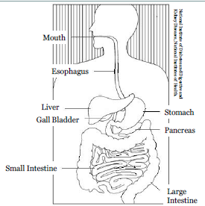
The Digestive System
Notes:
Digestion begins in the mouth, when you chew and swallow, and is completed in the small intestine.
• The esophagus connects the throat above with the stomach below.
• The stomach stores the swallowed food and liquid, mixes the food, liquid, and digestive juices, and empties the contents slowly in to the small intestine.
• The liver turns nutrients into forms the body can use.
• Bile is a substance that helps your body digest and absorb fats. It is produced in the liver and stored in the gall bladder until needed.
• The pancreas produces pancreatic juice that contains enzymes the help break down carbohydrates, proteins, and fat.
• The small intestine produces intestinal juice to further break down food and absorption takes place.
• The large intestine, also called the colon, removes water, potassium and sodium from the waste. The remainder is stored as a semi-solid in the lower part of the intestine until is eliminated.

Slide 4
Why is Digestion Important?
Process:
Food and drink is broken down
Body uses them to build and nourish cells
Provide energy
Digestive System This video describe the whole function of the digestive system in our body http://youtu.be/Z7xKYNz9AS0
Notes:
When you eat foods – such as bread, meat, and vegetables – they are not in a form that the body can use as nourishment.
Food and drink must be changed into smaller molecules of nutrients before they can be absorbed into the blood and carried to cells throughout the body.
YouTube video:
Digestive System This video describes the whole function of the digestive system in our body. http://youtu.be/Z7xKYNz9AS0

Slide 5
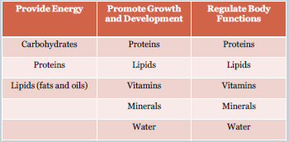
The Three Functions of Nutrients
Notes:
Nutrients provide energy by using carbs, proteins, and fats, promote growth and development and regulate body functions by using proteins, fats, vitamins, minerals, and water.

Slide 6
Basal Metabolic Rate
Your body uses energy for:
Automatic processes
Physical activities
BMI Calculator >> BMR Formula
http://www.bmi-calculator.net/bmr-calculator/bmrformula.php
Notes:
Follow link to site and ask for volunteers to input their data.
BMI Calculator» BMR Formula
http://www.bmi-calculator.net/bmr-calculator/bmr-formula.php
The BMR calculator allows you to calculate your Basal Metabolic Rate (BMR) as well as other information relating to the calories you burn a day. To use the calculator, simply input details about yourself such as you age, gender, weight and height. The calculator will then calculate an estimate of your BMR and adjust you BMR by various factors to allow you to see an estimate of the calories you burn a day based on your level of activity.
Automatic processes include breathing, digesting food, and creating new cells.
Physical activities include work and exercise.
The more active you are the more energy you use.

Slide 7
Food Intake and Physical Fitness
Tips
Make at least half your grains whole grains.
Vary your veggies
Focus on fruits
Get your calcium rich foods
Go lean with protein
Visit http://www.choosemyplate.govfor more:
Healthy Eating Tips
Starting Points
Your food and physical activity choices each day affect your health - how you feel today, tomorrow, and in the future. http://www.choosemyplate.gov/healthy-eating-tips.html
Notes:
Your food and physical activity choices each day affect your health — how you feel today, tomorrow, and in the future. These tips and ideas are a starting point. You will find a wealth of suggestions here that can help you get started toward a healthy diet. Choose a change that you can make today, and move toward a healthier you.

Slide 8
Questions?

Slide 9
References/Resources
Textbook:
Kowtaluk, Helen. Food for Today. Eighth. New York, New York: Glenco, McGraw-Hill,2004. 81-83. Print.
Websites:
National Digestive Diseases Information Clearinghouse - Your Digestive System and How it Works http://digestive.niddk.nih.gov/ddiseases/pubs/yrdd/?debugMode=false
Calculates the basal metabolic rate http://www.bmi-calculator.net/bmr-calculator/bmr-formula.php
Frequently asked questions on Nutrition A to Z http://www.faqs.org/nutrition/Met-Obe/Nutrients.html
YouTube:
Digestive System This video describe the whole function of the digestive system in our body. http://youtu.be/Z7xKYNz9AS0

